Slide 1


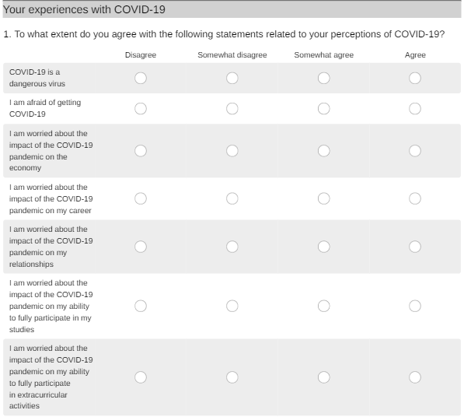
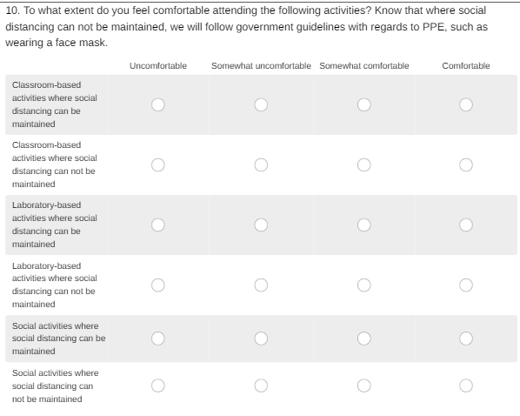
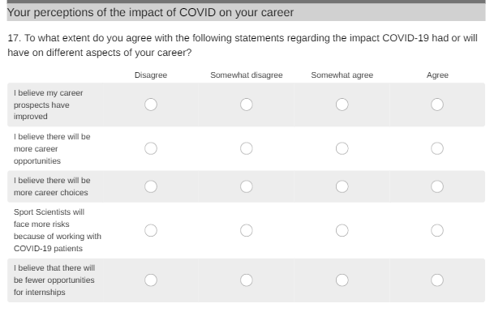



Sport Science Student Perceptions of Learning and Teaching during the COVID19 Pandemic
Hannah Moir¹, Ann Ooms², Elizabeth Pummell¹, Nicola Swann¹ & Ricarda Micallef¹
¹School of Life Sciences, Pharmacy & Chemistry, Kingston University London, ²School of Nursing, Kingston University & St George's University of London
INTRODUCTION
AIMS
The United Kingdom (UK) went into national lockdown on 23 March 2020 due to the Covid-19 pandemic
The emergence of COVID-19 resulted in a dramatic change to Learning and Teaching in Higher Education.
Sport Science undergraduate students faced a blend of online and on campus teaching, with practical and laboratory sessions restructured to reduce the risks.
To determine the views and behaviours of Sport Science students to gain insight into their perceptions of COVID-19 and their campus-based learning and teaching experience in order to evaluate attitudes to learning and risks.
METHODS
Design
Questions were themed around ‘perceptions and experiences’, ‘university life’ during the COVID-19 pandemic and ‘adapted behaviours’.
Distribution
Analysis
Data was captured using Survey Monkey online data collection tool and transposed into Microsoft Excel and SPSS (v26) for data evaluation.
Ethics approval was granted by Kingston University Ethics Committee.
A 25-question online questionnaire based cross-sectional study.
The survey link was circulated via email to 125 undergraduate Sport Science students in September 2020.
Seventy-four students responded (50% were first year students newly enrolled, 47% were female and 79% were 26 years or under).
Framework method for thematic analysis was conducted.
RESULTS
““miss the social interaction”
“hard to
concentrate working online”
62% were afraid of getting Covid-19
88% believed Covid-19 is a dangerous virus
Anxious
Nervous
Uncomfortable
88% believed their studies would be impacted
75% were comfortable attending
Practical / laboratory activities even without social distancing
Uncertainty
77% were comfortable with in-person classroom-based teaching
vs.
Confidence
Contact: H.Moir@kingston.ac.uk
@KUSportExSci
CONCLUSIONS
Excitement
Students acknowledged the risk of COVID-19, but were not averse to attending campus and were confident to engage in face-to-face teaching.
More concerned about the experience of online-learning, loss of social interaction and student support than mitigated risks associated with on-campus group learning environments.
Expected influence of, and engagement with the teaching and learning experience and impact outcomes, such as acquisition of key skills.
Main anxieties were related to placement and job opportunities, with students feeling employment prospects would be affected.
Indicates a need to implement pedagogical strategies to support students but also consider their transition to a workplace where they will be supporting the long-term care and treatment of COVID-19 patients.

