Slide 1



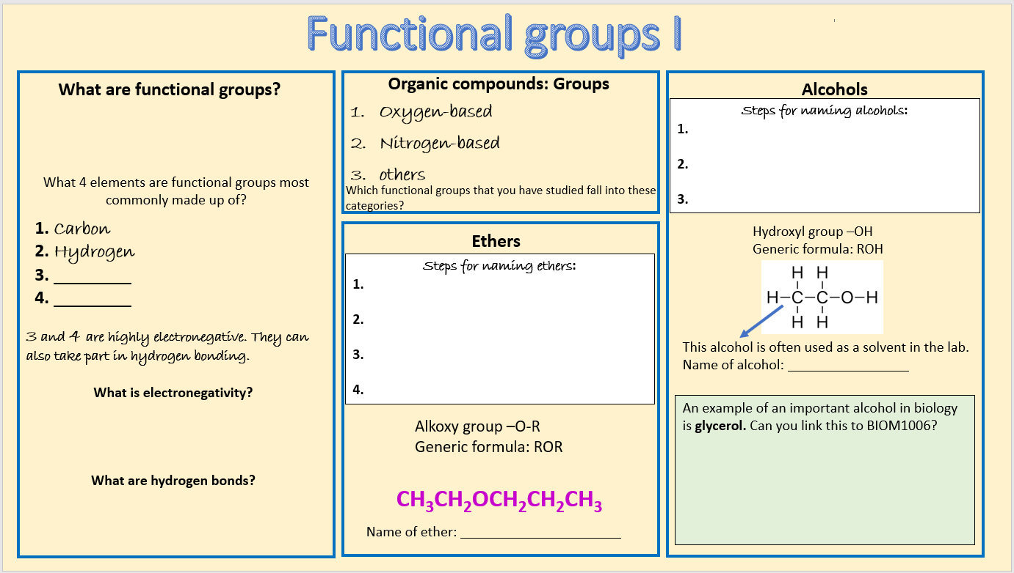
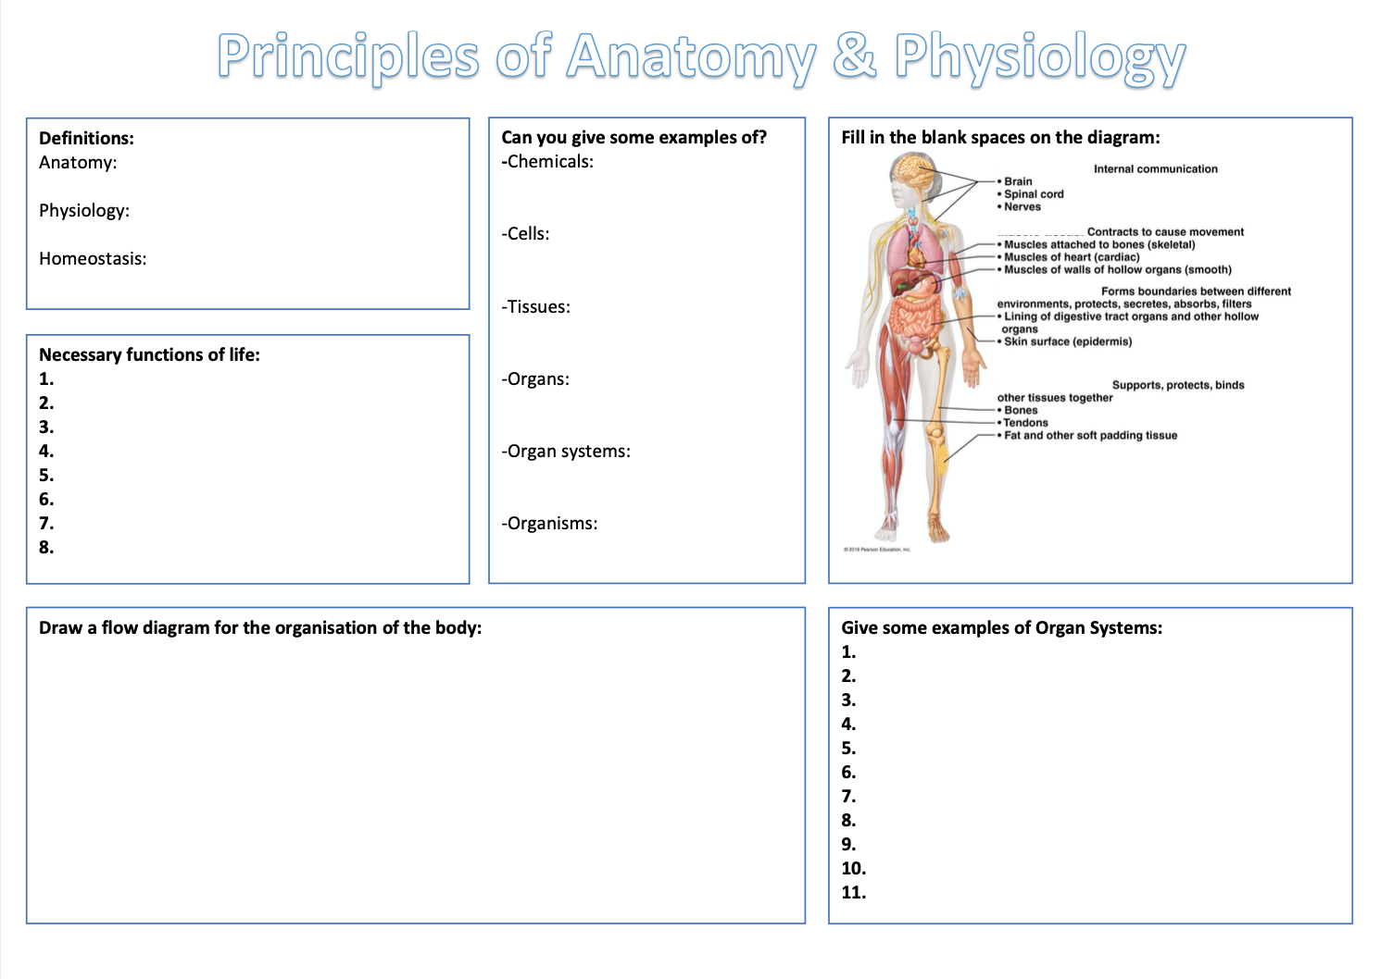
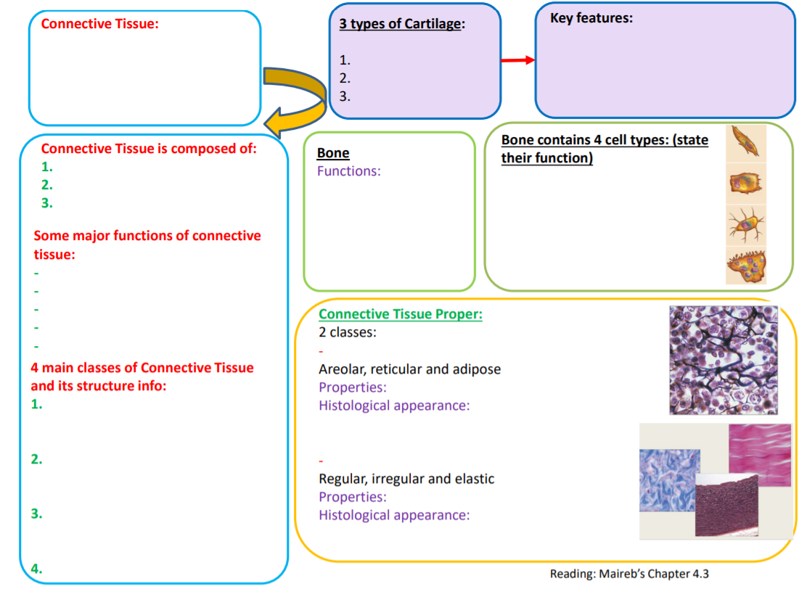
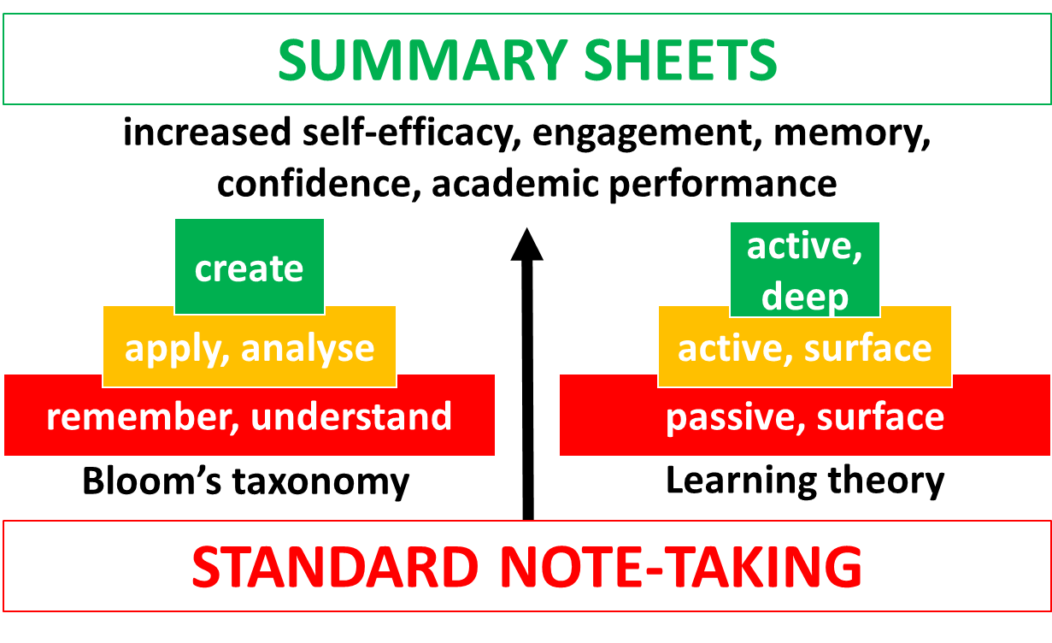
Summary sheets:
a scaffold for more effective, active note-taking and cognitive processing of (remote) lectures
Jo V Rushworth, Rachel Cornish, Mansi Patel and Harlin Gulati
1
3
Examples of summary sheets made by students and staff
Key benefits to students and staff
The problem:
note-taking
4
note-taking is passive, ineffective for learning and poses challenges for disabled students
remote note-taking is more difficult, especially in live sessions
There is a correlation between quality of student notes and student achievement (Kiewra et al. 1991)
19
as the sector moves towards blended, flexible learning, note-taking scaffolds need to compliment remote learning
summary sheets boost student engagement and comprehension of material prior to live class
fosters self-efficacy e.g. awareness of tricky areas requiring help
supports flipped classroom; facilitates active processing of asynchronous content
Video: How do I make a summary sheet?
Video: staff benefits
2
A solution:
summary sheets
summary sheets (2 min movie) provide a UDL scaffold for learners to take notes and process information in a flexible way (by hand or computer)
summary sheets support a flipped classroom approach, encouraging learners to engage with pre-recordings and take notes as they learn. This is especially useful for remote teaching
Notes about the authors: Rachel, Mansi and Harlin are second year Biomedical Science students and Student Lecturers at De Montfort University, Leicester. They have created summary sheets for first years.

Slide 2
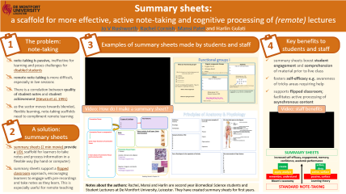

Back to poster

Slide 3
Back to poster
(Summary sheet made by Harlin Gulati)

Slide 4
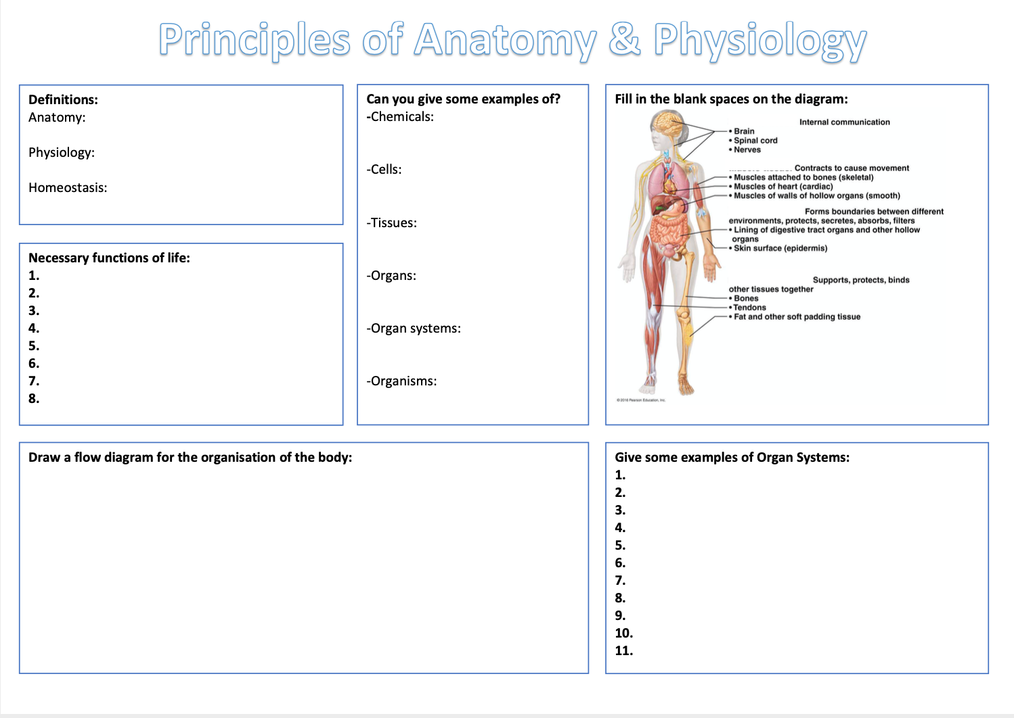
Back to poster

