Slide 1

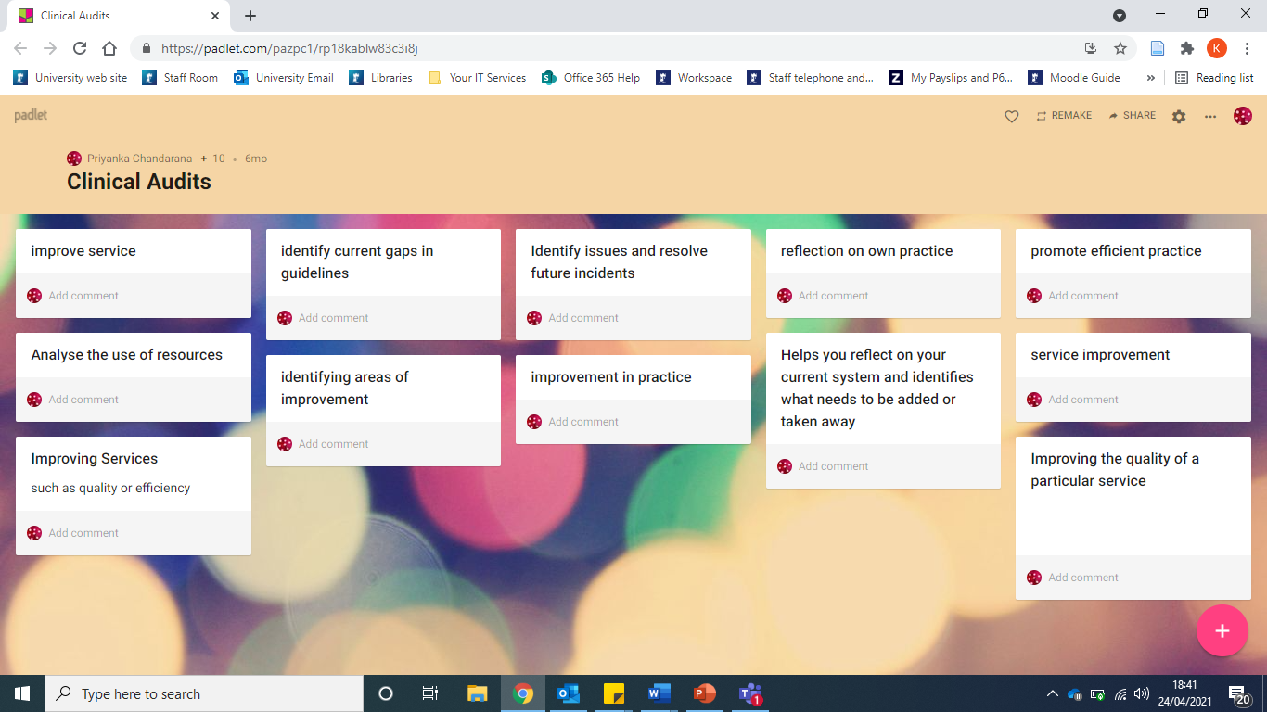
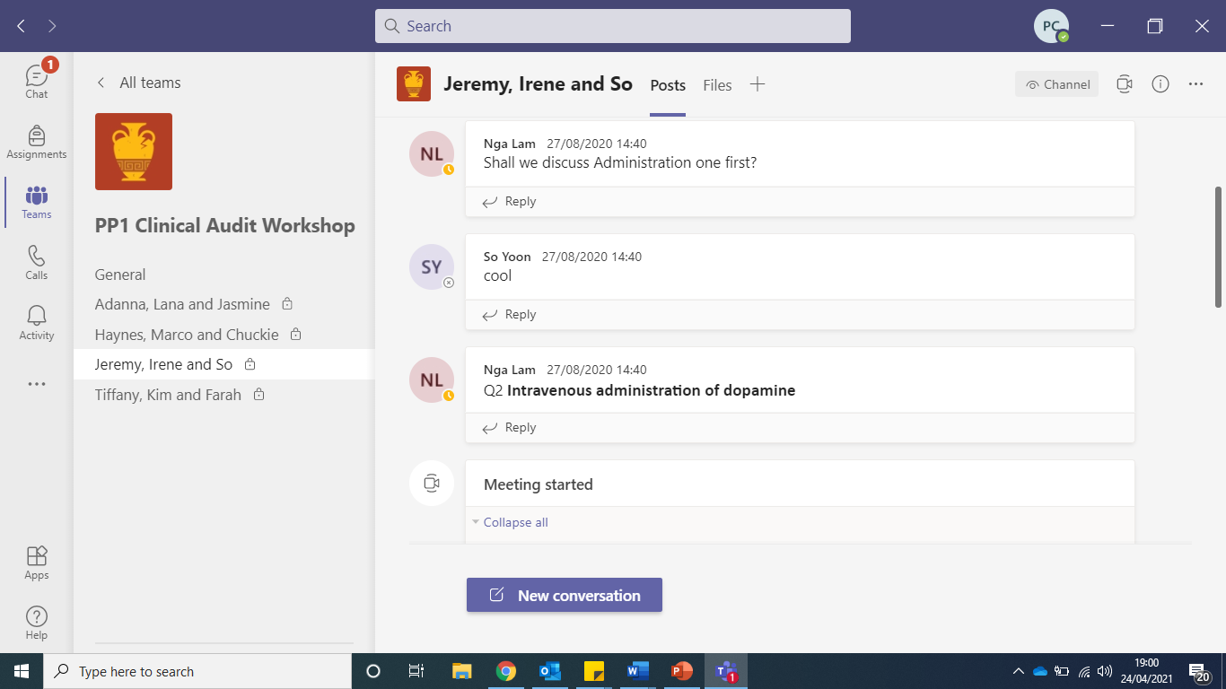
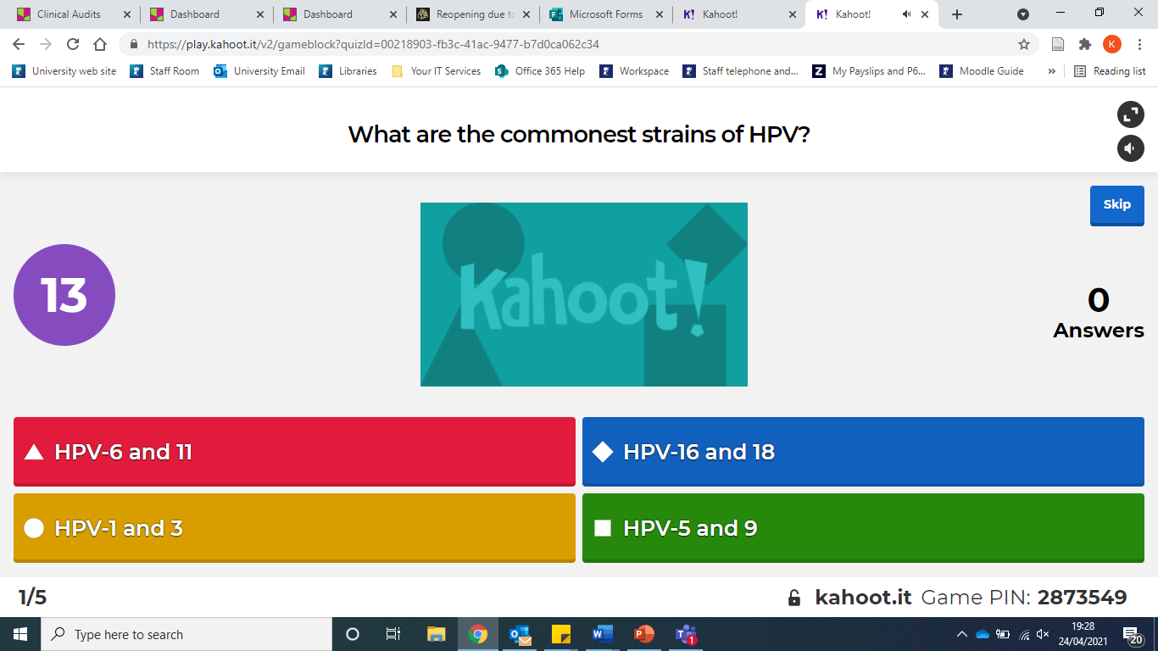
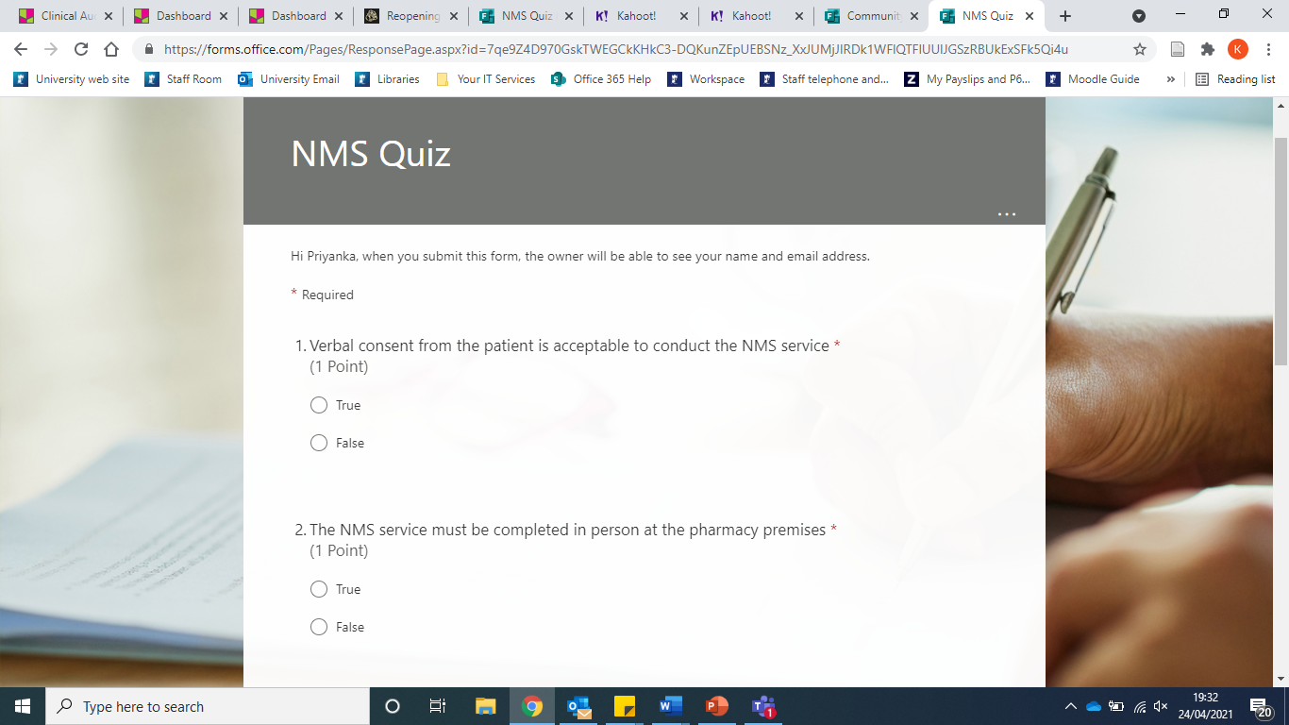
A Reflection on Designing Virtual Learning Experiences
Teaching core skills, behaviors and competencies
Priyanka Chandarana
Assistant Professor in Pharmacy Practice
Teaching Approach
Student engagement: Active participation leads to knowledge gain. Focuses is on what the student does.
Development of behaviours and skills: Students are required to do. Engagement at the higher levels of Millar’s Pyramid.
Expert level: Work-based assessment require students to be at expert level.
Learning Technologies
Padlet
Microsoft Teams
Kahoot
Microsoft Forms
Challenges
1. Student Engagement, Focus & Motivation
Encourage reflection: “What have you learnt” surveys
Communication: Guidance on preparation and follow up work, Explain session benefits (examinable content) and how content is relevant
Encouragement: Gamification, leader boards for group work or quizzes
2. Academic Barriers: Time Constraints & Capabilities (IT skills)
Collaborative working & training: share resources, tips, consider individual skill set
3. Remote Students
Time zones: use doodle polls to map student availability
IT issues: identify early, pre-record material, use worksheets/handouts, record & upload
Q&A sessions & Online register
Virtual bulletin board allows collaboration
Small group activities via channels and breakout rooms
Live and interactive formative assessment
Variety of questions Collate responses
Feedback
Focus Points
Teaching methods ultimately create the learning experience. Formative assessment, feedback and the use of case-studies formed the basis of my methods for online teaching. My reflections were in action allowing improvements to be made. Throughout the focus remained on the student’s experience and reactions., how I facilitated student learning, the opportunities provided for students to learn, develop and share and on session planning.
Improvements
Planning: Consider added complexities of online teaching and plan for technical issues.
Student participation: Increase activities instead of lecture-style content delivery.
Control: Reduce my need for full control of the session.
Silence: Being comfortable with silence during online activities.
Student feedback: Focus feedback on teaching quality and overall student experience. A questionnaire assessing student understanding before and after the session.
Through increasing the incorporation of activities, control is taken away from me and handed over to the students. Instead, I can focus on more effective planning and structure, confident that this will ensure students stay on track and reduce my need for full control. To plan effectively I will apply theory when deciding student activities and consider the resulting development of knowledge and skills. I will learn to become comfortable with silence by focusing on the positives this can bring to students’ development and confidence.
Looking Ahead
Hybrid learning
E-learning packages
Recorded face-to-face lecture content
Supplementary online activities
Thinking about the future there may be more incorporation of hybrid teaching within our curriculums. We can utilise the learnings and positives we have found from the past year as we continue with this new normal. This could be through e-learning packages that consist of recorded lecture content supplemented with online activities between videos. As we hopefully return to a more pre-covid way of teaching at university , we can continue to utilise the learning technologies that have worked well and encourage completion of online quizzes after lectures, use of Padlet during group work to collate and share ideas, or Padlet as the new Q&A forum.
“I believe learning is a result of educational experiences. Teaching online does not mean this experience should be compromised.”

