Slide 1



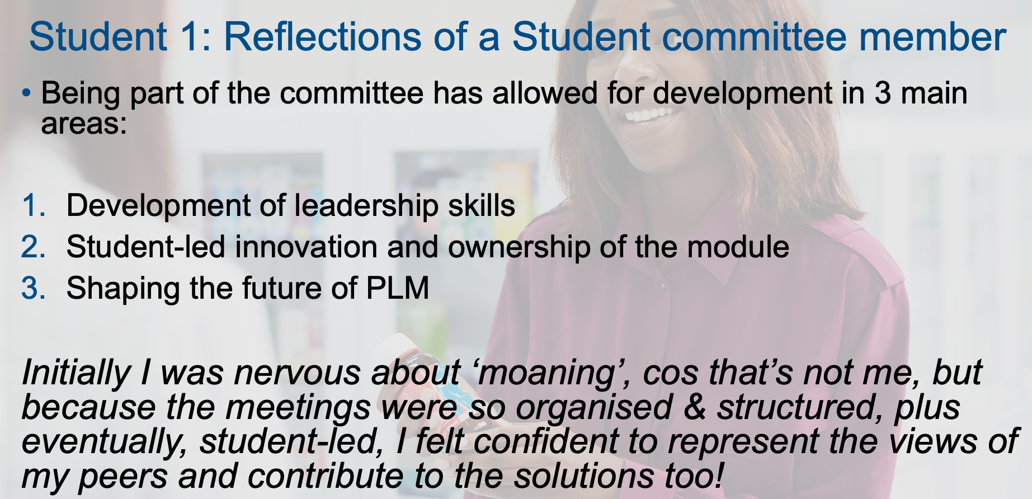
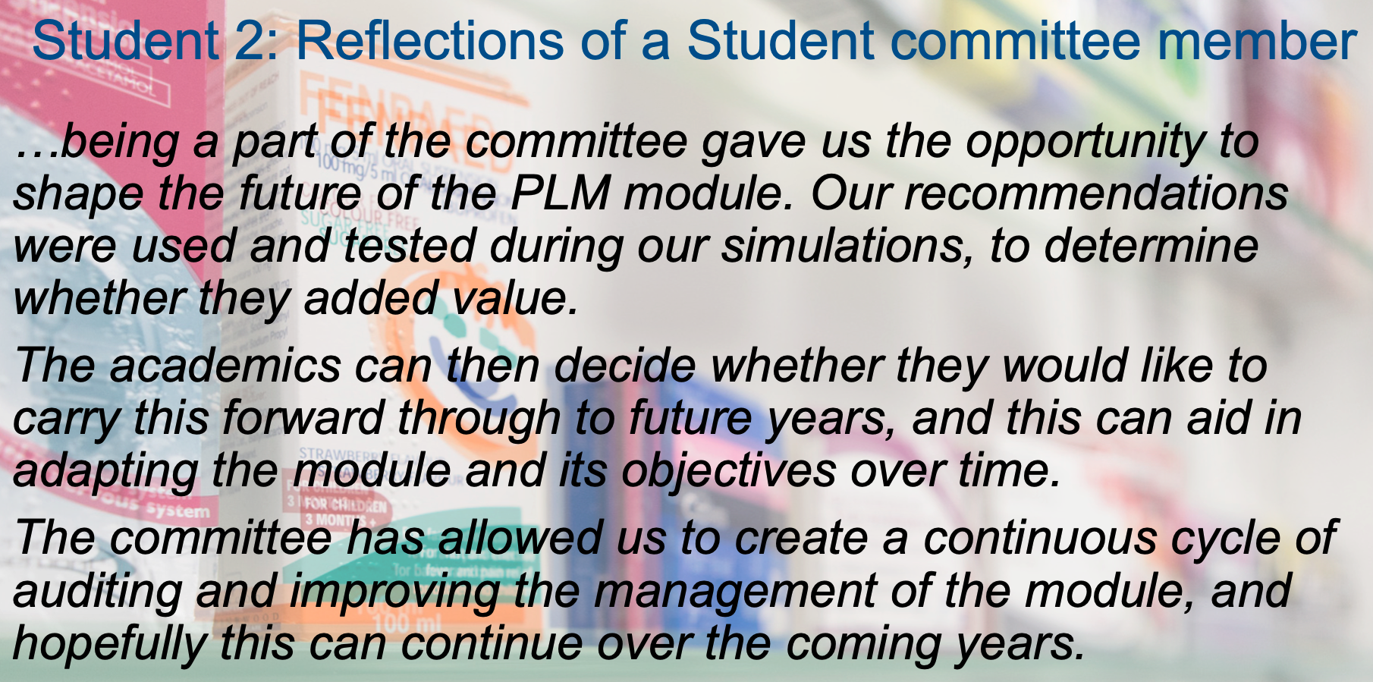
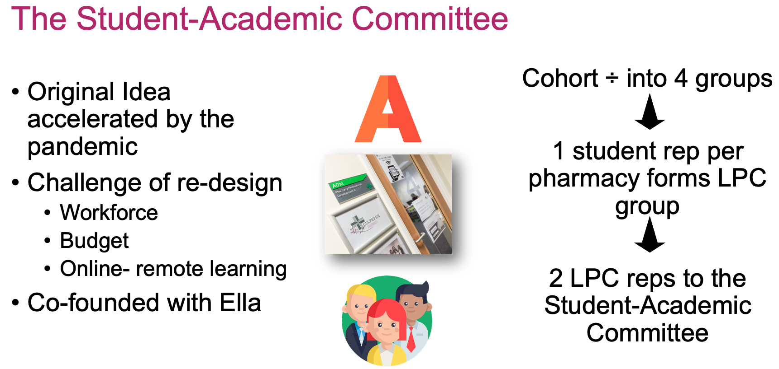
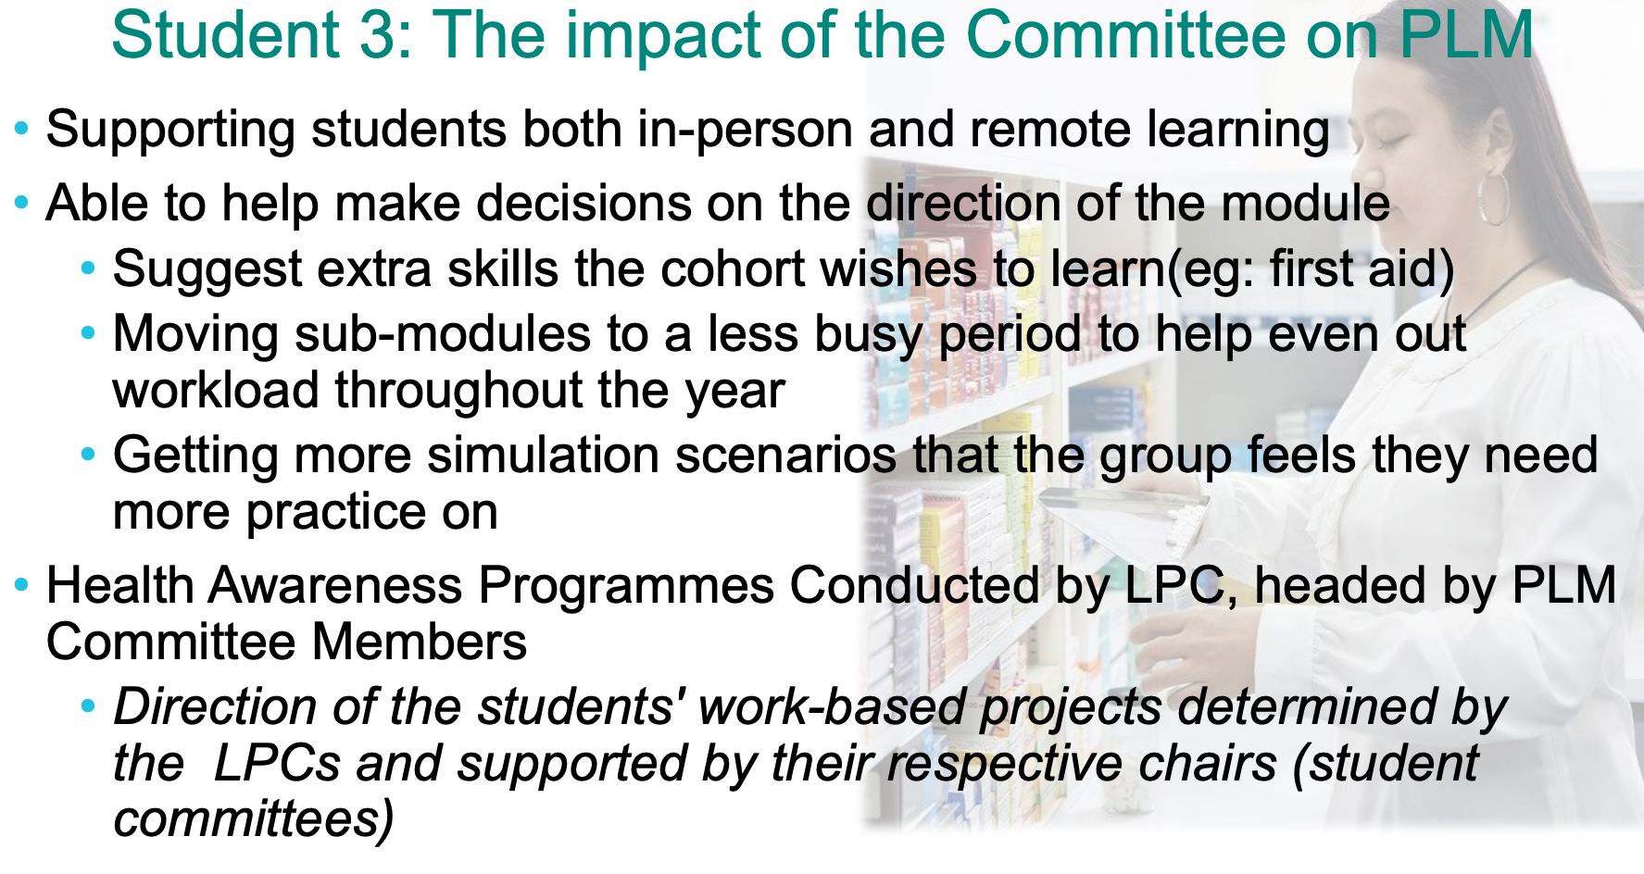
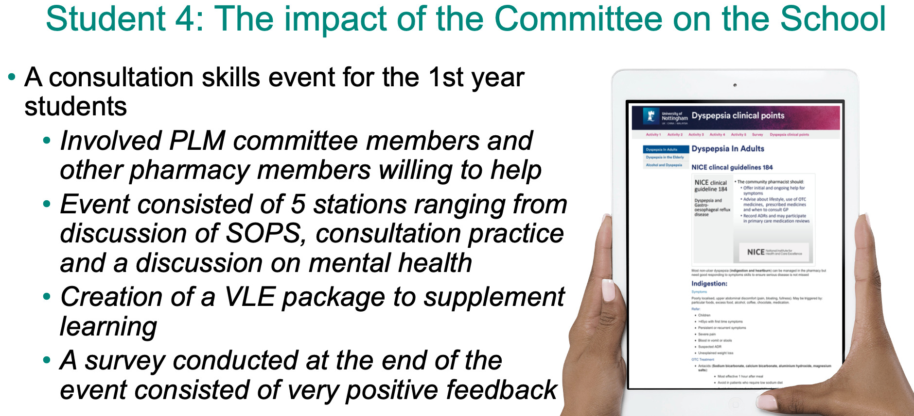
Horizons in STEM Conference 2021:
Student and Academic reflections on the co-design of final year Pharmacy masters module
V.Solanki¹, P.Chandarana², E.Marchant², S. Avner², F. Rashid², K. Oweh², N.Ilori², R.Dudhia², S. Stecka², W.Soo²
¹vibhu.solanki@nottingham.ac.uk, University Of Nottingham, Nottingham NG7 2RD
²University Of Nottingham, Nottingham NG7 2RD
Background
Comments and observations
The Pharmacy Leadership and Management (PLM) module provides an experiential learning simulation drawing on leadership and management skills coupled with clinical problem solving.
Designed to reflect a wide range of the skills detailed in the Initial Education and Training of Pharmacists (GPhC 2011), teams of up to six students run their own primary care-based pharmacy business competing against each other over a total of twelve days.
PLM is a well-established, highly efficient yet logistically complex final year module, which was challenged on how it operates and delivers world-class teaching during a global pandemic. Students this year have participated in the redesigned module both remotely online and in person. During the simulation each pharmacy nominated a representative and from the ten representatives, two were elected to form a student-academic committee.
Current Limitations and New Process
The academics in PLM noticed the difficulties in adapting operationally large modules based on the feedback from the Teaching and Learning Committee (TLC) and Local student forums, due to the frequency of the meetings, changes could only be made to benefit future cohorts. The creation of student-academic committee was designed to provide greater student access to the PLM academic team, allow more creative co-design of content and provide a more rapid response to student needs during the module. Weekly meetings before, during and after simulation created opportunities for resolution of student queries and create a platform for the committee to actively innovate during the module.
Eight students took part in the committee with two replacements made due to personal reasons. Student took notes during meetings and encourage to make monthly reflections on the committee to share with the academic team.
Results
Conclusions
The students produced on average one or two reflections each across seven months of the module. Some students only provided reflections in May after the simulations had finished , with three students only providing reflections due to the submission of this poster.
Thematic analysis of the ten reflections resulted in three key themes regularly commented on:
Committee members leadership skills development
Committee-led innovation & module ownership
Current and future strategic development of the module
Academics observed the students within the committee demonstrating signs of module ownership, interacting with other academics and students confidently across all four years.
Academic reported large benefits to having the committee, mainly around in the moment feedback, validation of content and student support on key decisions. The module convenor did however report the process at times highly involved and mentally draining.
Overall, the student-academic committee has been a success, with all eight students reflecting on the three key themes: personal development of their leadership skills, greater voice in shaping the current and future strategy for the course and finally, students felt they had a greater platform for student-led innovations. They truly felt they had co-ownership of the module.
The academics involved in the module comment the improvements made to the module via committee feedback and have been impressed with the student-led innovations and the leadership demonstrated.
References
Pharmacy Regulation. 2011. Future pharmacists Standards for the initial education and training of pharmacists. [ONLINE] Available at: https://www.pharmacyregulation.org/sites/default/files/GPhC_Future_Pharmacists.pdf. [Accessed 22 June 2021]
Horizons in STEM Higher Education Conference, 29th- 30th June 2021, The Open University
Poster presentation (poster/abstract number TBC)

