Slide 1

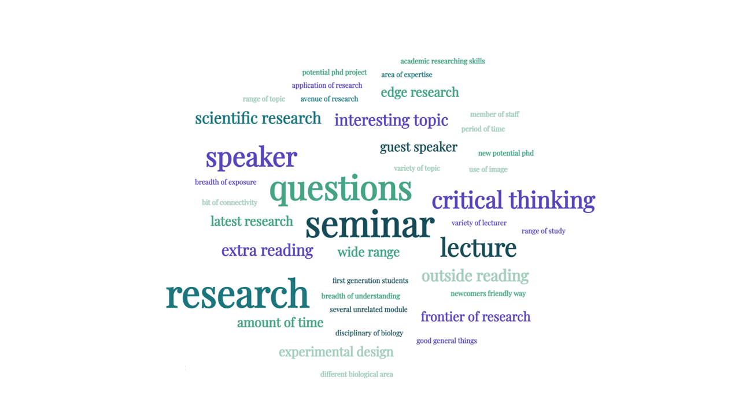

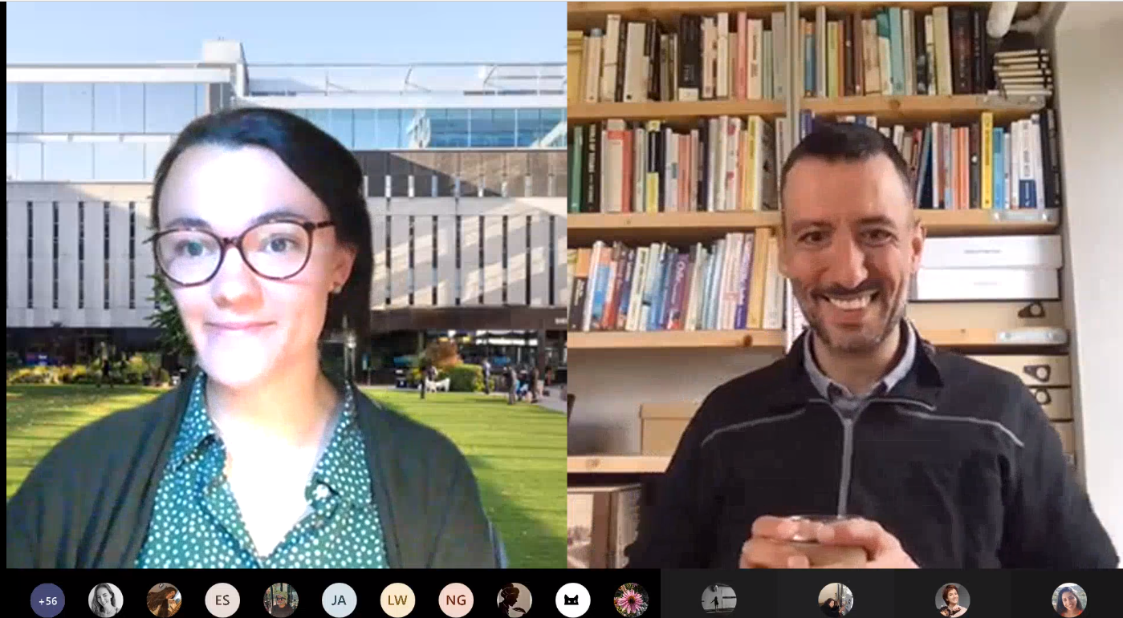

Building community and exploring research through the Life Sciences Undergraduate Seminar Series
Dr Catherine Mansfield (c.mansfield@imperial.ac.uk)
Department of Life Sciences, Imperial College London
Does your department do something similar? I’d love to hear from you! Please do get in touch.
Over the past year, our undergraduates have been studying remotely from all over the world. The online Undergraduate Seminar Series was developed last year in the Department of Life Sciences, Imperial College London, to foster a sense of community and belonging remotely, as well as to build bridges between teaching and current research in a research-focused academic department. The seminar series provides undergraduates with an opportunity to genuinely engage with departmental research through a series of non-assessed seminars and discussion sessions.
Inclusivity
The seminars were student only creating a non-intimidating environment aiding students’ confidence in asking questions. The online nature of the seminar series allowed them to be inclusive for on-campus and remote/international students.
Students who were less familiar with research seminars before university study commented that they found the seminars inclusive and confidence-building:
Structure
“As a first generation student (also WP and BAME), I don't often have the opportunity to critically discuss biological research with family or friends … By attending these seminars I have gained practise in discussing scientific research which has given me more confidence to speak up and ask questions not only during the seminars but during lectures for my modules too!” (Seminar Series attendee Yr2)
We invited 2 academic staff speakers per week from within our department to record a 20 min seminar and attend for Q+A live on MS Teams.
Speaker 1 pre-recorded seminar streamed
Speaker 1
live Q+A
Speaker 2
pre-recorded
seminar
streamed
Speaker 2 2 live Q+A
Word cloud generated from students’ feedback
Skills developed
All students from Yr1-3 were invited to attend promoting vertical integration.
Attendance fluctuated between
20 and 60 students per week.
Seminars and Q+A were
also recorded and could
be accessed afterwards.
92% of feedback respondents definitely or mostly agreed with the statement: ‘The DoLS UG Seminar Series reinforced the development of a sense of community in the department’
Scientific curiosity
Critical thinking
Asking questions
Presentation skills
Most commonly mentioned skills developed
Realistic
Reflections
Undergraduates are
often not exposed to a
significant amount of current
research until towards the end
of their degree which can make
transitions to postgraduate study
challenging.
The seminar series mimics a research seminar series allowing students to build confidence in this setting and become more familiar with the research taking place in their department, contributing to a sense of community.
The seminar series has helped to build a sense of community. One of the most valuable parts of the seminars has been to show and model and more human side to academia with many speakers discussing their route into academia.
Getting students to treat research seminars differently to their assessed lectures has been a challenge! In future years, we hope to build a reflective element into the seminar series and hopefully build on how this initiative is evaluated.
Aiming to create an open and realistic dialogue between academics in the hosted Q+A.
Thanks to all the seminar speakers over the last 2 years who have put together seminars, to the department, especially Anne Dell and Huw Williams for supporting this endeavor, and to our students for always being curious and asking insightful questions.

