Slide 1


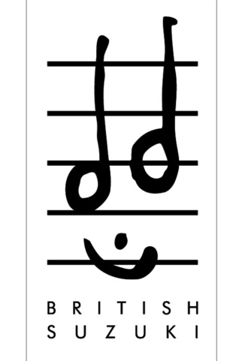
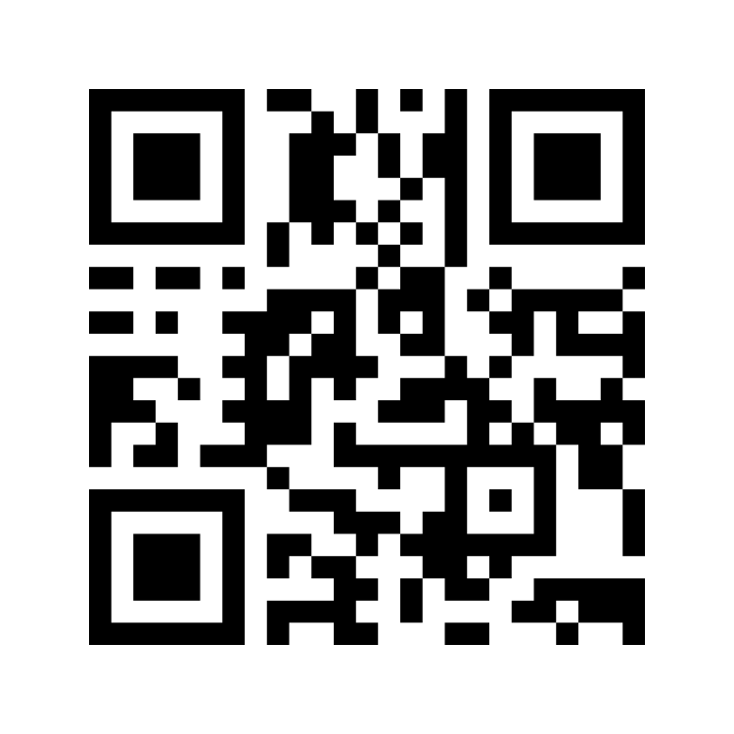
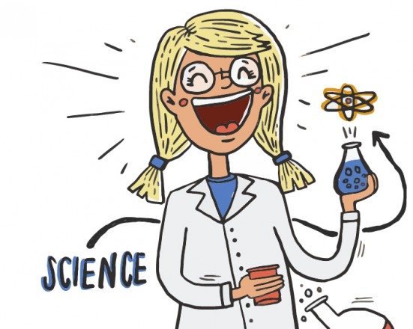

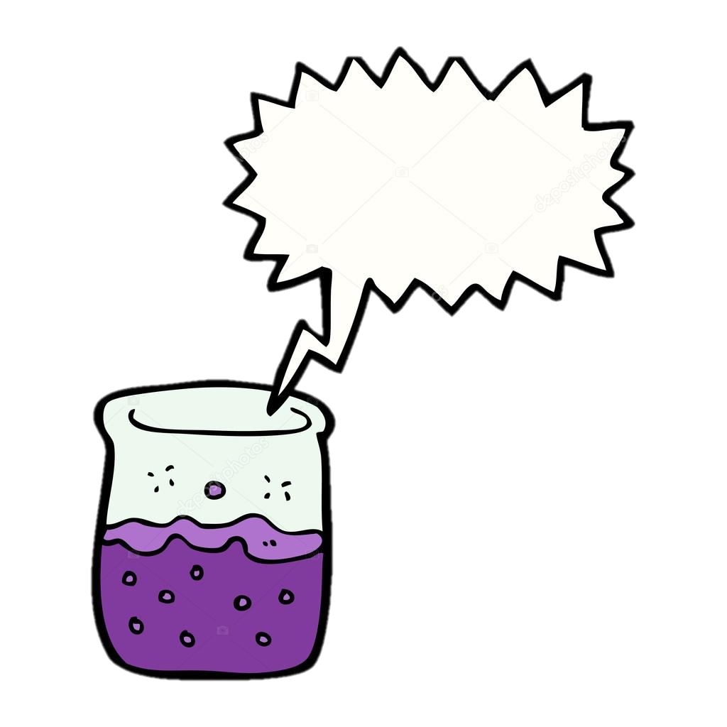
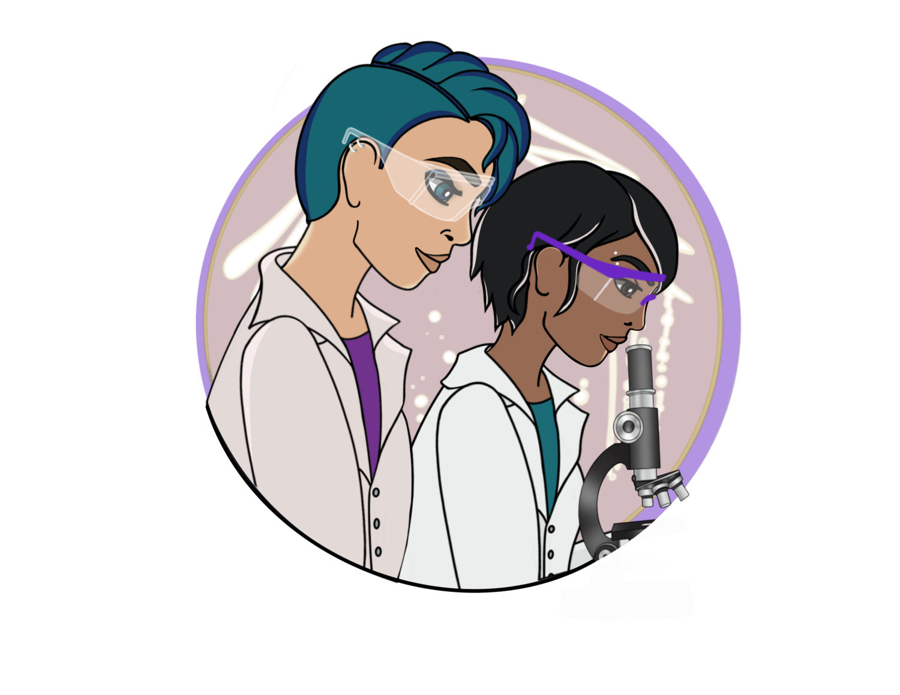

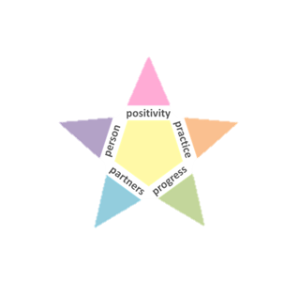
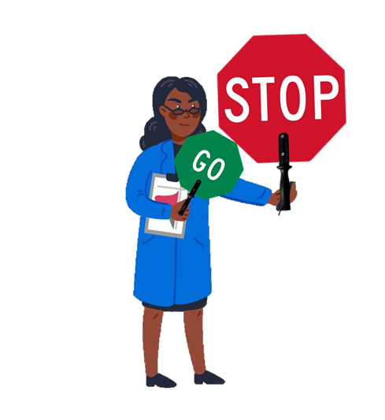
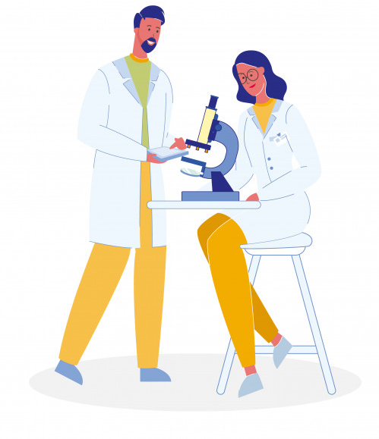
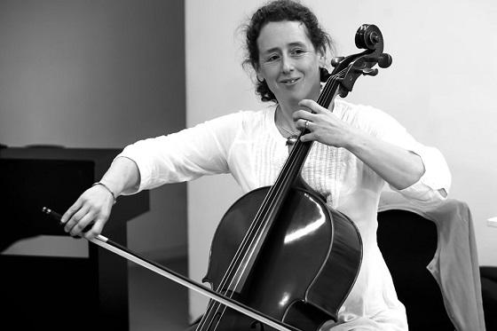
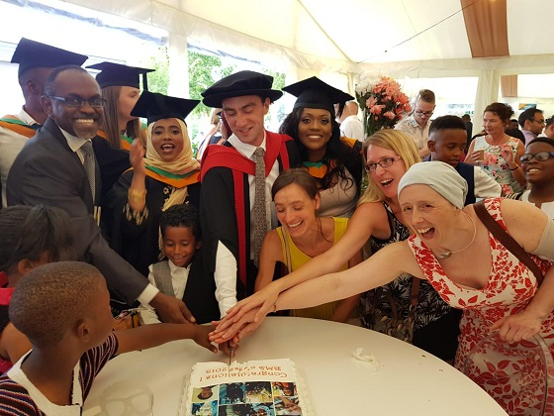


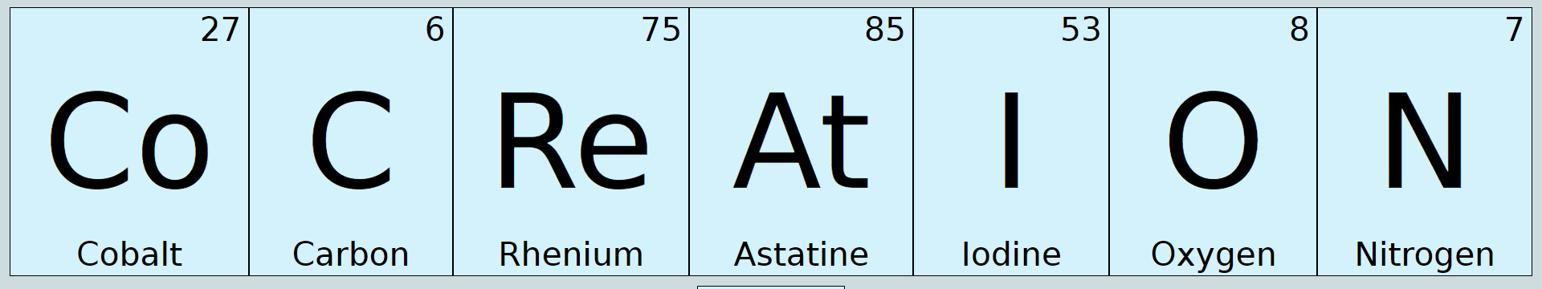
The STAR method:
re-thinking undergraduate science teaching with notes from the Suzuki Method of music education
Libby Sherwood, Heather Clemson, Aidan Hamilton, Tessa Oakley, Nancy Daly, Finley Spathaky and Jo Rushworth
VOTE HERE FIRST!
Do you think that all students
are born with an equal ability
to excel in a STEM subject?
Positivity
2. STAR pedagogy
Active learning, games and rewards make learning fun
Aspirational, inclusive language demands excellence from all -
not just “the best students”
Ladder mark schemes and
feed-forward raise aspirations
YOU CAN!
STAR point | Related pedagogic theory and ideas with examples
Positivity | UDL, game-based learning, Vgotsky’s ZPD
Practice | Constructivism, the spacing effect, retrieval practice
Progress | Bloom’s taxonomy, threshold concepts, differentiation
Partners | Co-creation, near-peer teaching
Person | Humanist learning, self-efficacy
1. Background
Person
Practice
The Suzuki Method postulates that talent is acquired rather than inborn, in the same way that all children learn to speak their mother tongue fluently.
“Every student can” - Suzuki music teachers believe that every child can excel, with the right learning environment.
Dr Jane Sherwood (1969-2019) used a Suzuki approach to teach Biomedical Science, providing a nurturing, holistic and rigorous pedagogy which fostered excellence for all. Here, we try to encapsulate and continue her work in the STAR framework (Figure 1).
Know your students better
Don’t just teach a STEM subject; teach your students with compassionate pedagogy
Embed employability skills & personal development into the STEM curriculum
Daily practice, review and
repetition e.g. daily question, bioBREAKFAST
How can you get your students “practising deliberately”?
Flipped classroom: use live sessions for review, troubleshooting and
working on key concepts
3. Initial findings
Partners
Progress
Increased engagement, satisfaction and pass rate
Easier transition for year 1
Excellence is clearer for all: students set more ambitious long-term goals but more reasonable immediate expectations
Greater sense of community and participation
Mixed year and level peer working
to raise aspirations: “real models”
Student buddy families
Regular staff peer-observation
Co-creation e.g. student lecturers
Students track progress and
self-identify areas to work on
Checkpoints or hinge-points: is your foundation firm enough to build?
Differentiation provides support
and challenge: “Goldilocks Zone”
Listen to Aidan’s reflections about Jane and her teaching
Please leave your feedback…
We would love to hear your thoughts, ideas and questions here. Do leave your details if you’d like to join in and we’ll be in touch.
Acknowledgements: Zina Zelter, Carey Beth Hockett, John Spathaky, Allen Lieb, DMU Centre for Academic Innovation (CAI), all of Jane’s former students and colleagues for their help
Figure 1. The STAR approach.
The five pointers of the STAR are explained verbally () with ideas for the STEM classroom.
Notes:
Aidan’s reflections of Jane (typed):
I first met Jane in 2010. It was at a residential summer school for Suzuki cellists in Suffolk: the first event in my training towards becoming a Level 1 Suzuki teacher. With a limited knowledge of the world of the Suzuki way of learning, now, suddenly, I was immersed in it. And the task before me was daunting. I know I was relieved to discover I wasn’t the only participant with a university teaching background; my subject is English. Being able to share and compare experiences with Jane was a great help in adapting to this new environment. One of the first times I took part in a play together with other trainees and teachers, there were moments when I was utterly lost, such as when a more advanced Suzuki piece was chosen. I happened to be at the back of the group and sitting next to Jane. When the leader launched into Webster’s ‘Scherzo’, I froze. Jane, sensing my unease, leaned over and offered reassurance: ‘Don’t worry, it’s one of her favourites. If you don’t know it, then just sit this one out.’ That was exactly what I needed to hear. Later, on other courses – several in London, one in Spain – I’d always make sure I observed one of Jane’s lessons. Allied to her enthusiasm for cello playing and her infectious energy, there was a firmness and clarity in getting the message across. While teaching the trill in the Boccherini Minuet, she said: ‘It doesn’t matter how slow, but it must be right’; and: ‘It’s no good doing lots of repetitions, unless it’s right’. Children were transfixed when she was demonstrating something. And she made sure the points sank in. Along with everything I learnt from her lessons, I’m also grateful for Jane’s responses to questions sent electronically. For instance, when the issue of the size of children’s bows was raised, her answer began by making the point that there were various solutions: ‘My take on this may be different to others,’ she wrote. She then explained in detail her approach to transitioning a child to a bigger instrument and the implications for the bow. On this occasion, she signed off with a friendly nudge: ‘Will you be at Cellofest this year?’ It was a privilege to know you, Jane. Thank you for your energy, for your kindness, and for your wisdom. I miss you.

