Slide 1

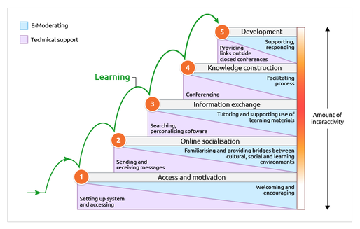

Encouraging and supporting group interaction and discourse in a one week session
A Swali, J Wayte, H Corbett and J Jia
School of Biosciences, University of Nottingham, Sutton Bonington Campus, LE12 5RD
Background:
Replacing an interactive classroom session with a week of online activities, to support the design and execution of scientific research projects. The aim was also to encourage group working and confidence during a one-year course impacted by the pandemic.
Result:
Compared to previous years where students had a single classroom session, this online approach built up students’ expertise in learning and working together. Not only did they have a more pro-active final session, but their critical thinking and problem solving skills were more developed.
Background:
Replacing an interactive classroom session with a week of online activities, to support the design and execution of scientific research projects. The aim was also to encourage group working and confidence during a one-year course impacted by the pandemic.
Result:
Compared to previous years where students had a single classroom session, this online approach built up students’ expertise in learning and working together. Not only did they have a more pro-active final session, but their critical thinking and problem solving skills were more developed.
Method:
Gilly Salmon’s 5 stage model (see Fig. 1) was used to structure a developmental process. Students were motivated to take part in simple online conversations which became more scientific in nature. Through the steps, they learnt to collaborate and give each other feedback.
Figure 1: The Gilly Salmon 5 Stage Model (https://www.gillysalmon.com/five-stage-model.html#)
Conclusion:
Taking students on a journey in the run-up to an online teaching session only requires 10 minutes/day of their time, but leads to a better outcome.
The 5 steps used in this session:
1) Students asked each other Qs designed to extract lots of useful information.
2) Provided each other with feedback on question construction.
3) Moved onto framing scientific questions to problem solve, received tutor feedback on questions asked.
4) Collaborated to write aims and objectives and provided feedback to peers.
5) Constructed hypothesis in breakout rooms.

