Slide 1

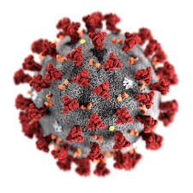




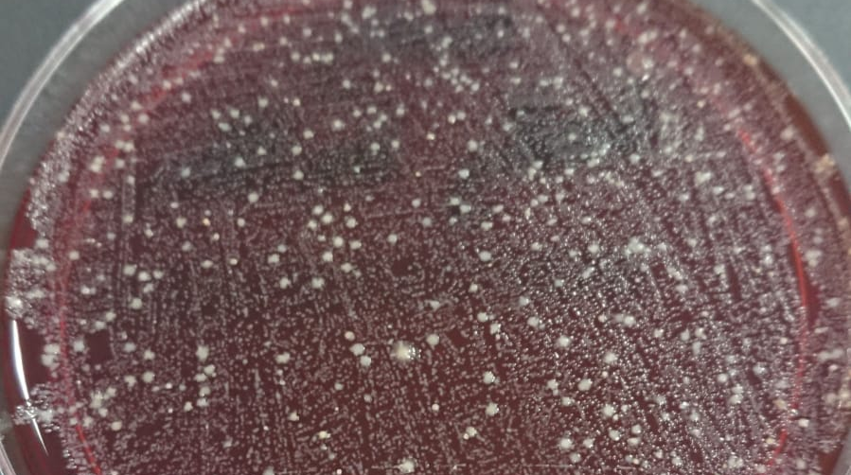

Microbiology intro labs on Zoom:
swabs, masks and belly button fluff
Mel Lacey and Tim Nichol
^{m.lacey@shu.ac.uk}
Traditional delivery
Session 1: Inoculating agar plates in large group lecture
Plate 1: Object swabs
Plate 2: Skin swabs
Plate 3: Before and after hand washing (soap or hand gel)
Session 2: Small group lab session to analyse plates and discuss results
Courses:
Biosciences (~250 students)
Nurses (~500 students)
@MelMLacey
@Tim_Nichol
Online delivery
Session 1: Live online session where students voted on which sites the two academics should swab
Plate 1: Object swabs (low and high)
Plate 2: Skin swabs (low and high)
Plate 3: Before and after hand washing
(soap or hand gel)
Plate 4: Coughs with and without masks
Session 2: Follow up live online session to share pictures of plates and analyse and discuss results
Mel’s belly button swab:
this was voted for very frequently!
Outcomes and feedback
Outcomes: Covered all the learning material that was in the pre-COVID sessions
Best attendance of online live sessions to date
Extensive discussions in the chat
Lots of relevant questions
It was A LOT of fun
Feedback
"I can't wait to find out results from the lab next week"
"An amazing session, engaged through out and learnt a lot. Thanks so much."
"Who knew that I could be so interested in Microbes."
Notes:
Hello, my name is Madalena Oliveira, I am a second year PhD student and welcome to my poster titled B-cell epitope prediction and immunocytochemistry methodology for eIF2B detection in neuronal and glial cells.
To give a bit of a background, the eukaryotic initiation factor (Eif2b) is a guanine exchange factor which is essential for protein synthesis, and it is composed of five subunits, showed in figure 1. eIF2B bodies are cytoplasmic foci detected by ICC, which contain subunits of the eIF2B complex. We have shown that we can detect eIF2B bodies of different sizes and subunit composition in mammalian cells. The study of these bodies is important in understanding the physiology of cells and possibly give insight into diseases that are caused by mutations within the genes encoding eIF2B.
To do so, ICCs are carried out. However, the reproducibility and specificity of antibodies can impact the analysis of the eIF2B bodies. Our overall aim is to characterize the endogenous eIF2B bodies in neuronal and glial cells through the detection these bodies via ICCs. To do so, we want to optimize our ICC methodology through selection of the optimal secondary antibody, prediction of eIF2B exposed epitopes through B-cell epitope prediction softwares and comparison of detected epitopes and with commercially available primary antibodies. By utilizing B-cell epitope predictions we can detect eIF2B amino acids which are exposed and applying this knowledge when selecting primary antibodies for ICCs.
The ICC methodology workflow was the following: ICCs were carried out for the detection of the endogenous subunits using an astrocytoma cell line – U373 cells. A Zeiss LSM 800 confocal microscope and Zen 2.3 analysis software were used for imaging, data processing and analysis. The B-cell epitope prediction software that were employed are BepiPred and DNASTAR, which examine the eIF2B sequence, and DiscoTope, which examines the structure of eIF2B. Several PDB files, bound and not bound to eIF2 molecules were used for the epitope prediction. PyMOL was used as a visualization tool of the eIF2B complex and to compare epitope prediction.
Initially, ICCs were carried out using previously published primary and secondary antibodies, and localization of all eIF2B subunits was detected, as we can observe in figure 3. However, we observed varying signal intensity upon ICC of the different subunits, and eIF2B gamma and epsilon displayed weak signals, showed by the Fluorescence intensity analysis in figure 4a.
Given that primary antibodies had been validated in previous studies, we firstly attempted to increase the signal with a different secondary antibody. Our analysis showed that alexa fluor 594 gave the most consistent signal intensity eliminating the variability from different excitation wavelengths. Utilising alexa fluor 594, ICC of eIF2B gamma and epsilon consistently showed weak fluorescence signal intensity.
B-cell epitope prediction servers were used to access antigenic and exposed residues of each eIF2B subunits. Amino acids presented by two or more servers were highlighted in the figure 5.
Having these epitopes highlighted for each subunit, we then compared with primary antibodies used and recommended antibodies on Human Protein Atlas. Here we show the results for the epsilon subunit., shown in Table 2. Not all recommended antibodies appeared to bind to a higher percentage of matching amino acids. However, both recommended antibodies bind to residues highlighted by DiscoTope, which analyses the structure of the eIF2B structure.
In order to visualize the DiscoTope residues, we used PyMOL showed in figure 6 and it indicates that these amino acids are exposed, thus available for primary antibody binding, which should increase ICC signal.
To determine if these bioinformatic results would translate into in vitro experiments, we analysed the fluorescence intensity of the original primary antibody and recommended antibodies. It is possible to observe in figure 7 that these recommended antibodies that bind to discotope highlighted amino acids, increased the signal intensity.
To conclude, ICC is a powerful methodology, yet the selection of the primary antibodies employed is overlooked. We here describe bioinformatic tools which can aid antibody selection, thus facilitating the study of non/denatured complex structures, such as eIF2B. However, when analysing the bioinformatic results and in vitro experiments, it is important to consider about the categories of B-cell epitope prediction servers employed and the PDB files used, due to sections being unmodeled, which could be a limiting factor in bioinformatic analysis, impacting the overall bioinformatic results. Analysis of endogenous eIF2B bodies can provide new insights into diseases that are caused by mutations in these genes. We intend to improve eIF2Bγ ICC signal either through biotin/streptavidin signal enhancement or more effective primary antibodies. Additionally, the characterisation of size distribution/subunit composition of eIF2B bodies will be carried out through co-localization, and comparison between different cell line will be performed.
Thank you for listening and I hope you enjoyed my poster. Please contact me if you have any questions.

