Slide 1

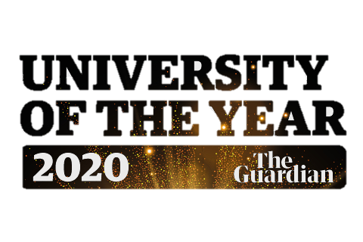

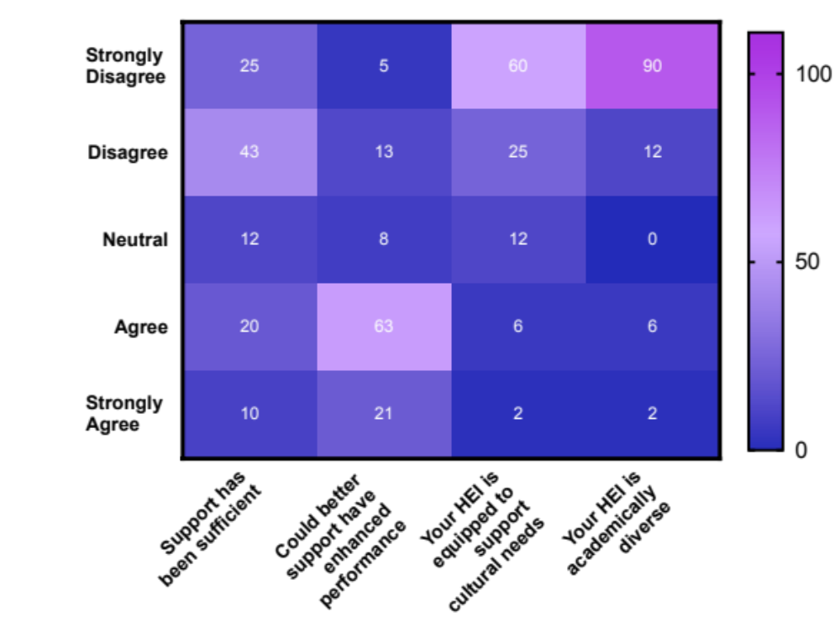















Breaking Through The Glass Ceiling: Addressing The Attainment Gap Through The Staff & Student Perspectives
Dr Karan Rana, Ayesha Hanif, Ariana Mugore, Deepa Mistry, Neda Nadilouei and Rabia Mehmood
Background
Key Findings
Recommendations
Existing literature has identified Black, Asian and Minority Ethnic (BME) students enrolled in higher education institutes (HEI) are subjects of attainment disparity. It is the imperative of HEI’s to foster equality, and harbour an inclusive environment. This study aimed to probe staff and student perspectives to better understand the level of support available to students and whether it could be a contributor to the attainment disparity.
When asked whether students were aware of the attainment gap, 63% of students were unaware of both what the term meant and factors which elude to attainment disparities. Respondents agreed more awareness regarding the issue ought to be raised by HEI and reinforced throughout degree programs.
Whilst students and staff agreed HEI excelled in certain elements, but highlighted enhanced BME representation throughout degree programmes was necessary. This includes inculcating conversations around diversity, brining in BME role models. Establishing a “safe-haven” for conversation. Participants strongly felt staff members could better empathise with BME students, if they were more culturally aware.
63%
Methodology
Participants mostly disagreed that pastoral support at their HEI was sufficient and the majority agreed enhanced support could have improved their academic performance. 77% students felt their university was not equipped to support their cultural needs. Finally a large proportion strongly disagreed with the statement their HEI was ethnically diverse.
What universities do well: | How universities can improve:
Good facilities and equipment | Bring in more BME staff
International buddy scheme | Extra English lessons and translators for international students
Widening participation programme | A module where students can teach each other about cultures
International buddy scheme | Scholarships
Wellbeing services | BME society
Prayer rooms/facilities | More representation, Role models
A2B scheme | Take Ramadan into consideration for Muslim students
Societies | Offer more non-alcoholic based events
Diverse student cohort | More cultural events
Focus groups
Online focus groups
Study Population
Staff Views
110 students, including 82 females, 28 males, with an average age of 20 years from a variety of universities were interviewed. All students were enrolled on STEM courses and in their final year of study. The staff population consisted of 15 members, working across STEM departments.
85% of staff agreed that BME students would benefit from better support and HEI should tailor support services to specific ethnicities. Staff expressed concerns that
Future Work
White
5
Asian
68
A study looking at enhancing cultural awareness in HEI, which will be led by undergraduate students. Collate data and views from students and staff to develop resources, specifically a handbook to help educate academics. Students will be invited to deliver a summary and aim to widen implementation of the data and handbook, across departments
Black
29
Arab
8
“from discussions with BME students they need more support with securing placements in technical disciplines
“I think our white colleagues need to educate themselves about other cultures and beliefs, as I feel often the view is the “white way” is the right way and therefore everyone is judged against that benchmark ”
“As HEI we need to increase the role of BME members of staff within the department. This should not be limited to open days. There is an increased need for BME role models”

