Slide 1


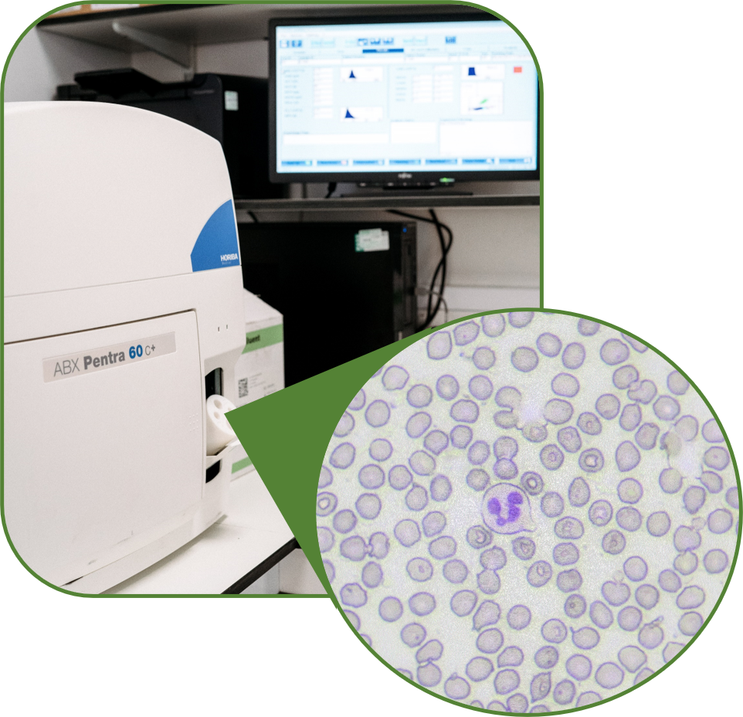
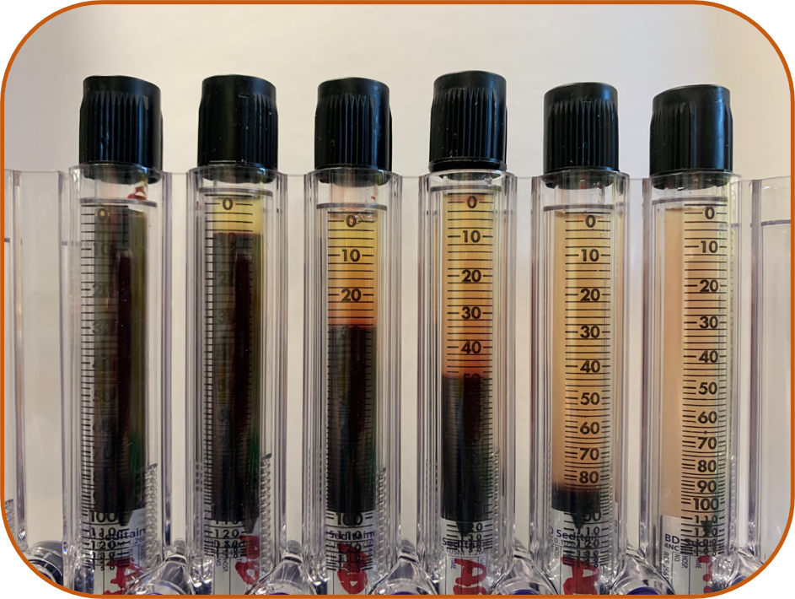
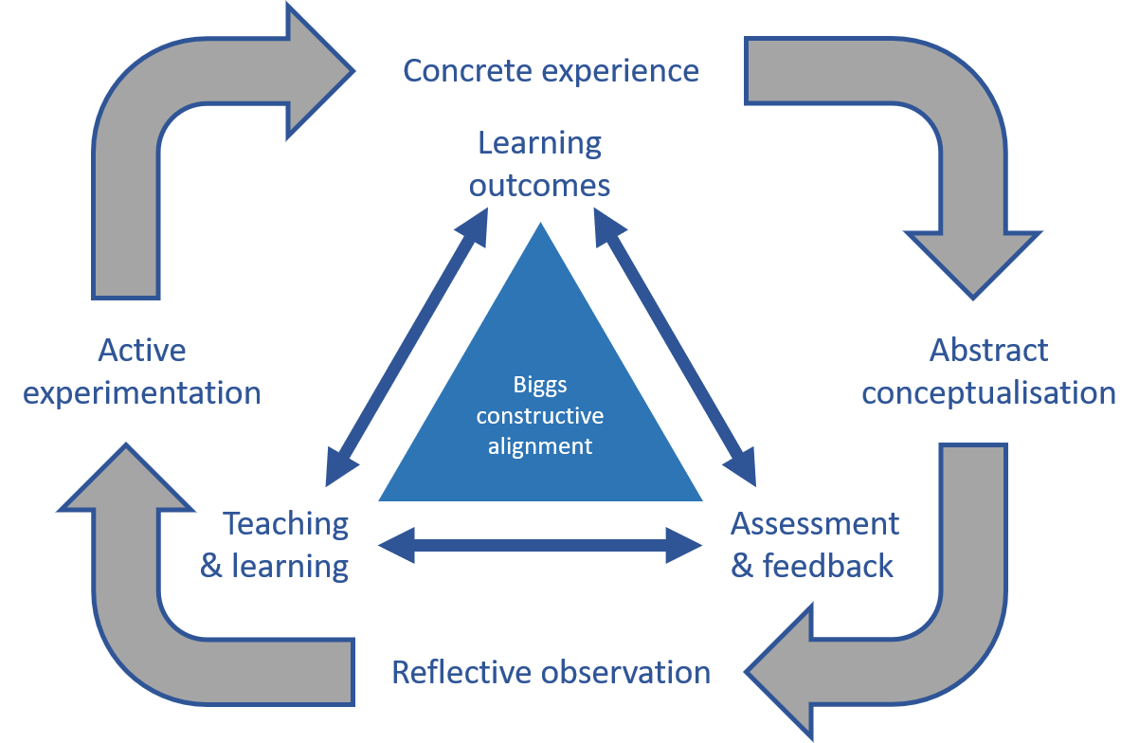
Evaluation & Refinement of Undergraduate Haematology Education
S.A Dawson; J.D Taylor; S Jones – School of Science, Technology and Health, York St John University, York YO31 7EX
Introduction/Rationale
Haematology and Transfusion Science is a key pathology discipline of Biomedical Science. Despite A-level/BTEC curricula [1] requiring a basic understanding of blood composition, undergraduate students have limited prior-knowledge compared with other disciplines (e.g. biochemistry or microbiology). Additionally, very few students have worked with blood in a practical context prior to their degree.
A significant constraint for haematology practical classes relates to H&S issues when analysing both normal and pathological blood samples. Whilst normal parameters can easily be investigated using student finger-prick/venepuncture samples, investigating rare disease phenotypes/conditions is further compounded by their rarity and lack of easy access to pathologic blood samples.
There is currently no literature on how to deliver a practical-based haematology and transfusion science module, addressing both normal and abnormal physiology.
Here we outline our combined approach using the tenets of Biggs’ constructivist alignment [2] and Kolb’s model of experiential learning [3] (Figure: 1).
Evaluating what we’re doing now…
We have created a consolidated theoretical and practical framework to teaching normal blood physiology, centred around practical activities and clinical case-studies [5]. This allows students to implement active experimentation, gain concrete experience, evaluate the underpinning concepts and reflect on their learning [6] using: Case studies; data analysis; authentic assessment and higher cognitive skills.
We have also successfully developed a method to modify a healthy blood sample to mimic a pathological state (Figure: 2).
This allows students to safely visualise simulated pathological samples and perform the associated analysis and interpretation. Our practical conceptualisation activities combining laboratory analysis and linked authentic assessments has been refined annually based on student evaluation and has increased in complexity, continuing to fulfil the requirements of the PSRB. Student attainment has improved from 57% (±14.4) in 2016-17 to 64% (±11.9) in 2020-21.
Refining what we’re doing next…
Our first-hand experience of working in practice plus feedback from Biomedical Scientists who train new graduates, has illustrated that increasing automation within haematology laboratories needs to be reflected in our teaching approach. Thus there is a need to more closely align student understanding of the underpinning concepts of practical haematology, with ‘how’ and ‘why’ the automation used in practice clinically derives a specific result; a so-called "peek behind the curtain".
A simulated pathology that does have altered cell composition would be chronic myelogeneous leukaeamia (CML). Theoretically, by artificially increasing the number of granulocytic white blood cells in the "pathological" sample, the automated full-blood count analyser would return a diagnosis suggestive of CML.
In consultation with the manufacturer and using non-human blood plus bespoke analyser software profiles, we are creating a series of novel, simulated and automated diagnostic haematology approaches. These will be disseminated as a series of free open access learning resource for HE colleagues.
Currently we consolidate both manual practical techniques and their equivalent automated versions by teaching both concomitantly. The students interpret data from both methods to consolidate their comprehension.
This is limited to normal samples and pathologies that do not alter the cellular composition of blood, owing to the challenge of simulating pathologies with altered cell fractions, especially for automated diagnostic instruments.
Erythrocyte sedimentation rate (ESR) is a blood test used as a non-specific clinical marker of inflammation. The pathological changes associated with this test result from a change in density of the cells versus the plasma, rather than the frequency of different cell populations. By adding increasing concentrations of Ficoll-paque to alter the specific gravity of plasma within the sample (Figure: 2), we are able to use normal blood to replicate a range of abnormal results.
1
2
3
4
5
6
Figure: 3
An automated full-blood count analyser, which automatically enumerates the different cell populations. (Inset : a micrograph of a prepared blood film, as viewed when performing manual differentiation of cells).
Figure: 2
A normal blood sample (1) with increasing concentrations of ficoll-paque (10-15%) to demonstrate a wide-range of clinically-relevant pathologies (2-6 respectively).
Integrating these theories, we have designed a module containing a range of real-world and simulated practical activities, data-interpretation and clinical case-studies, to deliver authentic assessment [4] and ensure employment ready graduates.
Figure: 1
The combination of constructivist and reflective paradigms, adapted from Biggs (1996) and Kolb (2015).

