Slide 1

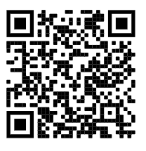
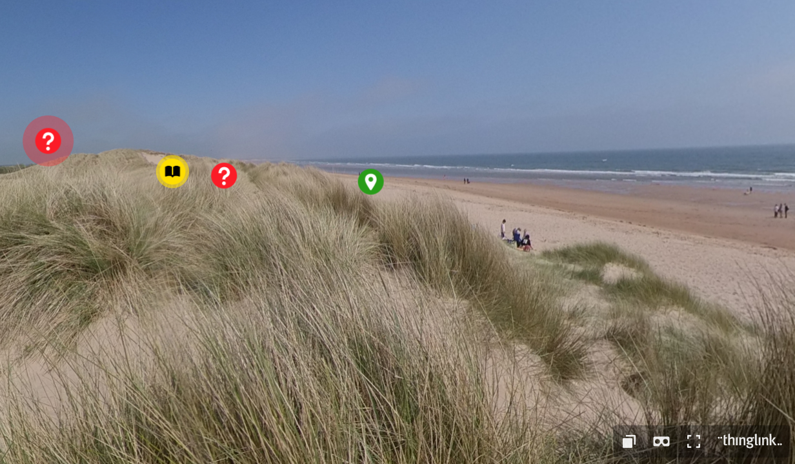
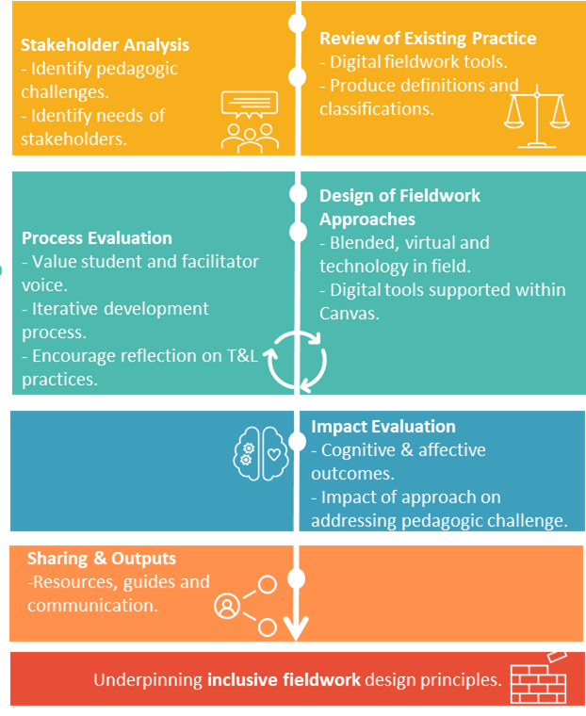




Expanding the field- Classifications and perceptions of digital fieldwork
Janine Maddison, School of Natural and Environmental Sciences, Newcastle University. Supervisors: Dr Sara Marsham & Dr Richard Bevan
Hear me talking about Virtual Fieldwork on the Geog Pod Podcast - Episode #30
Rationale
A signature pedagogy within the Biosciences¹, yet fieldwork has been identified as being ‘at risk’² and there is a continued need to better understand the value of fieldwork. Digital fieldwork practice is growing, yet studies have focussed on single case study events³. An understanding of perceptions and experiences of digital fieldwork will enable this emerging practice to be integrated within existing fieldwork models. Despite the benefits of fieldwork, some communities are under-served⁴. Digital fieldwork has a role in addressing pedagogic challenges of the under-served. This poster presents work completed within the exploration stage of this research. It reviews existing practice which will inform the use of digital tools within the design phase.
3. Review of existing practice
To inform the design phase of this research, Scopus was used to source relevant literature. Abstract analysis using inclusion factors resulted in 152 journal articles. Two stages of qualitative coding were adopted
Open coding into fieldwork delivery mode.
Emergent coding was used under broad headings.
Results from this coding are shown in Figure 1.
Figure 1: Highest frequency emerging codes for ‘Defining Characteristics’ and ‘Fieldwork Purpose’ segmented by delivery mode.
4. Digital tools to support fieldwork
Informed by the exploratory stage, three fieldwork approaches will be developed. Each will encompass a range of digital tools to address pedagogic challenges within fieldwork. All digital tools will be hosted within the existing Learner Management System for access by students.
An example of one of these tools is shown in Figure 2.
Figure 2: 360° image presented within ThingLink with student tasks and links to further information.
2. Research methodology overview
The methodology is divided into distinct stages over the four-year life span of the research project.
Sharing Y4 Evaluation Y3 Design Y2 Exploration Y1
https://arcg.is/10zLmO0 Follow link to go on your own digital fieldwork experience to Druridge Bay sand dunes.
5. Share your views on digital fieldwork
Use this QR code to share your experience and perceptions of digital fieldwork.
References
¹Munge, B., Thomas, G. & Heck, D. 2017. Outdoor Fieldwork in Higher Education: Learning From Multidisciplinary Experience. Journal of Experiential Education, 41, 39-53.
²Smith, D. 2004. Issues and trends in higher education biology fieldwork. Journal of biological education, 39, 6-10.
³Horodyskyj, L. B., Mead, C., Belinson, Z., Buxner, S., Semken, S. & Anbar, A. D. 2018. Habitable Worlds: Delivering on the Promises of Online Education. Astrobiology, 18, 86-99.
⁴Beltran, R. S., Marnocha, E., Race, A., Croll, D. A., Dayton, G. H. & Zavaleta, E. S. 2020. Field courses narrow demographic achievement gaps in ecology and evolutionary biology. Ecology and Evolution, 10, 5184-5196.
https://arcg.is/0LbCGX Follow link to see anonymous results from the survey.

