Slide 1
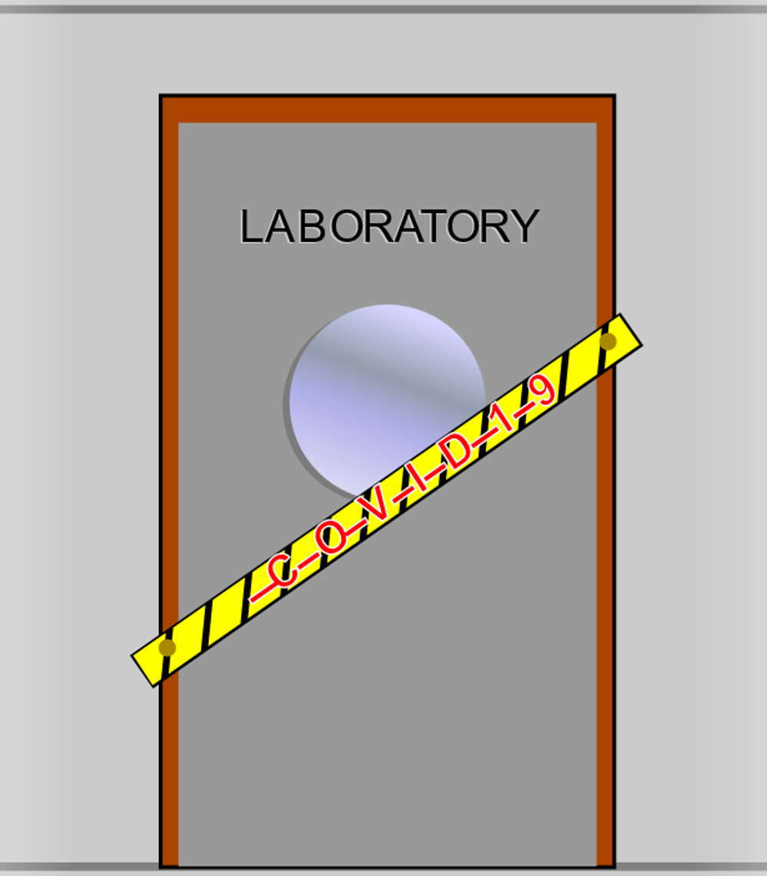
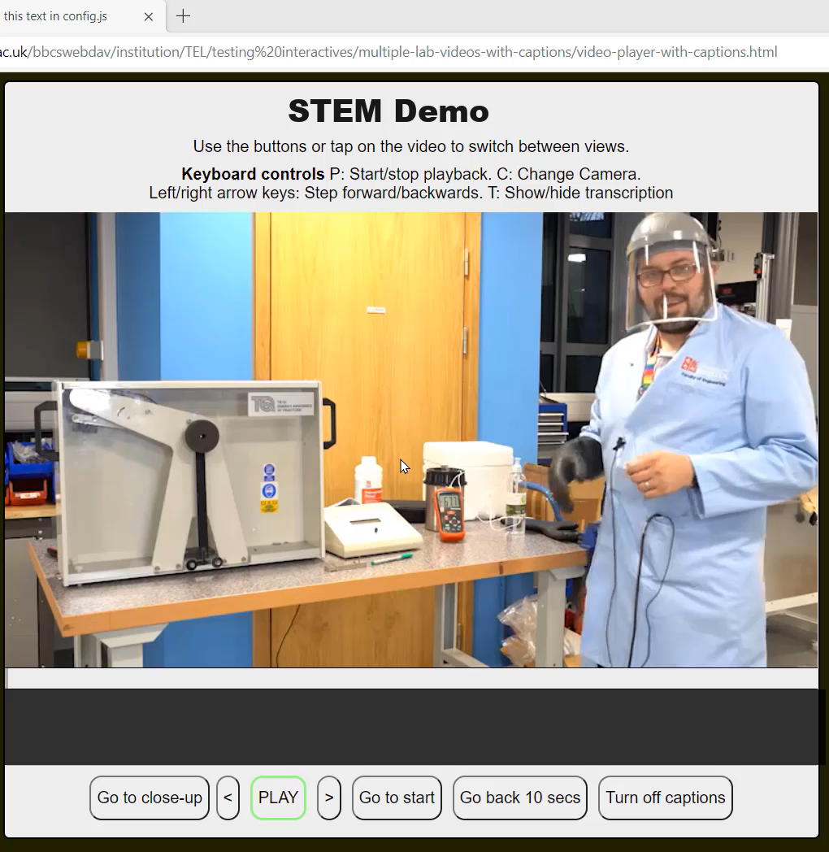
Dual stream video for online lab augmentation
J. Ross, P. Uglow, C. Tseloudi, M. Nutbeem and S. Lancastle
Co-development
Requirements
Students tested and shaped development via surveys
Multiple cycles of development and improvement
Digital Education Office provided web development and expertise
Academic community provided underpinning science
Diverse student circumstances, labs
shut around the UK
Replace an on-campus lab offering
Video lab solution providing interactive choice of view
Compatible with a wide selection of hardware
Evaluation
76% of student survey responses suggest a preference for multi-feed video
96% of student responses suggest an increased likelihood to engage with whole video
95% of student responses suggest no technical difficulties
Solution
Dual-stream video
User choice
Integrated captioning
Robust to bandwidth variations
Integrated into VLE
Facilitates inclusion and diverse student situations
“I like the variety of being able to switch as it mimics being in a real lab where you would be looking at different things as and when you choose”
“Very good idea. Ten points to Gryffindor”
“I found the switching camera option extremely useful. We’re more actively involved in the experiment since we will likely not be able to do it ourselves.”
Read more and try it out at bristol.ac.uk/dual-video-lab
Any questions? Contact joel.ross@bristol.ac.uk

