Slide 1

Flipping the Classroom
Results from a pre-pandemic study to inform a post-pandemic future
Charlotte Price |  | Maria Walker
ad5778@coventry.ac.uk |  | Maria.Walker@wbs.ac.uk

Slide 2
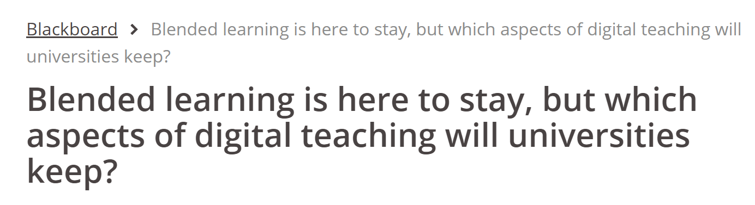

The pandemic effect
COVID-19 has turned the world upside down
The higher education sector has been forced to embrace online and blended learning…
Is this a good change for HE? Difficult to evaluate with so many confounding factors from the pandemic
Notes:
Set the scene. Step change in the education sector, but how are people feeling about that? Proper evaluations and reflection are needed, but anecdotally people (staff and student) have found the past year a struggle. Students haven’t necessarily had the best experiences with online and blended learning, but is this down to the general stress of COVID, the haste with which teaching delivery has been pulled together or a genuine dislike of online and/or blended learning?

Slide 3
Teaching statistics
At WBS 1st year UG students take a core statistics module
  The current intake is around 600 students per year
  Around 20% of the cohort is British – it’s very multicultural
Some students have studied no maths since GCSE level while others have studied A level (or equivalent)
It’s a challenging module to teach!
Notes:
Set the scene

Slide 4
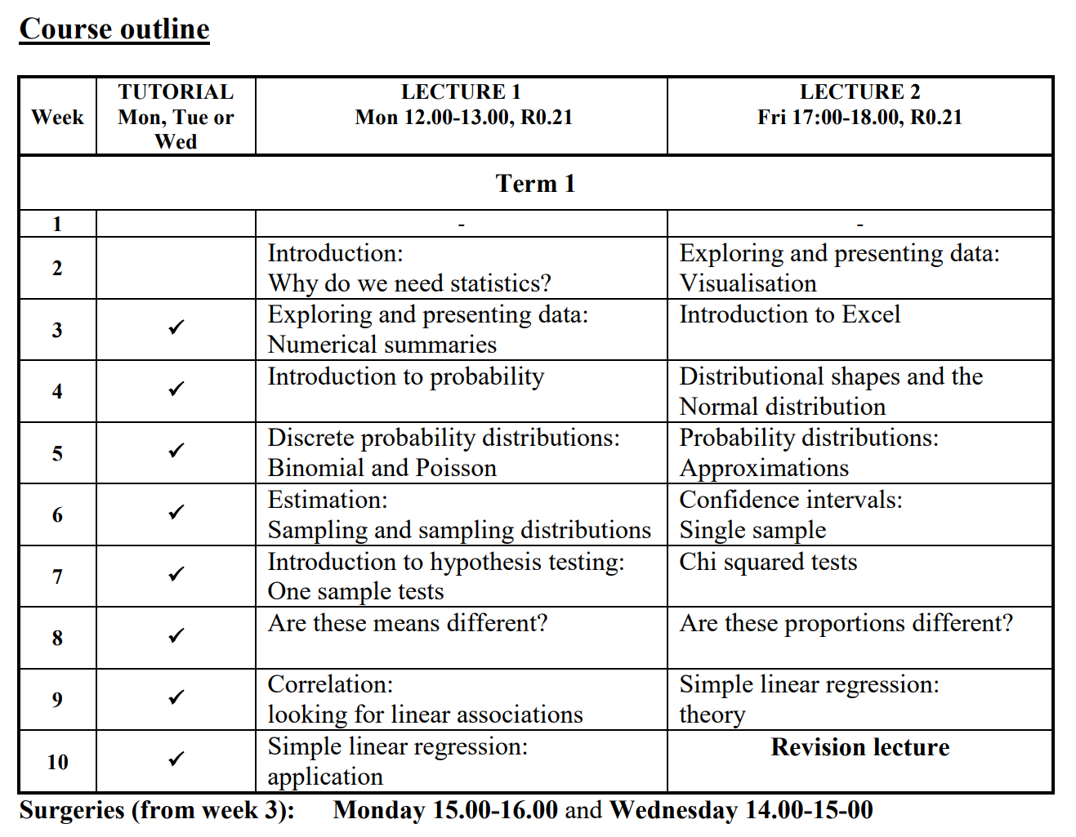
Back to 2013…
I took over as module lead and lecturer in 2013
  Cohort size was 480
Started to make improvements
  Re-wrote module materials
  Inclusion of a mid-term online assessment in 2014
  Additional support for students
  Live lectures recorded by Maria Walker
Notes:
In 2013 the module was run in a conventional way with two f2f lectures per week and a tutorial class. Work put on mywbs and live lecture recordings done.

Slide 5
Flipping the classroom
The announcement of a leap in student numbers in 2015 prompted a radical change to the course delivery…
We decided to flip the classroom
A flipped classroom “uses technology to move lectures outside the classroom and uses learning activities to move practice with concepts inside the classroom” (Strayer, 2012)
Strayer, J. (2012) How learning in an inverted classroom influences cooperation, innovation and task orientation. Learning Environments Research, 15, 171-193.
Notes:
Go back to 2015 when we decided to flip the classroom….set the scene, talk about what we did.
At WBS, first year students take the core module Quantitative Analysis for Management 1 (QAM1), a foundation course in statistics. Some students have studied no maths since GCSE level while others have taken a range of quantitative A Levels (or equivalent), which makes this a challenging module to teach. A major re-write of the module materials in 2013, followed by a move to include a mid-term online assessment in 2014, has resulted in consistent positive student feedback. However, the announcement of a large increase in student numbers in 2015 prompted the most radical change to QAM1 yet, teaching using a flipped classroom. A flipped classroom “uses technology to move lectures outside the classroom and uses learning activities to move practice with concepts inside the classroom” (Strayer, 2012).

Slide 6
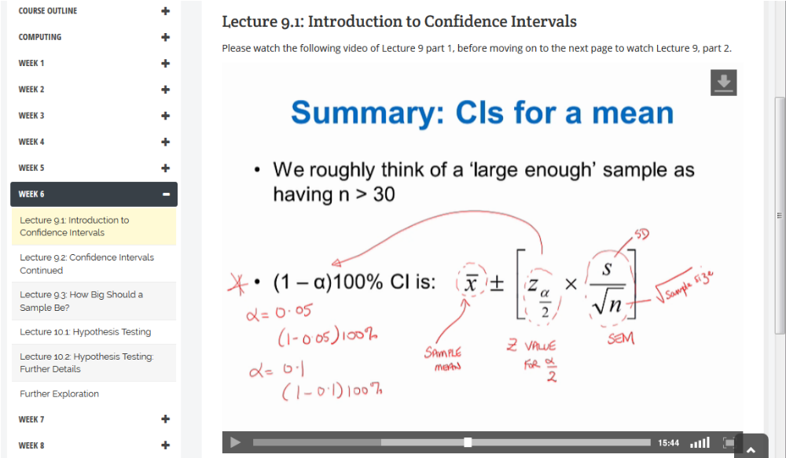
Here’s what we did…
Step 1: Record the lectures
Recorded using TechSmith Camtasia 8
Lectures broken into parts with average length 25 mins
Videos professionally edited
A mix of talking to camera, PP presentation, hand-drawn annotations, explanatory workings

Slide 7
Here’s what we did…
Step 2: Prepare interactive classroom sessions
Weekly tutorials re-written to focus on group work
Lecturer moved from large lectures to smaller group teaching
Notes:
Remind the audience of the context for all of this – it was done before online learning and blended learning were really popular. As such, we were pushing boundaries. Talk about my workshops and the fact I had 3 or 4 people (me and tutors) at each workshop – better learning experience. Students undertook group work.

Slide 8
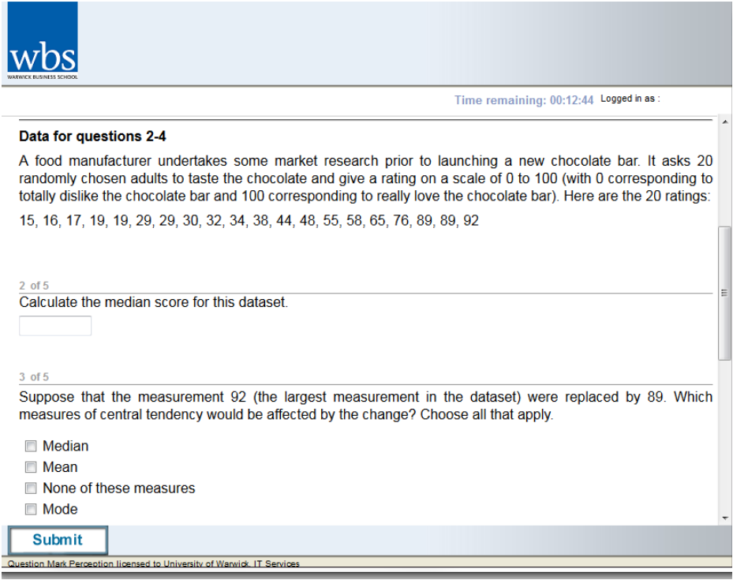
Here’s what we did…
Step 2: Prepare interactive classroom sessions
Weekly tutorials re-written to focus on group work
Lecturer moved from large lectures to smaller group teaching
Step 3: Prepare online class tests
Online tests introduced mid and end of term using Questionmark Perception
Question variants created using Excel
Randomisation of questions to reduce collusion
Notes:
Remind the audience of the context for all of this – it was done before online learning and blended learning were really popular. As such, we were pushing boundaries.

Slide 9
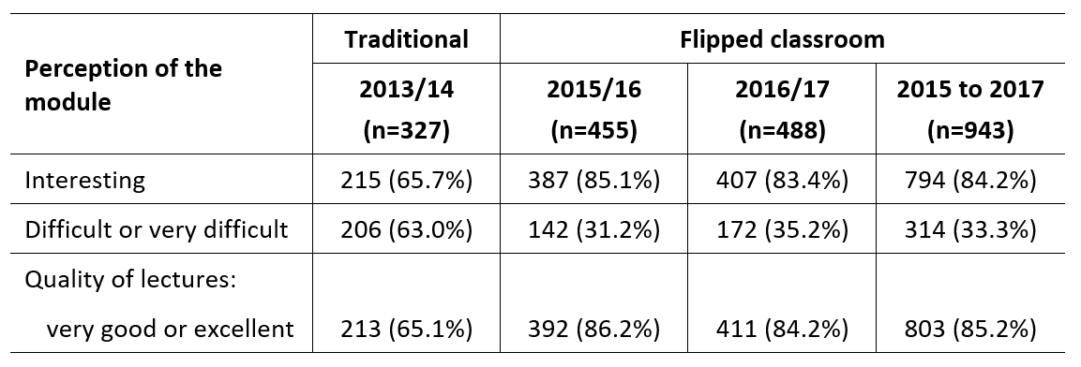
Did students like it?
Price, C and Walker, M (2018), “Improving the accessibility of foundation statistics for undergraduate business and management students using a flipped classroom”, Studies in Higher Education, https://doi.org/10.1080/03075079.2019.1628204
Notes:
Broadly speaking, yes they did. Point out that the lecture slides were the same under both teaching modes.

Slide 10
Did students like it?
Price, C and Walker, M (2018), “Improving the accessibility of foundation statistics for undergraduate business and management students using a flipped classroom”, Studies in Higher Education, https://doi.org/10.1080/03075079.2019.1628204
Notes:
Broadly speaking, yes they did. Point out that the lecture slides were the same under both teaching modes.

Slide 11
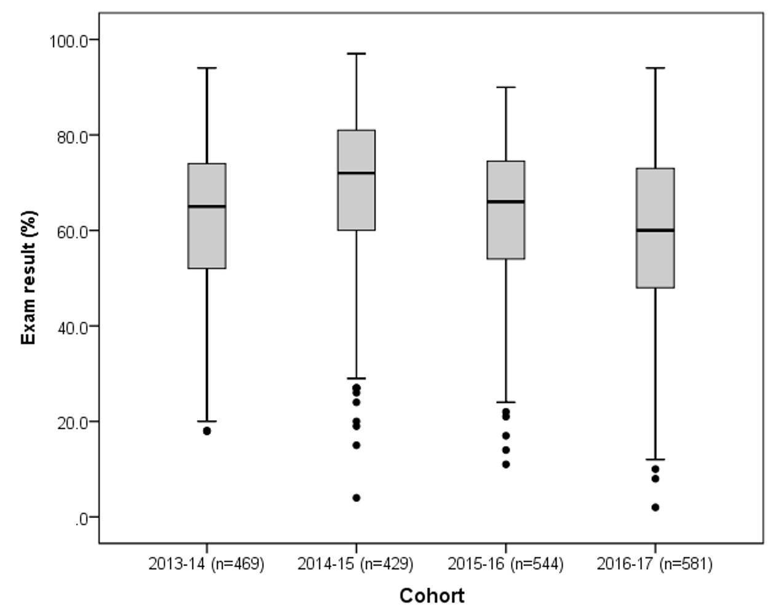
Exam performance
Notes:
No big differences in exam performance – discuss this and the fact that we were happy enough with that as questions would be asked about changes to the exam if we saw big changes.

Slide 12
Pros and cons
Pros of flipped classroom | Challenges of flipped classroom
Made module feel more accessible (e.g. perceptions of interest and difficulty) | It’s hard work! Time consuming to prepare Doesn’t (and shouldn’t!) reduce teaching hours
Lots of students liked being able to watch video lectures at own pace | Better to have support from professional eLearning specialists
Lecturer gets more access to students and vice versa Opportunity for students to ask questions Lecturer can observe and detect issues | Not everyone likes it Some people simply want traditional lectures Natural resistance to change For large cohorts, responses to FC can differ according to student characteristics and experiences
The online resources allow flexibility in structuring the teaching | Not necessarily suitable for all courses Better for large modules?
Notes:
Talk about the relationship Maria and I had in order to make this work. Discuss the fact that, in our experience, the experience was worth it as it was so well received by students. However, it’s not without its challenges and it requires a lot of hard work in order to do it properly.

Slide 13
Final thoughts…
This study gives a positive insight into blended learning outside of the turmoil of a global pandemic
Ideally, blended learning needs to be proactive and not reactive (….not possible over the past year, but possible going forward)
Blended learning is more than just moving materials online
It’s not an easy option, but can improve the student experience
Notes:
Blended learning is a different philosophy. You have to change the whole delivery of the module and focus more on the student experience.

Slide 14
Any questions?

