Slide 1

Addressing the challenges of delivering a laboratory class when students are miles away
Sarah K Coleman and Caroline L Smith
School of Life Sciences
University of Westminster
Horizons in STEM HE Conference 2021

Slide 2
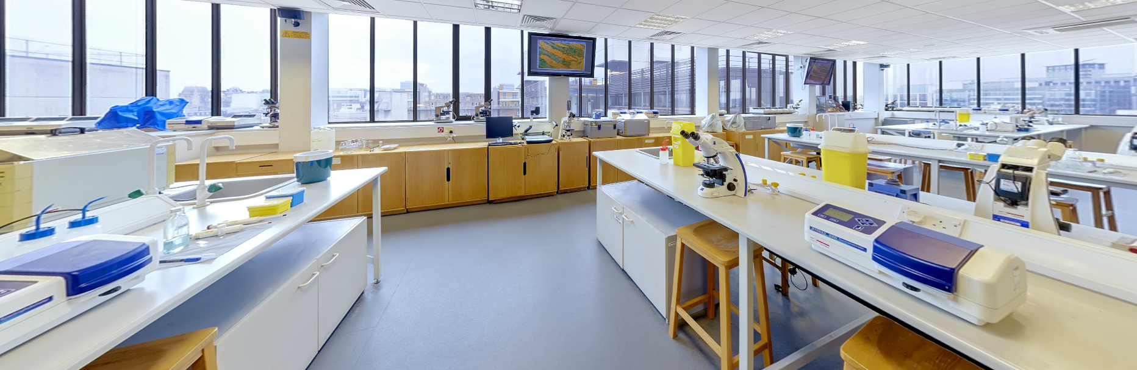
Laboratory Classes for Life Science students
Requirement professional bodies and employers
Range of laboratory competencies and psychomotor skills
School of Life Sciences had ~700 1st year students 2020-21

Slide 3
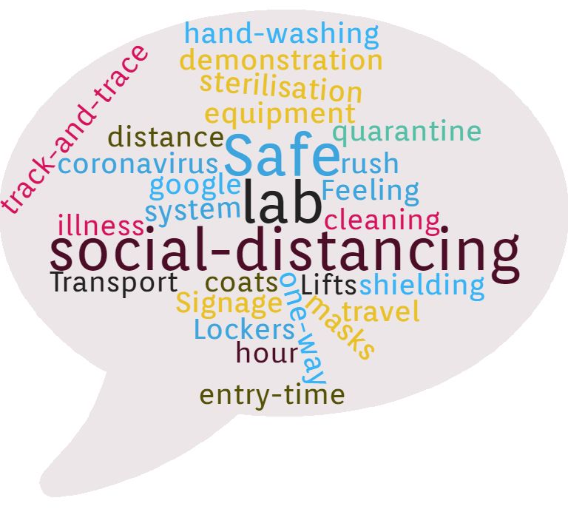
How to Adapt during Covid19 pandemic?

Slide 4
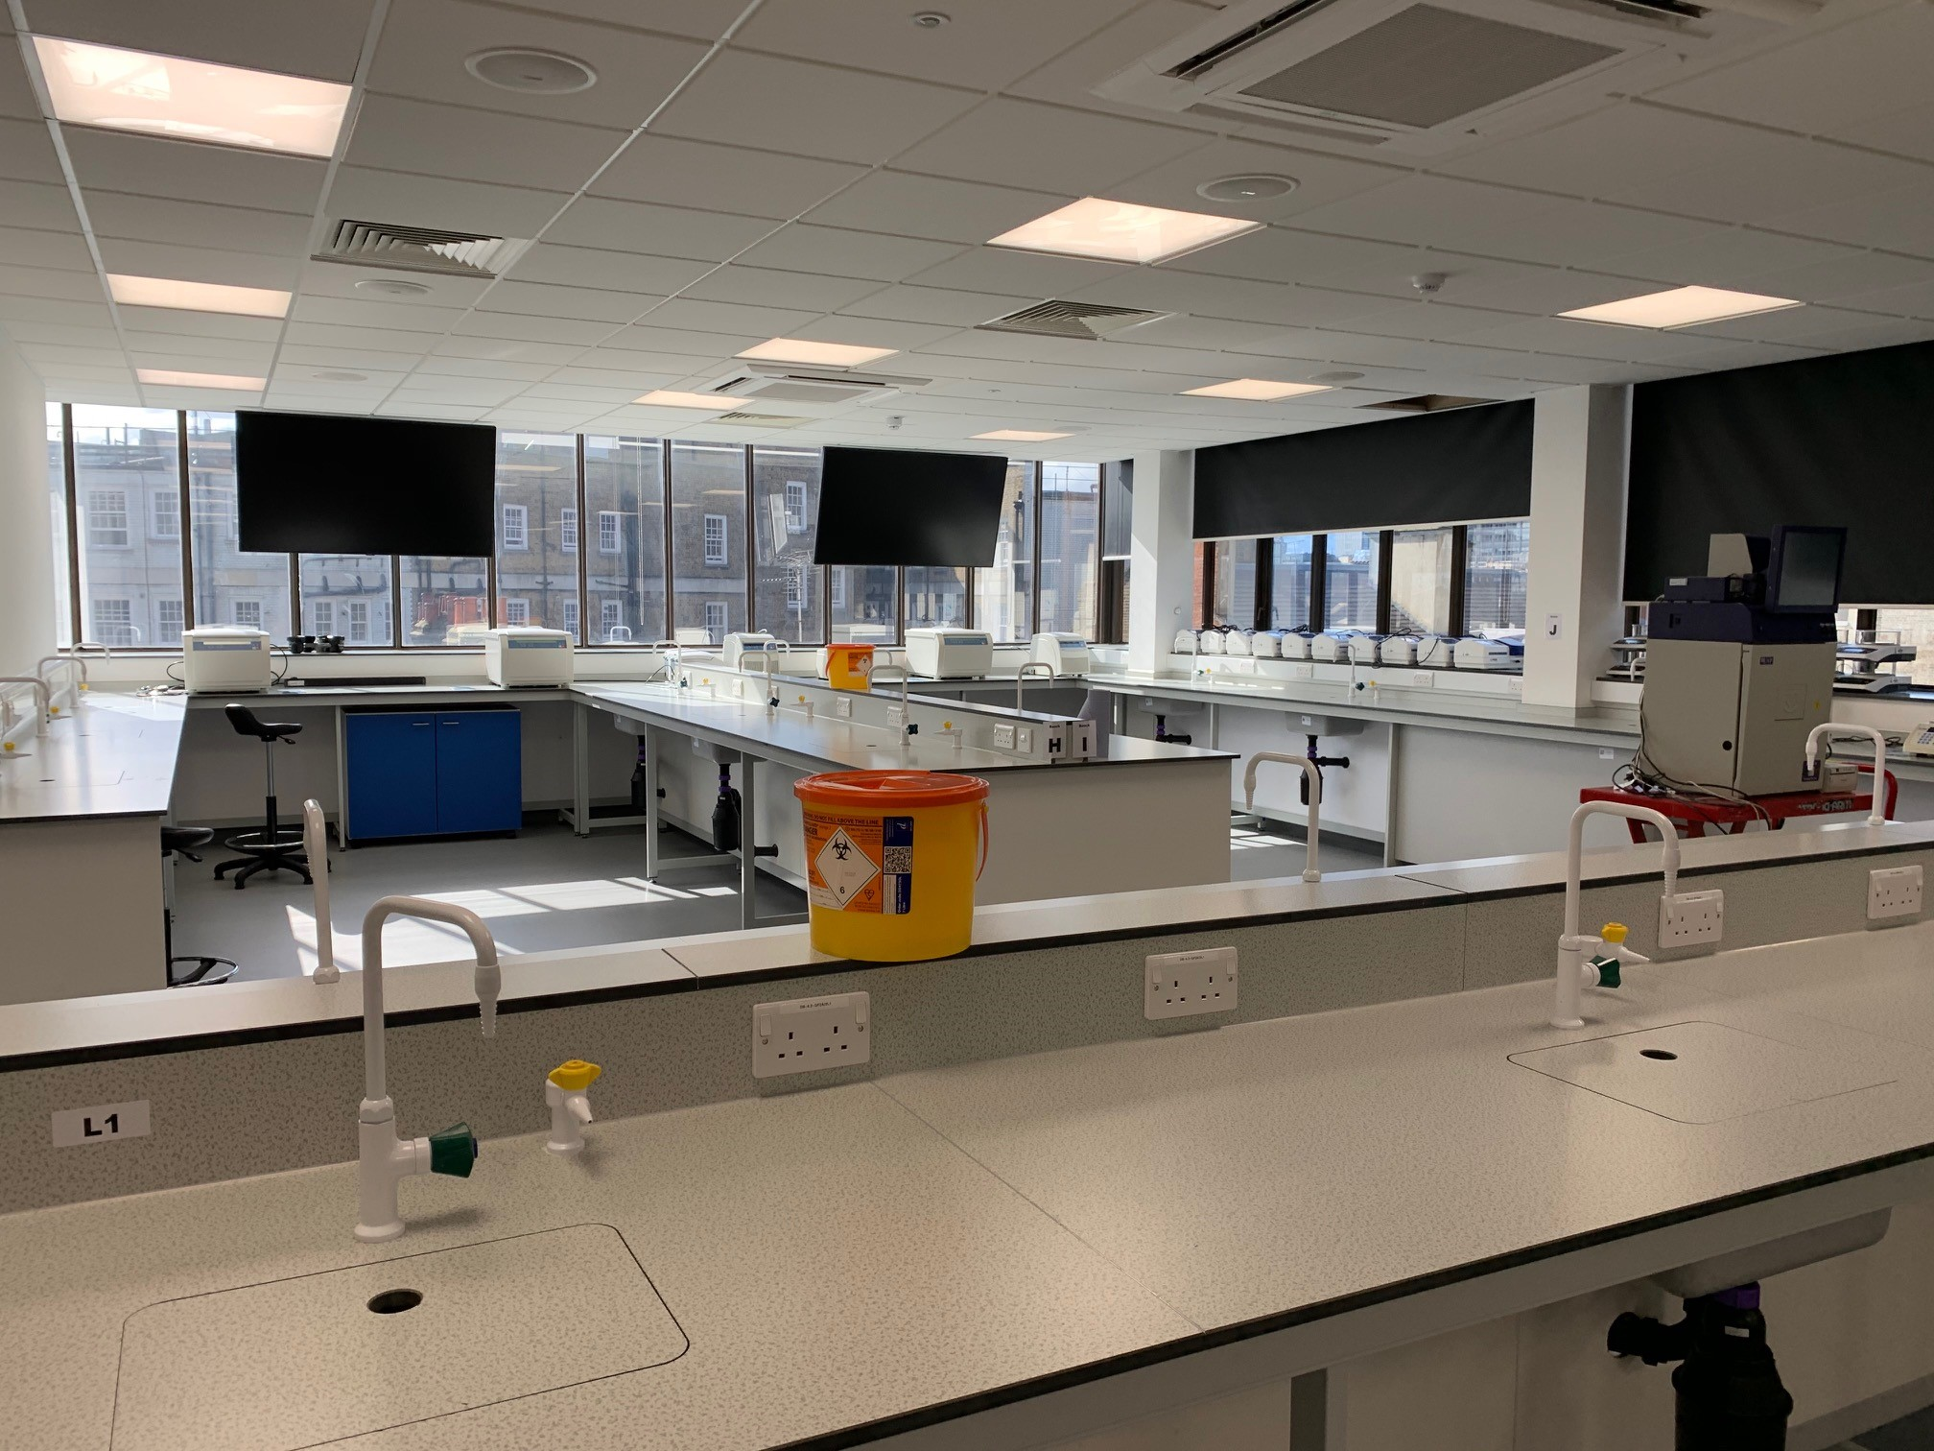
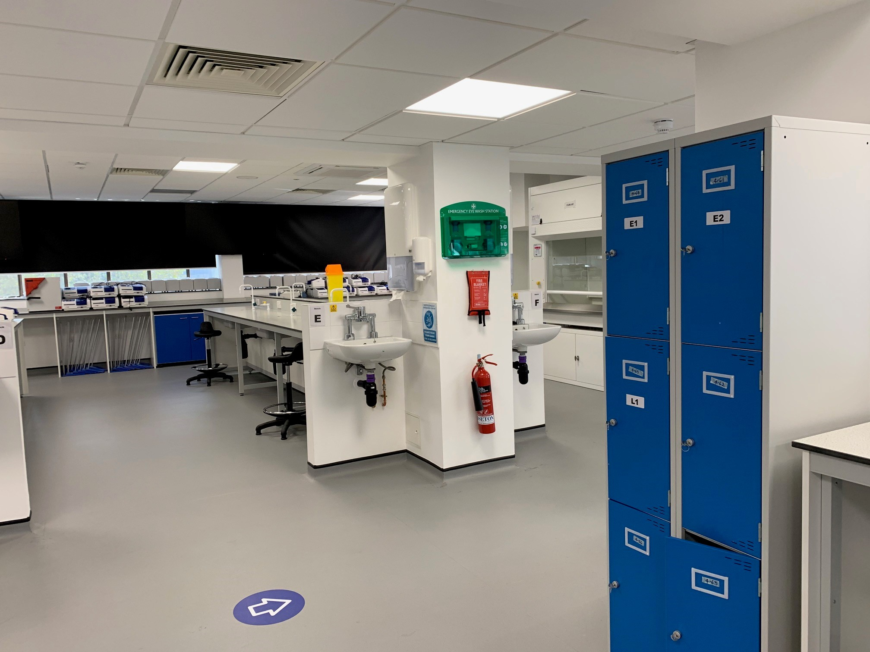
Laboratory Classes for Life Science students
Teaching Labs | Normal Capacity | Covid19 Capacity
Lab One | 80 students | 13 students
Lab Two | 96 students | 16 students
Lab Three | 136 students | 19 students

Slide 5
Assumption 1:
Most students would want to come on-site if permitted (and able to).
Assumption 2:
Many students would not be able to come on-site (even if permitted).

Slide 6
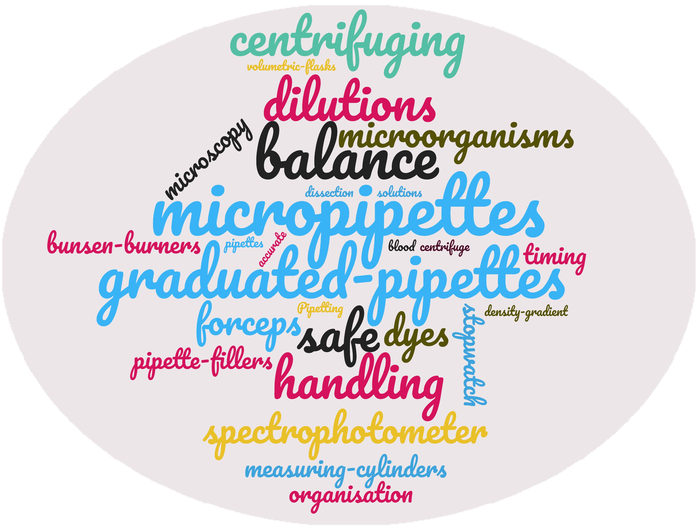
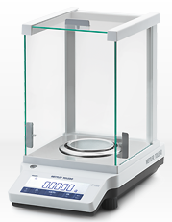
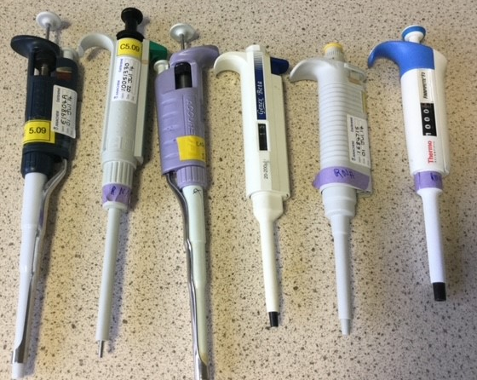
Requirement to teach key psychomotor skills
Introducing key laboratory equipment and techniques
Demonstrate relevance of Health and Safety considerations
Introducing data handling and critical thinking

Slide 7
Assumption 1:
Most students would want to come on-site if permitted (and able to).
Assumption 2:
Many students would not be able to come on-site (even if permitted).

Slide 8
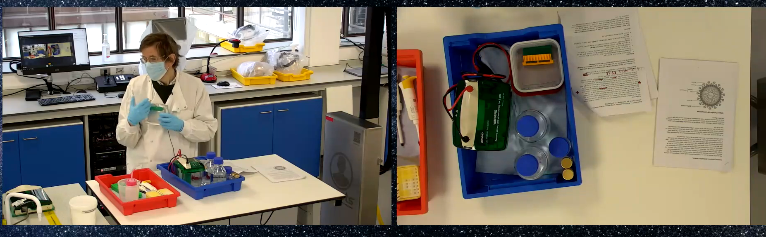
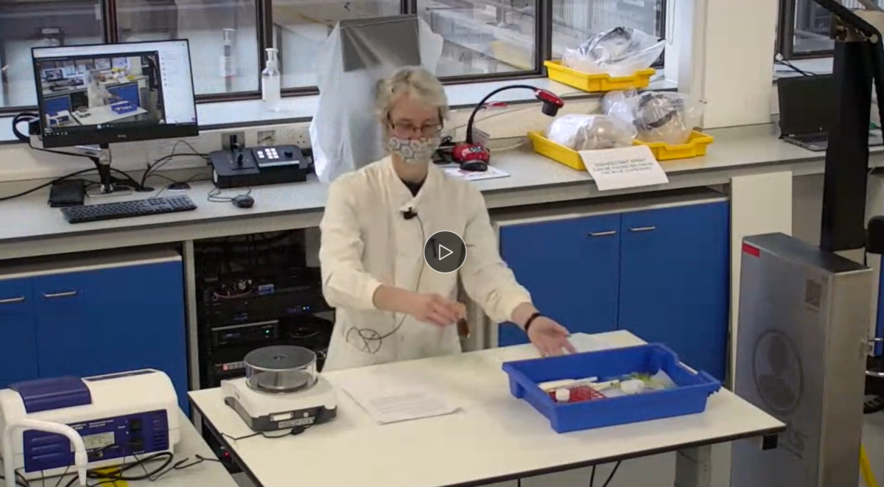
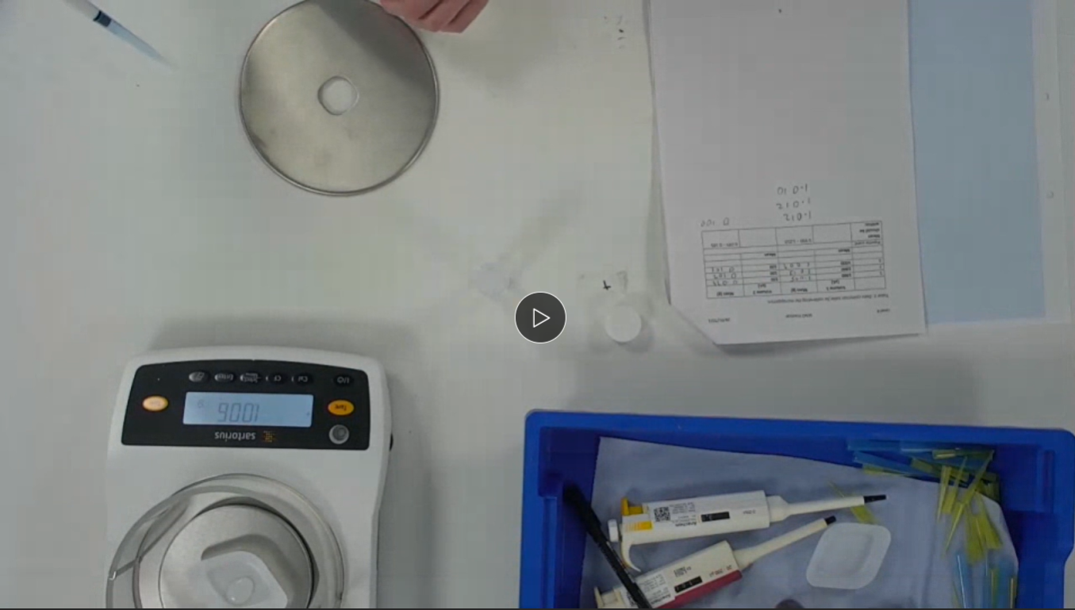
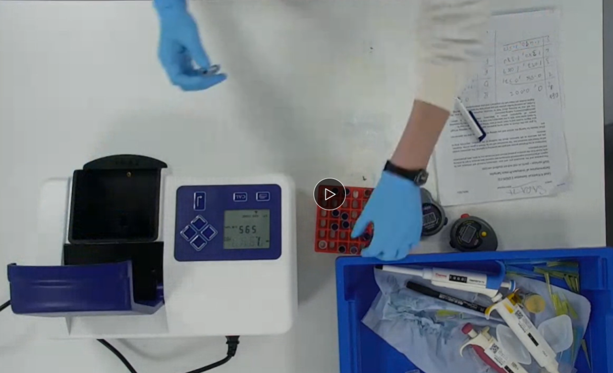
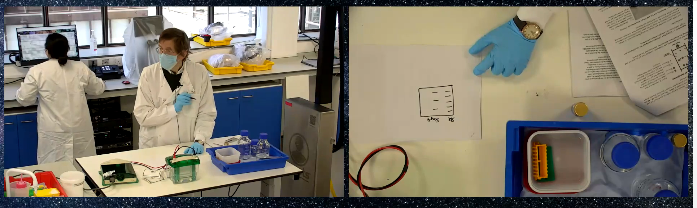
SMOTs Camera One
SMOTs Camera Two

Slide 9
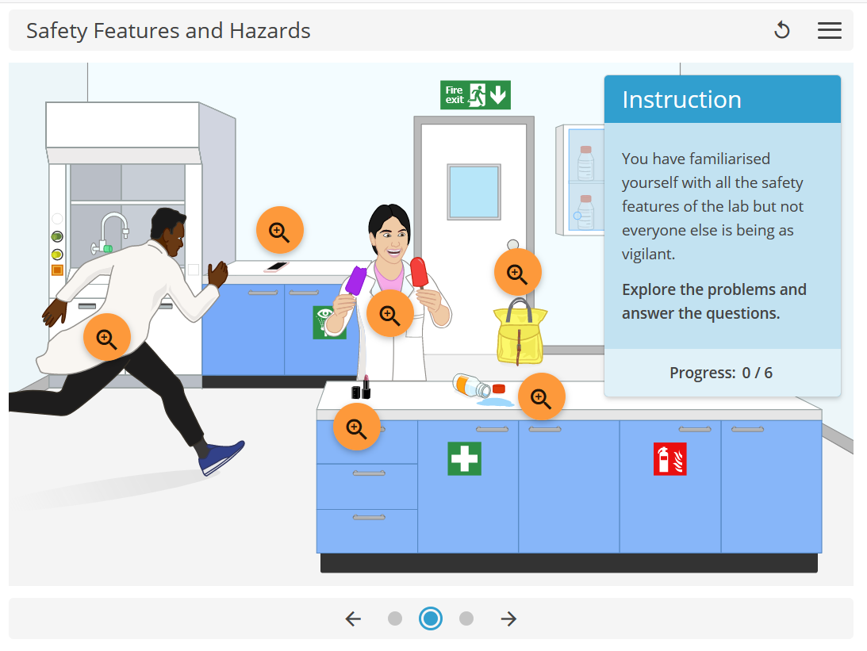
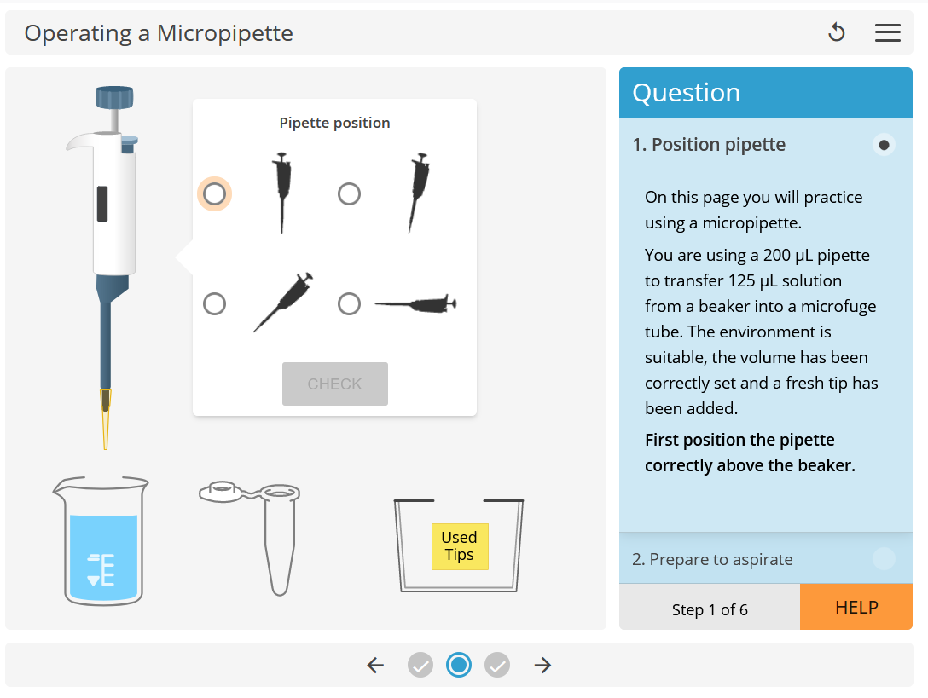
Pre-Laboratory training
Utilised selected virtual laboratory simulations

Slide 10
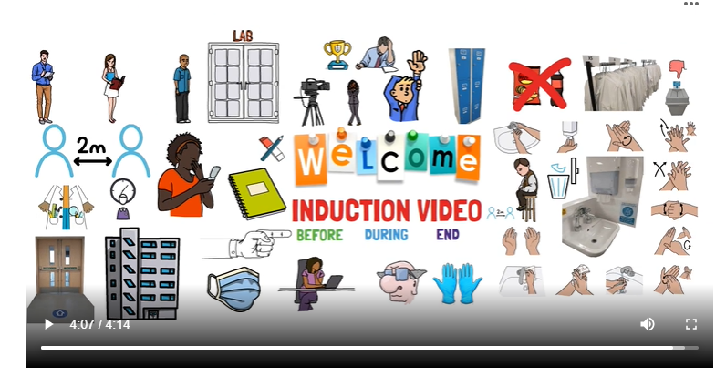
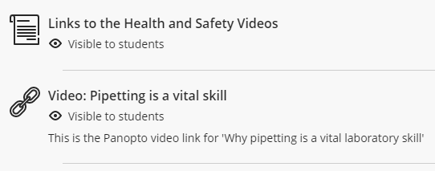
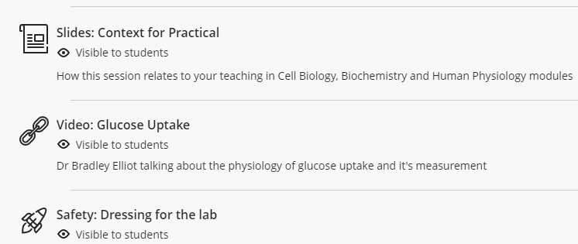
Pre-Laboratory Material:
Created by Mr Burak Pirincci

Slide 11
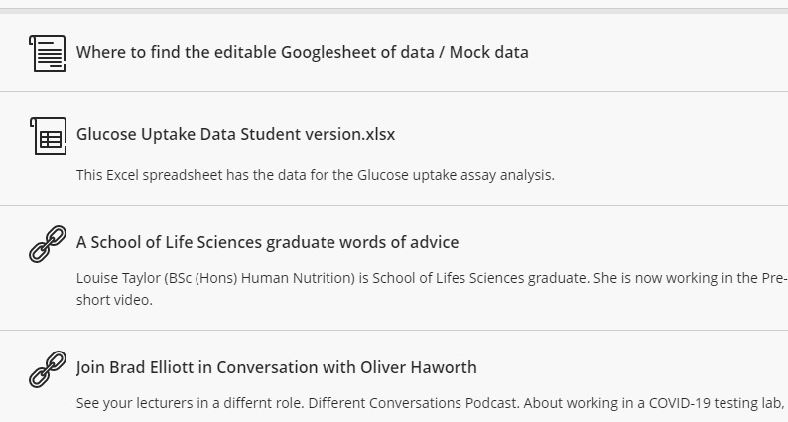
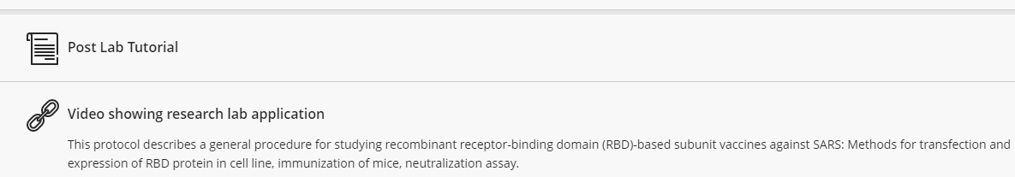
Post-Laboratory Workshop:
Data Analysis
Graphing
Wider context
Face-to-face
Online

Slide 12
Methodology
Virtual Learning Environment (VLE) login data
Deployed Likert-type student surveys
On-going staff reflection and discussions

Slide 13
First year students attendance
Total registered students = 707; semester 1
31% attended on site
59% logged in for live-stream BUT only 27% were logged in for the whole session
Total registered students = 700; semester 2
16% attended on site
44% logged in for live-stream BUT only 22% were logged in for the whole session

Slide 14
Student feedback
Students who attended on-site valued meeting peers and lecturers as well as taking part in the lab session.
Students who attended the live-stream cited concerns about Covid-19 (personal and family) as the greatest barrier to attending onsite.

Slide 15
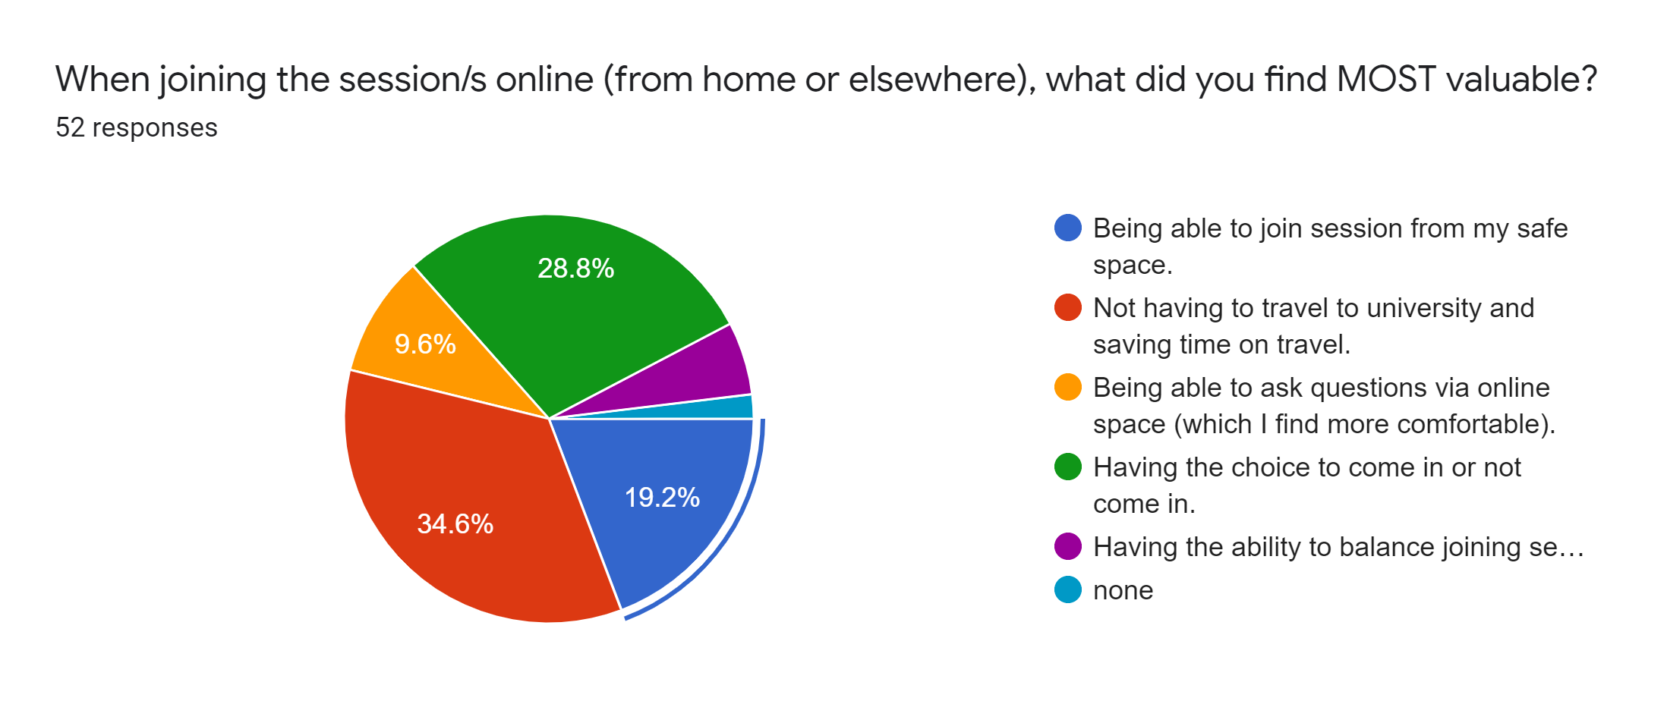
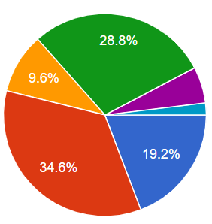
When joining the laboratory classes live-stream what did you find MOST valuable?
Being able to join from my safe space
Not having to travel to University and saving time
Being able to ask questions via online (which I find more comfortable)
Having the choice to come in or not
Being able to balance the session with other responsibilities
N=52
None
Over 70% of 1st years surveyed (n=36) said they would be likely or very likely to attend a streamed session if could not attend in person

Slide 16
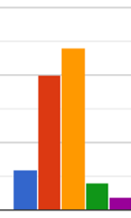
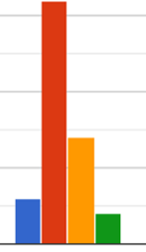
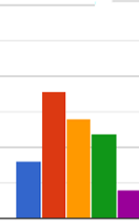
Likert-type responses to statements about the live-stream laboratory classes
Broadened my understanding of laboratory equipment
Strongly
agree
Agree
Broadened my understanding of how to work in a laboratory
Neutral
Disagree
Strongly
disagree
Is something I would like to see continued

Slide 17
What aspects of the Livestream did you enjoy? (free text responses)
“clear demonstration of equipment and procedures”
“the effort that the university made..”
“engagement of professors / teachers with the students…”
“can follow it easily”

Slide 18
Pre-Laboratory training
Utilised selected virtual laboratory simulations

Slide 19
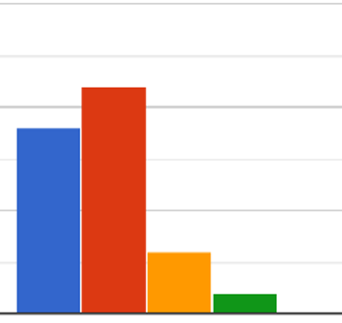
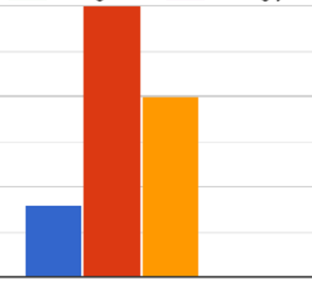
Student views on the pre-lab virtual laboratory simulations
Varied according to whether they attended an on-site or a livestream session
Completing the pre-lab virtual laboratory activity supported my learning for when I attended…
Strongly agree
Agree
Neutral
Disagree
Strongly disagree
On-site
Livestream
Academic staff “…Genuinely impressed with how good my groups basics of pipetting were…”

Slide 20
Summary 1 – Student
Students appreciated the effort to develop Live-streaming and On-site laboratory practical sessions
The live-streaming provided students a chance to engage the laboratory sessions whilst shielding from Covid-19
Most students reported good quality Live-streaming experience
Students found the Live-streams useful broadening understanding of laboratory skills and applications

Slide 21
Summary 2 – Academic Staff
Practise improves the experience for both filming crew and staff leading the session
Academic staff are specifically needed to interact with the Live-stream students
Increased activities and virtual labs for Live-stream students are needed to keep students engaged
Despite high quality SMOTs cameras poor student connectivity depreciated the student experience of live streaming

Slide 22

Acknowledgments
Dr Louise Usher
Dr Abi Azeez
Dr Rumy Begum
https://learningscience.co.uk/
All the laboratory technical, IT technical, University reception team and academic staff who helped make this happen!
“...hopefully for the next academic year in-person learning will be the main focus and available...”

