Slide 1







Using Student-led Individually Created Course &
Researcher Development Framework to capture the experiential learning of a cohort of interdisciplinary PhD students on an industry project.
The EPSRC and MRC Centre for Doctoral Training in Optical Medical Imaging
Layla Mathieson, Fumi Kitagawa, Jean O'Donoghue (University of Edinburgh)
Kirsty Ross (University of Strathclyde)

Slide 2

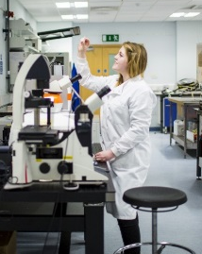
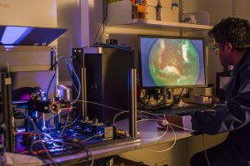
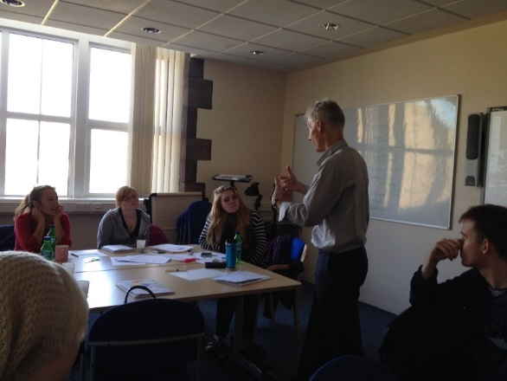
The EPSRC and MRC Centre for Doctoral Training in Optical Medical Imaging
The EPSRC and MRC CDT in Optical Medical Imaging
Interdisciplinary research
Healthcare Innovation and Entrepreneurship.
Notes:
JEAN
In this case study we outline our experience of co-designing a new Student-led Individually Created Course (SLICC), in close collaboration with an industry partner, and a cohort of PhD students to develop innovative solutions to key future healthcare problems. and the SLICC was developed and delivered virtually during the lockdown in Spring 2020.
Placement as part of taught programme

Slide 3
Student Perspective
The EPSRC and MRC Centre for Doctoral Training in Optical Medical Imaging
Request for course in response to lockdown
Initial discussion with Canon and setup of course
Preliminary investigation in subject of interest
Selection of disease of interest
Interim feedback
Developed final proposals
Present final solutions to Canon
Self evaluation assessment
Completion of course
Notes:
LAYLA

Slide 4
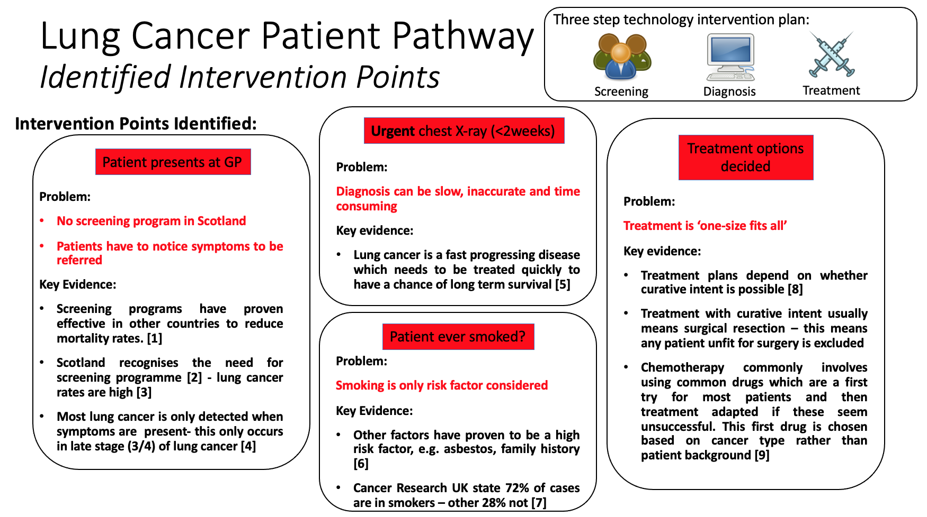
Project Output
The EPSRC and MRC Centre for Doctoral Training in Optical Medical Imaging
Notes:
LAYLA

Slide 5
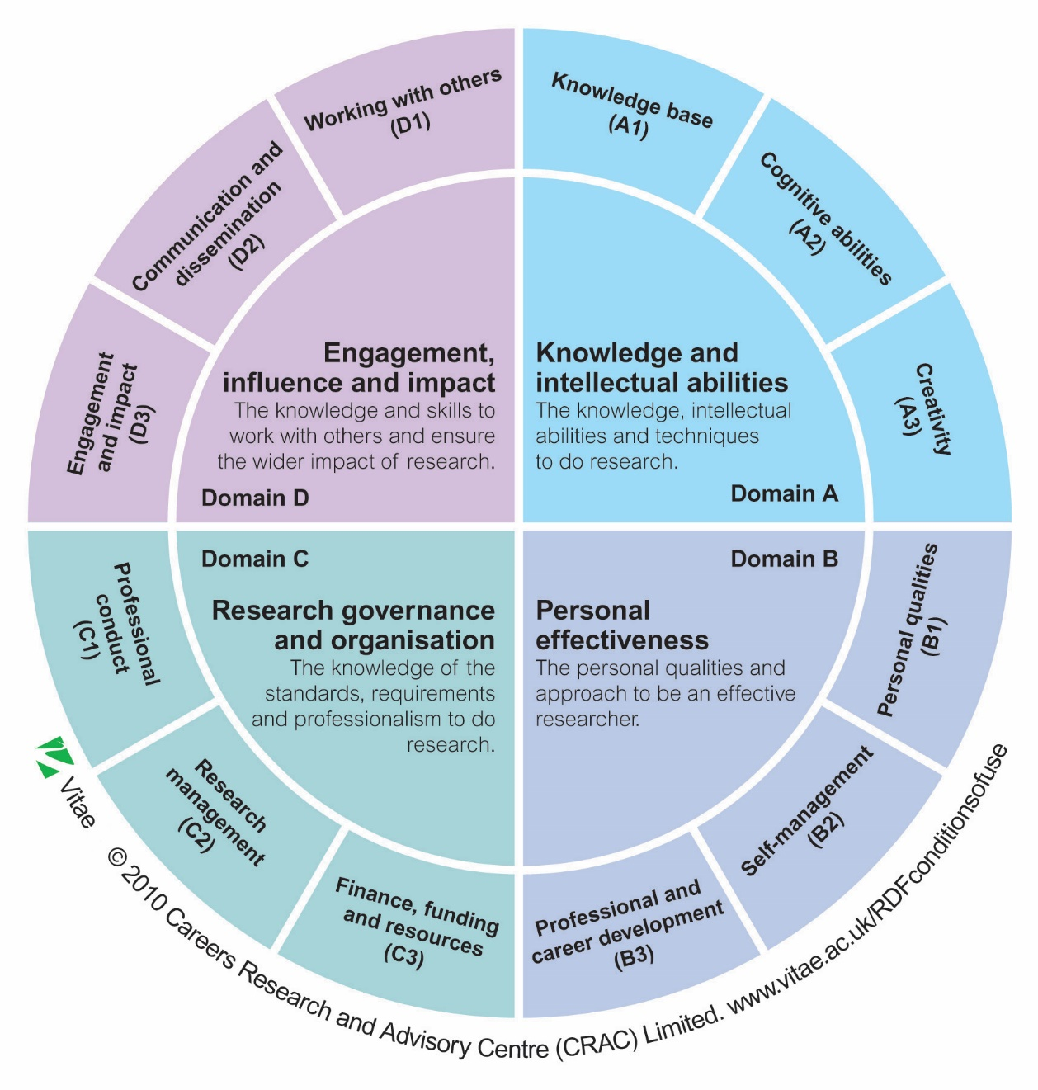
Researcher Development
Framework
(RDF)
The EPSRC and MRC Centre for Doctoral Training in Optical Medical Imaging
Notes:
KIRSTY

Slide 6
Student-led Individually Created Course (SLICC)
The EPSRC and MRC Centre for Doctoral Training in Optical Medical Imaging
The SLICC as a reflective learning and assessment framework with an e-portfolio and providing academic credits for experiential learning
  flexible and agile, providing a fully online mode of learning with external partners.
  the SLICC mechanism combined with the Researcher Development Framework (RDF) empowered the students to recognise their own experiential learning with respect to developing as a researcher.
  could be adapted in many other settings (e.g. consultancy projects, work placements etc) with CDTs, other PhD and Research Master’s programmes.
Notes:
FUMI
The students’ learning experiences were transformative in nature, individually and collectively – all happened during the lockdown.
the SLICC format can be flexible and agile, providing a fully online mode of learning with external partners capable of addressing wicked problems.
the SLICC mechanism combined with the RDF empowered the students to recognise their own experiential learning with respect to developing as a researcher.
It could be adapted to look at evaluating work placements, capstone projects and students’ consultancy projects in many other settings (e.g. CDTs, other PhD and Research Master’s programmes).
The (SLICC) is a reflective learning and assessment framework using an e-portfolio and providing academic credit for experiential learning. Students define their own learning experience and outcomes, with a clear structure supported from the outset by their SLICC tutor (Riley et al., 2017).

Slide 7
Acknowledgements
The EPSRC and MRC Centre for Doctoral Training in Optical Medical Imaging
Canon Medical - Dr Ken Sutherland, Andy Wilson and colleagues
Dr Adeel Shafi (OPTIMA alumnus)
OPTIMA students
  Emma Alexander and Daisy Dickinson
  Alex Chappard and Rhona Muir
  Alyson Lam and Giulia Rinaldi
  Paige Shaw and Layla Mathieson (co-presenter)
Notes:
FUMI

