Slide 1

Does taking part in a healthy lifestyle challenge enhance student learning and change their attitudes to people living with obesity?
Dr Louise Dunford
Associate Professor of Physiology & Nutrition
louise.dunford@dmu.ac.uk
Agata Buczak, Amena Abdulla, Jessica Jin, Zoe Redshaw
All images in this presentation are copyright-free images from Pixabay or Wikipedia under commons licences, unless otherwise indicated

Slide 2
Context
Year 3 module for Medical Science and Nutrition undergraduate students
Module includes topic of weight management
Learning outcomes:
To gain a systematic understanding of the challenges to treating obesity
Communicate information, ideas, problems and solutions in reflective writing
Issue: lack of understanding of the challenge of losing a substantial amount of weight, and maintaining weight loss

Slide 3


21-day Challenge
Why?
Severely obese people would need to change many aspects of their diet and lifestyle to lose weight and keep it off for good
Doing just one thing for 21 days can give students an idea of how hard it is for them
Can it also change students’ attitudes to and beliefs about obesity?

Slide 4

21-day Challenge
Everyone completes a challenge for 21 days
This needs to be health related: to food/drink or activity
This is NOT a diet; all challenges have to be approved by staff
Needs to be something done every day
It needs to be a challenge (i.e. difficult enough to be hard, but not so difficult it becomes impossible)
Assessment: Reflective journal

Slide 5
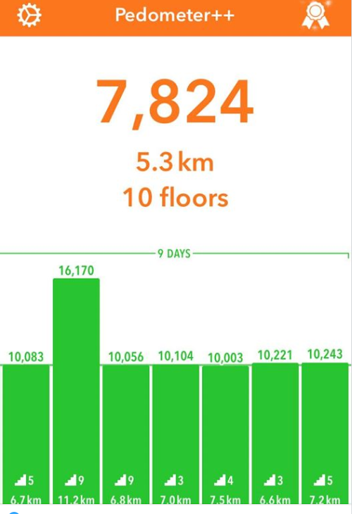
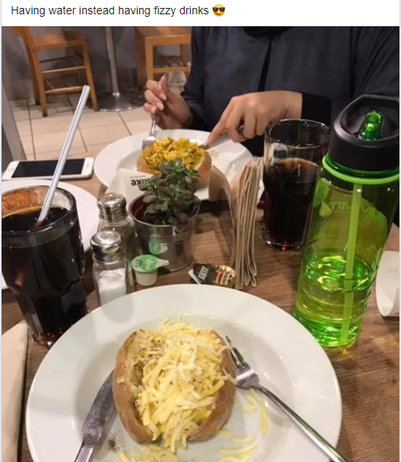
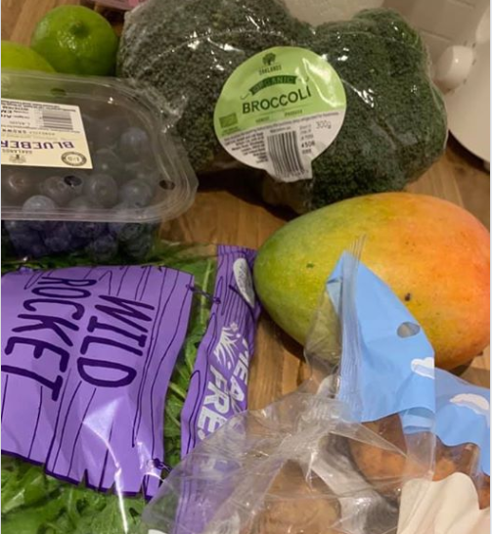
21-day Challenge: Examples

Slide 6
How it works
Student co-create the challenge, and the assessment criteria
Keep food/activity diaries for three days, and then review each others’ anonymously and make a recommendations for a challenge
Students can accept the recommended challenge or choose their own
The students set the 21-day Challenge rules
Co-create marking criteria for the assessment

Slide 7
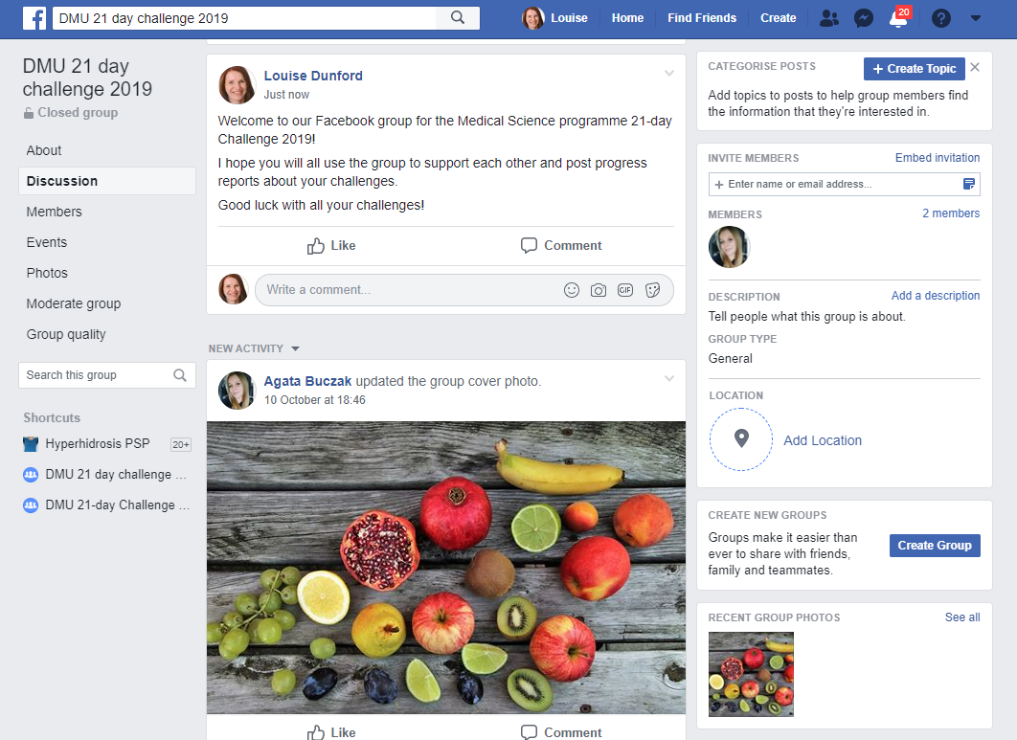
Support Group

Slide 8


Does it enhance student learning?
Improvement in reflective assignment scores ~5%
79% of students think it is not easy to lose weight
90% of students said taking part had given them an insight into the challenges of trying to sustain long-term changes to diet and lifestyle
I found it really hard, which made me realise how hard it would be for someone to make changes permanently
Doing the challenge myself made me understand the teaching on this module better

Slide 9

Does it change attitudes and beliefs?
Undergraduate research project
Students completed a validated questionnaire about their attitudes to, and beliefs about people with obesity, before and after taking part in the challenge
Although students reported increased empathy it did not change their underlying attitudes or beliefs

Slide 10
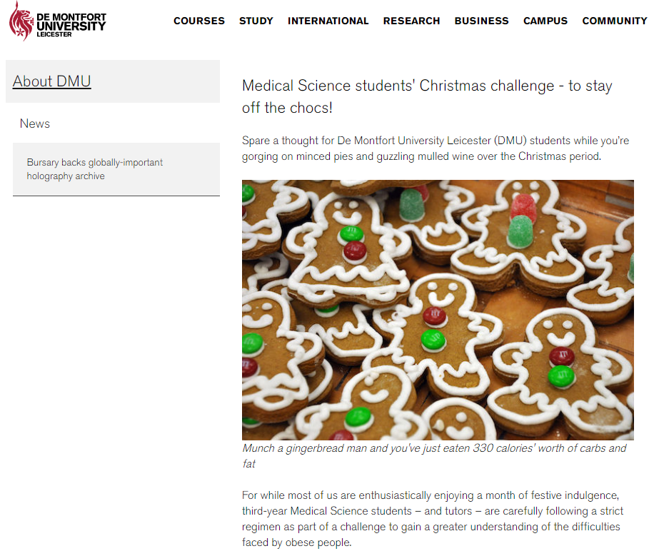
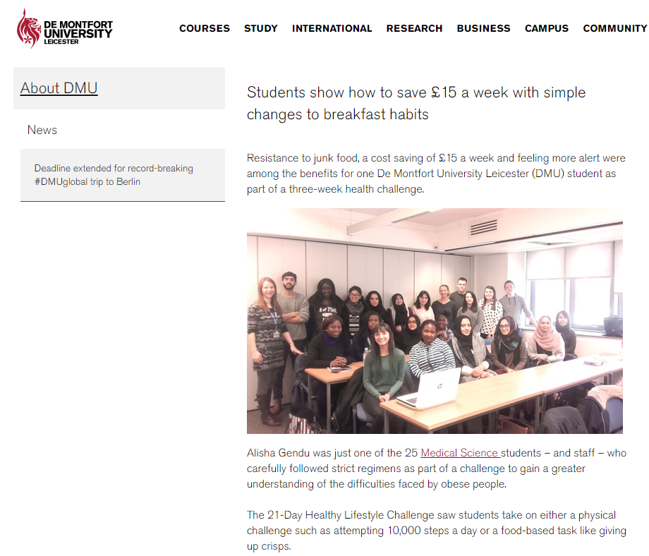
21-day Challenge

Slide 11

Questions?

