Slide 1

Enhancing learning through online, open-book MCQ examinations
An example from the Biosciences
Alfred Thumser
Ian Bailey, Sarah Bailey, Rita Jabr & Simon Lygo-Baker
University of Surrey

Slide 2
Background information
Module information
Assessment pattern
Previous MCQs

Slide 3
Advantages of Multiple-Choice Exams
Speedy reporting of assessment results
Individual item difficulties and discriminations can be calculated
References: An Analysis of Negative Marking in Multiple-Choice Assessment, Alan Holt, 19th Annual Conference of the National Advisory Committee on Computing Qualifications (NACCQ 2006); Nicholls, G. (2002) “Developing Teaching and Learning in Higher Education”, Routledge Farmer, 2002

Slide 4
Disadvantages of Multiple-Choice Exams
Good items are difficult to write
A lot of time is required to construct a good test
Guessing is encouraged
References: An Analysis of Negative Marking in Multiple-Choice Assessment, Alan Holt, 19th Annual Conference of the National Advisory Committee on Computing Qualifications (NACCQ 2006); Nicholls, G. (2002) “Developing Teaching and Learning in Higher Education”, Routledge Farmer, 2002

Slide 5

Rationale
Why open-book MCQ assessments?

Slide 6
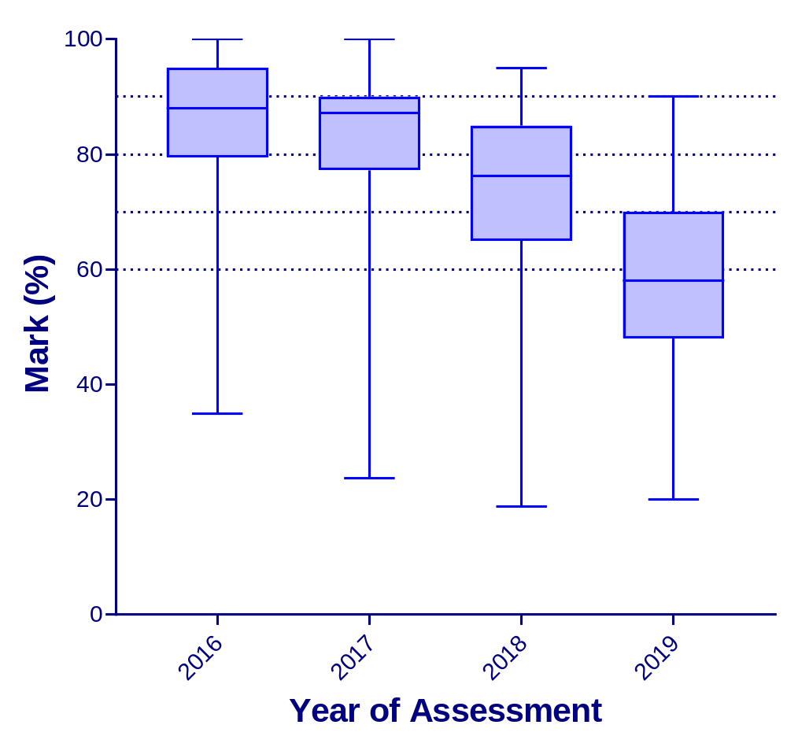
Notes:
2016 2017 2018 2019
Number of values 194 240 268 313
Minimum 35.00 23.70 18.80 20.00
25% Percentile 79.50 77.20 65.00 48.00
Median 88.00 87.15 76.30 58.00
75% Percentile 95.00 90.00 85.00 70.00
Maximum 100.0 100.0 95.00 90.00
Range 65.00 76.30 76.20 70.00
Mean 85.21 82.90 72.55 58.10
Std. Deviation 11.64 11.90 15.97 15.17
Std. Error of Mean 0.8355 0.7683 0.9753 0.8576
Skewness -1.173 -1.780 -1.018 -0.06477
Kurtosis 1.509 4.644 0.5477 -0.5471

Slide 7
Response 1 (2016 ⇨ 2017)
‘Naïve’ question review
Average: 85% ⇨ 83%
Range: 35% - 100% ⇨ 24% - 100%

Slide 8
Response 2 (2017 ⇨ 2018)
Test Item Analysis
Workshop: MCQ tricks & traps (2018)
Collusion: 24-hour access
Average: 85% ⇨ 83% ⇨ 73%
Range: 35% - 100% ⇨ 24% - 100% ⇨ 19% - 95%
Notes:
Avoiding MCQ cues
How to write better MCQ questions
Managing a question bank and generating exam papers

Slide 9
Test Item Analysis & Decision Making
Item discrimination
(also referred to as the Point-Biserial correlation)
Point-biserial relationship between how well students did on the item and their total test score.
Range: 0.0 to 1.00.
The higher the value, the more discriminating the item:
0.40 or higher - very good items
0.30 to 0.39 - good items
0.20 to 0.29 - fairly good items
0.19 or less poor items
Test Item Analysis & Decision Making, Measurement and Evaluation Center, University of Texas at Austin
Approaches to data analysis of multiple-choice questions. Lin Ding and Robert Beichner; PHYSICAL REVIEW SPECIAL TOPICS - PHYSICS EDUCATION RESEARCH 5, 020103 2009
Notes:
Items with discrimination values near or less than zero should be removed from the test. This indicates that students who overall did poorly on the test did better on that item than students who overall did well. The item may be confusing for your better scoring students in some way.

Slide 10
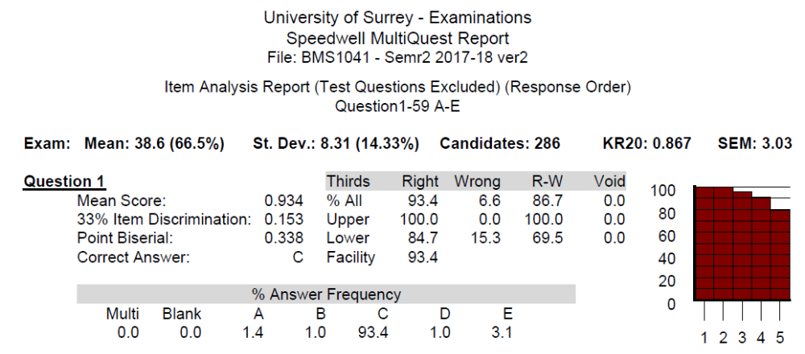
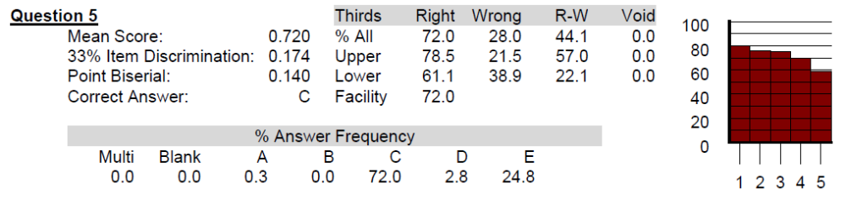
Notes:
KR20: Discrimination index

Slide 11
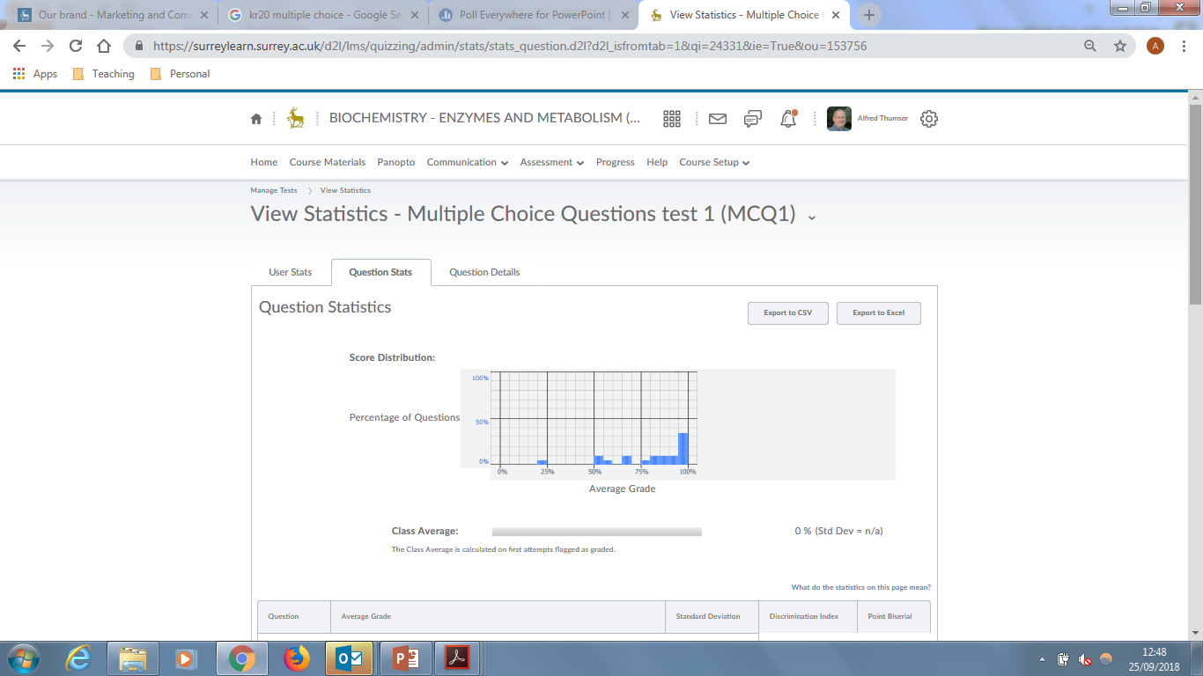

Slide 12

Reflection (2017 ⇨ 2018)
Average: 85% ⇨ 83% ⇨ 73%

Slide 13
Response 3 (2018 ⇨ 2019)
Average: 85% ⇨ 83% ⇨ 73% ⇨ 58%
Range: 35% - 100% ⇨ 24% - 100% ⇨ 19% - 95% ⇨ 20% - 90%
Student-informed questions

Slide 14
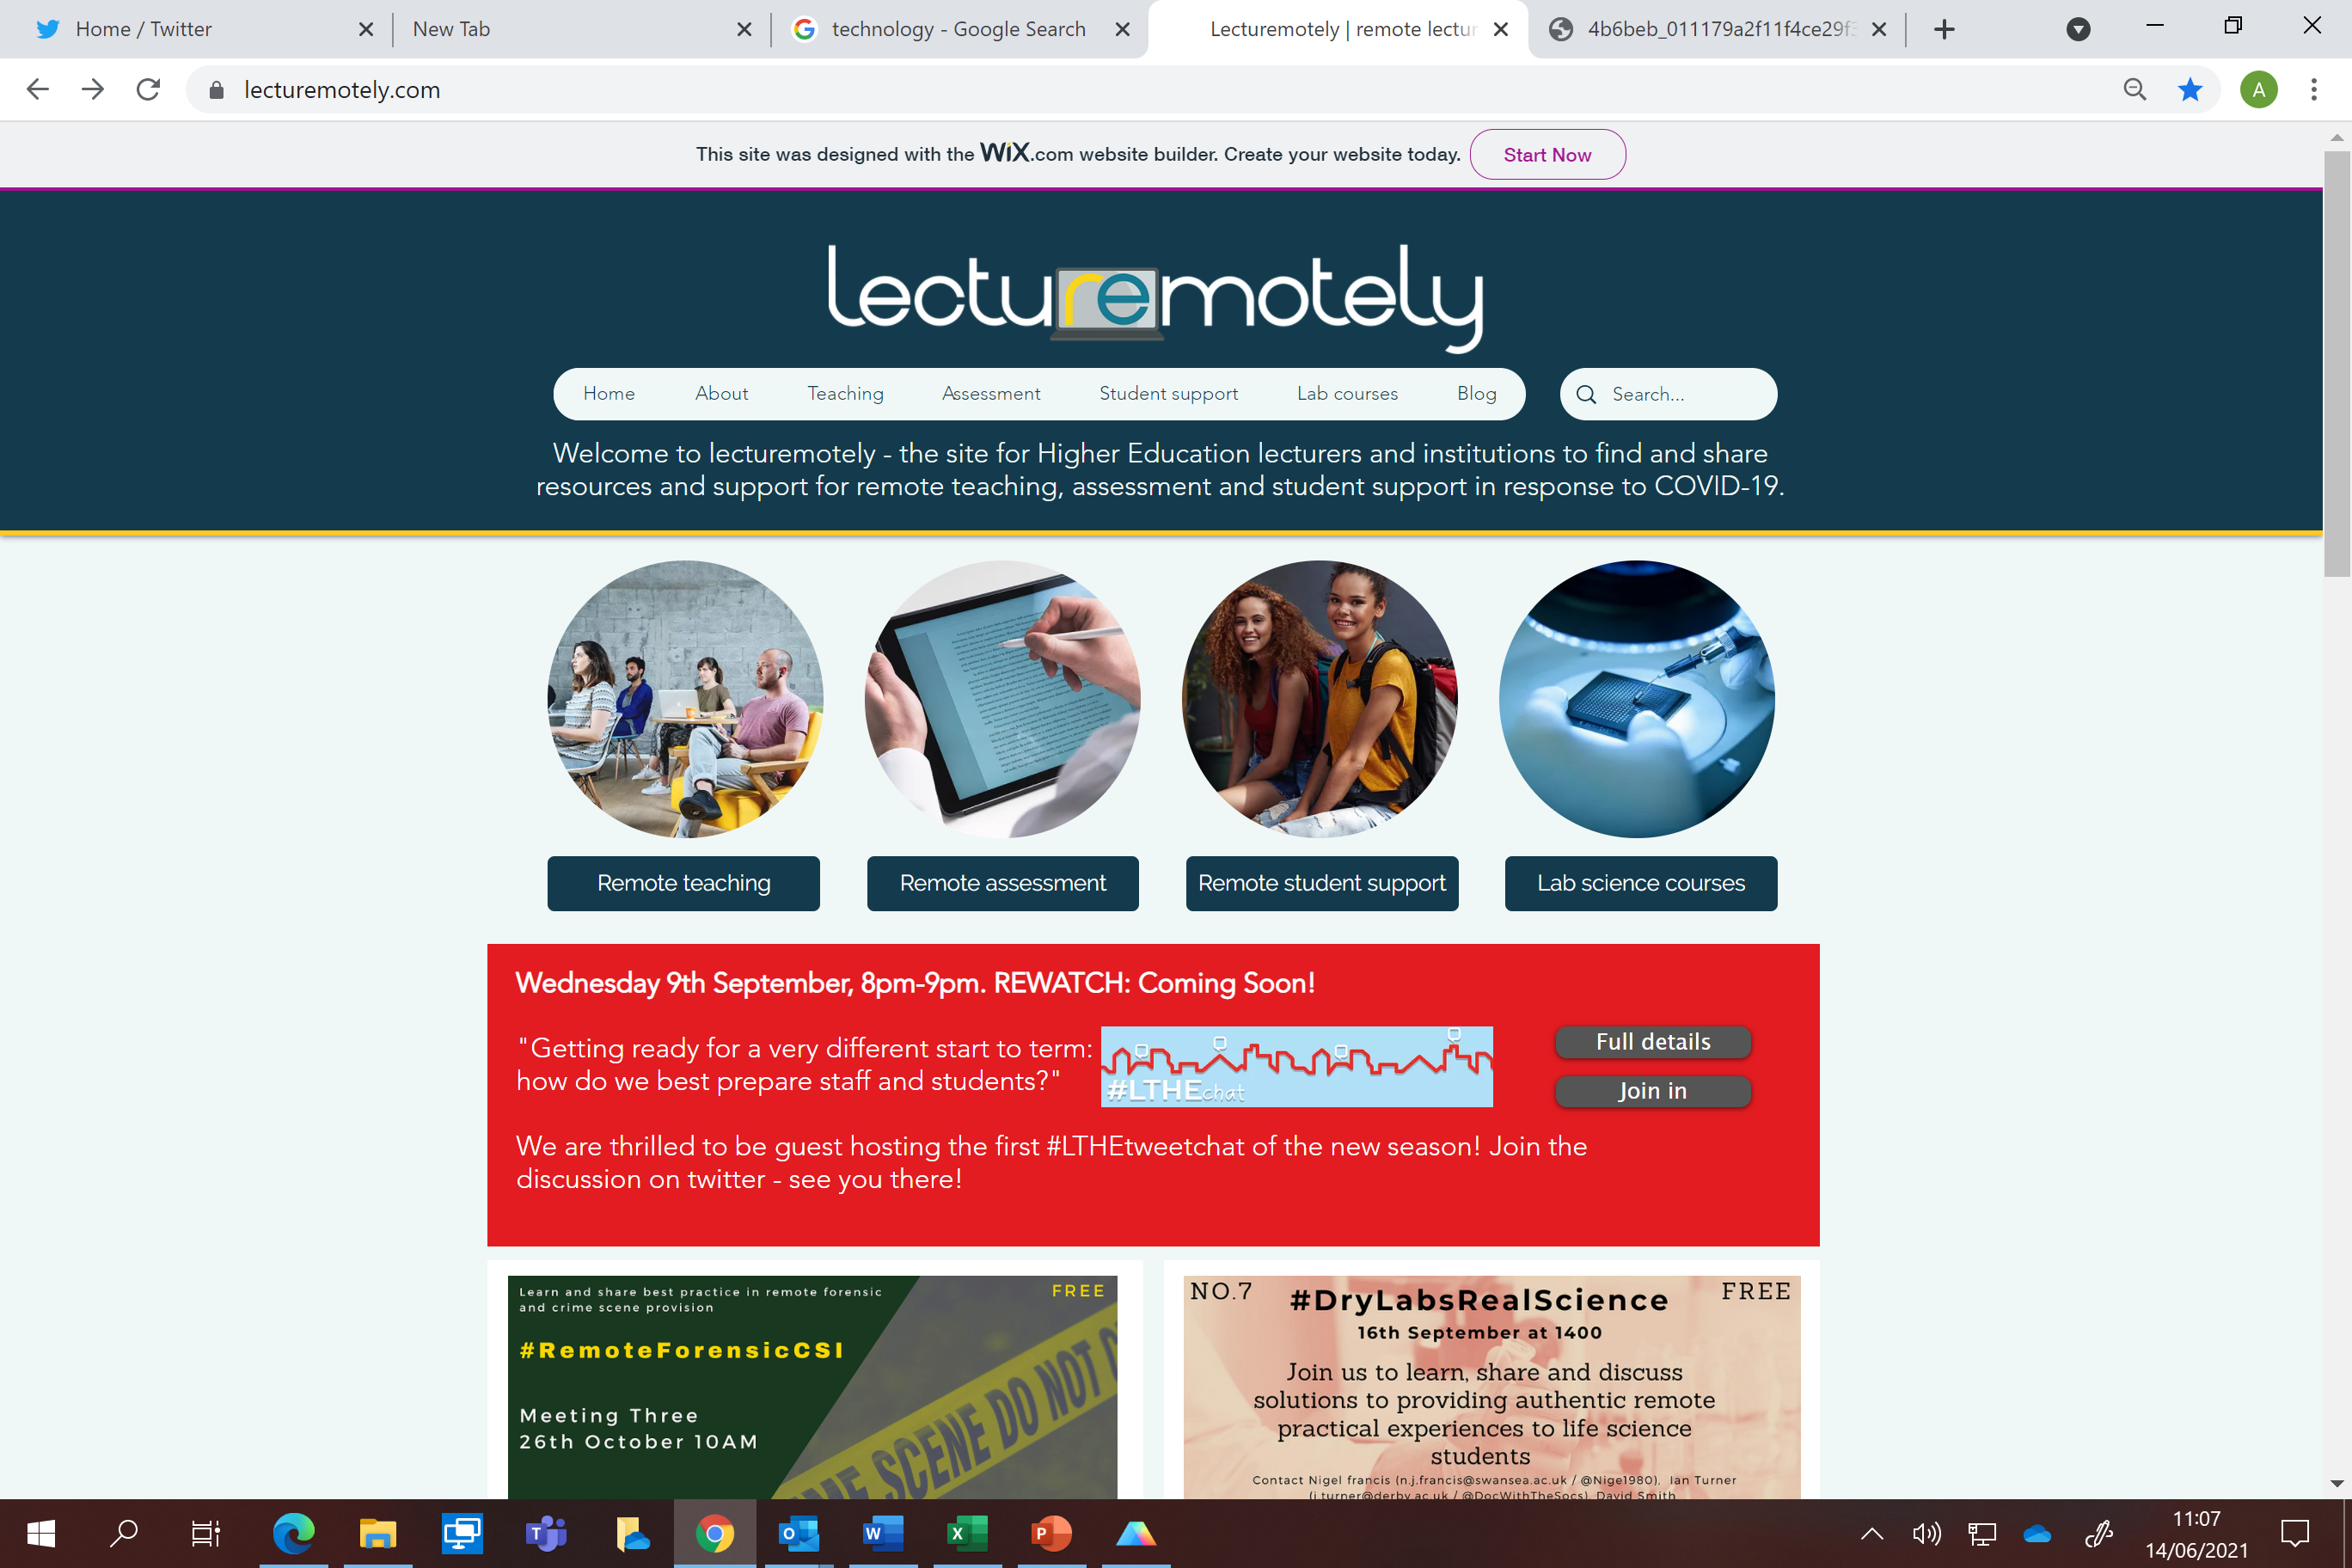
https://www.lecturemotely.com/

Slide 15

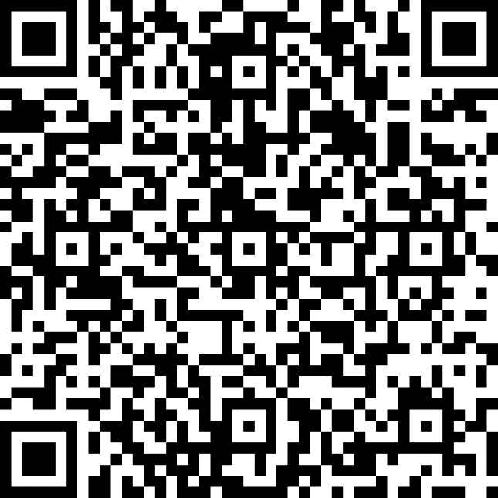
Conclusions
Open book MCQs can assess conceptual understanding
Open book MCQs are not easy to write
Excellent resources are available

