Slide 1
Implementation of exam proctoring for an end of module exam: Case study from the Department of Pharmacy
Dr Ali Al-Kinani, Dr Shereen El Nabhani, Dr John Fletcher and Kyren Burns

Slide 2



Overview
Rationale
Intervention/Implementation
Procedures and Measures
Outcome
Reflection
Notes:
Over the next 10- 15 minutes I will provide you with the rationale of why we used remote invigilation, how we implemented the SOP that we used and will share with you some of our results and reflections

Slide 3
The need for remote invigilation
The Covid-19 pandemic has changed the way that HE institutions conduct students' assessments.
Remote examinations are becoming the new norm
Ensuring exam security and validity is challenging with remote examinations .
HE providers have started to use different methods to ensure exam integrity with one being proctoring¹
Gamage KAA, Silva EKd, Gunawardhana N. Online Delivery and Assessment during COVID-19: Safeguarding Academic Integrity. Education Sciences. 2020; 10(11):301. https://doi.org/10.3390/educsci10110301
Notes:
The Covid-19 pandemic has changed the way that HE institutions conduct students' assessments.
Remote examinations are becoming the new norm
However, ensuring exam security and validity is challenging with remote examinations . Can we ensure that a students’ performance in an assessment is due to merit not academic misconduct?
Of course, this is important for all courses especially pharmacy as we are a healthcare professional course and patient safety is crucial and therefore we need to ensure that our students’ performance in assessment in due to their merit not due cheating or colluding.
HE providers have started to use different methods to ensure exam integrity with one being proctoring¹

Slide 4
The need for remote invigilation
Google trends for online proctoring between June 2016 and June 2021
2. https://www.google.com/trends
Notes:
searches for online proctoring have seen a general growth in recent years
as we can see we are not the only one interest in remote invigilation, there is a global interest and the value market for the remote invigilation is over $61 million/year in the US only and it is expected to go even higher

Slide 5








Remote Invigilation Explained and Options
Virtual proctoring involves online invigilation of students during exams
Real-time Remote Invigilation with a Live invigilator
Record & Review Remote Invigilation
Automated Remote Invigilation.
We are aware that no one approach is 100% cheat proof. However, we wanted to put something in place to Prevent and Deter cheating
3- Remote Invigilation or Online Proctoring | TestReach
Notes:
Thinking of the human invigilation yes, it is the most bulletproof approach however it is labour intensive, staff intensive and challenging during covid. Therefore remote invigilation can solve the issue
There are different technologies for online invigilation these are:
1- Real-time Remote Invigilation with a Live invigilator
A big advantage of having a live invigilator during the exam is that if any exceptional circumstances arise, they are immediately captured and dealt with through an infringements process.
2- Record & Review Remote Invigilation
This approach may have a cheaper price point as there is a lower level of human involvement, there are some obvious drawbacks. There are no people to help and guide candidates during their exam and there are usually no real-time interventions.
3- Automated Remote Invigilation
market feedback suggests that neither examining bodies nor their candidates are quite ready to deal entirely with a machine for higher stakes exams.
An essential part of automated invigilation is the calibration step, which can take some time to get right. If the software is not correctly calibrated, in the case of over sensitivity there may be a large number of red flags raised during the exam,.

Slide 6
Factors to consider for Remote Invigilation
Understand the VLE capabilities
Technology and equipment
Data privacy
Financial aspect
Inclusivity
Technology literacy
Assessment content

Slide 7

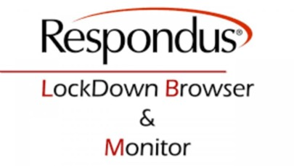
LockDown and Respondus Monitor®
LockDown Browser is a locked browser for taking quizzes in Canvas. It prevents students from printing, copying, going to another URL, or accessing other applications during an assessment.
Respondus Monitor® builds upon the power of LockDown Browser, using a student’s webcam and industry-leading video analytics to prevent cheating during exams

Slide 8
Before setting the exam: Implementation strategies
Survey
Highlighted any student(s) without the required technology, digitally disadvantaged and/or unsuitable environment.
Technical check
Hands on experience for the students before the main exam. It also helped to identify any issues
Instructions
Clear instructions about the exams and highlight any prohibited items and/or actions during the exam. Also, main contact point was clarified should any issues arise during the exam
Check
Reviewed the students’ technical check and highlighted any issues.
Support and Backup
A team of staff was available should be there is any issue(s) during the exam
Notes:
We tested the software for two module, the first one was for an in-module test in PY6040 where historically the test used to be run on campus online with lockdown browser and human invigilator. Which would give us a good indication about the technology. The second check was performed with an End of year exam for PY7010 as the students sat a paper-based exam on campus with human invigilation (just before covid) and this would be our benchmark for the software testing, and it’d effect on students’ performance.

Slide 9
Survey and technical check results
The survey was completed by 112 students with the outcomes below
8 students opted for on campus sitting due to
  Unsuitable environment
  Unreliable internet
4 students required human invigilation due to
  Being overseas (Iran) where VPN is needed
  Needing a human reader
  Unreliable internet post technical check
Notes:
The survey was generated in Canvas quiz with yes and no question and this helped us to identify students with different issues

Slide 10
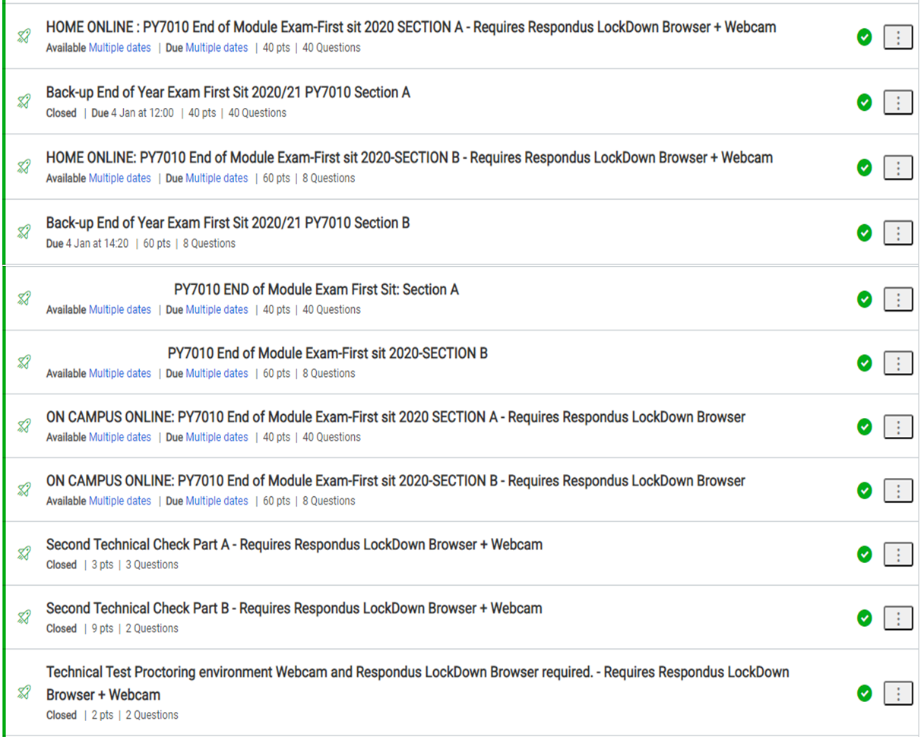
Exam Setting on Canvas
Four versions were created on canvas
  Home online
  Campus online
  Home with human invigilation
  Back up

Slide 11
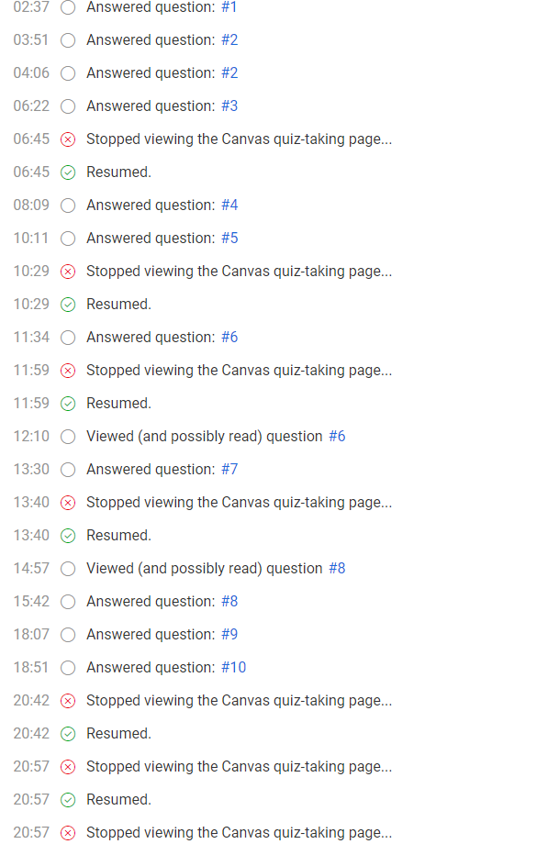
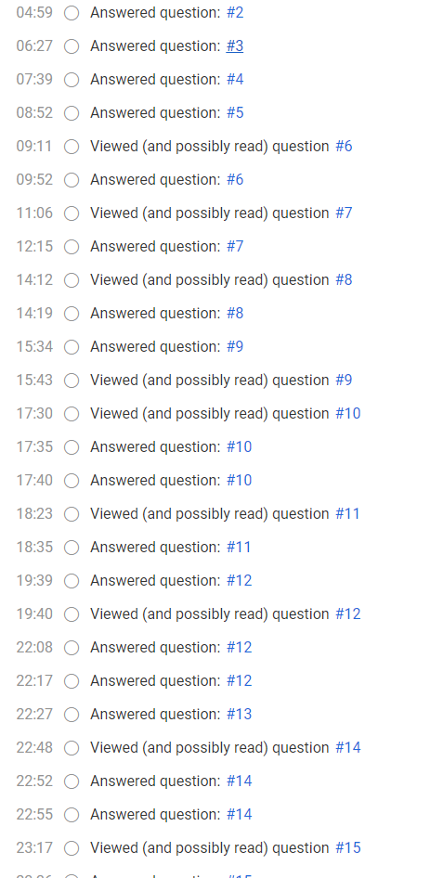
Online exam last year
(NO proctoring)
Online exam this year
(WITH proctoring)
Outcomes

Slide 12
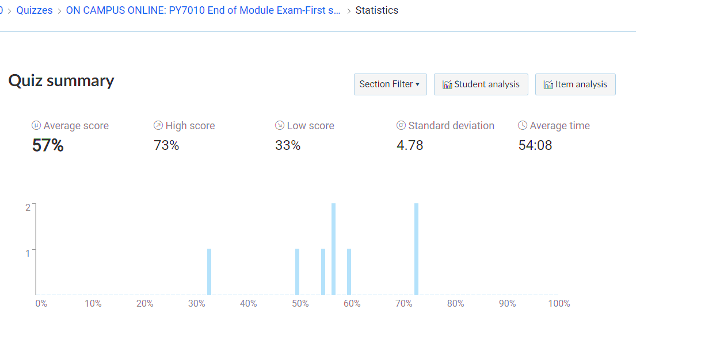
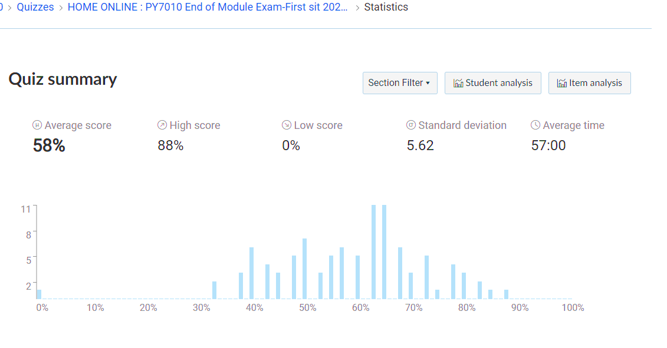
Outcomes

Slide 13
Outcomes
This system was used successfully for an end of module examination in January.
Out of a cohort of 112 students, 103 completed the exam online
The overall exam average mark was 58% (range 24%-82%), there was no statistically significant difference (p> 0.05) in average marks between the students who sat the exam online at home and those who sat it on campus.
The overall average mark and pass rate were similar to the previous year where students sat a paper-based exam on campus with human invigilation.

Slide 14
Message to take
Students’ performance between this year and last was comparable leading us to conclude that both the system worked as intended and that students were not disadvantaged by its implementation.
Technical support is essential
There is an increase in the global demand for remote invigilation with several HE, Royal Colleges and examining bodies using different proctoring software
Notes:
Students’ performance between this year and last was comparable leading us to conclude that both the system worked as intended and that students were not disadvantaged by its implementation.
Technical support is essential
There is an increase in the global demand for remote invigilation with several HE and examination bodies using different proctoring software

Slide 15
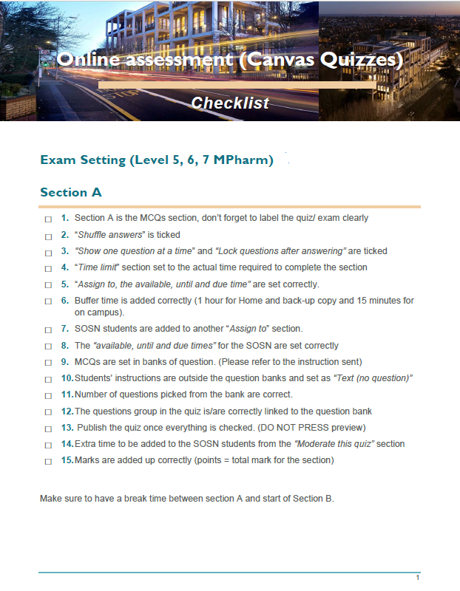
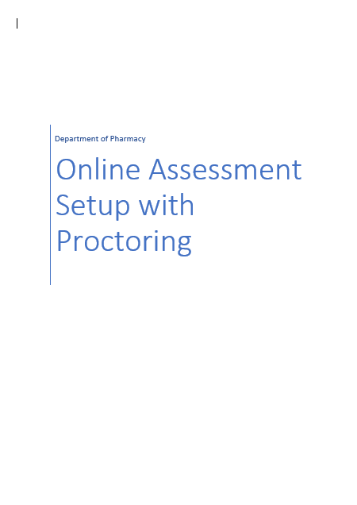
Reflection
Throughout the process we adopted a listening approach.
Different layers of QA were implemented to ensure exam consistency
A guideline was prepared for both students and staff to ensure students will have the same experience throughout.
A checklist on exam sittings was generated and shared with staff to ensure exam sitting consistency
Notes:
With implantation of a new technology, you need to adopted a very supportive open communication with the students because there will be a lot of anxiety to try something different.
Therefore throughout the process we adopted a listening approach where we organised several open forums with students where they were able to share some of their concerns and questions such as privacy, who is going to preview, toilet break(s), technology needed and noise level.
Different layers of QA were implemented to ensure exam consistency
A guideline was prepared for both students and staff to ensure students will have the same experience throughout.
A checklist on exam sittings was generated and shared with staff to ensure exam sitting consistency

Slide 16
Subsequent wider implementation
Based on the positive experience with these two modules, the department decided to implement remote invigilation for all our end of year exams.
“Remote invigilation leads” role within the department was created to help in providing induction, training and support to both staff and students.
For each exam, a support team was in place to help the students, with one of the “Remote invigilation lead” available to support staff if needed.
The support team was available on MS Team for easy access by the students
Notes:
Everything considered, remote invigilation offers such significant benefits over face-to-face exams, that it’s not really a case of “if” it will be adopted at scale, it’s more a case of “when”. With many providers offering a cloud-based solution, there is the added advantage that it can easily be piloted or tried out for one specific cohort or exam and this can help build the business case and get stakeholder buy-in, particularly as initial candidates can be surveyed to get their feedback as par t of the process.

Slide 17
Thank you for listening

