Slide 1


Searching for Best Practice in the Successful use of Mark Schemes:
Top Ten Tips for Successful Post-hoc Marking
Dr Simon Lock
Prof. Lucy Berthoud
Dr Becky Selwyn
STEM Horizons Symposium June 2021

Slide 2
Contents
Aim
The Challenge of Marking
Methodology and Survey
Initial Results
Top Ten Tips
Take the survey!

Slide 3

Aim
Constraints of pre-defined marking criteria
Flexibility to accommodate uncertainty
To identify current best practice in reaching a balance between…
With uncertainty due to...

Slide 4
The Unknowns
Quality of course materials (esp. changes in materials – such as switch to pre-recorded video)
Effectiveness of content delivery (esp. changes in delivery – such as switch to online teaching)
Effectiveness of tuition (esp. changes in tuition – such as switch to online teaching sessions)
Effectiveness of personal study (esp. when impacted by health and personal issues)
Suitability of assessments (esp. change in assessment – such as move to “open book”)
Suitability of assessment platforms (e.g. online exam platforms, inflexible automarking tools)
Extent of Plagiarism and Collusion (esp. with change in assessment – such as online exams)
Student engagement with materials (esp. changes in consumption – such as move to remote learning)

Slide 5

As well as theses “Known Unknowns”
there are also the…
“Unknown Unknowns”

Slide 6
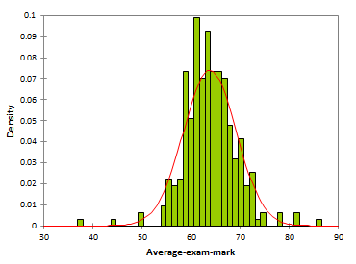
Worrying Symptoms in mark profiles
“Big Head” – lots of students getting 1st class marks
“Big Tail” – lots of students failing the assessment
“Hard Ceiling” – many students "maxing out" the mark scheme with 100%
“Bi-modal” – 2-way split in the cohort (big success and big failure)
“Flat profile” – students spread thinly across the entire mark range

Slide 7
Methodology
“Current Practice” Focus Group
“Speculative Practice” Focus Group
Candidate Strategies
Review by Key
QA Stakeholders
Feedback
and Opinion
Analyse Feedback Derive Guidance
Guidance
for Educators

Slide 8
Survey
11 Key Stakeholders Surveyed (Exams Officers, QA Personnel, External Examiners)
Our aim was to seek their opinion on the acceptability of our identified strategies
Strategies to both raise and lower students marks
Opinions were expressed on the following scale:
We also asked whether they had seen the strategies in use – should be interesting !
Let's take a look at some of the more interesting responses...
Totally Unacceptable
Generally Unacceptable
Undecided
Generally Acceptable
Totally Acceptable

Slide 9
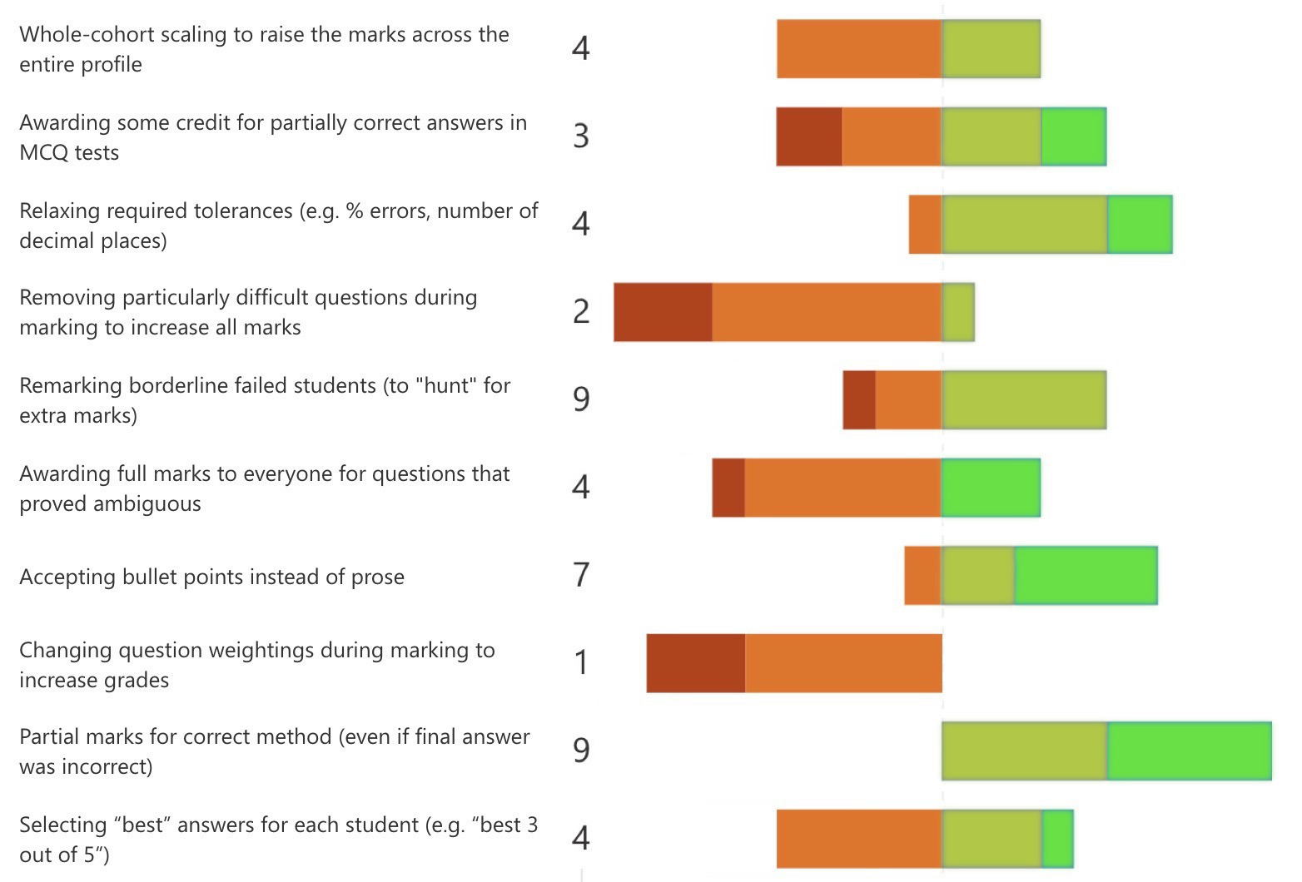
Strategies for INCREASING marks

Slide 10
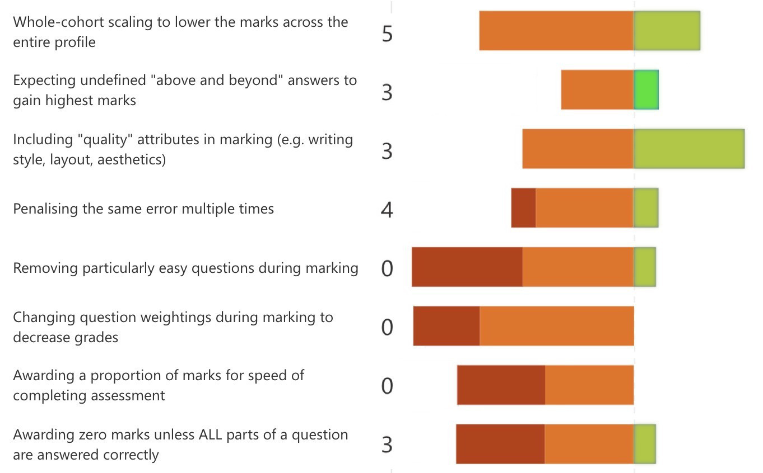
Strategies for DECREASING
marks

Slide 11
There are a lot of issues and discussion points in there
As a useful take-away, we've crafted the main findings into our…
Top Ten Tips

Slide 12
1.
2.
3.
4.
5.
6.
7.
8.
9.
10.
Embrace uncertainty: Perfect prior knowledge is an elusive ideal
Accept the existence of uncertainty and the need for post-hoc marking adjustment
Everything is relative: Focus on "achievement" in "the current learning context"
Rather than "absolute attainment" on a bed of shifting sands
Don't expect universal agreement: Someone won't like your approach
(if you look hard enough) Aim for "local" acceptability and approval
Plan ahead: Try to write questions "susceptible" to post-hoc marking
You might not need it, but you may welcome the flexibility if things don't go as expected
Ensure suitable challenge: Increasing marks is more acceptable than decreasing them
It's hard to pull down a whole profile - especially with no differentiation
It's all been done before: Any approach you can think of has been used before
Even the ones that probably shouldn't have been
Consistency is key: What you do to one student's mark, you should do to all students
Especially important if there is a team of markers all working in parallel
Be guided by parity: Calibrate marks and boundaries with other assessments
Historically, Institutionally, Individually, Disciplinarily
Ensure transparency: Be prepared to justify final marks to all stakeholders
To that end, maintain a clear paper trail of adaptations and calibrations
Fairness is everything: Remember that the aim of marking is to achieve a "fair" assessment
This doesn't imply high marks - abnormal or "symptomatic" mark profiles are detrimental to all

Slide 13
Insightful quotes
… a posteriori mitigation by unit directors, either way, should be avoided. In practice, this is likely used every year by a majority of staff members.
… submission moderation should be only be applied when the assessment itself has deficiencies. The quality of the cohort should not cause moderation...
I am very surprised at the options that have been proposed, and in most cases I find them unacceptable.
Changing this during the marking process is like changing the rules of the game after the game has started - this is not acceptable.
… we often find many ways to justify increasing marks, as we seem to have a strong aversion to failing students; that should change.
with a rigorous internal moderation … then the problematic questions … should be weeded out or modified appropriately prior to the examination

Slide 14
Have YOUR say at:
http://tinyurl.com/post-hoc-marking
Interesting to see - do practitioners agree with QA staff ?
Thanks for listening!

