Slide 1
Engaging Students Through Feedback at Scale on an Introductory Programming Course.
Simon Grey s.grey@hull.ac.uk
Neil Gordon n.a.gordon@hull.ac.uk
Computer Science
School of Engineering and Computer Science
University of Hull, U.K.

Slide 2
Overview : why?
It is widely recognised that feedback is an important part of learning.
Properly closing the feedback loop implies that effective feedback results in a meaningful change in student behaviour.
However, often individual feedback takes time to produce, and for large cohorts of students it can be difficult to provide feedback on draft work in a timely maneer.
One strategy to provide feedback quickly to a large cohort is to char the workload across multiple staff members, but this introduces an additional problem in ensuring that the feedback and marking are equitable.

Slide 3
Overview : what?
We attempted to create an objective, reusable marking rubric to provide students with feedback on assessed coursework in an introductory programming module.
In this talk, we will analyse some of the data generated from feedback provided for 139 pieces of work from 4 different markers.
We consider whether the attempt to create an objective rubric was successful.
We also consider the impact of feedback provided for the draft coursework of 84 students’ final performance.

Slide 4
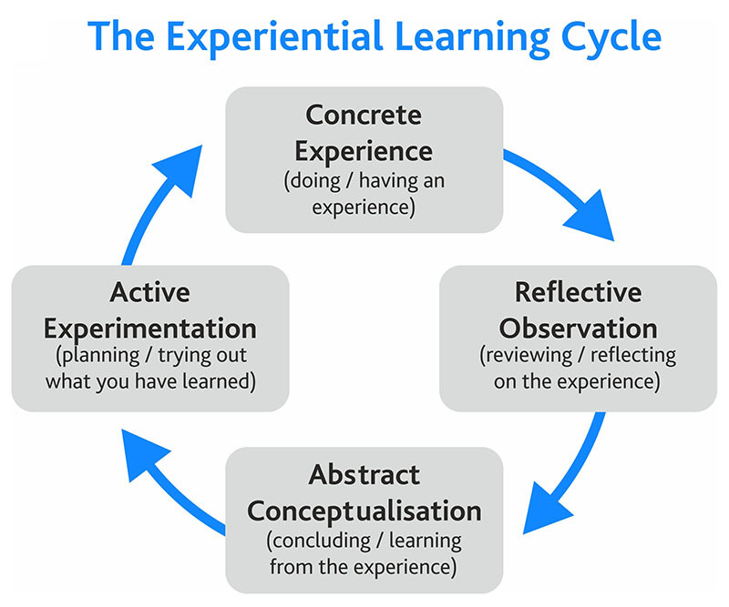
Kolb’s Experiential Learning Cycle
Notes:
In this model of learning students build a mental model of whatever topic they are considering – next they test the model and observe the feedback from that test. If their test passes they build confidence in their model, which is good. If their test fails, that is great! They have found a flaw in their mental model and
The faster we can perform this iterative process – this is also something that we have seen in industry, and in the tools adopted by industry.
Kolb’s experiential learning cycle
Flow – “1000 hour expert concept of Deliberate Practice”
Requires a Growth Mindset (Dweck)

Slide 5
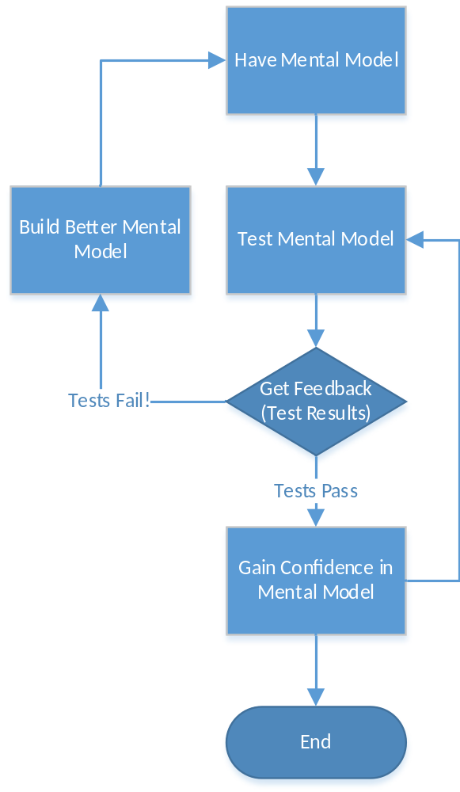
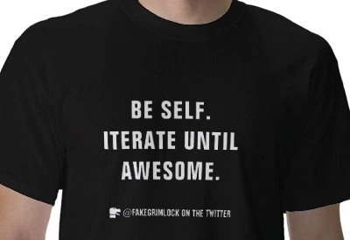
Where does the learning happen?
Requires Deliberate Practice (Ericsson, 10000 hour expert), a Challenge closely aligned to skill and fast feedback (Csikszentmihalyi, Flow)
Requires a Growth Mindset (Dweck) to see failure as an opportunity
Notes:
Consider where the learning happens – it is only by rigorously testing our mental model, finding where our mental model fails and adjusting accordingly that we learn.
This requires “deliberate practice” (Ericsson, 10,000 hour expert) and “challenges closely aligned to skill level” and “immediate feedback” (Csikszentmihalyi, Flow)
This is something that we also see in practices, processes and tools used in industry. By developing better techniques to test reliably and iterate faster industry is able to perform more iterations on a problem, and develop better solutions.

Slide 6
Providing Meaningful and Timely Feedback in Programming
Compiler Tools
  Compiler tools like Visual Studio provide developers with rich feedback if you know how to use them
Programming Tutor Application
  Easily accessible
  Provides a highly scaffolded environment for programming
  Providing Meaningful and Timely Feedback

Slide 7
Brief Diversion - Programming Tutor
A highly scaffolded programming environment
Instant, meaningful feedback
A method to measure engagement with learning material
Used as Summative Assessment
  100% module mark (year)
  10% module mark alongside ACW and Examinations (year)
Could not use the Programming Tutor (2021) as a result of the pandemic, but we did experiment with GitHub classroom
Notes:
Could not s

Slide 8
Feedforward Assessment
Want to provide feedback that results in a change in student behaviour
That means students need feedback with enough time to understand the feedback, make changes and get a better summative result
Time is very tight, but for larger assessments it is more difficult to automate feedback
Need to parallelise feedback generation across staff
Used as Summative Assessment
  100% module mark (year)
  10% module mark alongside ACW and Examinations (year)
Could not use the Programming Tutor (2021) as a result of the pandemic, but we did experiment with GitHub classroom

Slide 9
Rubric Design
Objective
  Avoid ambiguous terms like “Good” or “Very Good”
Accessible to student if they understand the content
  If you try to avoid specific terms that students should understand this can lead to misinterpretation
Reusable
  Want parity year on year
  Sections on abstract functionality and code quality should persist year on year

Slide 10
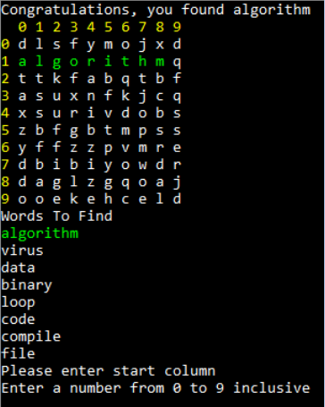
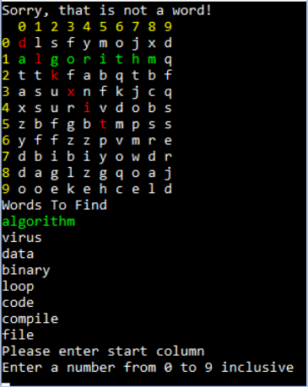
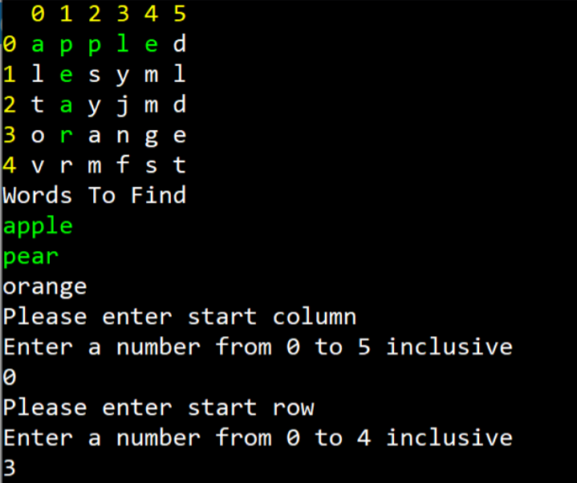
ACW Example

Slide 11
Specific Functionality – Does It Work? (30%)
Set up board (5%)
Display Wordsearch (10%)
Enter Coordinates (5%)
Give Appropriate Feedback (5%)
Detect win, reset and play again (5%)

Slide 12
Abstract Functionality and Code Quality (70%)
Use of Console Based Menus (5%)
Saving to and Loading from a File (10%)
Use of Methods (15%)
Use of Structured Data (15%)
Exception Handling (10%)
Self Commenting Code (5%)
Use of Explicit Comments (5%)
Use of Source Control (5%)

Slide 13
Rubric Efficacy
139 assessments marked by 4 different markers
For pragmatic reasons each marker marked a section of the alphabet
If the rubric was objective we would expect the marking profiles to be similar

Slide 14
Rubric Efficacy – Marker Profiles

Slide 15
Rubric Efficacy - Conclusions
The use of a (more) objective rubric did support the idea of multiple markers – without redress to a separate moderation process after marking.
The profile of the marking shows similarities for 3 of the 4 markers – this indicates some success in objective marking.
The disparity for the 4th (outlier) does show that subjective issues are hard to rule out.
Further work is to analyse the various rubric categories to determine what categories are more objective and which are more subjective.

Slide 16
Feedforward Efficacy
80 students submitted a draft for feedback
59 students did not submit a draft
We will look at the marking profile of first attempts and final attempts
  For those who did not submit a draft these are the same attempts
For those who submitted drafts we will look at the increase in mark between their first and final submission

Slide 17
Feedforward Efficacy – First Attempts

Slide 18
Feedforward Efficacy – Final Attempts

Slide 19
Feedforward Efficacy - Conclusions
In some cases an increase in functionality resulted in a decrease in quality
Take up of the change for feedback was fair – though still disappointing
The profile in the previous draft does show that those who chose to submit a draft had a higher final mark profile, and their profile changes from the normal profile in the first attempt to a skewed (positive) profile in the finals.

Slide 20
Overall Conclusions
The rubric proved helpful for marking a medium to large module, with multiple markers.
The rubric and feedback mechanism for the assessment shows the benefits where students do engage with feedback.

