Slide 1


Horizons in STEM Higher Education
”Discussion boards don’t work” :
Evaluating use of a course blog for teaching Second Year Medical Biochemists
Dr Chris Willmott
Dept of Molecular
and Cell Biology
University of Leicester
cjrw2@le.ac.uk

Slide 2
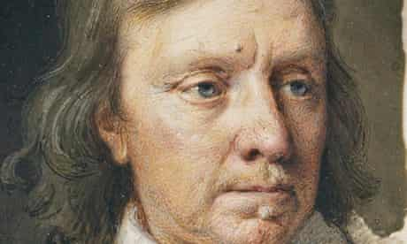
Context
Second year core module for Medical Biochemists (n=34)
Usually three assignments: - Video on a bioethics topic (30%)
- Graphical abstract (30%)
- End of module SAQ paper (75 mins, 40%)
This year: End of module exam replaced by
development of a Shared Resource Collection
Spoiler: This will be a warts ‘n all description
https://tinyurl.com/CromwellWarts
Notes:
GA on a paper produced within the Dept – as well as improving ability to read paper and summarise, also introduces them to some of the research being done in house.
Initial concern that team-based video would need to be replaced and that no exams would be held. In the end video task was able to go ahead and many modules had open-book exams online. However, by the time that decision was made significant effort had been invested in developing the alternative activity described here.
This will be a warts ‘n all description, this is definitely a task worth considering, however some of the lessons in how to implement it were learnt the hard way.

Slide 3
Content of module
MB2050: Applications of
Medical Biochemistry
Molecular techniques in
medicine and research
Drug design and development
Bioethics
Nucleic acid hybridisation
Protein expression
CRISPR & Genome editing
Monoclonal antibodies
Antibody-based assays
Genomics
Scientific principles
Therapeutic inhibitors
Developing antibacterials
Structure-modelling exercise
Video project
(Dovetails with bioethics content
in BS2000)

Slide 4
Rationale for assignment
Assessment = driver for engagement
Previously: exam only assignment in module that re-visited breadth of the lecture programme
Looking for replacement that would require students to reflect on multiple topics within the module
Decided to Shared Resource Collection
- Submitted as blog posts and comments, using integrated
Blackboard tool
Notes:
Assessment = driver for engagement, only things that are marked considered worthwhile

Slide 5
Shared Resource Collection assignment
Basket 1
Scientific Principles in Drug Design
Nucleic Acid Hybridisation techniques
Therapeutically Useful Antibodies
Plasmid Structure and Protein Expression
Functional Genomics
Basket 2
Structure-Activity Relationships
Developing a Pharmaceutical/ Antibiotics
Molecular Visualisation/ Enzyme inhibitors
CRISPR and Genome Editing
Immunity and Antibodies
Monoclonal Antibodies/ Antibodies in Research
T cells and Transplantation
Window 1
29th October
Window 2
17th November
Window 3
3rd December
Window 4
11th January 21

Slide 6
Benefits of SRC assignment
Replaces exam in module
Benefits:
- developing resource location and critical evaluation skills
important for yr 2 and yr 3, especially for your project
- “evidence of outside reading and/or originality of thought and
analytical skill ” needed for access to highest coursework marks
- no revision for this module over Christmas
- anticipate most people will achieve higher marks in this task
than they would for exam

Slide 7
Shared Resource Collection assignment
Students must submit (at least) one review in each window
Submissions must have standard format:
    Name of resource (including link, if applicable)
    The review (max 300 words)
    Date of review
    Author’s name
    Name of lecture block with which the review fits

Slide 8
Shared Resource Collection assignment
Students could earn up to 10 credits per window
Four windows = 4 x 10 = 40% of mark for module
Students must submit one post per window, but not limited to one
Additional posts, and appropriate comments on other people’s posts, could also receive credit
Additional posts/comments can earn no more than 4 credits in any window

Slide 9
Example marking scenarios
Alex submits one post worth 9 marks with no supplementary post in that window or comments on other people’s posts
Total mark = 9
Bindu submits one post worth 8 marks, plus two additional supplementary posts and comments on other people’s posts which are considered worthy of the full 4 additional marks
Total mark = 10 (you cannot exceed 10 marks per window)
Charlie submits one post worth 7 marks, plus a additional supplementary posts considered worthy of 3 additional marks.
Total mark = 10

Slide 10
Example marking scenarios (continued)
Dina submits one post worth 5 marks, plus two additional supplementary posts and comments on other people’s posts which are considered worthy of the full 4 additional marks
Total mark = 9 (you cannot boost mark for principal post by >4)
Edgar makes comments on other people’s posts that would have been worthy of 2 marks, but fails to submit any post of their own during a relevant window
Total mark = 0 (submitting your own work is a necessary threshold to achieve any marks in a given window)

Slide 11
What types of resources?
Flexible = following list is not exhaustive
(if in doubt, please check applicability before posting review)
    • Books
    • Primary research papers
    • Review articles
    • Websites (authoritative)
    • Multimedia resources: Podcasts, TV and radio programmes,
    YouTube videos, etc
NB You may not write reviews of any of papers provided for the Graphical Abstract task, nor any that fit theme of your bioethics video

Slide 12
Marking criteria
Relevance to taught course – how well does it fit with the lecture block you have identified?
Quality of reflection/thought – posts must do more than just summarise content. Offer reflection or critical thinking about resource [note: this is good training for next year’s project].
Quality of writing – is review well written and free from errors?
Originality – a post will be valid if someone else has also reviewed it, provided review is entirely different. Intentional contrasting of perspective is welcomed. Repeated selection of same resources reviewed by others will be penalised.

Slide 13
Comments
To be eligible for credit, comments must demonstrate critical thinking
    “Great post ”
    “This resource/review was rubbish ”
    “Thank you for your interesting observations on the programme. I didn’t find it quite as helpful as you appeared to, because…”
    “Additional to the valuable points you’ve already made, I also thought this was an excellent resource because…”





Slide 14
“Discussion boards don’t work”?
Was my colleague right?

Slide 15
“Discussion boards don’t work”?
Was my colleague right?
No: - Quality of some of the shared resources was excellent
- Students enjoyed the assignment
- Students recognised acquisition of skills & knowledge via task
- Some aspects of reviews improved

Slide 16
“Discussion boards don’t work”?
Was my colleague right?
No: - Quality of some of the shared resources was excellent
- Students enjoyed the assignment
- Students recognised acquisition of skills & knowledge via task
- Some aspects of reviews improved
Yes: - Blog post marks did not improve across windows
- Posts did not elicit interactivity in way we hoped

Slide 17
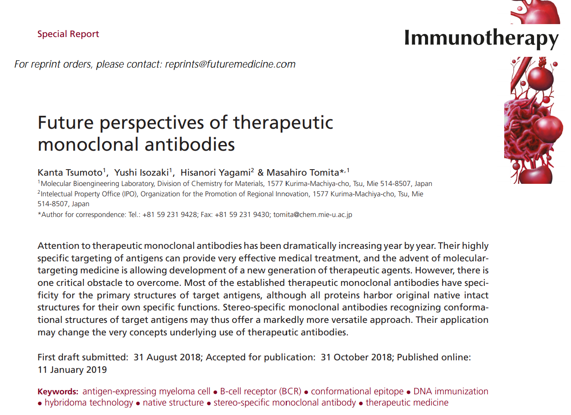
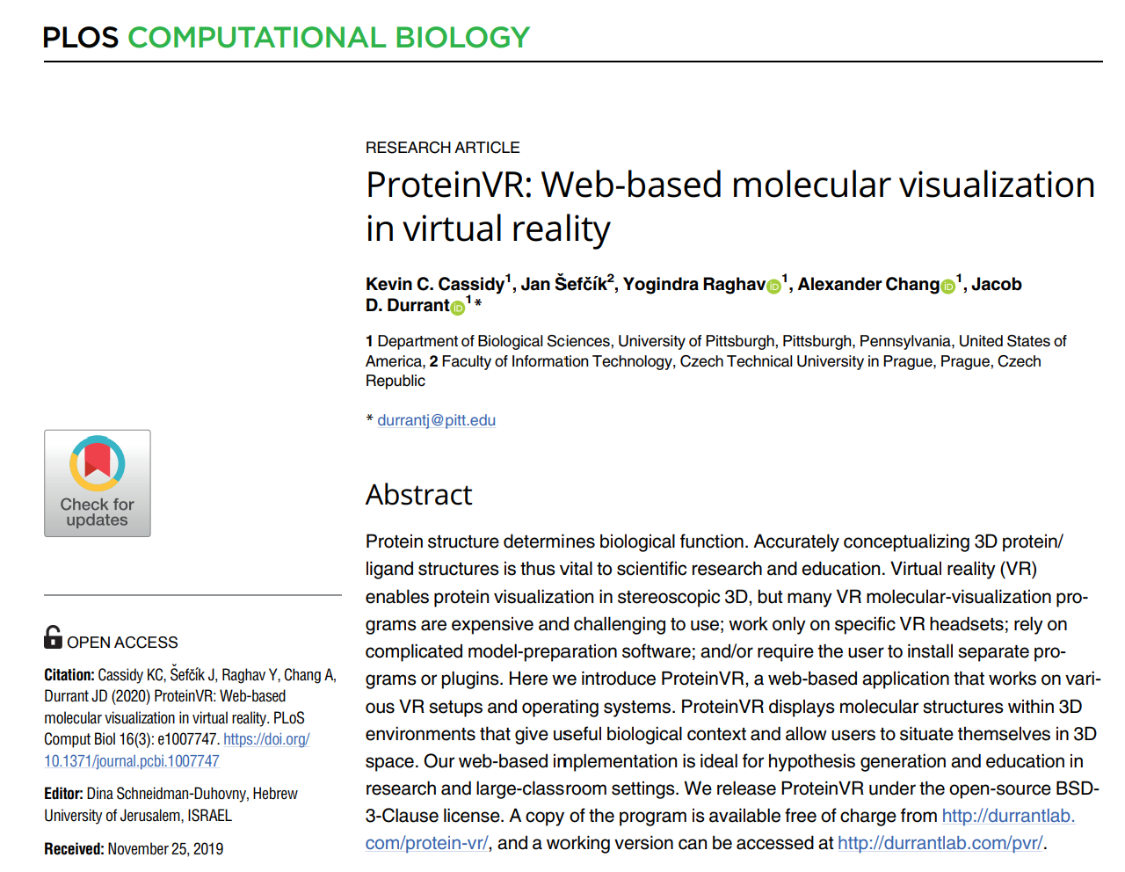
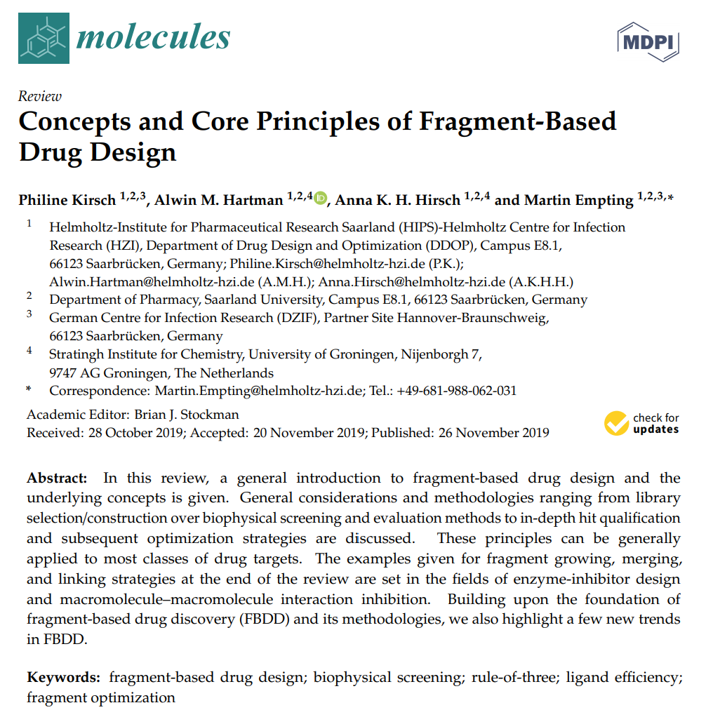
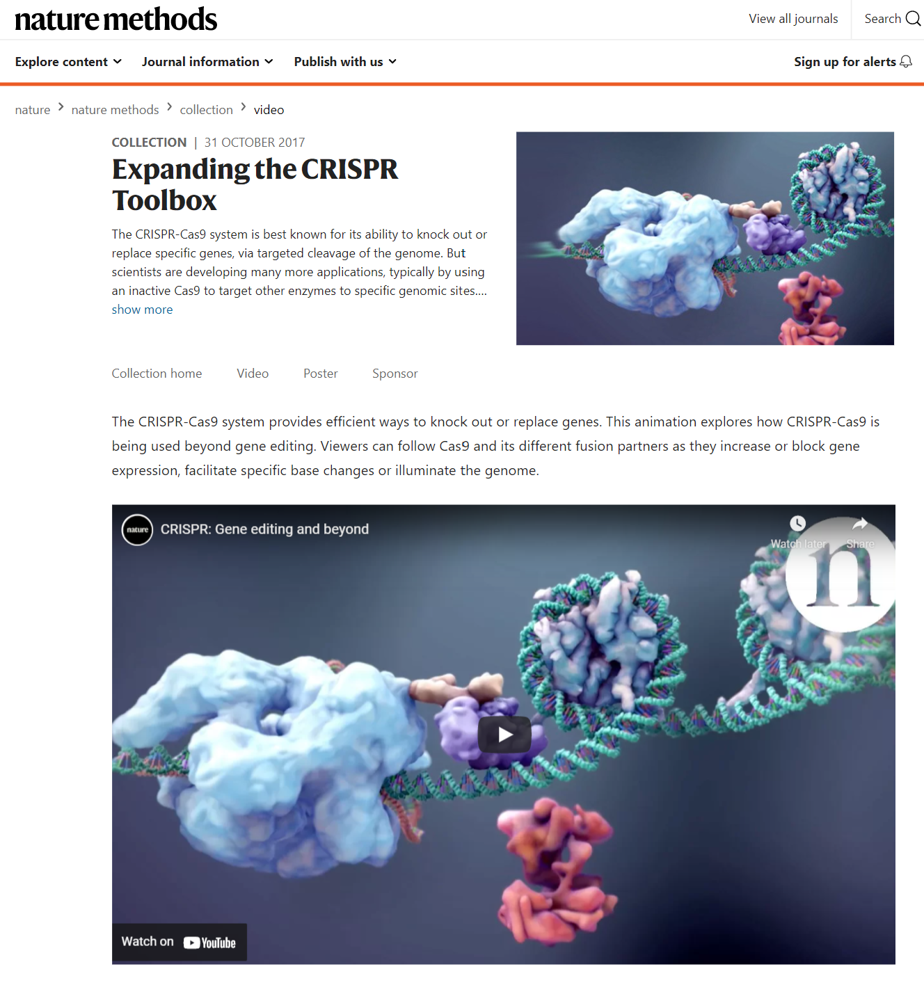
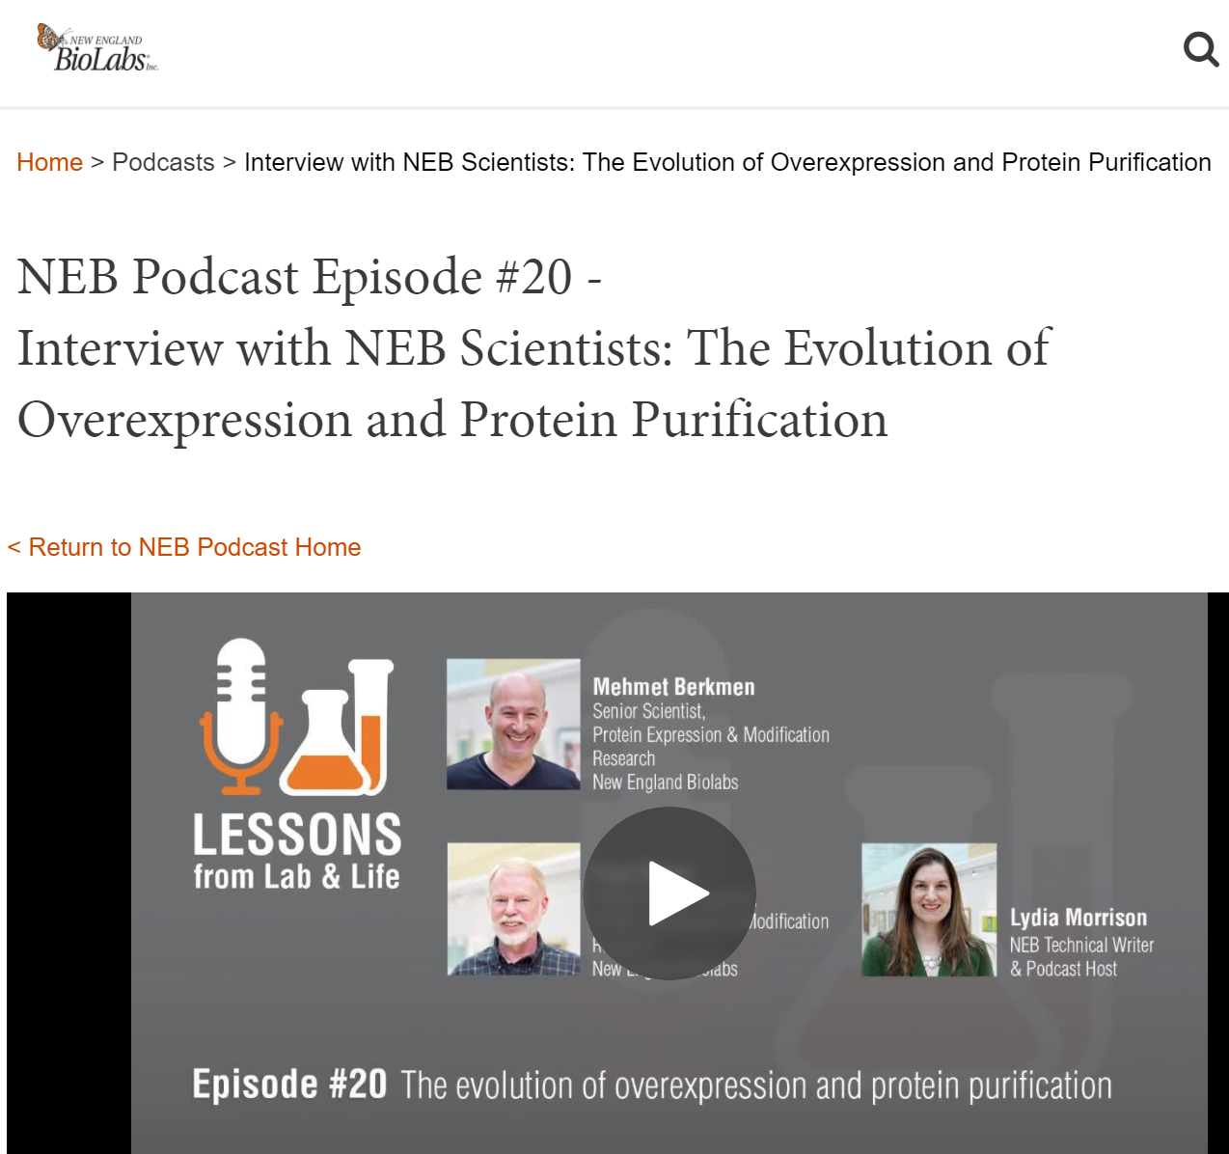
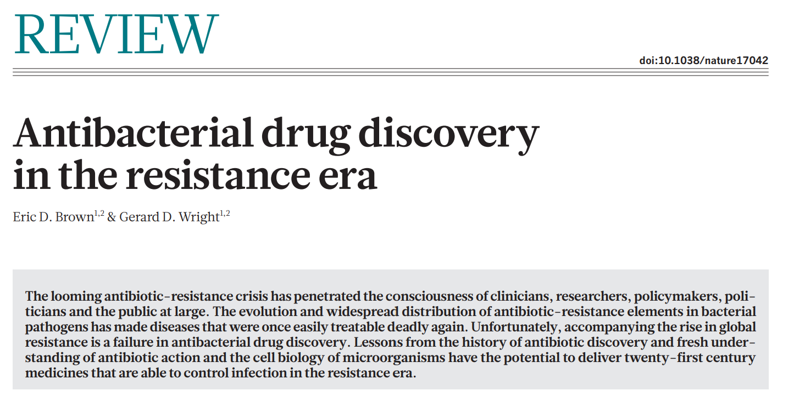
Some shared resources were excellent
Notes:
Diversification over time
Initial obsession with ‘bias’ and lack of diagrams in articles faded
Growing awareness that content of paper might have aged badly over time, even if it is highly cited

Slide 18
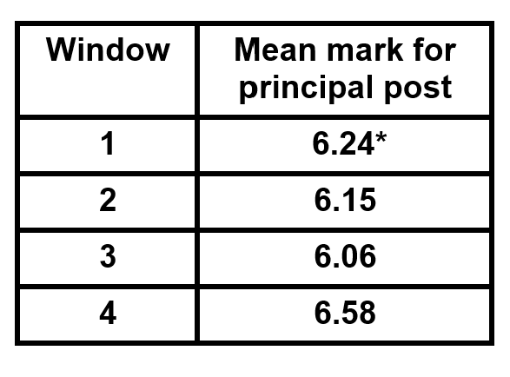
The ‘quality’ of blog posts did not improve significantly over time
* First posts were generously marked
A “good post” needed two dimensions:
- focus on a valuable resource,
- review involving critical thinking
( > summarising content)
Few posts hit “sweet spot” with both dimensions
Students did not engage sufficiently with other people’s posts
and/or feedback to gain the intended benefits from task
Notes:
Some posts just re-iterated/summarised the content, did not review
Some resources were not very relevant and/or had not aged well

Slide 19
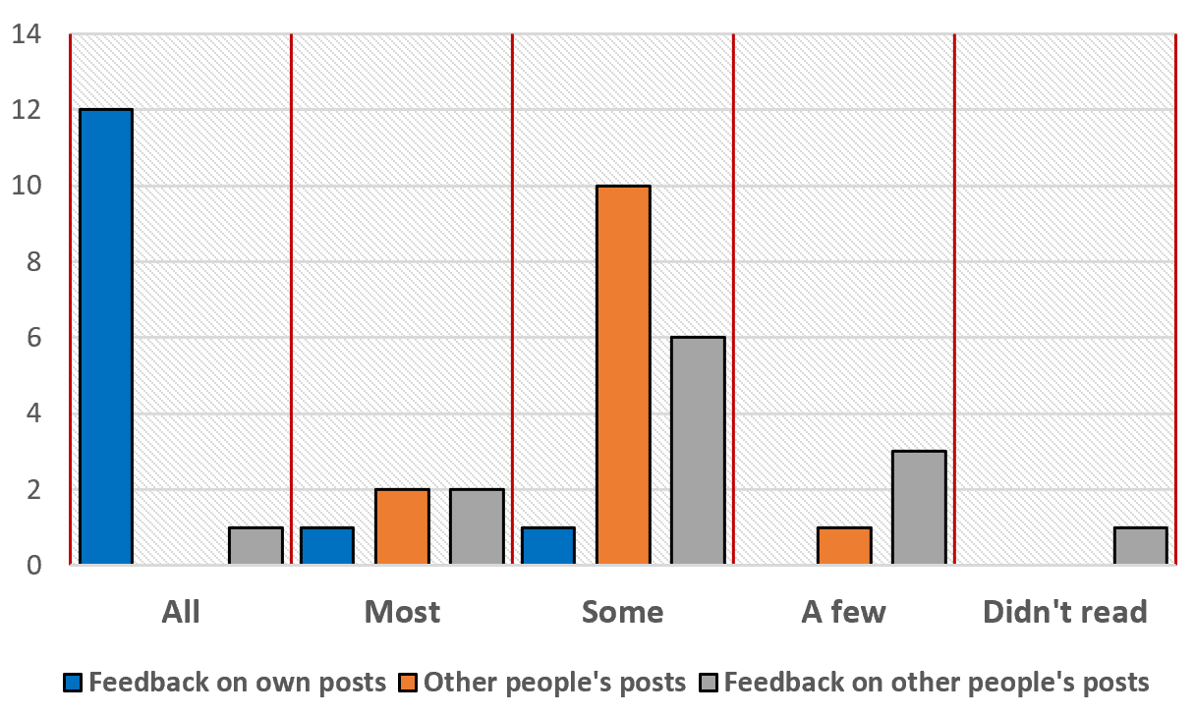
Engagement with posts and feedback (n=13)

Slide 20
Some posts elicited responses, but few led to significant discussion
Some posts received comments, but this rarely led to back-and-forth discussion (“interactivity”) and/or multi-person commentary
An important contributory factor to the limited interactivity was posting of reviews shortly before deadline
Notes:
Interactivity (work of Sheizaf Rafaeli and colleagues at Haifa University)

Slide 21
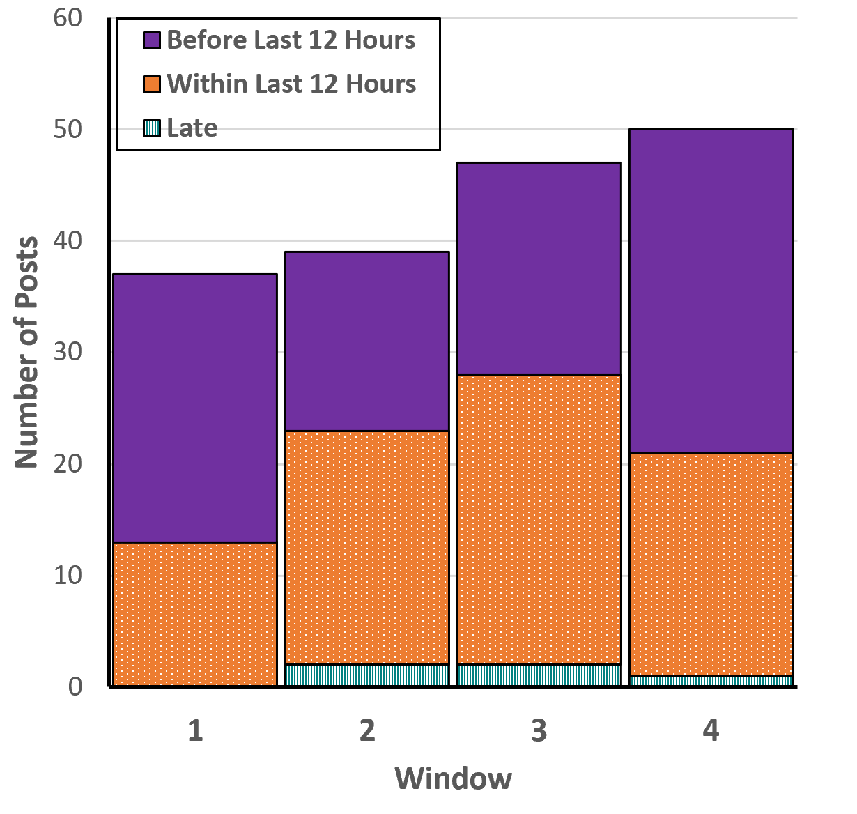
Number and timing of posts
Between 35% (Window 1) and
60% (Window 3) of reviews were submitted less than 12 hours before the 8 AM deadline
(or were late)
Ability to establish discussion on the content was therefore significantly restricted
50
47
39
37

Slide 22
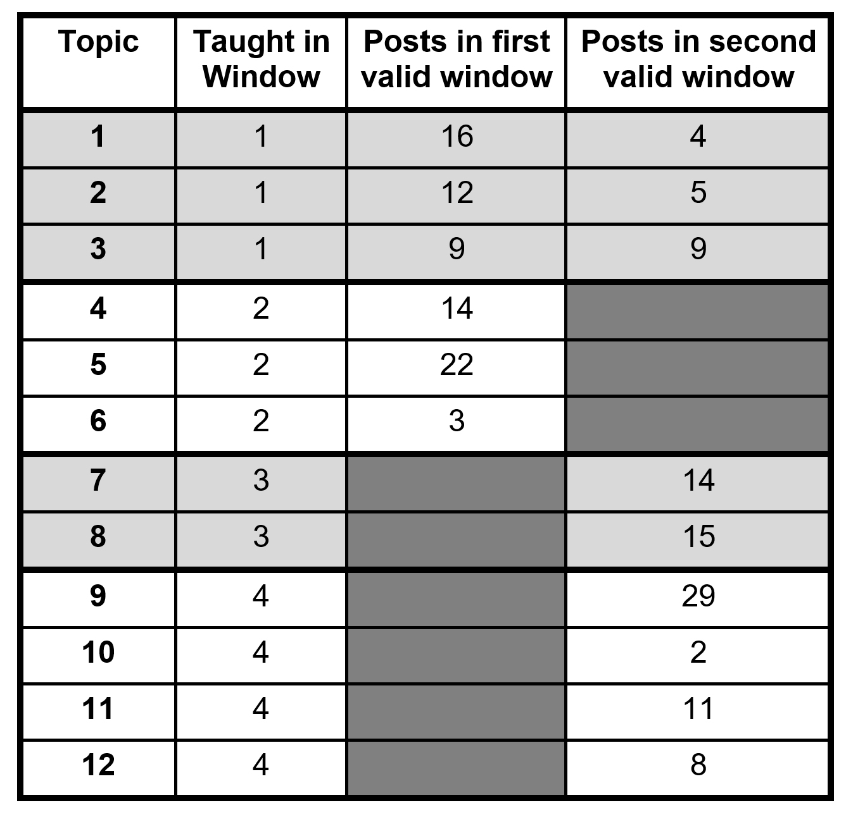
Distribution of review postings
Reviews about any topic could be posted in two valid windows
No-one posted about a topic prior to coverage in the core programme
Students only really “cross-posted” about W1 topics during W3
This may have been due to less new material being covered in W3
One comment was posted on a W2 review during W4

Slide 23
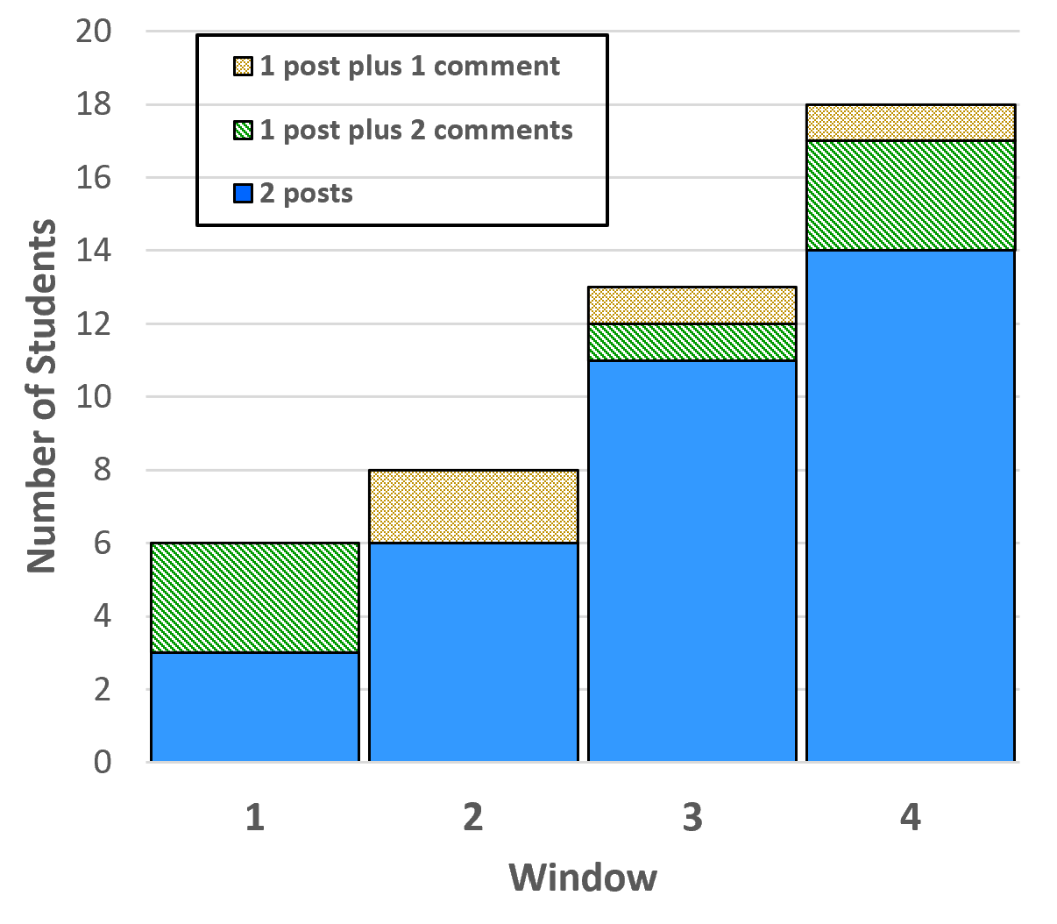
Students achieving maximum mark (n=34)
By Window 4, 53% of students were achieving maximum marks for their contributions
Most (41%) were achieving this via writing of two posts
Some students did not achieve 10 marks, despite >1 contribution if principal post worth 5 or less
18
13
8
6

Slide 24
Are we running this assignment next year?
No ☹
Exercise already valuable and could have been tweaked to improve
However:
- Burden of marking and especially timing of marking was issue
(even before substantial increase in cohort size in 21-22)
- Marks for module considered too high
Exams are permitted again

Slide 25
If you are considering running a similar task
Give annotated examples of posts a priori, overtly detailing strengths and weaknesses. Include:
- review of excellent resource that lacks critical thinking
- good reflection on a poor resource
- good review of an excellent resource
Ditto for comments
Suggest having a deadline for posts and a later deadline for comments within same submission “window” (and/or require comments)
Identify platform that would allow multiple, anonymous contributions
Notes:
Poor review of good source, eg just restating the contents
Our students were encourage to read feedback on all posts, but many did not – require this?

Slide 26
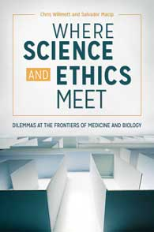
Any questions?
E-mail: cjrw2@le.ac.uk
Twitter: cjrw
Slideshare: cjrw2
Blogs: www.biologyonthebox.wordpress.com
www.biosciencecareers.wordpress.com
www.lefthandedbiochemist.wordpress.com
Biology in Broadcast Media playlist
https://tinyurl.com/BiBMplaylist

Slide 28
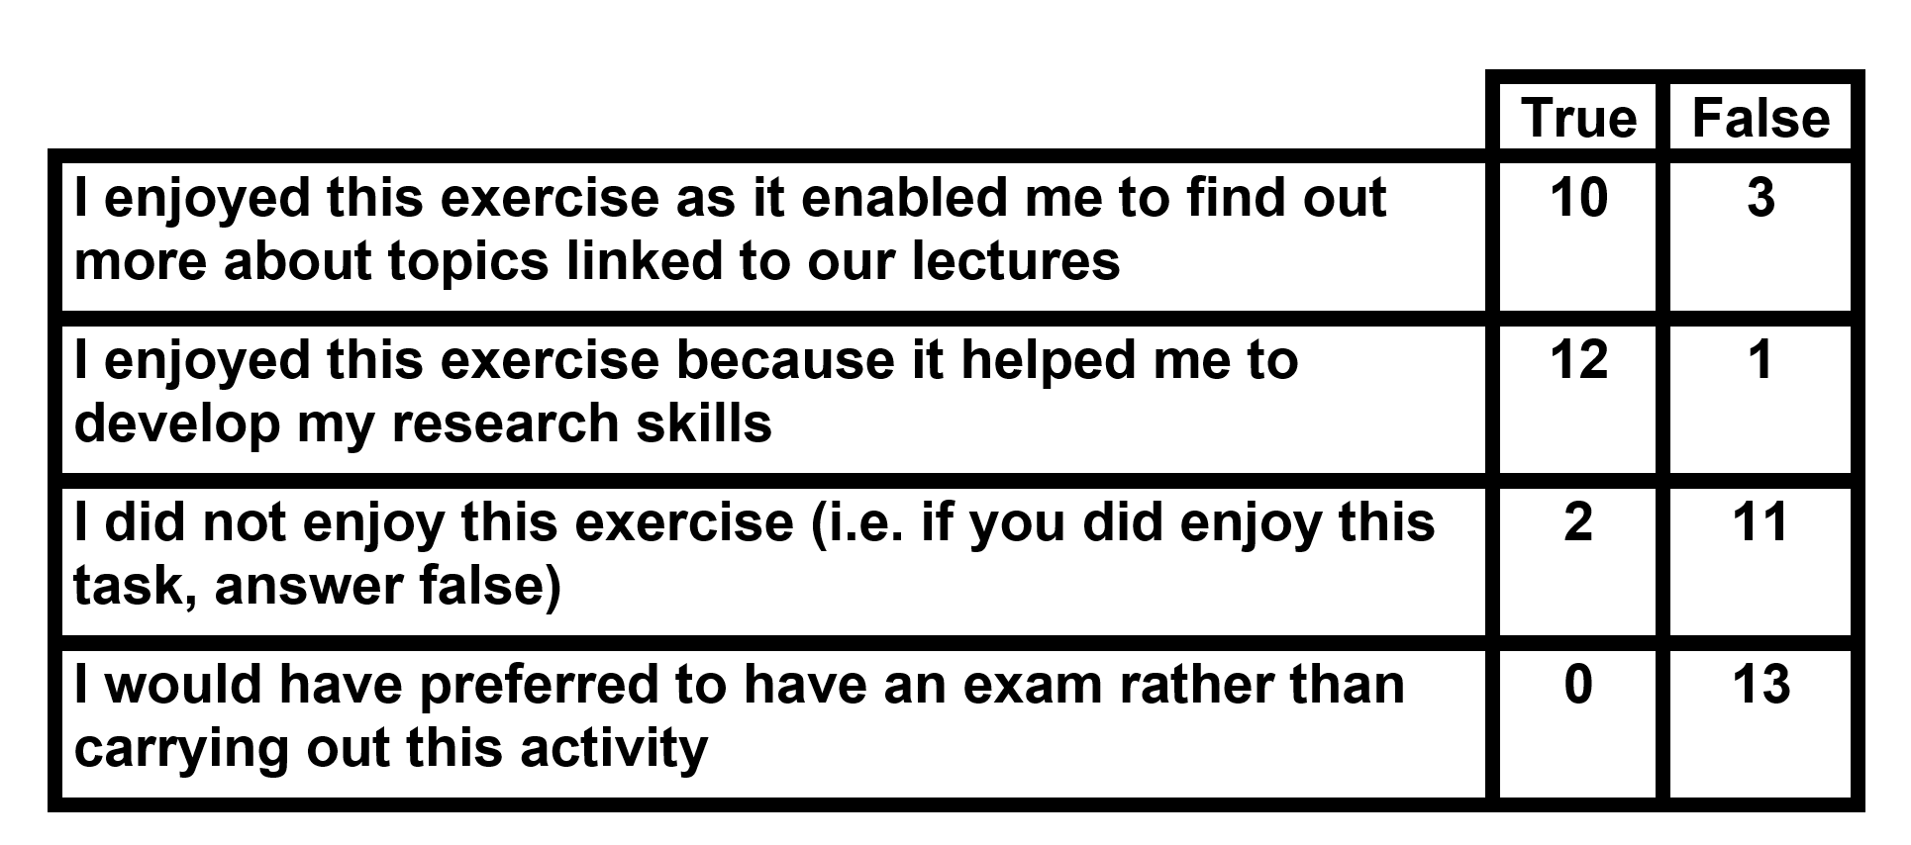
Questions about enjoyment (n=13)

Slide 29
Positive comments: Skills development
Aided my ability to think critically when looking at reviews that I want to use in other areas of the course
Makes you think critically about what information is relevant
Developed my critically thinking skills
The activity improved my research skills and evaluation skills
Helps develop research skills
Improved research skills
Aided my ability to be succinct with my words

Slide 30
Positive comments: Content & Knowledge
Improved knowledge from lectures
It reinforced knowledge from recorded lectures
Actually made me read more into topics
Get to see things from other people's perspectives
Able to read other blog posts
A more effective way of testing your understanding of the topic because you have to evaluate sources

Slide 31
Positive comments: Pragmatics
Provided a more relaxed piece of work to gain credit alongside exams and bigger projects
Caused much less stress than exams
Took time but not too much - not overwhelming
It was nice that it was short
Allowing multiple post submissions to gain marks
It provided an opportunity to find material that is of personal interest to us rather than already provided
Flexible resources could be used

Slide 32
Negative comments: Not anonymous
Anonymous submission, such as maybe using student ID rather than name. My feedback was mostly negative and I felt a little embarassed [sic] to have everyone know
Posts should be anonymous to elimate bias [sic]

Slide 33
Negative comments: Marking guidance
Explaining how to pick up marks - I received the same mark for each post even though I thought my later posts were better so I feel like I didn't improve at all
Examples of blog post to start before the first post
Definitely provide more examples of sources and more specific marking criteria. It was very hard to improve from post to post if the feedback provided was brief and did not provide specific targets for improvement.

Slide 34
How did you find 300 word limit?
Far too short 0
Too short 3
About right 11
Too long 0
Far too long 0

Slide 35
Requirement for four post during term (10% per submission window)
Too many for this amount of credit 3
The right number for this amount of credit 10
Too few for this amount of credit 1

