Slide 1
Jupyter Notebooks in the learning of Data Management and Analysis
An investigation of how Jupyter Notebooks enhance students learning of data management and analysis
Sharon Dawes, Chris Thomson, Stephen Rice & Stephen Bowles

Slide 2
Project Background
What are Jupyter notebooks and how did the project come about?

Slide 3
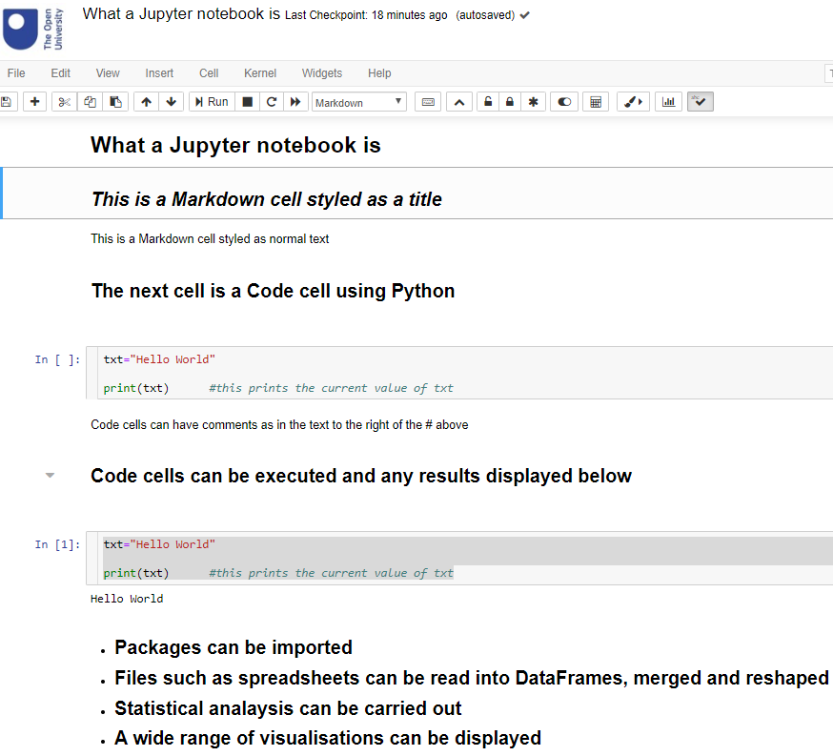
Project Background
What are Jupyter Notebooks?
JSON based
Run in a web browser
Has program code cells
Has Markdown cells
Displays results of running code
Serves as a project log book

Slide 4
Project Background
Background to Project
TM351 Data Management & Analysis use of notebooks in combination with VLE
Rewrite of M269 Algorithms, Data Structures & Computability
Various other computing science & maths modules starting to use notebooks
Need to find out how well notebooks support student learning

Slide 5
Research Questions
What we hoped to find out

Slide 6
Research Questions
What we hoped to find out
Does the use of notebooks effectively support students in their studies of the module learning outcomes?
Do notebooks allow the students to integrate theory and practice?
Do students have technological problems in using notebooks?
Does the use of notebooks dictate when and where students are able to study?
Is the use of notebooks restricted by usability or accessibility constraints?

Slide 7
Research Methodology

Slide 8
Research Methodology
Data Gathering
Survey of 301 TM351 students from 3 cohorts
Follow up interviews with 10 students (29 opted-in)

Slide 9
Research Methodology
Data Analysis
Quantitative analysis carried out using:
  Jupyter Notebooks
    Employing Pandas and Scipy packages
Qualitative thematic analysis carried out using NVivo
Warning – questions are paraphrased on graphs to keep labels readable!

Slide 10
Analysis and results

Slide 11
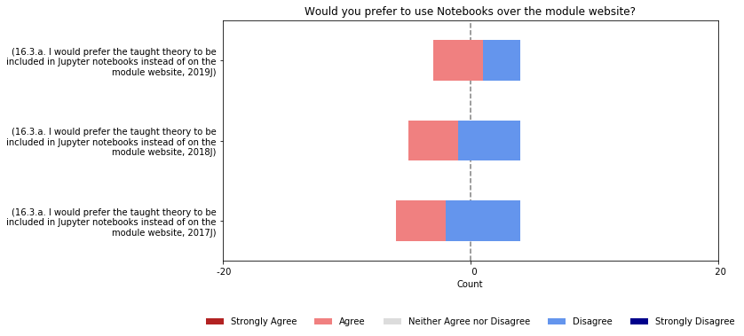
Survey: Respondents were split evenly over more use of notebooks
Longer bars means more responses, so compare proportions of answers

Slide 12
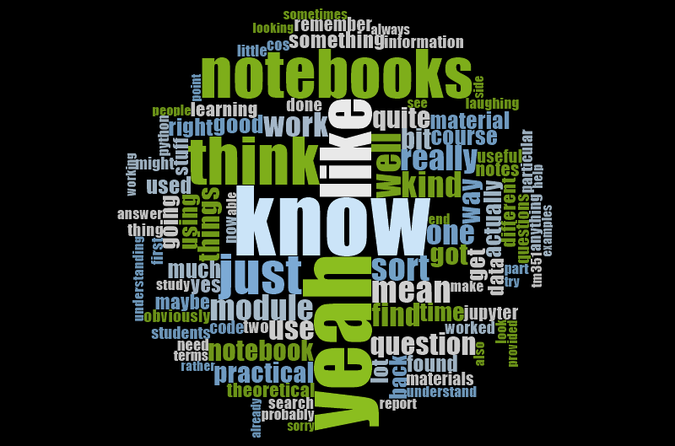
Thematic Analysis of Interview Transcripts
What did students tell us abut?

Slide 13
Did the notebooks support their study?

Slide 14
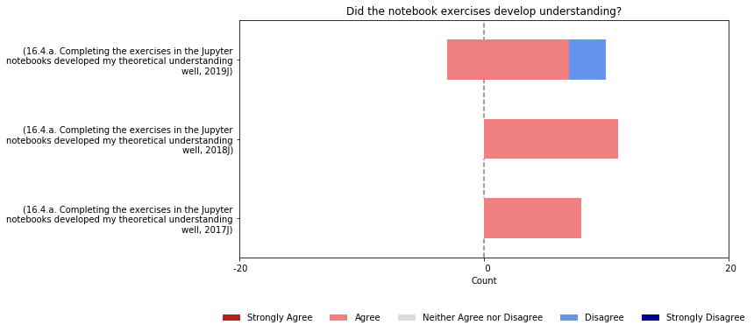
Survey: The notebooks were effective

Slide 15
Thematic Analysis of Interview Transcripts
Did their notebooks support their studies?
"I’d read through all the theoretical stuff first and then I’d tackle the practical stuff afterwards. ….They were very separate in my mind."
"Working through the materials and kind of seeing the benefit of working in that kind of environment of mixing both the kind of the code, your visuals, and your descriptive findings in one place it’s a very compelling way of working generally for kind of these data analytics type problems."
"I liked the fact that the notebooks were immediate, you didn’t have to sort of mess around getting set up with like an IDE or compiling code or anything like that, it more or less just ran, you know, you can type a line of code and then you get an immediate response."
“
“
Different students unsurprisingly used the notebooks in different ways…but the notebooks appeared to support different learning styles well.

Slide 16
Integrating information sources

Slide 17
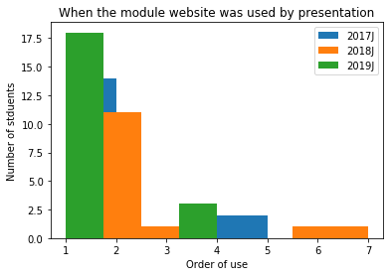
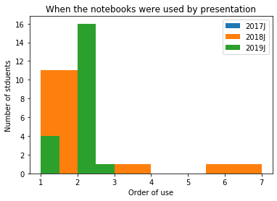
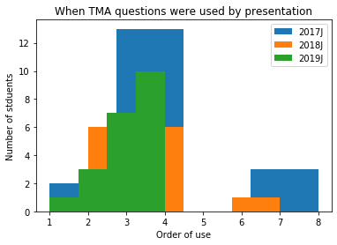
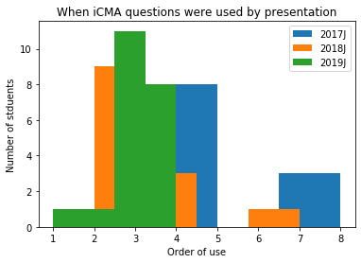
Survey: Order of use by study material
The order of use number indicates at what point in the module the student looked at that source, where 1 is the first source looked at and 7 the last. They may have selected more than time to indicate revision of material.

Slide 18
Thematic Analysis of Interview Transcripts
Could they integrate theory and practice effectively?
“I prefer to understand the theory before diving into the practical so I tended to read the theory side before dipping into the practical and do that all in one big go."
“I would read through the materials on the website as though it was an online book and …use the practical examples presented in the Jupyter workbooks to either reinforce it or to pull it apart and prod it should I not think I’ve quite understood it."
“As soon as I was able to answer the assignment question sufficiently well to my satisfaction I then moved on to the next phase of reading theory for the rest of the module."
“
“
Students seemed to cope well with the mix of notebooks for practical work and theory on the VLE

Slide 19
Thematic Analysis of Interview Transcripts
Could they integrate theory and practice effectively?
“I'm fairly familiar with the concepts of programming, so I tend to go through the note books first, then attempt the iCMA questions the first time around then do some more studying.”
“I think there were some points in the reading where I was referred to a notebook and in the well behaved little student that I am I would duly go away and do it at that point.”
“
“
…and some students followed the rules to the letter.

Slide 20
How prepared were the students?

Slide 21
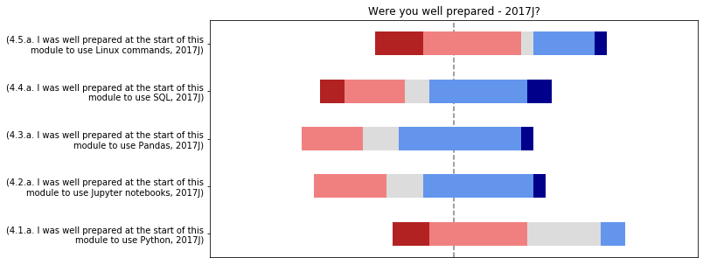
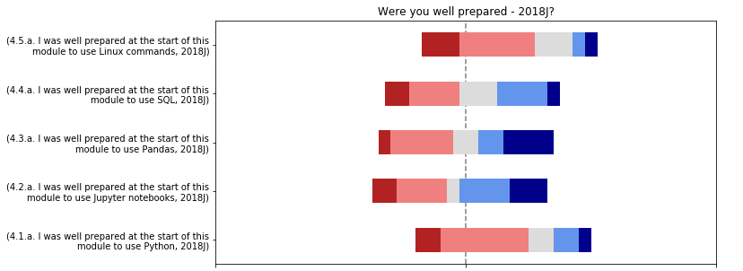
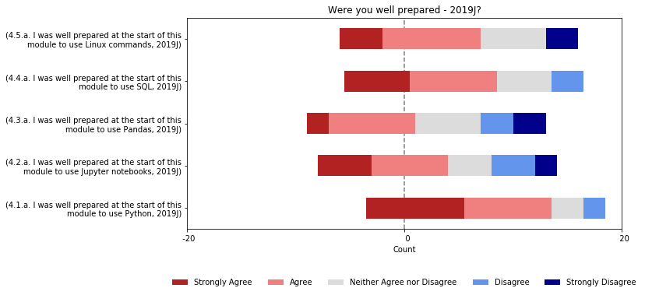
Survey results
Students becoming more prepared as time goes on
Longer bars means more responses, so compare proportions of answers

Slide 22
Thematic Analysis of Interview Transcripts
Were there technological problems?
“Virtual machines …obviously they can take quite a lot of storage space."
"I installed the VM onto a Debian Linux host machine, and this required some additional work to find relevant dependencies, configuration settings, etc..."
"This wasn't an issue during the module, but I used Jupyter notebooks in my final project to use with TensorFlow and found performance was an issue when running in the VM due to the VM configuration."
"Theoretically …it should have been possible to run [a notebook] on someone else’s environment but...it could have been a bit problematic if you were running a piece of code that expected a particular amount of RAM or data storage knowledge."
"They are great for users with no Python of database experience but this would be rare by the point of stage 3 and the notebooks are very frustrating to complete simple tasks in."
“
There were certainly issues but an optional server environment has proved popular this year and may have fixed some of these.

Slide 23
Where did students study?

Slide 24
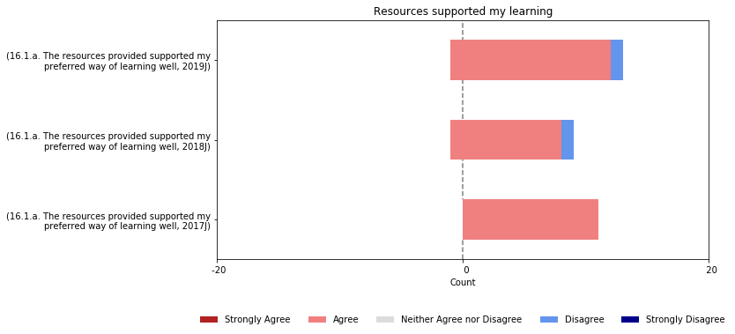
Survey: Students found resources supported them
Longer bars means more responses, so compare proportions of answers

Slide 25
Thematic Analysis of Interview Transcripts
Did the notebooks dictate when and where they could study?
"Where I work everything is locked down …however in my break I can use [my] work computer to read materials on the OU website …putting everything on Jupyter notes would have made it harder for me to keep up..."
"I was commuting a lot at the time so I’d pick up on bus journeys and train journeys and read them [the materials] on my mobile phone as much as I could."
"The theoretical material, which was presented by a web browser, I tended to print …and read it paper based."
"I’d go to the library, the local library, I’d go to the pub, and I actually found the background hubbub of noise quite conducive to work."
So it’s clear that some students at least need to be able to study some of their materials offline and are choosing which ones work best for them at various times and in various places.

Slide 26
Access to information

Slide 27
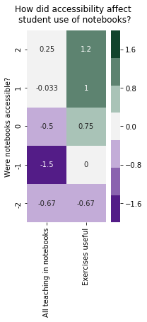
Survey: Did Accessibility make a difference?
We saw that students who found the accessibility of notebooks problematic also did not want them used for more teaching, and found the exercises were not useful.
“Books are the optimum study resource for a great many people: indexed and easily searched.“
“There was no guide or appendix for the notebooks. this meant that I had to open up and search through multiple notebooks anytime I needed to find anything.”
“The Jupyter notebooks are a good way to represent small code blocks but for practical activities they are very frustrating to complete simple tasks in and make simple commands on a command line take much longer than normal.”
“It would be immensely helpful to have more, simple questions to work through in Notebook form (not dissimilar to iCMAs) to help embed the volume of techniques in the reading.”
“The Jupyter notebooks have limited formatting capability in comparison to web pages (I have found) so I think the theoretical materials are probably much better presented on web pages rather than Jupyter notebooks.”
“I feel like the notebooks and iCMAs were most useful in terms of learning theoretical concepts in a practical way. However, I found some of them a bit long-winded.”
“I would prefer all theory in the module epub files and just save Jupyter for practicing practical work and assignments. However, after converting the notebooks to html it was quick and easy to search and read them.”
Notes:
It's notable that 6 out of the 55 students responding explicitly mentioned using their own books as a study source
Those who felt the notebooks were accessible (in bin 2) gave an mean agreement of 0.25 (scale -2, to 2), slightly agreeing that they would like all teaching in notebooks, but those who found the notebooks not accessible (bin -1) said clearly they did not want all teaching in notebooks. Equally they found they could take or leave the examples.

Slide 28
Thematic Analysis of Interview Transcripts
How could the use of notebooks have been improved for usability?
"it would be really useful to have a good search application that could … go through every notebook on your hardware."
"One thing I would say is that actually now the one that I did recently where they were using GitHub, that was like really the first time I’d used that and it was quite nice having version control cos what I was doing for 351 was just manually I think, backing stuff up."
"It was just more time consuming to track back through the notebooks but what I did find useful, as I mentioned, was the summary of each of the formulae and code structures that had been prepared by a student based on his going through each notebook and extracting the key pieces of code."
"The main thing that I’d have found frustrating at the time…there was no glossary provided…"
"I would say to try and keep an index of the headline topics that a notebook covered."
Our students suggested several resources they’d find useful to improve usability. They were making good use of a wide range of resources but those using Macs found searching Notebooks easier that those on PCs.

Slide 29
Thematic Analysis of Interview Transcripts
What about accessibility?
“Just learn the keyboard shortcuts, learn how to delete and merge cells basically.”
"You had to use, so, if you had a cell that was non-code that you wanted to enter text into you quite often had to use, you know, primitive html break to get proper line breaks."
Being able to use keyboard shortcuts was clearly important for some. Accessibility issues worried students in the survey more than this group.
However clarity of what was in the narrative cells was clearly an issue.

Slide 30
What next?

Slide 31
What next?
The results show that where the technology works the pedagogy supports perceived student learning.
Learners could adapt the materials to their study preferences acceptably, the offline local install of the notebooks was effective in allowing this for students with laptops but posed issues for those using mobile phones.
But that there are issues with accessing the information during revision and review cycles.
Discussion with module teams
  Do additional resources need to be provided
  To help students find content?
  To enable students with accessibility issues to achieving learning outcomes?
  Consider enabling resources for use on phones and tablets
Further research
M269 introduction of notebooks
TM351 use of cloud based software which could remove technical challenges some students face in running the software

Slide 32
Any Questions?

Slide 33
THANK YOU

