Slide 1

The Virtual Palaeosciences Project: connecting, innovating and sharing online pedagogies in a traditionally hands-on field
M. Jane Bunting (University of Hull), K. Bacon (Galway). E. Hurrell (UCLan) and ViPs Coordinating Group members

Slide 2
The palaeosciences
The study of past environments and environmental change
Taught in multiple “degree disciplines”
  Geography
  Archaeological Science
  Environmental Science
  Ecology
  Geology
Typically taught through activities: classic course sequence includes fieldwork, wet laboratory work and microscopy
Transition to blended/online initially regarded as “impossible” by some colleagues.

Slide 3
Project aims
• Create shared archive of virtual palaeoscience online educational resources (OERs)
• Support palaeoscience academics to incorporate OERs and technologies effectively in teaching
• Upskill the palaeoscience community - sharing expertise and resources on creation of OERs, sharing the work
• Improve understanding of learning in the palaeosciences
• Use OERs as tools to improve accessibility, diversity and inclusivity of palaeoscience learning

Slide 4
OERs and inclusivity
Replacement – in times of crisis
  COVID, a broken leg, an unavoidable absence

Slide 5
OERs and inclusivity
Replacement – in times of crisis
  COVID, a broken leg, an unavoidable absence
Preparation and confidence-building
  maximise value of in person, laboratory or field hours
  Time in person can be costly for students, resources limited for academics
Supplement and contrast
  Virtually visit alpine glaciers to compare with in person visit to once-glaciated Lakeland
Assessment
Diversity – expert talk series

Slide 6
The Virtual Palaeosciences Project
March 2020 – finding resources was a key challenge
A few colleagues got together to share what they had
Set up a mailing list, had a workshop, became a project
Creating a community of practice
  For finding and creating Online Educational Resources
  For effectively using OERs in online, blended, and in person settings, especially to improve accessibility and inclusivity
  For pedagogic research
  Not just academics – technical staff, ECR demonstrators, practitioners

Slide 7
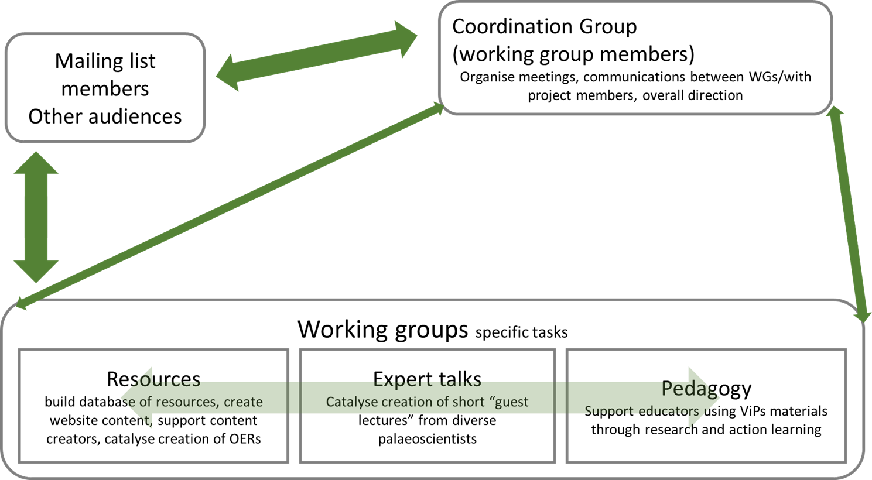
Structure

Slide 8
What we did so far
Database of over 380 OERs with student reviews (interns) and more being added
Four workshops
“Coffee seminars” to share practice and experience
Newsletters, website and social media
New products – e.g. eSlide (Stephen.Juggins@ncl.ac.uk) – web-based microscopy simulation

Slide 9
The pedagogy working group
Major concerns identified
  Delivering learning outcomes
    Recreating hands-on experiences
    Replacing fieldwork
  Student engagement
  Staff time commitment
  Student access to online materials

Slide 10
Approach to supporting pedagogy
Took a “pedagogic journey” approach
  What do students need to be able to do?
  Exploring how conventional learning outcomes and session plans could be replaced with different mixtures of OERs
  Sharing ways to foster engagement and get students working together
  Building community, sharing experiences, sharing simple solutions
    E.g. engagement and understanding checks using varied tools

Slide 11
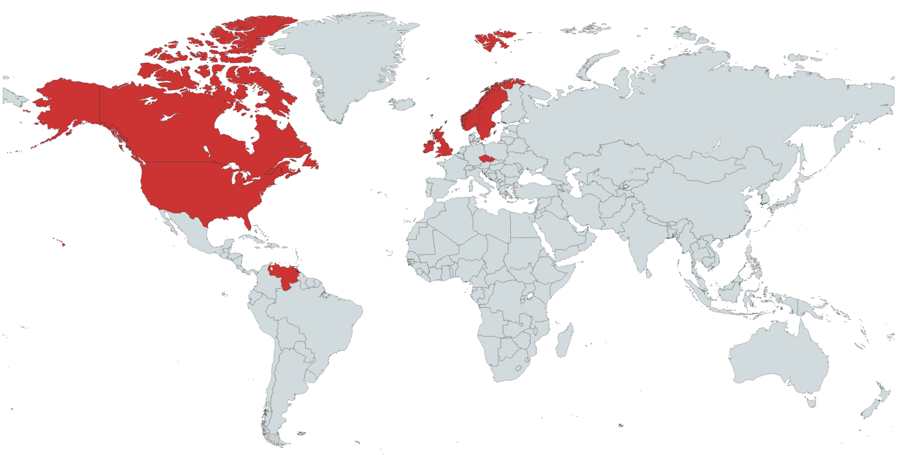
Researching pedagogy
First part - exploration of how palaeoscience academics adapted to the 2020-21 academic year
Survey - international sample, not all ViPs members
Individual reflections from researchers
26 respondents from 8 countries

Slide 12
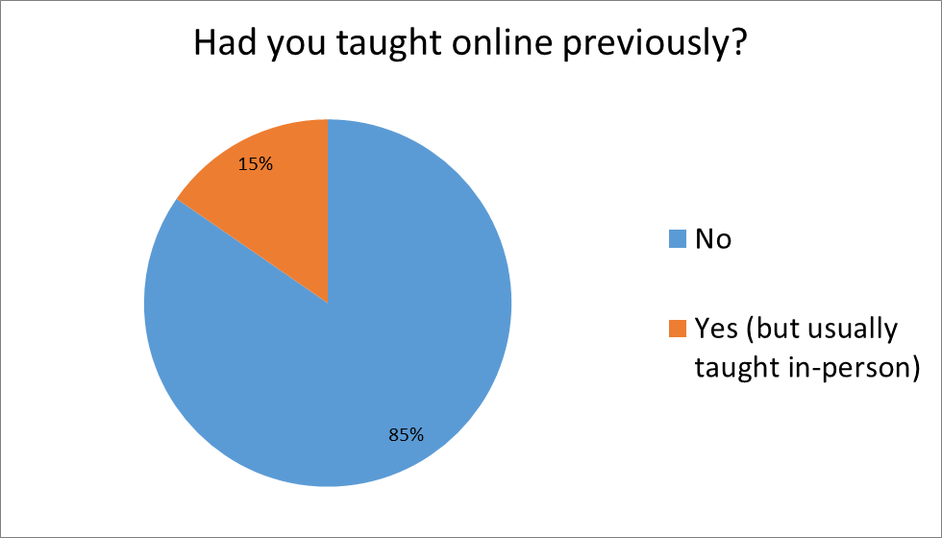
But most had to use it extensively in 2020-21
Respondents had limited prior experience with online teaching

Slide 13
Emerging themes (analysis ongoing)
Major concerns at the start of 2020-21
  Practical work, fieldwork, student engagement
Support provided by institutions was very variable.
  Common pattern of EITHER technology OR pedagogy support
Importance of focusing on using a few tools well rather than trying to do everything
Generally positive about future blended learning rather than reverting to all in person
NEXT STEP – student experiences with OERs (2021-22)

Slide 14
Lessons and next steps
Blended, digitally enhanced learning is here to stay
  Academics learnt they can do it
  Students know it is possible
  Challenge will be balancing expectations to do it ALL

Slide 15
Lessons and next steps
Blended, digitally enhanced learning is here to stay
  Academics learnt they can do it
  Students know it is possible
  Challenge will be balancing expectations to do it ALL
Virtual communities are “real” and can be effective
  Saving a lot of repetition, support, pooling experiences

Slide 16
Lessons and next steps
Blended, digitally enhanced learning is here to stay
  Academics learnt they can do it
  Students know it is possible
  Challenge will be balancing expectations to do it ALL
Virtual communities are “real” and can be effective
  Saving a lot of repetition, support, pooling experiences
Collaboration e.g. with new Erasmus+ project – digital learning resources for geography and related disciplines

Slide 17
Lessons and next steps
Blended, digitally enhanced learning is here to stay
  Academics learnt they can do it
  Students know it is possible
  Challenge will be balancing expectations to do it ALL
Virtual communities are “real” and can be effective
  Saving a lot of repetition, support, pooling experiences
Collaboration e.g. with new Erasmus+ project – digital learning resources for geography and related disciplines
OERs have huge potential for improving diversity and inclusivity – e.g. diverse voices from the “Expert Talks” working group

Slide 18
For more information
M.J.Bunting@hull.ac.uk
@DrMJBunting
@Palaeosci_ViPs
https://virtualpalaeoscience.wordpress.com/

Slide 19


Thank you!
Coordinating Group:
Kim Davies (Bournmouth University)
Niki Evelpidou (University of Athens)
Michelle Farrell (Coventry University)
Britte Heijink (University of Amsterdam)
Simon Hutchinson (University of Salford)
Steve Juggins (Newcastle University)
Tim Lane (Liverpool John Moores University)
Antonia Law (Keele University)
Matt Law (Bath Spa University)
Meriel McClatchie (University College Dublin)
Des McDougall (University of Worcester)
Michaela Mariana (University of Nottingham)
Fabienne Marret (Liverpool University)
Encarni Montoya (University of Liverpool)
Danni Pearce (Norwegian University of Life Sciences)
Gill Plunkett (Queen’s University Belfast)
Steve Rogers (University of Keele)
Mehdi Saqalli (University of Toulouse)
Helen Shaw (Maynooth University)
Eileen Tisdall (Stirling University)
Irene Torreggiani (University of Oxford)
Maarten van Hardenbroek (Newcastle University)
Nicki Whitehouse (University of Glasgow)
Our project interns:
  Harry Bourton
  Elizabeth King
  Ahmed Alwardi
Research group funding
  University of Hull graduate internship

