Slide 1



Perceptions of science research: visibility and accessibility of science research as a career in post-16 Biosciences and Chemistry students
Accessibility of
Science
Research Group
Mel Lacey, Rachel Schwartz-Narbonne, Susan Campbell, Alex Hamilton, Catherine Duckett and Katherine Rawlinson
m.lacey@shu.ac.uk @MelMLacey

Slide 2
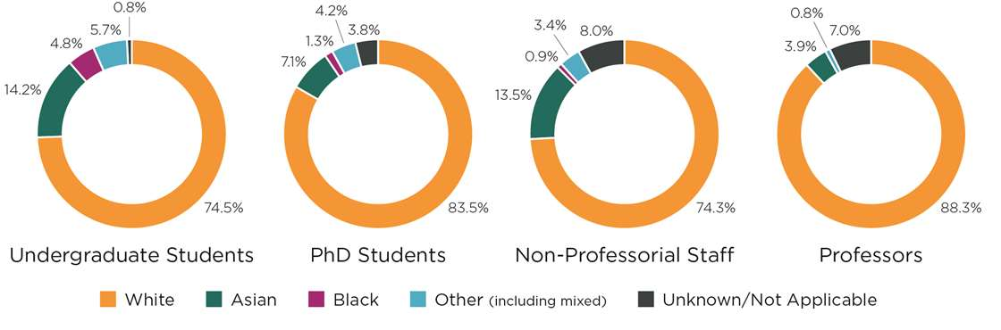
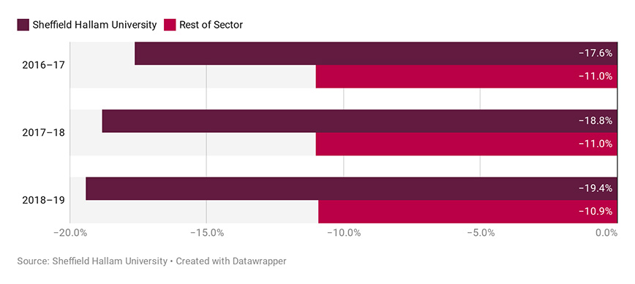
Science sadly does not represent society
RSC,
UK academia

Slide 3
How do we increase diversity in science?
Reduce the BAME awarding gap.
Better understand motivations for undergraduate career aspirations.
Increase research informed teaching within the undergraduate curriculum.
What about before students arrive in higher education?

Slide 4

Research questions
What is the visibility and accessibility of science research as a career in post-16 students?
Can higher education student-led interventions increase visibility and accessibility of science research as a career in post-16 students?

Slide 5



What we did
Data collection carried out questionnaire with post-16 school/college Chemistry students in Sheffield region.
Analysed data from 343 student responses to identify perceptions and barriers to accessibility of science research.
Focus groups with seven post-16 school/college teachers for perspective on how to influence perceptions.
Co-design outreach activity with student
researchers, pre and post questionnaires to
measure impact.

Slide 6
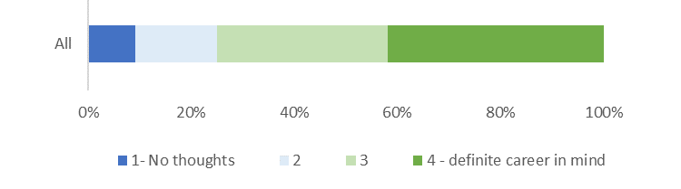

Post-16 students have developed career aspirations
No difference in ethnicity gender or qualification route
BAME students were less likely to aspire to research
than their White peers- 3% vs 10% (p < 0.05).
... and ....
were more likely to aspire to medicine, dentistry or veterinary studies – 33% vs 23% (p < 0.05).

Slide 7

Science researchers (Chemists) were perceived as “smart”
Theme | Frequency | Example
Fixed intelligence . | 137 | smart, intelligent, clever
Lab work | 42 | lab work, work with chemicals
Transferable skills | 44 | problem solving, determined, hard working
Knowledge | 26 | Expert, knowledgeable, educated
343 respondents to questionnaire. Research supported by

Slide 8
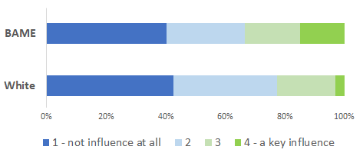
Post-16 student most influenced by parents in journey to HE
Parents (73 participants) and family (16 participants) were the most likely to influence students; teachers had less of an impact (11 participants).
BAME students more likely to be influenced by family and friend in decision to study at HE (p < 0.05).

Slide 9
Teachers’ perceptive: impact
Perception: “there is still the stereotype that if you're not upper class white and male that research chemist is not a career for you”
Influences: “prior views from their background, from their family, their mum or dad etc., they are often following in footsteps of people”
Science: “they are very uncomfortable with the idea that they do an experiment, and you might not know what the result is going to be”
Perception: “they still had that view that being a female scientist was an unusual thing”

Slide 10
Teachers’ perceptive: barriers
Teacher: “I [teacher] feel probably less equipped now because you know, it’s a long time ago since I was at university”
Teacher: “I am not sure staff are totally aware of what all courses are like at university”
Time: “We don’t get much time in terms of the lesson time…in secondary school or at A level”
Experience: “they don’t have those aspirations because they haven’t got that experience”

Slide 11
Teachers’ perceptive: influence
Expectations: “undergraduates to give an honest description of…what the course is like”
Research: “involve [students] with research…let them see the teamwork and the camaraderie.. the atmosphere you get in a lab”
Accessible: “think you’d have to have people that they would relate to… they come from a similar background so they can see themselves getting to that same position”
Practical work: “when you do a certain practical that’s when they start to realise, they want to do more about that”

Slide 12


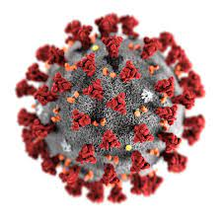
Co –designed outreach projects to increase visibility and accessibility of science research
Approach:
Final year projects: recruited five undergraduate project students > STEM ambassador training.
Four school/college partners: co-design
outreach research project.
Research backbone: impact of metals in soils on antibiotic resistance bacteria.

Slide 13
What the projects looked like
Initial meeting with school/college and research students
Designed project around soils chemistry, timing and length of sessions agreed
Pre-questionnaire
Research students planned and created bespoke resources
Introduction
sample collection (post to research students)
Methods and results
Student researchers’ HE journey and live Q&A
Post-questionnaire
Data analysis
Dissemination to school/college

Slide 14
Co-designed research increases accessibility of science research
More students felt they could be a research scientist after the project 15 students → 17 students.
School/college students were more likely to have strong career aspirations after the research project, 18 before vs 25 after.
All schools eager to be involved
next year.
“We’ve really enjoyed it and I’m looking forward to future collaborations”
38 respondents to pre and post project questionnaire

Slide 15
Thank you
“Especially thanks to James with all of the videos and resources – they were brilliant and very informative”
Special thank you to the student researchers:
Dea Abdullah, James Clayton, Joe McConnell, Chloe Nowill and Efi Gkiata
Questions, queries or comments please let us know:
Mel Lacey m.lacey@shu.ac.uk @MelMLacey
Rachel Schwartz-Narbonne r.schwartz-narbonne@shu.ac.uk
Susan Campbell susan.campbell@shu.ac.uk @sg_Campbell
Catherine Duckett c.duckett@shu.ac.uk @DuckettCJ
Kathy Rawlinson k.rawlinson@shu.ac.uk @KathyRawlinson

