Slide 1


Study skills for scientists - are students
prepared for the transition to a science
degree?
Dr Susan Campbell, Elise Charlton & Dr Kathy Rawlinson
Sheffield Hallam University
@sg_Campbell Susan.Campbell@shu.ac.uk
@KathyRawlinson K.Rawlinson@shu.ac.uk

Slide 2


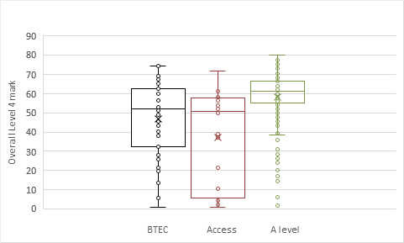
Along with many pastoral challenges facing students during transition to University the development of academic and professional skills can be challenging.
Within Biosciences and Chemistry, we are faced with an increasingly diverse cohort of students and need to ensure that this transition to academic study is successful for all students.
Over the last decade the number of students coming to university with Access and BTEC qualifications, or combinations of different qualification types has risen.
Preliminary analysis of student attainment data collected over the two years has identified groups of students with certain entry profiles who are more at risk of either not engaging or failing to achieve at level 4 (Fig 1).
Notes:
Since the KS5 curriculum reform, it is clear that work is required to help and support the needs of individuals and provide a smoother transition experience and early academic success.

Slide 3




Project aims
highlight the student voice by providing a qualitative report outlining the transition experience of students to degree level science study with different entry qualification profiles.
provide an evidence base to develop our courses in further supporting transition to degree level science study

Slide 4


Do entry qualification profiles influence how prepared a student is for degree level science study?
Does the entry qualification profile impact on the early student experience with science courses?

Slide 5


Invited all level 4 students to complete a study skills questionnaire (n=94)
Students were asked about these skills with respect to:
  Previous experience
  Perceived importance
  Perceived confidence
Communication skills
Lab skills
Study Skills
Your learning
Exam Preparation
IT skills

Slide 6
Confidence levels in skill areas varies with different entry qualifications
Students with Access qualifications reported to be significantly less confident in lab skills than all other skill areas (p<0.05 Wilcoxon).
Students with A level qualifications reported significantly lower levels of confidence in written communication and lab skills (compared to study and IT skills p<0.01 Wilcoxon).
Both Access and A level qualification students p<0.05 Kruskall Wallis

Slide 7
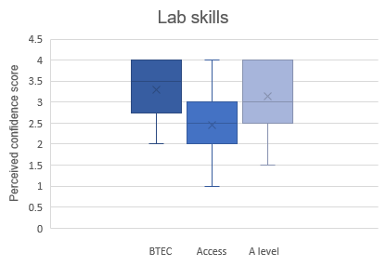
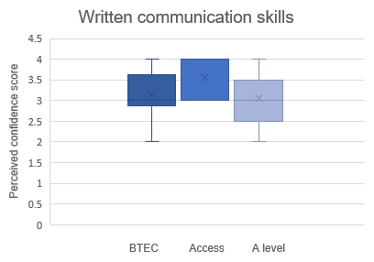
Confidence levels in written communication and lab skills is different amongst students with Access and A level pre entry qualifications
*
*
*p<0.05 Mann Whitney
Notes:
No sig difference in exam skills confidence levels – Covid effect????

Slide 8

Focus groups
Students who responded to the questionnaire were invited to focus groups.
The 3 focus groups were:
Students who had completed A levels.
Students who had completed BTEC qualifications.
Students who had completed a College Access course.
Three focus groups, up to 5 participants per group, 45 minutes each
Notes:
To further explore these emerging differences

Slide 9
Emerging sub themes-Skills
I feel like [in A levels we] didn’t [get] enough of promoting and showing the importance of communicating effectively
[at college] focusing more on exams skills rather than IT skills and other things
all your deadlines and juggling multiple tasks at once, you have to have that independence and you haven’t had that throughout your whole life because in school you have your teachers who are always there
and then you university comes and suddenly you are an adult and you have to have all the responsibilities
Emerging sub themes:
Students understand the importance of skills but felt unprepared.
Lack of preparation for the autonomy/independence that comes with University learning.

Slide 10
Emerging sub themes coursework
they didn’t place any emphasis on course work
A level student
Definitely like the coursework side of my course [best prepared for] BTEC student
I wasn’t prepared by my sixth form to write a proper scientific essay
A level student
I have done a lot of essays. I think I did about fifteen of them for my access course. Access student
Emerging sub themes:
Initial analysis suggests that BTEC students are more familiar with coursework and felt more prepared for coursework.
A level students reported not feeling prepared for coursework and spoke about anxieties around expectations and unfamiliar language/terminology used.
.

Slide 11
Summary and future work
Entry-qualifications do significantly impact confidence levels in skills such as those associated with lab work and written communication.
Emerging themes from the focus groups suggest specific skills that different qual groups could be supported in and that coursework is not perceived as an easy assessment.
Continue our analysis of the data!

Slide 12
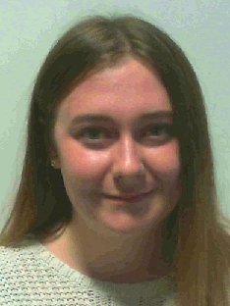
Acknowledgements
Elise Charlton (year 2 student)
SHU Teaching & Learning Enhancement Fund 2020-21
Accessibility of Science Research Group, BMRC, SHU

