Slide 1
Supporting Students’ Scientific Writing in the Age of COVID: Taking Kingston University’s
SEC Academic Success Centre (SASC) Online
Horizons in STEM Higher Education Conference:
Making Connections, Innovating and Sharing Pedagogy
S.E.J. Lambe and M-L. Ibsen
Wednesday 30 June 2021

Slide 2
SEC (Science Engineering and Computing)
Academic Success Centre (SASC)
SASC supports student writing in scientific disciplines across SEC at Kingston University.
It provides students with confidential advice on academic writing and study strategies.
This was provided as a drop-in service, prior to the Covid-19 pandemic, where students could come to talk to an advisor in person.

Slide 3
SASC: What We Do
Report writing
Presentations
Note taking
Time management
Exam revision
Referencing skills

Slide 4
SASC: What We Do Now
Online assignment submission via the Virtual Learning Environment (Canvas) for advisor feedback
One-to-one appointments
via MS Teams
Separate weekly online seminars for FX/UG
and PG students

Slide 5
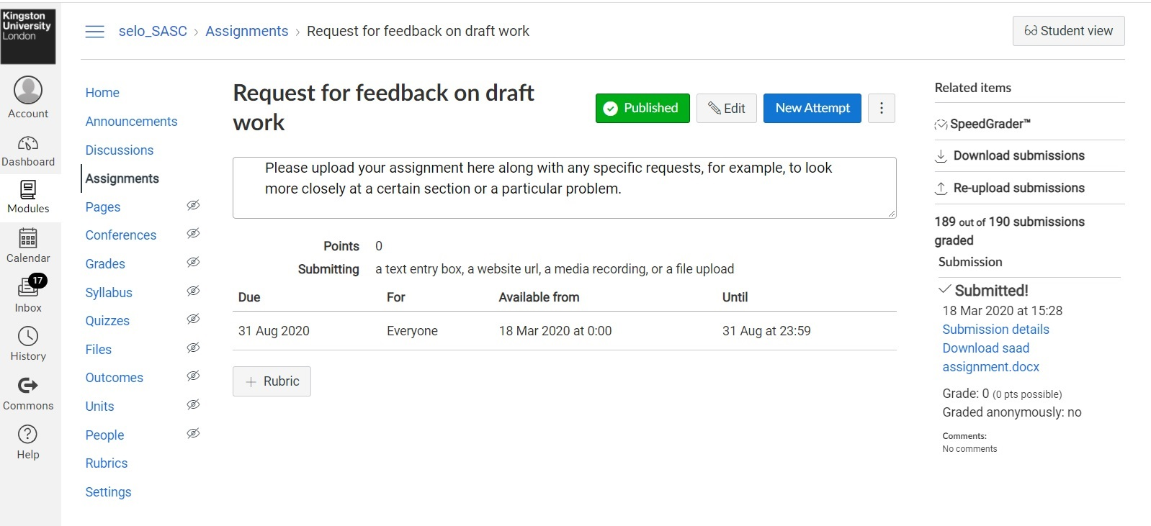

Slide 6
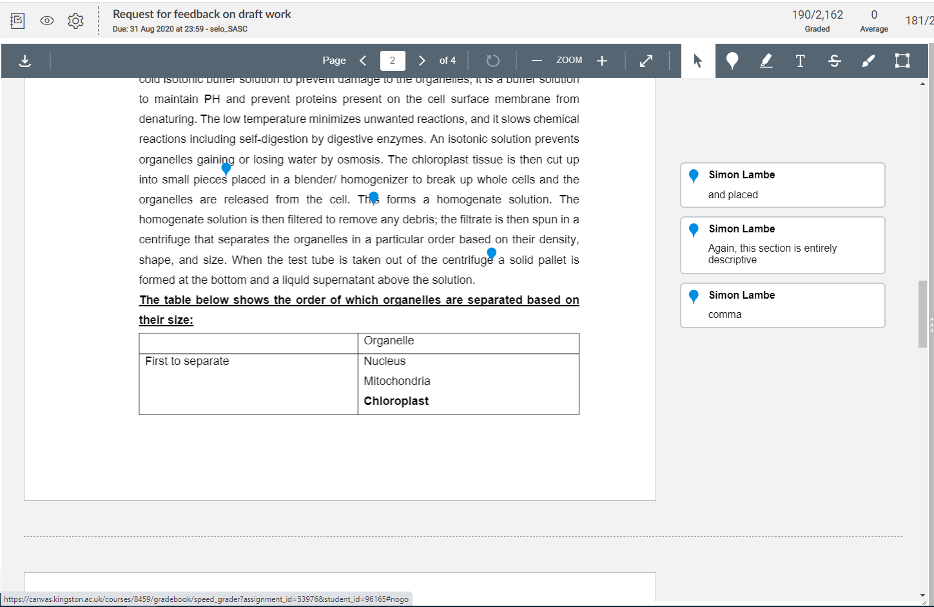

Slide 7
Online Seminars
Students particularly liked that they could just drop in and ask a question without needing to attend an entire session.
Being available – and visible – online made SASC far more accessible and inclusive to all students and was less disruptive to their study time.
We also liaised with our library team so that we had a library representative in attendance at all sessions.
These sessions covered topics including ‘What is SASC?’, time management, question analysis, presentations and research skills, as well as a regular forum for Q&A.
Meetings are always recorded so that students can go back into the chat and view the video as well as the questions asked at the time.

Slide 8
Data for 2019-20

Slide 9
Data for 2019-20
Level 7: by far the highest user with over 60%
Mainly owing to online weekly workshops during the summer
Level 4: good uptake, probably owing to SASC interaction with specific assignments

Slide 10
Data for 2019-20: type of advice given

Slide 11

Findings
Students we had not seen or heard from before had a new avenue open to them.
This online learning experience has proved extremely popular.
It has created new channels for communication with students, something we would like to continue in the post-pandemic world.

Slide 12

Any Questions?

