Slide 1
Demographic gaps in physics degree outcomes
Arran Stirton
Ogden Trust PER PhD Student
School of Physical Sciences
The Open University

Slide 2
Acknowledgements
Supervisory team
  Dr. Holly Hedgeland
  Dr. Annika Lohstroh
  Prof. Sally Jordan
Funding
  The Ogden Trust

Slide 3
In this talk…
Motivation
Literature Review
  UK PER literature on degree outcome gaps
  (Mostly) US PER literature on course grades
  UK HE literature on degree outcomes
Analysis of Advance HE data (2012/13-2018/19)
Discussion

Slide 4
Inequality in degree awards across UK HE
Motivation
In 2018/19:
83% of White graduates were awarded a 1st or a 2:1
68% of BAME ethnicities were awarded a 1st or a 2:1
Source: (Advance HE, 2020)
Well known, but how does it vary by subject?

Slide 5
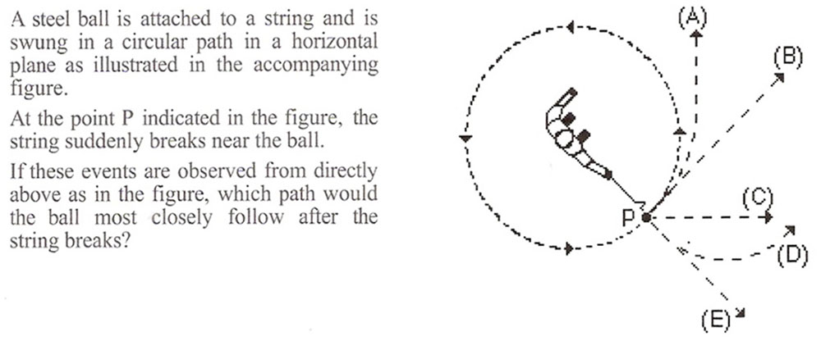
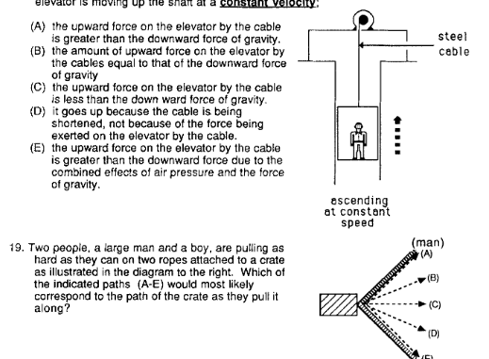
Inequality physics concept inventories
Motivation
On average, men outperform women on tests of conceptual understanding in physics (Madsen et al., 2013), around 13 p.p. for the FCI
Evidence of further gaps for ethnic minority students (Henderson and Stewart 2018), first generation status, and rural status. (Henderson et al., 2019)
But, CI outcomes != course grades
Image: conceptual questions
(creative commons)

Slide 6
Literature Review: Demographic Gaps
Literature Review
Core question:
  What are the demographic gaps in physics degree outcomes?
  Or… are physics degree courses equitable?
Three approaches:
  PER literature on UK degree outcomes
  PER literature on course grades
  General UK HE literature on degree outcomes

Slide 7
PER literature on UK degree outcomes
Literature Review
Thin on the ground
Elton (1968, 1969) – Small sample, no statistical tests!
    “Women are the equal of men, although perhaps a shade more persevering and less brilliant. On the other hand, the one woman who got a ‘first’ was listed as “top of the list by a large margin” in the most competitive institution in the sample.” – Elton (1968)
IOP Commissioned Reports
  Ethnic minority students in physics and chemistry (Elias et al., 2006):
  found statistically significant gaps for ethnicity.
  Physics Students in UK HE Institutions (McWhinne et al., 2012):
  Female advantage on BSc, no difference on MSc.
  Internal reports: IOP (2017, 2019)
  No statistical tests carried out. Enough data to determine no statistically significant gender gap in 2019 report, though ~2% gap observed favouring women.

Slide 8
PER literature on course grades
Literature Review
Plentiful, and but focused on gender gaps (Scherr, 2016) while also being generally US based and focused on introductory courses.
Tai and Sadler’s (2001) early large scales studied showed differential gaps for algebra and calculus based physics with some replications of the effect (e.g. Doctor and Heller, 2008). However, many studies showing no significant effect (e.g. Dew et al. 2021)
When not statistically significant, gaps still tend to be male biased (e.g. Kost-Smith, 2010), though this effect may only apply to introductory courses (Whitcomb and Singh, 2020)
Some evidence for ethnicity and first-generation gaps (Simmons and Heckler, 2020).

Slide 9
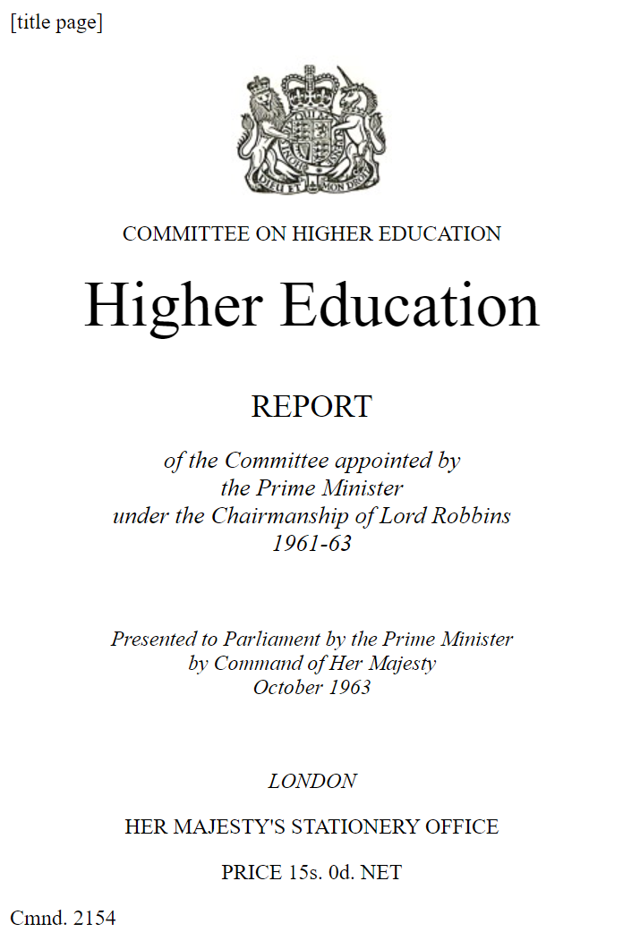
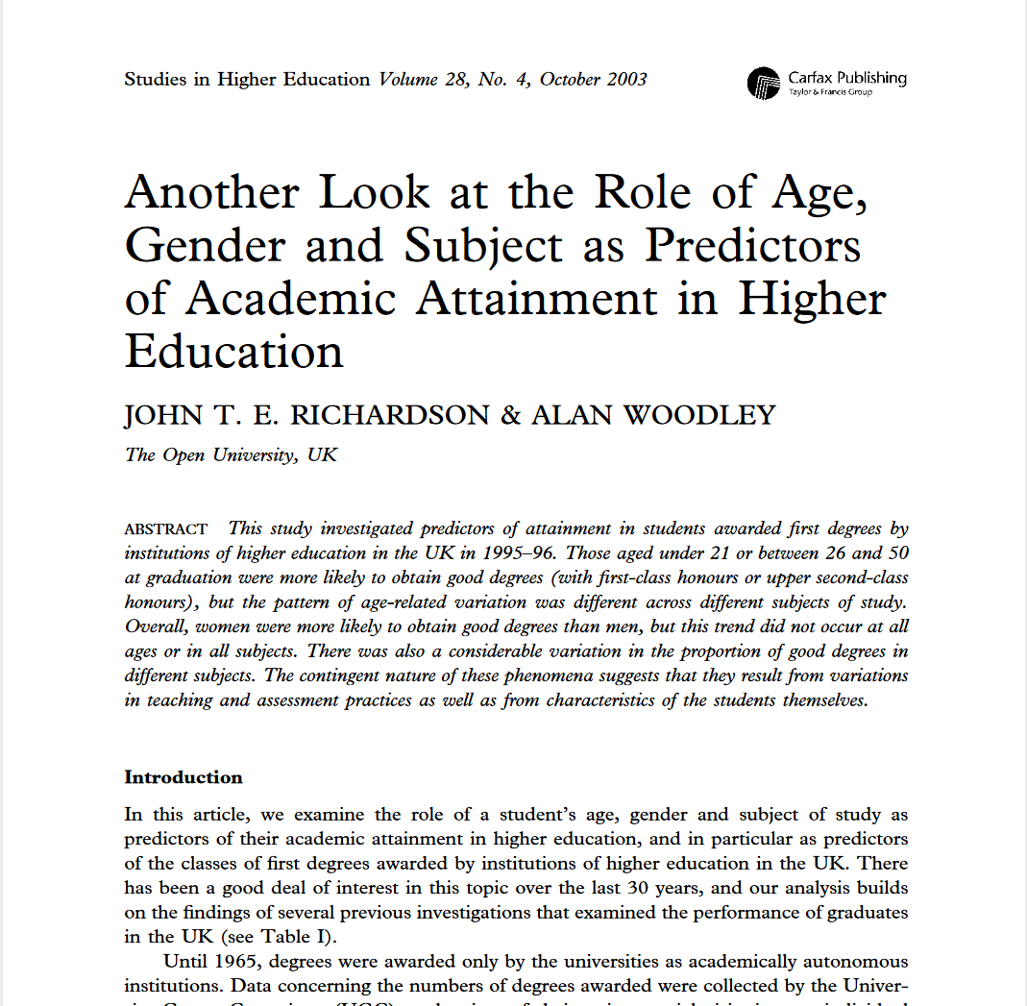
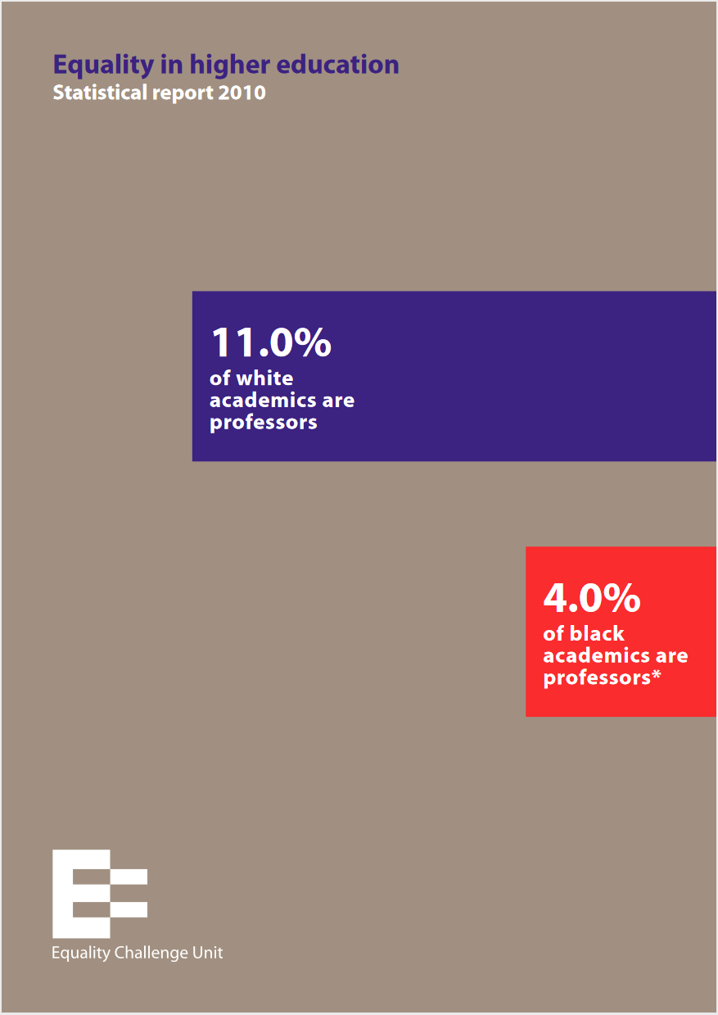
General UK HE literature on degree outcomes
Still gender focused until 1993,
The Robbins Report 1964
Cohort of 6,000 students.
Rudd (1984)
Used national data tables.
1994 onwards (HESA established)
  Richardson papers: age, gender, ethnicity, and disability
  Statistical reports (e.g. Brooke Nicholls) & regression analyses (see Richardson (2020) for examples)
2010 onwards
  Yearly equality reports by the Equality Challenge Unit (later Advance HE)

Slide 10
Gender Bias in UK Degree Classifications
Literature Review
Datapoints adapted from Richardson (2008) and Advance HE (2017, 2020)

Slide 11

An Analysis of Recent Data (2012/13-2018/19)
Methods: Data Source
Advance HE (Advance HE, 2014-2020)
  Data open access to member universities
Awarding gaps for graduates covering:
  Age
  Disability
  Ethnicity
  Gender
Awarding gaps broken down by subject area and SET/Non-SET
  SET – Science, Engineering & Tech. Subjs.
  Non-SET – Non SET

Slide 12
Joint Academic Coding System (JACS)
Methods: Data Source
Physical Sciences
  Broadly-based programmes within physical sciences
  Chemistry
  Materials science
  Physics (~24%)*
  Forensic & archaeological sciences
  Astronomy (~3%)*
  Geology
  Science of aquatic & terrestrial environments
  Physical geographical sciences
  Others in physical sciences
Subject area
Principle subjects
*Based on data from the HESA website for 2018/19

Slide 13
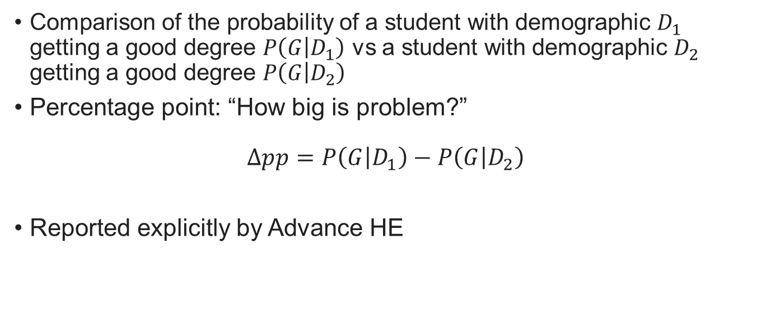
Measures
Methods
Comparison of the probability of a student with demographic $D_{1}$ getting a good degree $P\left(G | D_{1}\right)$ vs a student with demographic $D_{2}$ getting a good degree $P\left(G | D_{2}\right)$
Percentage point: “How big is problem?”
$$Δpp=P\left(G | D_{1}\right)−P\left(G | D_{2}\right)$$
Reported explicitly by Advance HE

Slide 14
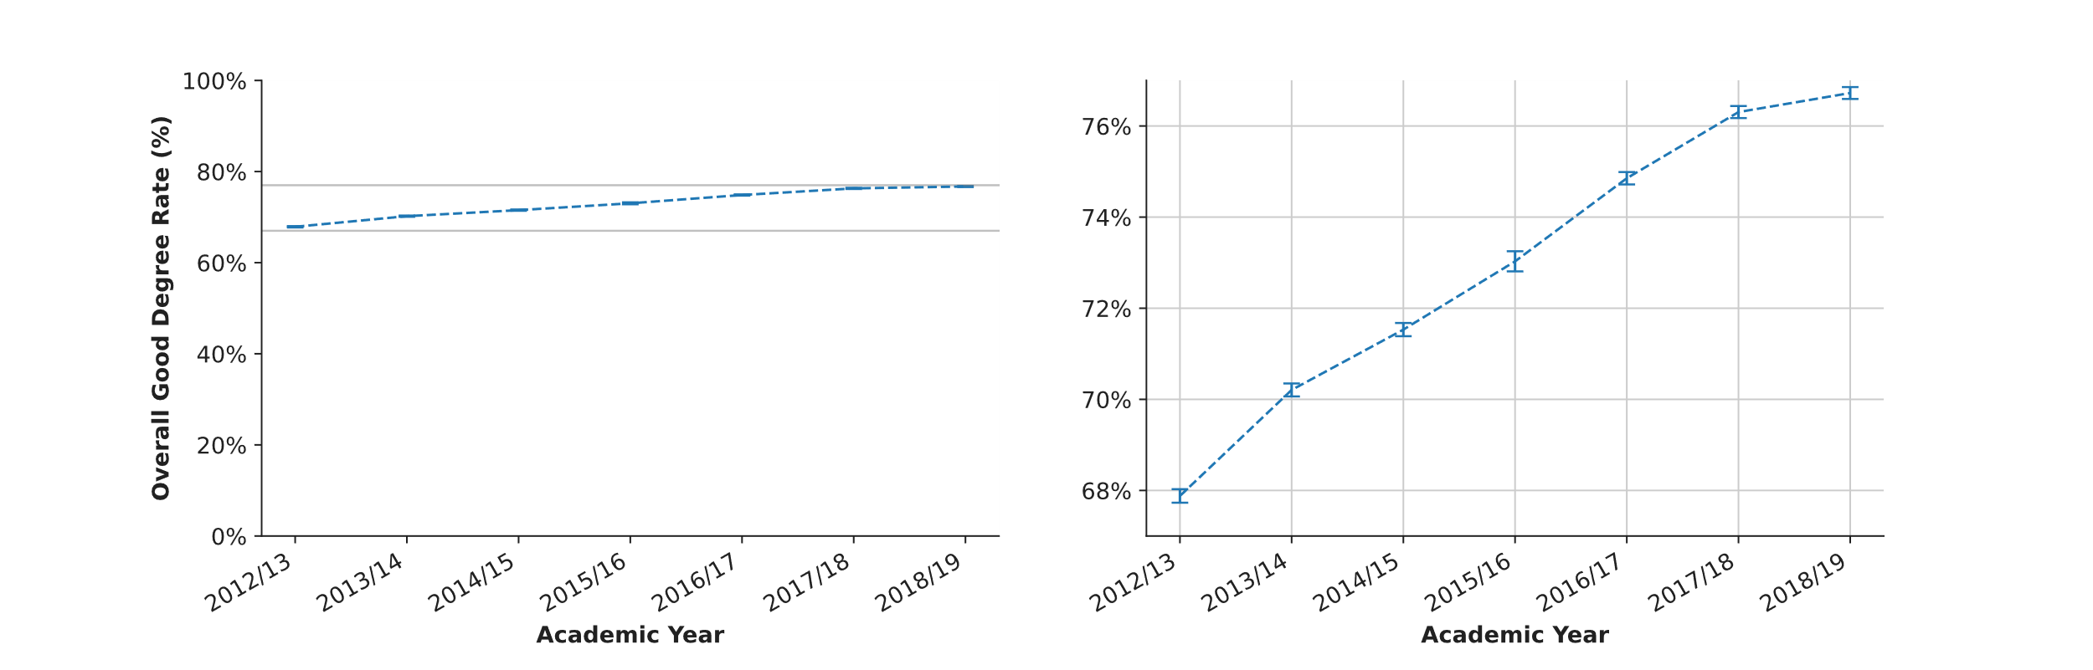
Grade Inflation (2012/13 to 2018/19)
3. Methods: Measures
Percentage of all students obtaining a good degree, by academic year
Error bars represent a 95% confidence interval.

Slide 15
Grade Inflation (2012/13 to 2018/19)
3. Methods: Measures
Percentage of all students obtaining a good degree, by academic year
8.8% p.p.
7 year period
Error bars represent a 95% confidence interval.

Slide 16
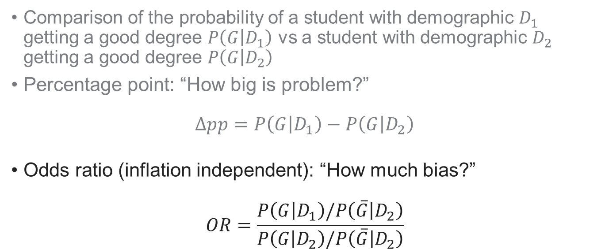
Measures
Methods
Comparison of the probability of a student with demographic $D_{1}$ getting a good degree $P\left(G | D_{1}\right)$ vs a student with demographic $D_{2}$ getting a good degree $P\left(G | D_{2}\right)$
Percentage point: “How big is problem?”
$$Δpp=P\left(G | D_{1}\right)−P\left(G | D_{2}\right)$$
Odds ratio (inflation independent): “How much bias?”
$$OR=\frac{P\left(G | D_{1}\right)/P\left(\overline{G} | D_{2}\right)}{P\left(G | D_{2}\right)/P\left(\overline{G} | D_{2}\right)}$$

Slide 17
Error Analysis
Methods
statsmodels (Seabold & Perktold, 2010) implementation of:
  Wilson confidence interval for proportions (as recommended by Brown, Cai and DasGupta, 2001)
  Newcome score percentage difference ~ Pearson Chi Squared Test (Agresti, 2000)
  Gart interval for odds ratio confidence intervals (see Agresti 1999 for discussion)
Key Limitation: Overdispersion
  All of the above depend on a binomial/multinomial model of student success. Very unlikely to be the case (e.g. Dean and Lundy, 2014)
  True confidence interval likely to be larger.

Slide 18
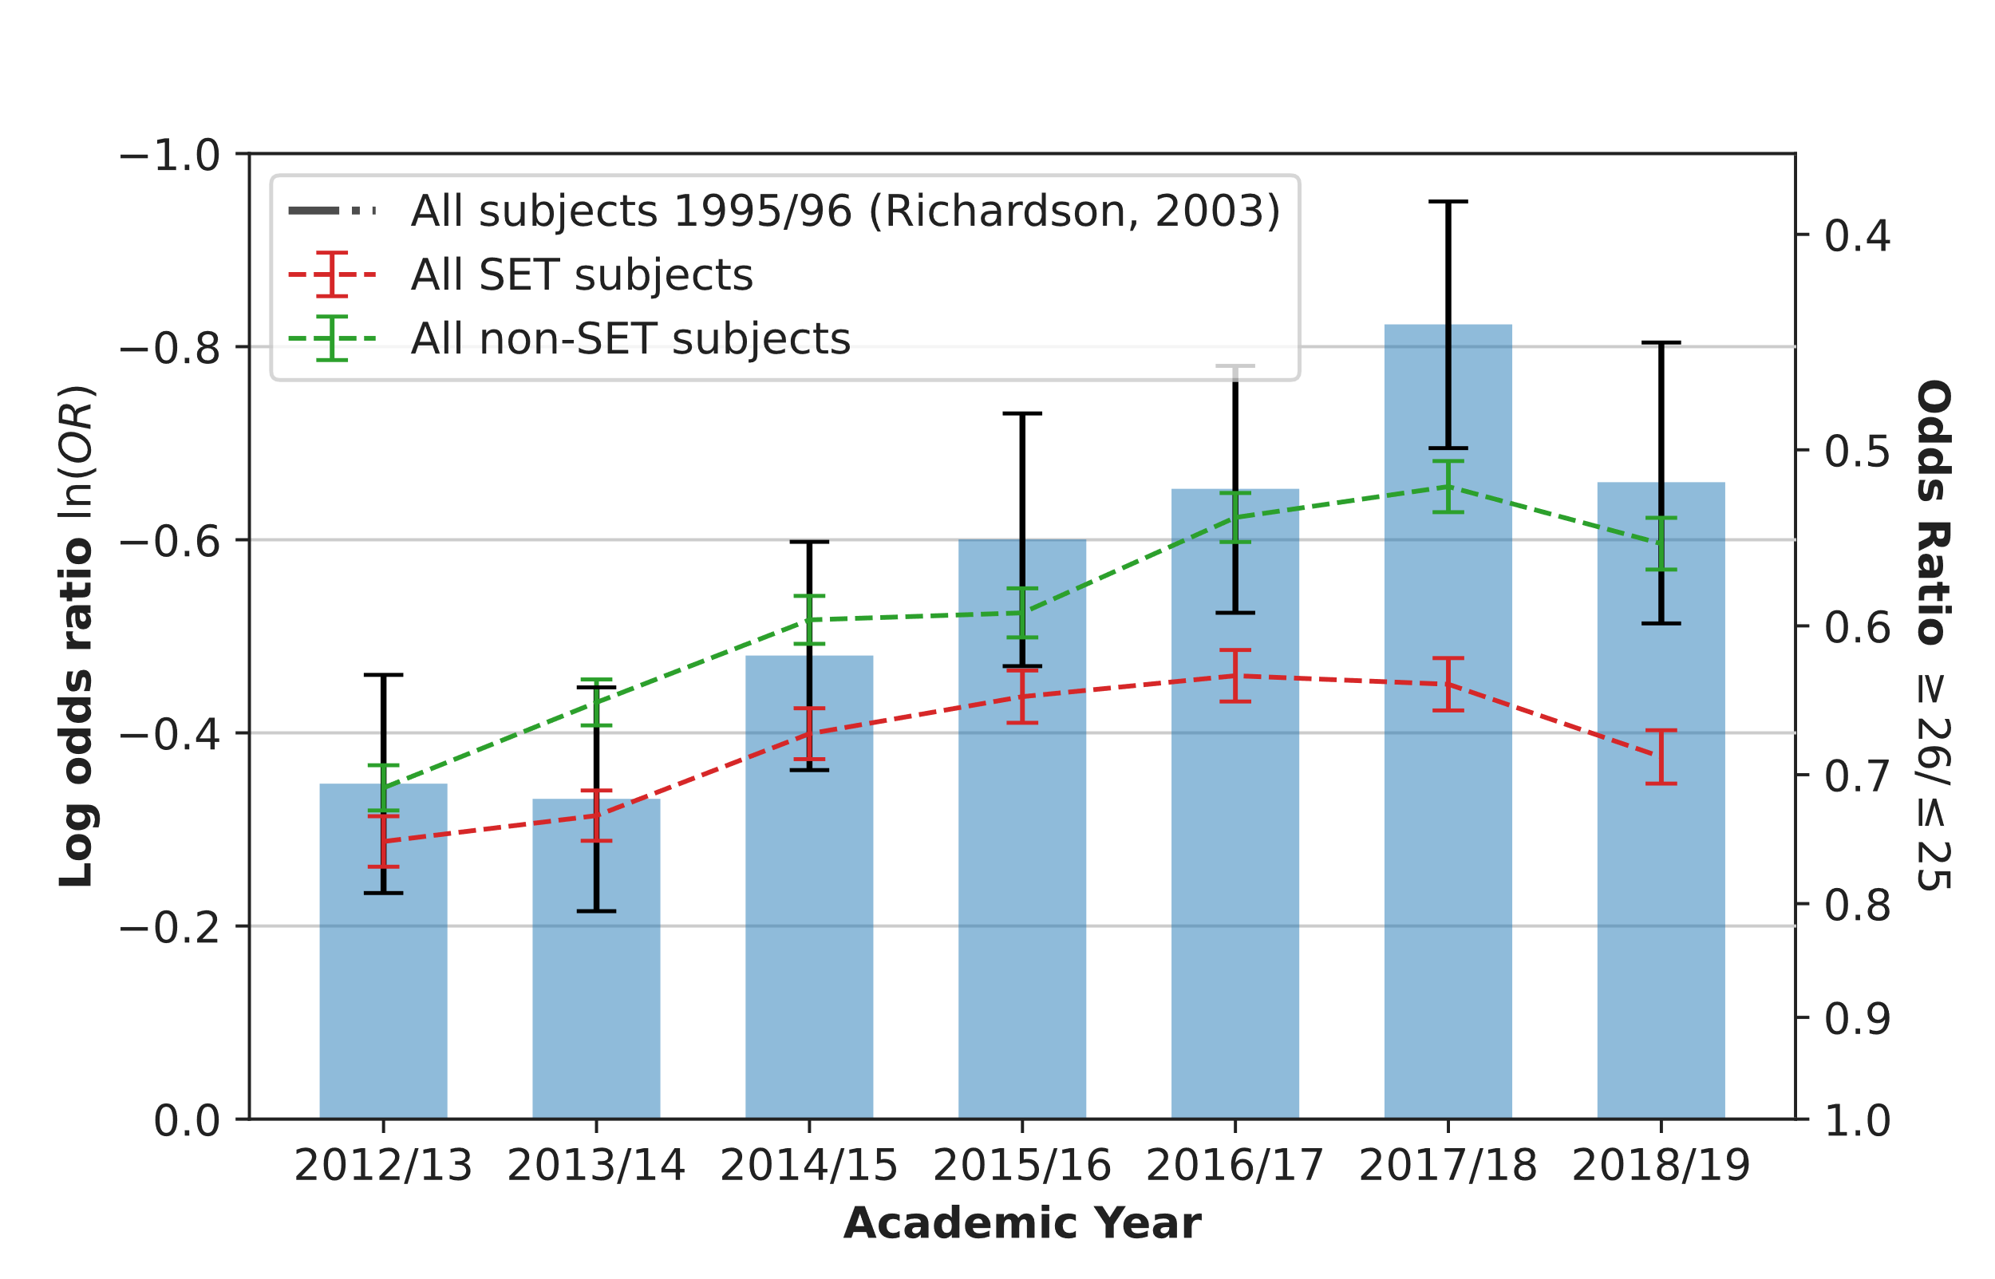
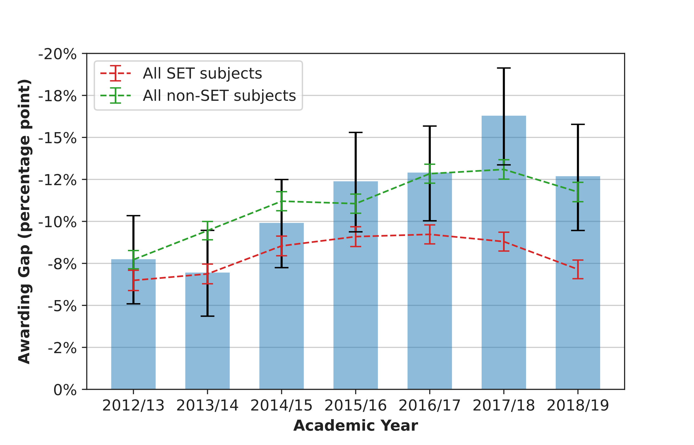
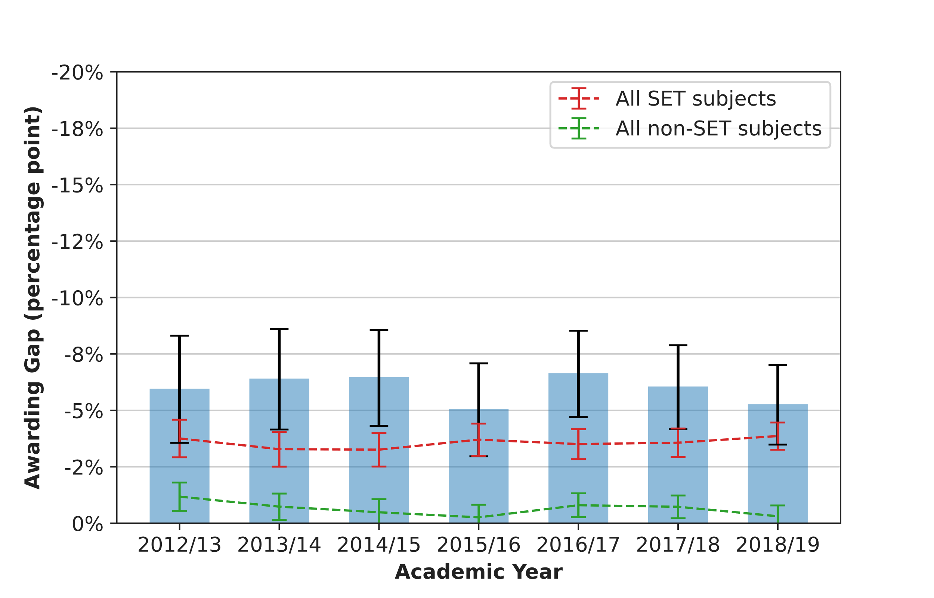
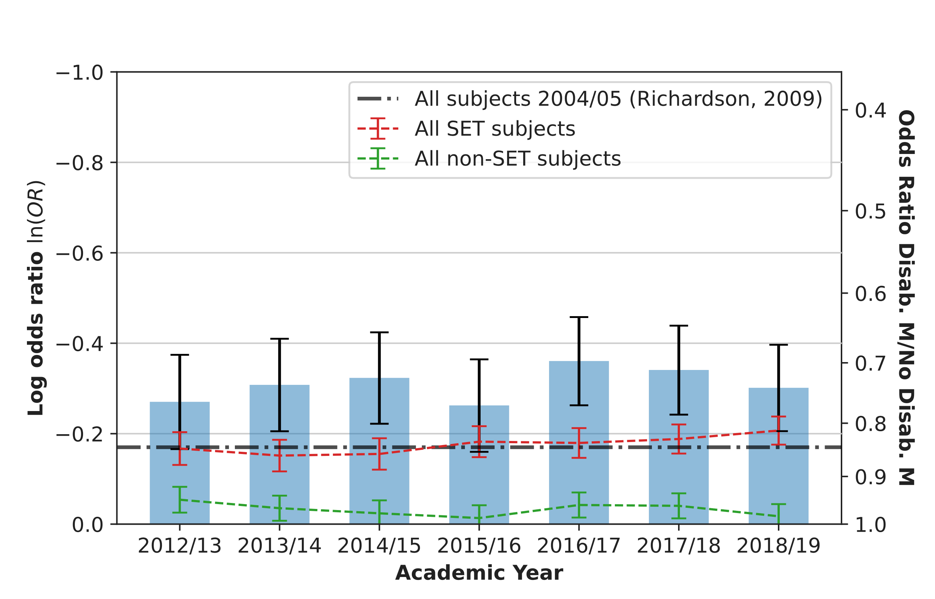
Age and Disability
Results
Awarding gaps for graduates aged 26+ vs graduates 25 and under
Age
  Growing gap between mature graduates (26+) and those under 25
  Age gaps does not match historic results of ln(OR) = 0.16 (Richardson, 2003)
Disability
  Stable gap between students with a disability marker vs those without
  Disability gaps in SET subjects matches historic results (Richardson, 2009)
Awarding gaps for graduates with a disability marker vs graduations without
Error bars represent a 95% confidence interval.

Slide 19
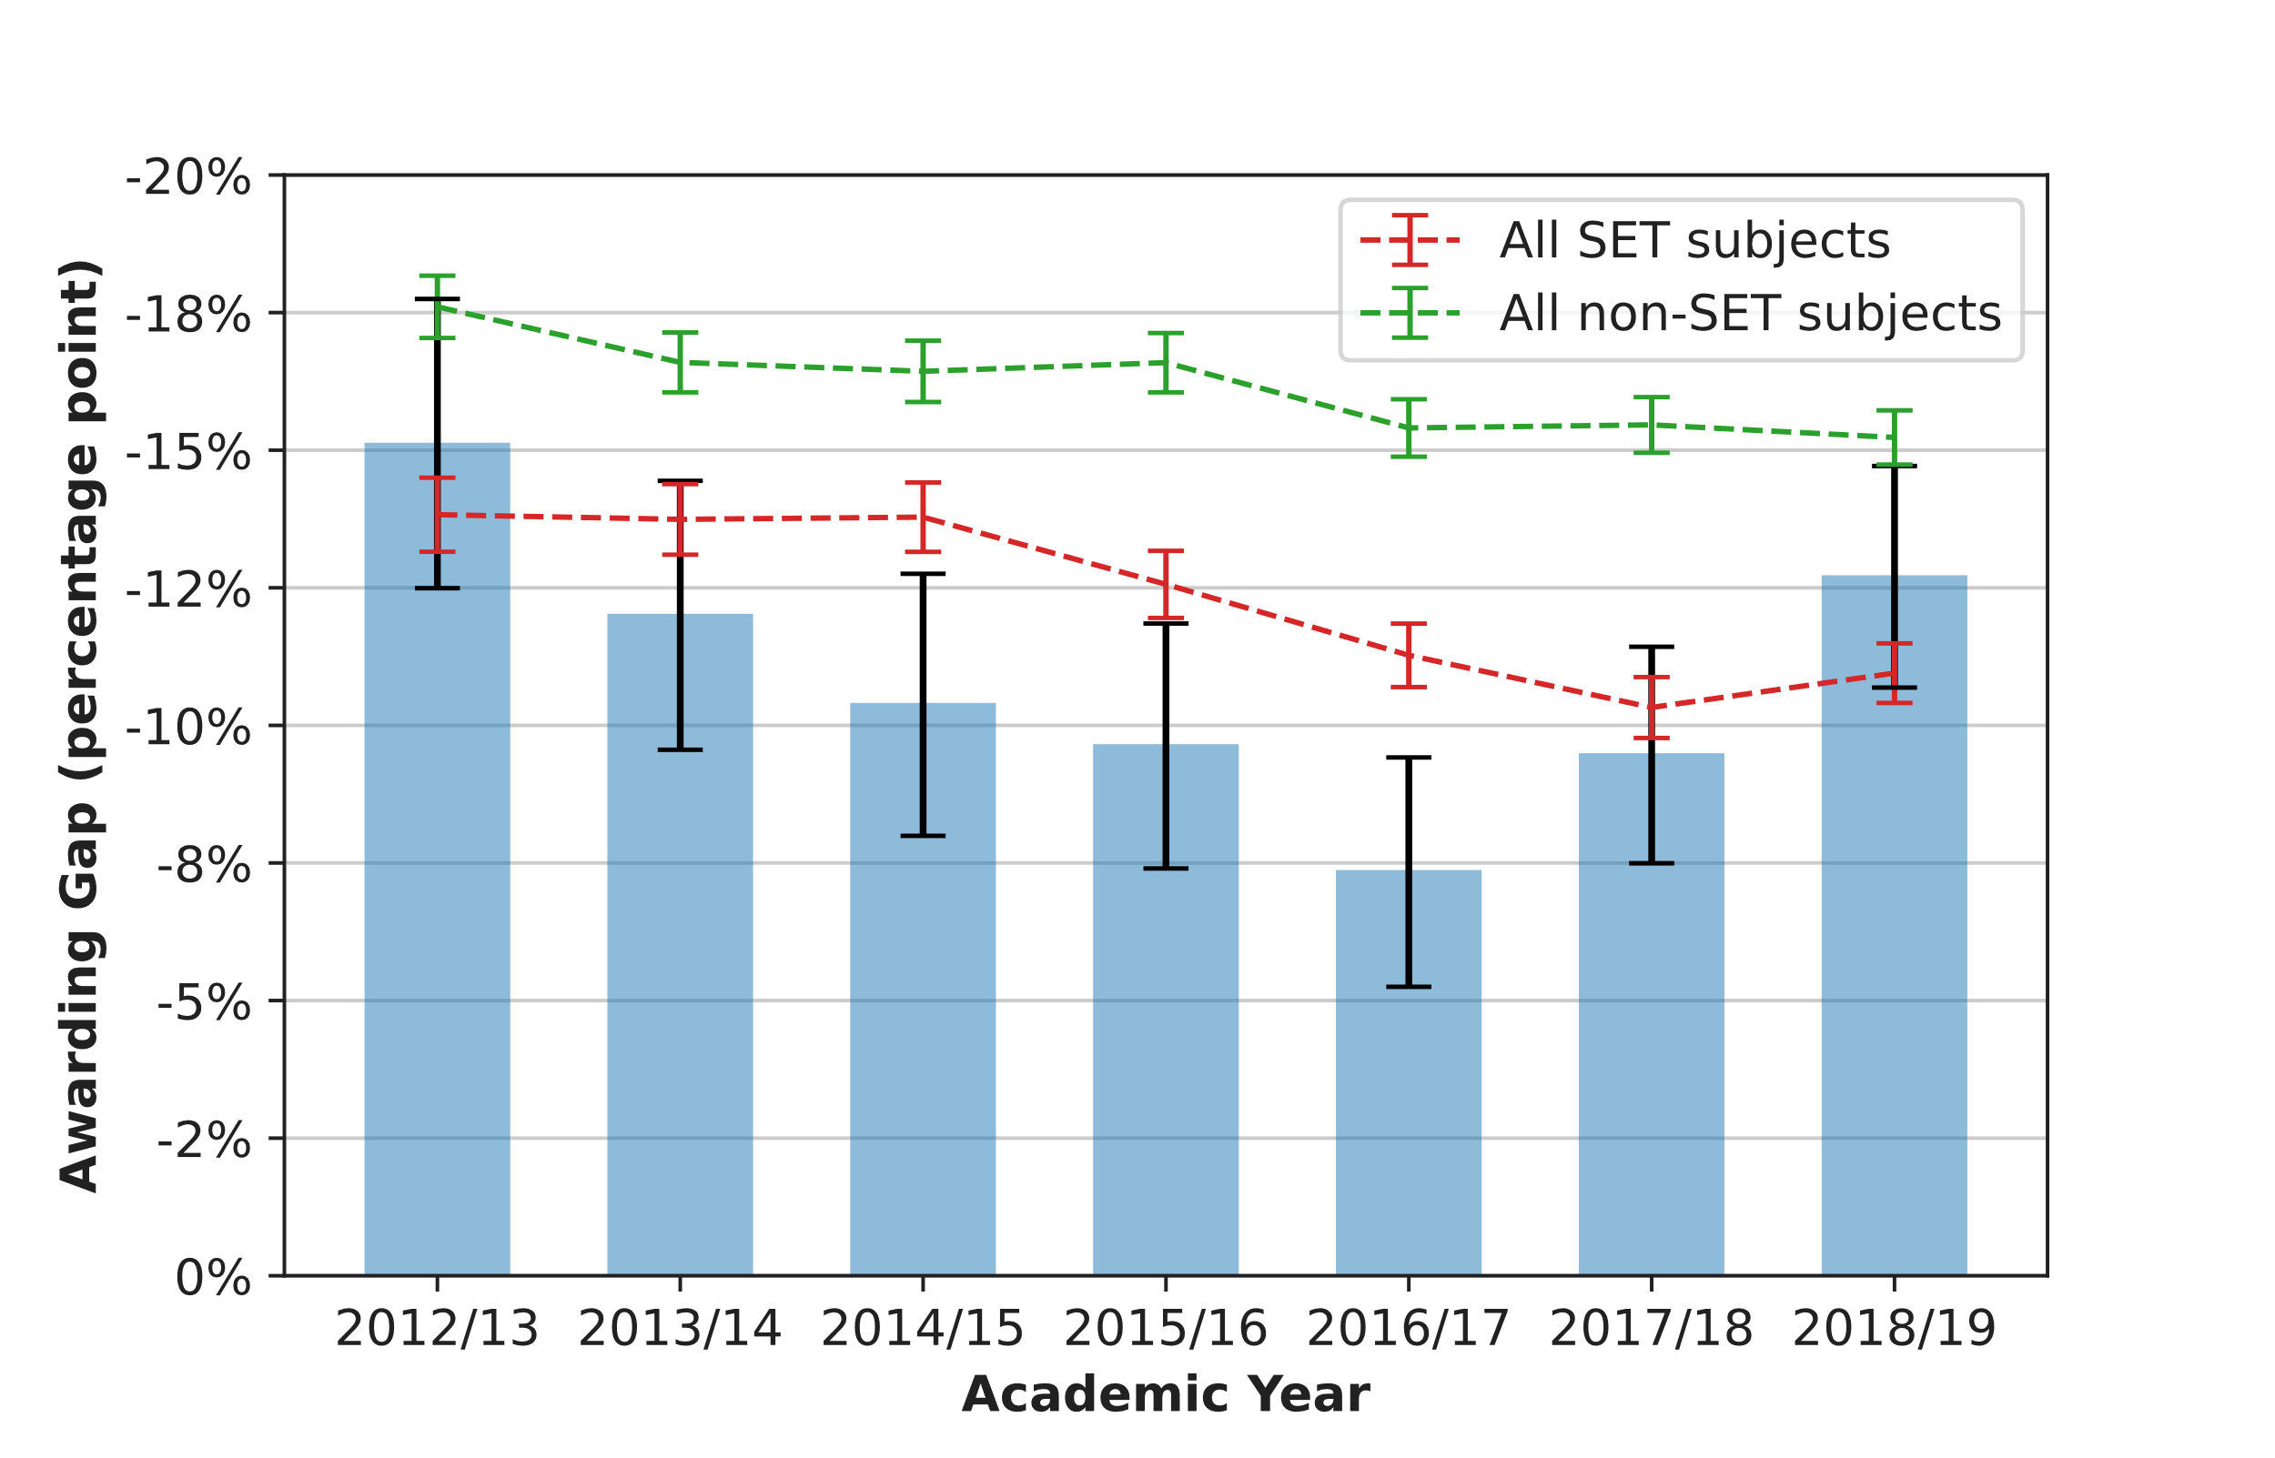
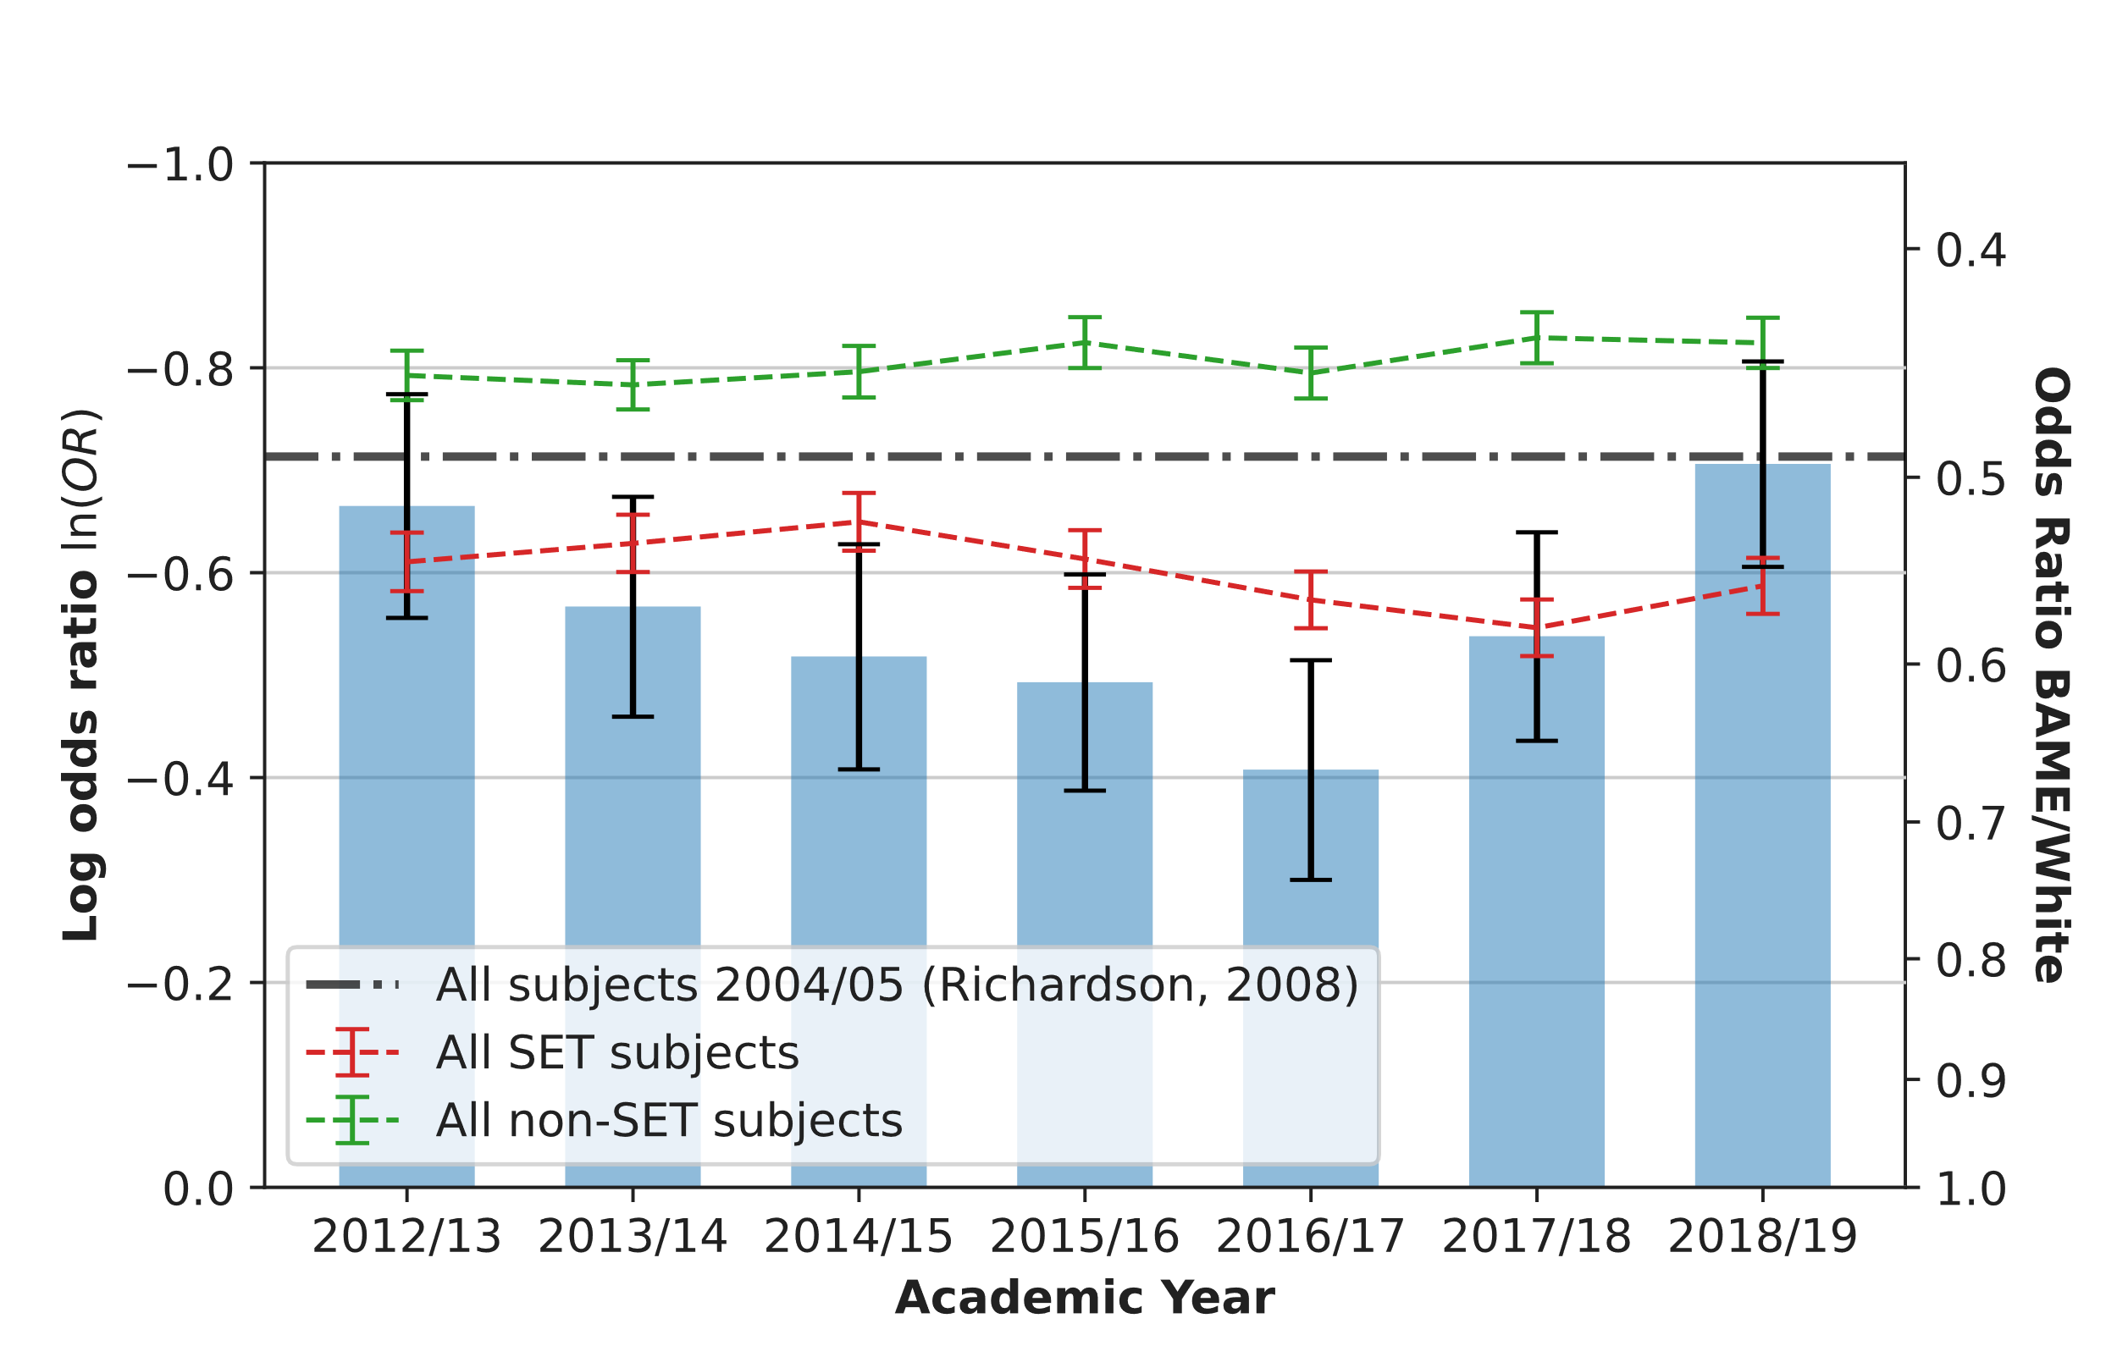
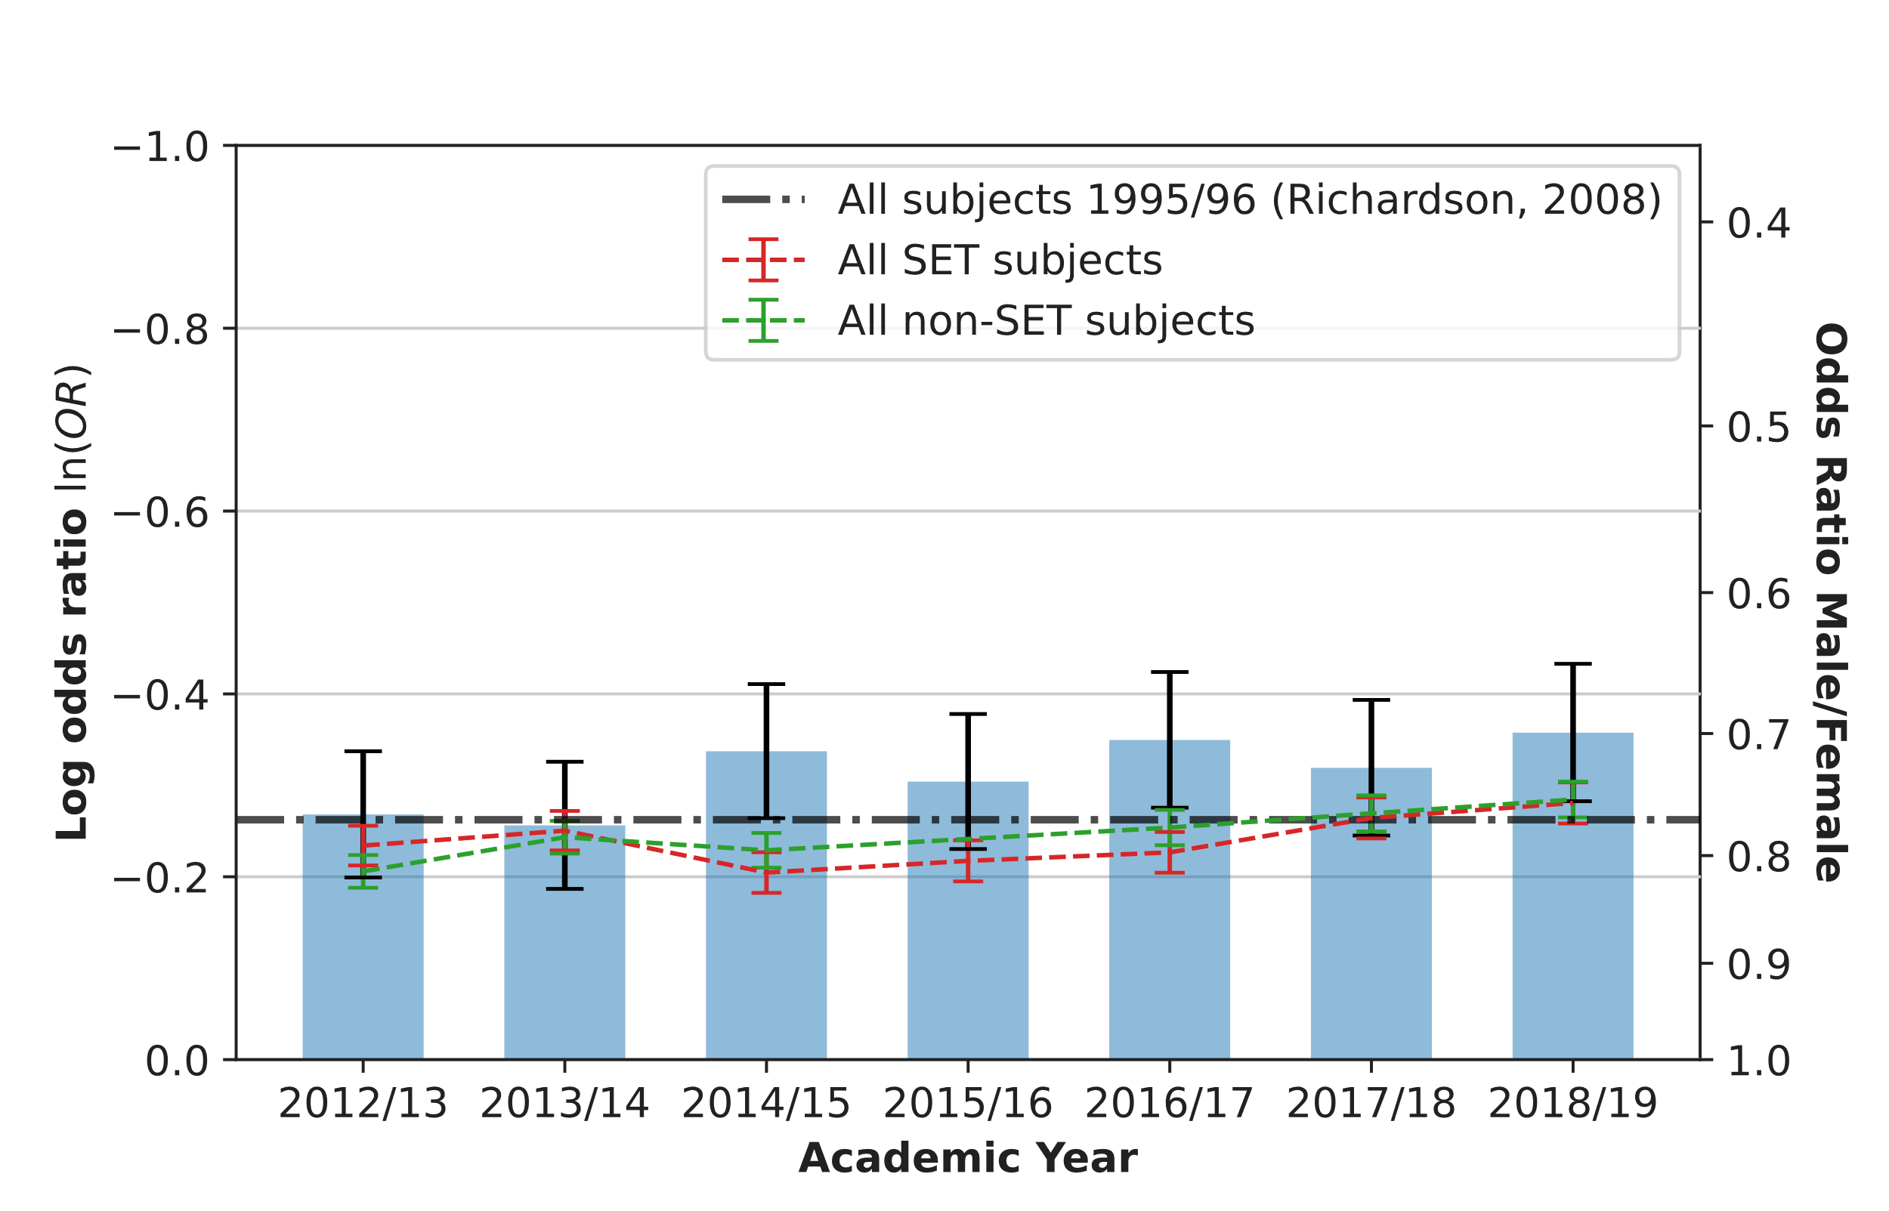
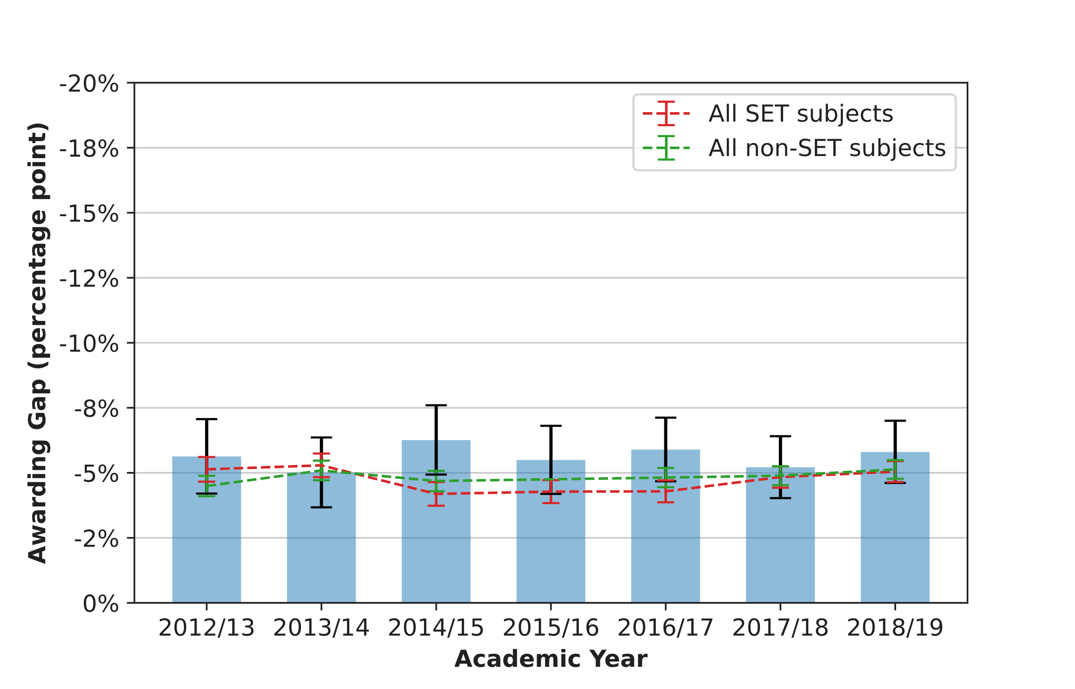
Ethnicity and Gender
Results
Awarding gaps for BAME graduates vs White graduates (UK domicile)
Ethnicity
  Highly variable ethnicity gap in physical sciences, but stable gap in other subjects
  Results consistent with Richardson(2008)
  IOP Comparison: (IOP, 2006) Suggests substantial ethnicity gaps in physics.
Gender
  Consistent gap in favour of women, & historically supported (Richardson, 2008).
  IOP Comparison: (e.g. IOP, 2019, 2012) suggest small gender gaps ~ < 1-2% substantial gap in BSc programmes.
Awarding gaps for male graduates vs female graduates
Error bars represent a 95% confidence interval.

Slide 20
What do we know?
Discussion
PER literature
  Gaps in concept inventories
  Heterogenous course gaps wrt. gender.
UK PER literature on degree outcomes
  Small national gender gaps, larger ethnicity gaps
Physical Sciences Data
  Small but significant national gender and disability gaps
  Large demographic gap for ethnic minority students
  Large demographic gap for mature students
  (Notably, this is not reported by Advance HE because the canonical comparison is students 21 and under on graduation, vs everyone else. Underestimates gap due to enhanced undergraduate courses.)

Slide 21
Limitations: Do we actually know what the gaps are?
Discussion
Simpsons Paradox
  National gaps do not necessitate course level gaps (p 50, Agretsi, 2013)
Overdispersion
  Student’s likelihood of success isn’t (bi/multi)nomially distributed (e.g. different courses, A-level grades, etc.) (p 7, Agretsi, 2013)
Correlation vs Causation/Confirmation Bias
  Demographic characteristics are culturally relevant may have no causal impact. (e.g. Walsh et al., 2020) “Gap-Gazing” (Gutiérrez, 2008).
Intersectionality
  Demographics can have interactive effects (Crenshaw, 1989), statistical approaches that account for this are needed (Richardson et al., 2020)

Slide 22
Next Steps: What’s needed?
Discussion
A robust multivariate, categorical, statistical analysis:
  A course level analysis that includes students leaving without qualifying
  Alternatives to multinomial based statistical tests and models
  Causal modelling and inclusion of non-demographic variables in the analysis
  Use models that allow for interaction effects between variables

Slide 23
Moving forward
Discussion
Perform an intersectional, course level analysis of demographic gaps on in UK undergraduate physics courses.
Procure a large, broad, Tailored Dataset from HESA (Short term)
  Scope: All students studying first degrees between 2012/13 to 2019/20, many variables.
  Progress: finalising the specification with HESA/Jisc
Carry out four statistical analyses (Mid term)
  Uncontrolled demographic gaps analysis
  Identify general factors: e.g. correlation between characteristics, institution factors, course format, etc.
  Identify physics specific factors (by comparing to other courses)
  Identify within physics factors (by looking at module drop out rates)
Further investigation into the role of assessment (Long term)
  Use results from C and D identify research directions. Possibly procuring focused datasets.
  Estimate size of bias due to differences in assessment measure

Slide 24
Three Key Takeaways
Summary
There are observable demographic gaps in physical sciences
A complex statistical question: we can’t be sure of the gaps in physics, or on a individual courses.
These gaps can and do change drastically with time: most notably the gaps across age and gender!
Contact email: arran.stirton@open.ac.uk

Slide 25
Endmatter

Slide 26
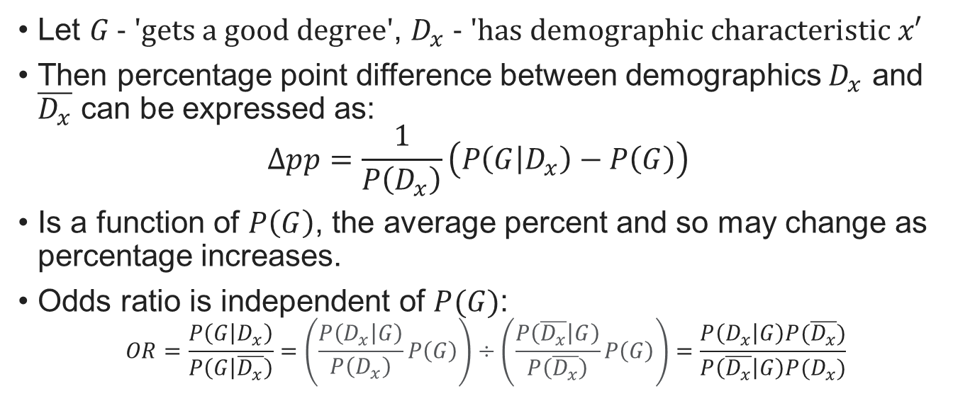
Appendix A: Grade inflation
Let $G\text{ − ′}\text{gets} \text{a} \text{good} \text{degree}\text{′}$, $D_{x} \text{− ′}\text{has} \text{demographic} \text{characteristic} x\text{′}$
Then percentage point difference between demographics $D_{x}$ and $\overline{D_{x}}$ can be expressed as:
$Δpp=\frac{1}{P\left(D_{x}\right)}\left(P\left(G | D_{x}\right)−P\left(G\right)\right)$
Is a function of $P\left(G\right)$, the average percent and so may change as percentage increases.
Odds ratio is independent of $P(G)$:
$$OR=\frac{P\left(G | D_{x}\right)}{P\left(G | \overline{D_{x}}\right)}=\left(\frac{P\left(D_{x} | G\right)}{P\left(D_{x}\right)}P\left(G\right)\right)÷\left(\frac{P\left(\overline{D_{x}} | G\right)}{P\left(\overline{D_{x}}\right)}P\left(G\right)\right)=\frac{P\left(D_{x} | G\right)P(\overline{D_{x}})}{P\left(\overline{D_{x}} | G\right)P(D_{x})}$$

