Slide 1
Practitioner examples of improving accessibility in online tuition
Horizons in STEM, 30 June 2021
Rachel Slater, Anne Campbell, Elaine McPherson, Christine Pearson

Slide 2

Plan for the session
Project aims
What do we mean by accessibility?
Data collection and analysis
Common adjustments
Tailored approaches
Next steps

Slide 3
Project aims and the project team
Main aims
Gather examples of how OU tutors (Associate Lecturers) adapt their tuition to respond to disabled students’ needs
Share common and more tailored approaches with OU tutors to help support accessibility in their tuition
Develop awareness and understanding of accessibility issues in tuition within the OU and across the sector
Project team
Core team Rachel Slater, Anne Campbell, Elaine McPherson, Christine Pearson
Advisors Vic Pearson, Jo Buxton, Kate Lister
Consultant Patrick Murphy
Notes:
I have moved Christine from advisor to core team – is that ok?

Slide 4
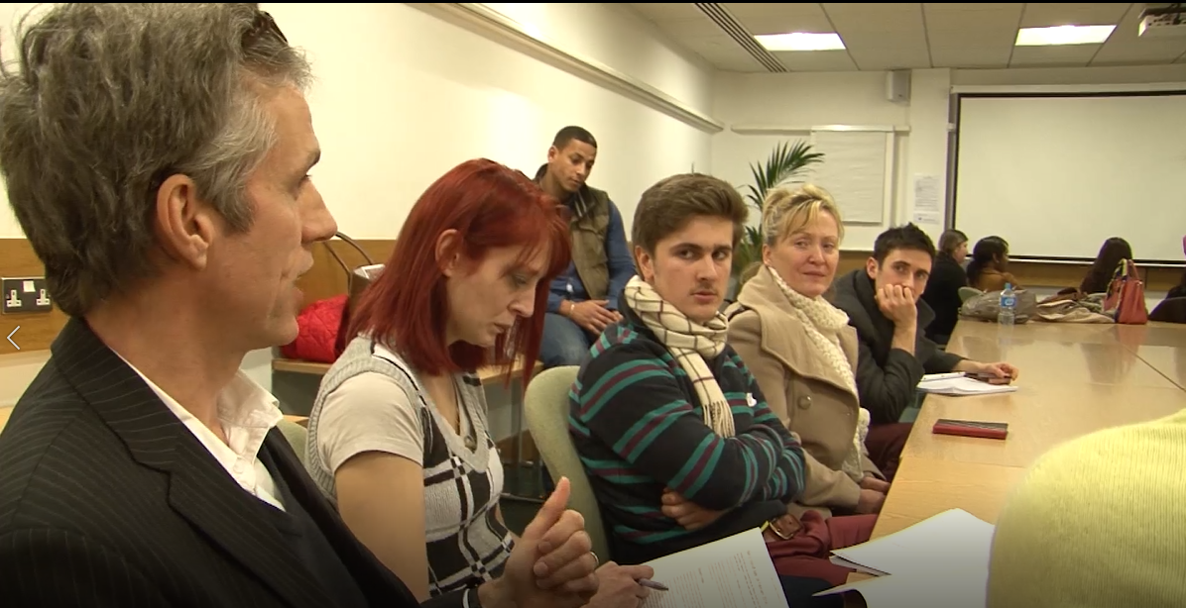
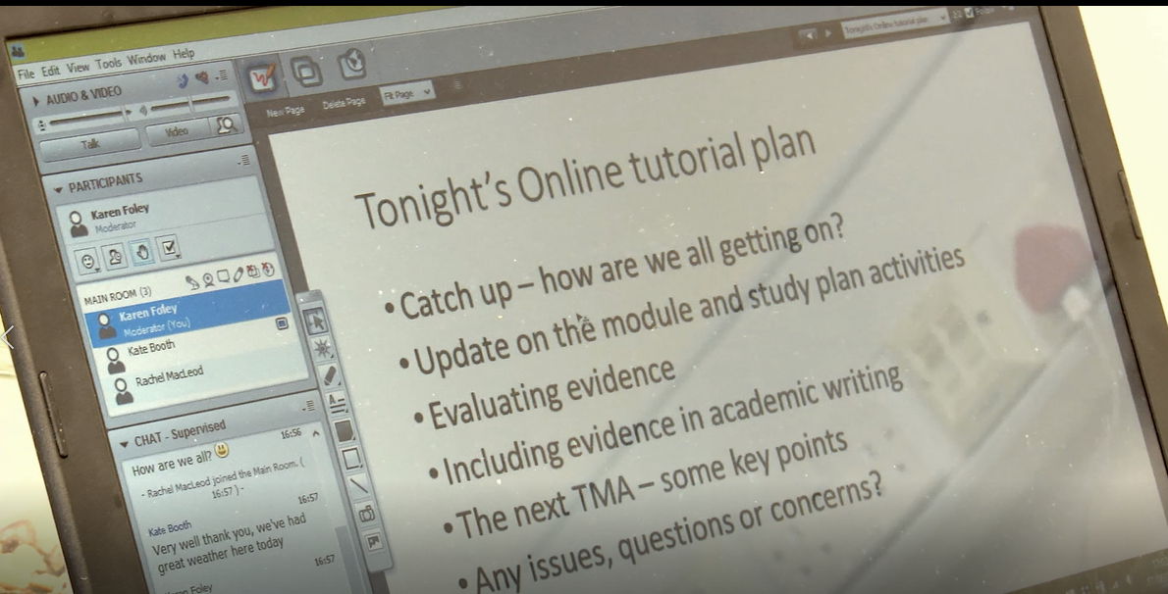
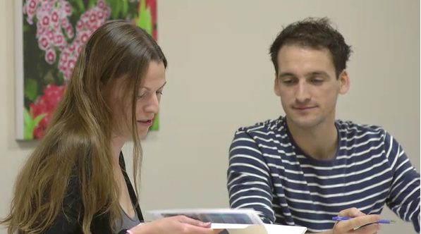
A note on terminology
Tuition
Any practices within the control of an OU tutor to support their students
Accessibility
Disability, long-term health condition, specific learning difficulty (eg dyslexia), mental health issue, anxiety – whether declared or not, and can change over time
Notes:
Important to note that accessibility is much wider than declared disabilities.
Could be an illness or other health condition, can be temporary or longer-term, can change over time
To be truly inclusive we wouldn’t need to provide adjustments – to me its more of a spectrum – materials should be fully inclusive wherever possible – but always likely that some students will need extra support

Slide 5
The OU model of supported open learning
Student Support Services
Peers
Student
TUTOR
Programme Level Support
Module
Notes:
Shows the different elements that go into supporting students
Something here about the tutor’s role within the OU – different from other institutions – very supportive role, aspects similar to a personal tutor or academic advisor in other institutions but not meant to be a personal tutor. Marking and tuition but often ends up anticipating and supporting student needs. Mention Staff Tutors
Tutor are not lecturers (not meant to be anyway!)
Feedback and feedforward on assignments
Optional tutorials – all currently online, held in online synchronous software (Adobe Connect)
Tuition/facilitation in forums
Available by phone/email/forum + some social media
Important to note these elements are connected, for example, Student support may work with tutors directly, and the module team will work with the programme as well as tutors and student services. Tutors line managed by staff tutors who liaise between students/tutors and module support services.

Slide 6
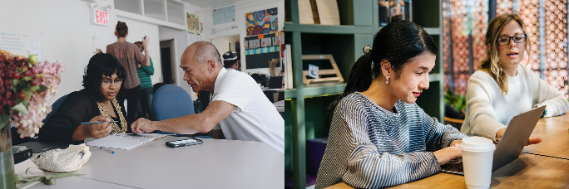
Number of students declaring a disability at the OU
Proportion of students in the OU declaring a disability has increased year on year since 2010/11
In 19/20, 31000 students or 17.5% had a declared disability
Not all students declare so true figure is higher
Notes:
We have to be careful on numbers – because other countries do not have same way of counting as us and may not include all the disabilities that we do

Slide 7
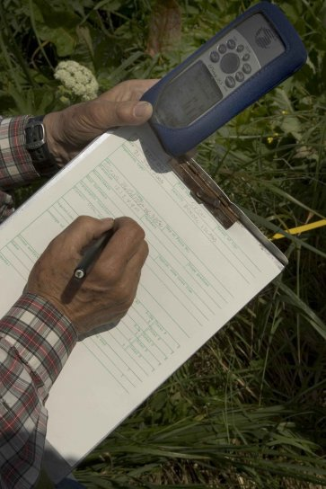
Method and data collection
Measuring accessibility practices and perceptions survey (MAPP 2019)
‘I have adapted my tuition practice to respond to a disabled student's need’
ALL: 292 responses, 85% agreed, 212 examples
STEM: ≈ 100 responses, 84% agreed, 71 examples
24 STEM tutors interviewed (mainly Level 1), one Educational advisor from student support
Photo by Hillebrand Steve, U.S. Fish and Wildlife Service
https://pixnio.com/science/data-collection-writting-data-on-paper
Interviews transcribed
Found common approaches and more tailored approaches
Interviewees not fully representative of STEM
(Engineering least-well represented)

Slide 8
Common Approaches

Slide 9
Consider the format of documents
Type face
Large font
Avoid italics
Colour background and colour contrast
Marking PDFs - feedback in document suitable for screen readers
Diagram descriptions covering the main learning points
Ideally create documents that students can easily change the format themselves, e.g. using ‘styles’ in Word
Notes:
These show the main formats referred to in the survey and interviews – there will be others. Word and PowerPoint
The extent to which all these points considered by tutors us likely to vary – will be very familiar to some tutors, less so by others
Our project doesn’t focus on the ‘how’ to make these changes, but we do have some useful links we will share at the end, and further work is needed to provide more comprehensive ‘how to’ guidance.
Colour background and contrast – would the type be readable by someone with different colour vision from you? You need a strong difference in tone as well as colour.
Diagram descriptions – not about a description of every point on a graph, but rather the description should cover the main learning points

Slide 10
Preparation / support for tutorials
Opportunity for 1:1 run through before tutorial and talk through issues afterwards
Materials may be provided in advance (slides and/or notes on the main points the tutor will make)
Reassure anxious students – ok to be silent
Polls instead of chat for student feedback
Pacing
Webcam for lipreaders
Keep familiar layout in online room
Notes:
Materials in advance can be very helpful, especially for students that may need longer to read text.
However, it is a balance between what's planned in advance and where the dialogue may go with questions in the session!
Another tip – if there are main points you plan to say not covered in the slides – have them in a word doc so you can cut and paste in the chat if you have deaf or hard or hearing students.
Chat box compounds the problem with reading time for some students, and they may be unable to focus on both the slide and the chat - read out any questions from the chat before answering
Many students anxious about tutorials – some feel this precludes them from attending – example of a tutor doing a one to one tutorials to build confidence, then encouraged attendance as a 'lurker' - steppingstone to fuller participation.
Reassure that they wont be asked questions or drawn attention to, can leave at any time etc
Polls are anonymous and can often get more students responding if anonymous compared to asking students to answer questions in the chat box

Slide 11
Preparation / support for independent study
Run throughs of module activities, e.g. ‘how to’ graphs, software, labs
Time management – must do and desirables, extensions
Consider the feedback style
  Key points
  Direct language
Additional communication
  Often telephone / email
  Set time for email exchange (email ‘ping-pong’)
  1:1 online room
Notes:
May need to tailor your feedback style to the student – anxious students may be overwhelmed by too much feedback - keep to the key points
Some students benefit from very direct language, for example student with autism
Ping-pong emails – set a time with the student for a back and forth email session
1:1 in online rooms can often be more effective then phone (examples given were working through maths problems and equations)

Slide 12
Tailored approaches

Slide 13
More tailored approaches to support
Tutor led materials
  Videos – screencasts – empty room recordings
  ‘how to’ walk throughs – compress files, screenshots, LaTeX and maths notation, drawing graphs, lab work
  written examples to explain concepts or carry out calculations in different ways
  use questions in feedback to invite a dialogue
Develop understanding by developing dialogue – study support approach, whether or not disclosed a disability
Collaboration between support staff important for complex cases
Notes:
More tailored approaches – often initiated to meet the needs of individual students but then might be of wider benefit
Tutor led
Videos – screencasts – empty room recordings – examples given include: to explain key concepts, science concepts, science notation, how to work in pictures rather than text…
there was also ‘media training’ at start – helping to navigate website, set up AC etc.
AC rooms and 1:1 or small group sessions v helpful for walk throughs – often better than speaking over the phone
Study support approach – meeting students’ needs as you see them, not based on assumptions of a label or disability flag - know from the student what will help them, often about taking time to understand the issues and ways to build confidence
Work with staff tutors / SSTs to help better understand the problems and how to resolve them.
Example of student with mental health problems who deferred – but they worked together so student could keep them same tutor

Slide 14
Working together
“we’re working together [Tutor and Advisor], she’s trying to maintain a dialogue with him and so am I…
If he sends an email to the University and it’s not responded to quite quickly, this is when his anxiety actually starts to kick in…
Both of us know the danger is actually when he disengages because that is when he’s likely to go off track…”
Notes:
Serious safeguarding / wellbeing concerns with this student – tutor immediately engaged with staff tutor and education advisors and they have continued to work together to support the student

Slide 15
Anxiety support
“couldn’t bring herself to submit assignments. She was so worried they would be rubbish...
on the first assignment she didn’t submit on the deadline…
I got in touch…she did get back to me and said I just can’t submit this, it is too bad…
I got on the phone and basically held her hand to submit it and she was in tears …it was about just basically me … saying look obviously I haven’t seen your work, but I will be giving you … constructive feedback, it will be how you can get a better score next time…
I basically had to talk her through just pressing that button to submit”
Notes:
Illustrates the importance of maintaining contact, and ramping up contact and picking the phone up when needed, if this interaction had continued by email it may not have had the same outcome or level of reassurance, but it’s a tricky judgement call, some students with anxiety may not feel comfortable speaking on the phone, it could add to their anxiety

Slide 16
Reaching out…
“Hmm, you just get on with it a lot of the time don’t you…
so you would sort of think, well do I send an email?
Do I get in touch?
Do I ring?
Is it appropriate to ring?...
“I was fumbling around in the dark…”
“…when I have a student who clearly has difficulties I will always have a quiet chat with my Staff Tutor”
“A difficult start…I worked with the staff tutor and advisor while we worked out the best way of helping him…”
Notes:
Not always easy to know the best approach.
Can be worried about saying the wrong things
Important to reach out – to staff tutor, to education advisor, to fellow tutors – but not always easy when working at a distance in a large institution!

Slide 17
And finally...
Key messages
Don’t make assumptions, treat all students as individuals and talk to them
Important to reach out
Informal conversations and building trust and confidence
Useful links
How to create accessible PowerPoint presentations | GOV.WALES
Creating accessible documents | GOV.WALES
Microsoft: Make your PowerPoint presentations accessible
WebAIM: PowerPoint Accessibility
Any questions?
Notes:
Important to get to know your students and what works for them, but what do you do if students don’t respond / engage – this came up as an issue and there is no easy answer, but important to try
The importance of reaching out – not just to students but also to advisors, staff tutors and peers – important to be supported and work together especially in complex cases
Useful links – we have some in house guidance and support – but just included ones here that are publicly available
webAIM has lots of useful information, but can be a bit overwhelming, just included the powerpoint link here (note it is not as up to date as the Microsoft link)
Accessibility Check option in Powerpoint now much simpler as it appears in the Review tab
Next steps - planning to develop ‘top tips’ for ALs plus a few more detailed examples of tutor led initiatives.

Slide 18
THANK YOU
CONTACT DETAILS
Rachel Slater rachel.slater@open.ac.uk
Anne Campbell anne.campbell@open.ac.uk
Elaine McPherson elaine.mcpherson@open.ac.uk
Christine Pearson christine.pearson@open.ac.uk

