Slide 1
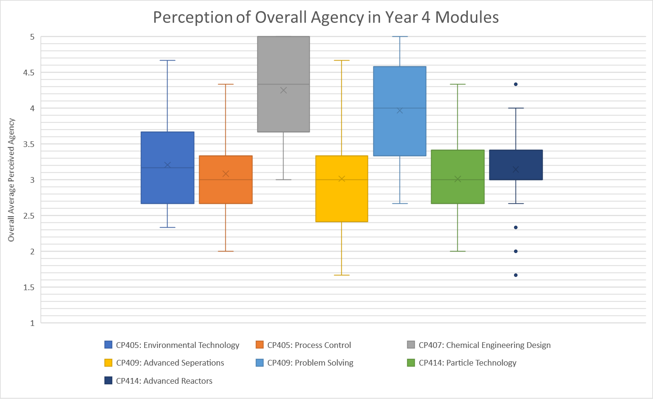

Student agency in chem eng: perceptions, connections, thinking
What is ‘agency’ and why bother?
Methodology
Agency (perception) and learning
How does it help?
Steven Pisani, Conor Teahan, Mark Haw
Chemical and Process Engineering
University of Strathclyde
mark.haw@strath.ac.uk

Slide 2


Student agency in chem eng: What is agency and why bother?
Extent to which a learner has scope to influence their own learning activities…
Extent to which a learner brings their own action to bear on their learning activities…
Emirbayer, M. and Mische, A. (1998). What Is Agency? American Journal of Sociology, 103 (4) 962-102.
Biesta, G. et al. (2008). Learning lives: Learning, identity and agency in the life-course. Teaching and Learning Research briefing, 51, 208.
Vaughn, M. (2020). What is student agency and why is it needed now more than ever? Theory Into Practice, 59(2), 109-118.
Bandura, A. (2001). Social cognitive theory: An agentic perspective. Annual Review of Psychology 52, 1–26.
Kockelman, P. (2007). Agency: The Relation between Meaning, Power, and Knowledge. Current Anthropology 48(3) 375-401.
Pictures: ThisisEngineering RAEng, Austrian National Library and Possessed Photography on Unsplash

Slide 3


Student agency in chem eng: What is agency and why bother?
Extent to which a learner has scope to influence their own learning activities…
Extent to which a learner brings their own action to bear on their learning activities…
Why?
  Life will inevitably involve making decisions, judgements, choices
  Education has a role in helping people learn to cope with these things
  Employers tell us these skills are what they need from graduates (and often what is lacking)
Pictures: Annie Spratt and Science in HD, on Unsplash

Slide 4



Student agency in chem eng: What is agency and why bother?
Extent to which a learner has scope to influence their own learning activities…
Extent to which a learner brings their own action to bear on their learning activities…
Why?
  Ensuring life can continue in the face of climate change will inevitably involve solving big problems
  Creativity, innovation, confidence, judgement all required
Pictures: Alex Belogub, Nikhita S, Andreas Gücklhorn, on Unsplash

Slide 5
Student agency in chem eng: Key questions and concepts
Where in a curriculum do ‘agency opportunities’ appear?
Where and how do students perceive agency opportunities?
How do students respond to agency opportunities?
Conceptual starting point: Margaret Vaughn’s ‘motivational, dispositional and positional’ dimensions of agency
  Motivational: students given ‘targets’ to aim for, obstacles to overcome (eg assessments)
  Dispositional: students given scaffolding on which to build their own understanding
  Positional: opportunity to interact, negotiate, influence others
Vaughn, M. (2020). What is student agency and why is it needed now more than ever? Theory Into Practice, 59(2), 109-118.

Slide 6
Student agency in chem eng: Methodology
Explore where in chemical engineering curriculum students perceive they have agency
Mixed methods:
  questionnaires across whole curriculum/full-time student body (n=60)
  structured interviews with final year MEng (year 5 in Scotland, n=12)
Student-designed research: final year MEng dissertation project(s)
Also looked at links between agency and critical thinking skills; and agency and career decisions

Slide 7
Student agency in chem eng: Agency perception: classes
Explore where in chemical engineering curriculum students perceive they have agency
5.0
Reveals different ‘types’ of class
Agrees with intuitive expectation here: top agency classes are CP407 Design Project and CP409 Problem Solving
Lower-agency perception for more typical ‘lecture-driven’ classes
4.0
Average Likert score (all 3 dimensions)
3.0
2.0
1.0

Slide 8
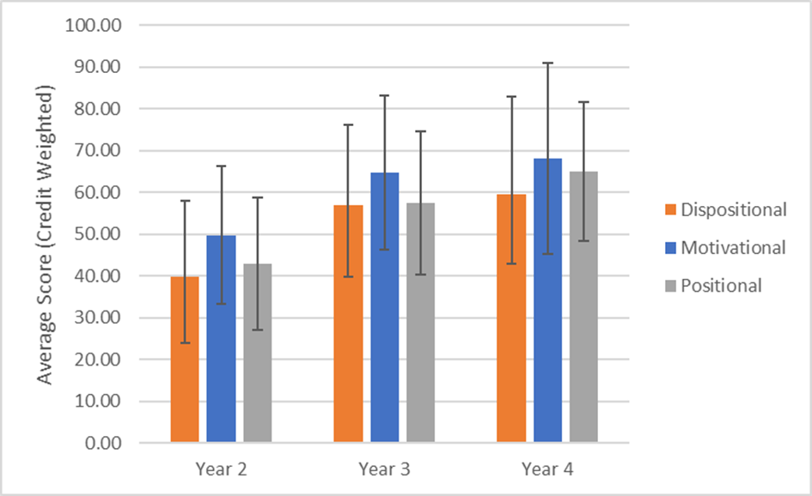
Student agency in chem eng: Agency perception: through course
Explore how students perception of agency builds over time
Now credit-weighted to account for larger components of the course
Trend for increasing sense of agency through course
Tendency for ‘motivational’ aspect of agency to be more strongly perceived

Slide 9
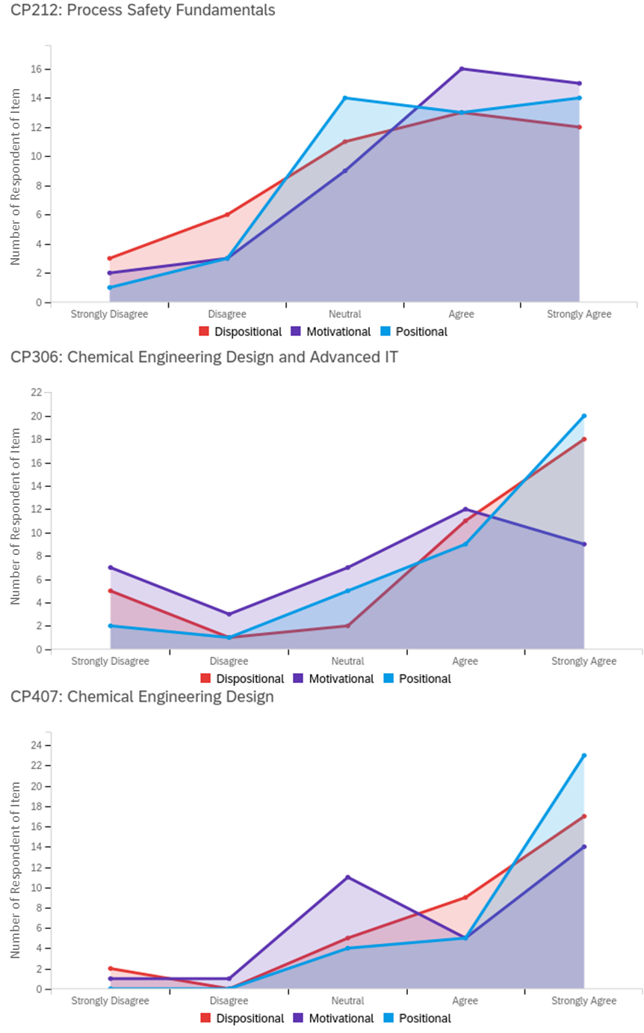
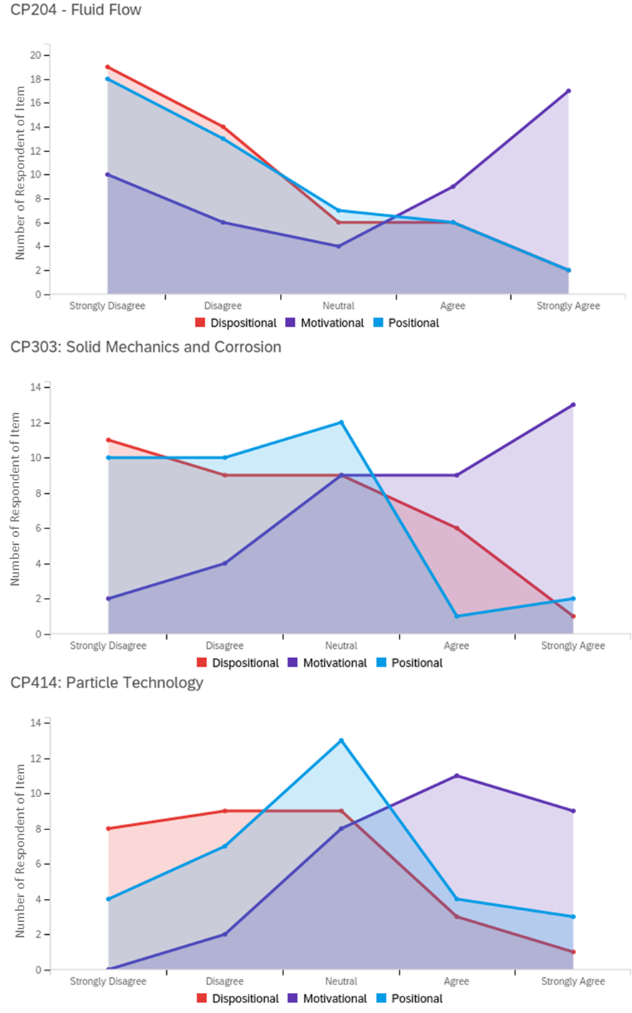
Student agency in chem eng: Dimensions of agency
Process safety
Fluid flow
15
20
Left: 3 ‘highest agency’ classes
Right: 3 ‘lowest agency’ classes
‘Motivational’ aspect always more strongly perceived
Difference is in ‘dispositional’ and ‘positional’
10
5
Number of respondents
Y3 Design/Adv IT
Solid mechanics
20
10
10
5
Y4 Design project
Particle tech
20
10
10
5
Likert: strongly disagree → strongly agree

Slide 10
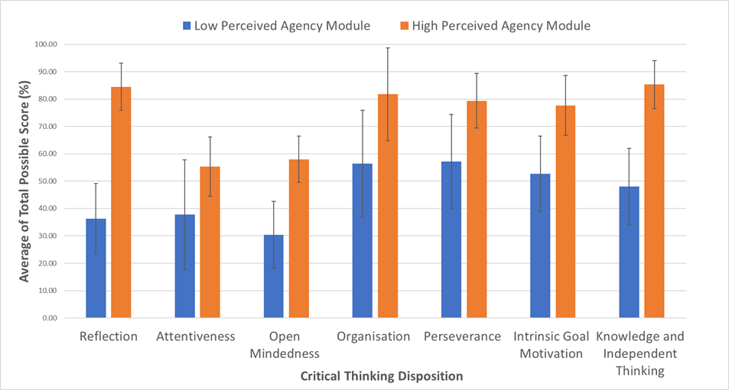
Student agency in chem eng: Critical thinking
Does perceived agency correlate with development of critical thinking?
SENCDTS scale
Students scored development of 7 critical-thinking skills from their ‘lowest agency’ perceived module and from their ‘highest’
High agency particularly correlated with reflection skills…
S. Quinn et al, "Development and Validation of the Student-Educator Negotiated Critical Thinking Dispositions Scale (SENCTDS)," Thinking Skills and Creativity, vol. 38, p. 100710, 2020/12/01/

Slide 11
Student agency in chem eng: So what?
How do we use this emerging picture of the role of agency?
  IChemE accreditation (and many employers’ shopping lists) mainly driven by ‘content’: ability to do calculus, knowledge of heat and mass transfer, recipe for designing a distillation column…
  Should we be thinking just as much about provision of agency opportunities?

Slide 12
Student agency in chem eng: So what?
How do we use this emerging picture of the role of agency?
  Do we know how students respond to agency opportunities?
  Should we be thinking just as much about how agency opportunities enable learning?

Slide 13
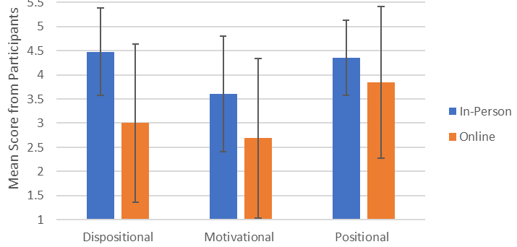
Student agency in chem eng: So what?
How do we use this emerging picture of the role of agency?
  Are ‘agency skills’ more dependent on wider conditions and situation of learning and learners?
  How might diversity and equity issues impact students’ response to agency opportunities?
Y3 Design—comparison of 2020 (online) and pre-2020 perceptions

Slide 14
Student agency in chem eng: Summary
Emerging picture of
  how different classes are perceived to provide agency opportunities
  how agency might develop through a course
  how different dimensions of agency are perceived
  How perception of agency correlates with critical thinking skills
Acting with agency is important in learning, working, and life
Agency also important for democratic society… critically judging information, actions, risk, character…
mark.haw@strath.ac.uk

