Slide 1
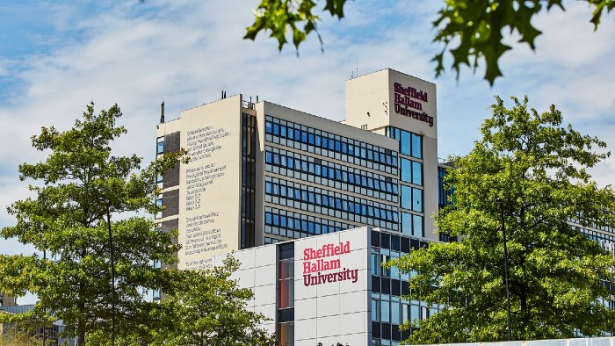


#DryLabsRealScience - a collaborative network addressing virtual delivery
Dr Nigel Francis
Dr David Smith
Prof Ian Turner
Case Study
Dr David Smith
Dr Tom Bassindale
Dr Bob LeSuer
@dave_thesmith
#AccessibilityOfScience
Research Group

Slide 2
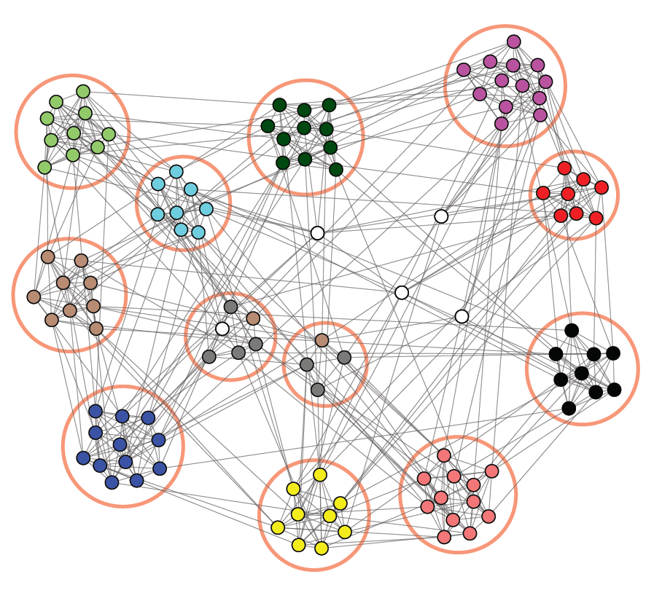

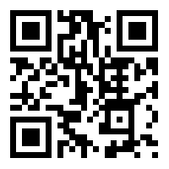
What have we done so far?
We have created a community of practice
Notes:
Set up to face the challenge of COVID19 to lab teaching.
Community of Practice (CoP)
One of several – (Chem/Phys)
Sharing of ideas
Collaborative teaching
10 meetings (11th organised for 28th April)
620+ accumulative attendees
11500+ hours devoted to network (equivalent of 1400+ 8 hour working days)
35 different projects presented
Only 48% of attendees felt able to influence department policy before attending rose to 90% after attending
Approx. 50% had met new people at meetings approx. 75% had subsequently made contact with those new people
96% had recommended #DLRS to colleagues with 94% gaining in confidence in their own teaching practice from attending

Slide 3


What have we done so far?
We have created a resource of material
https://www.lecturemotely.com

Slide 4
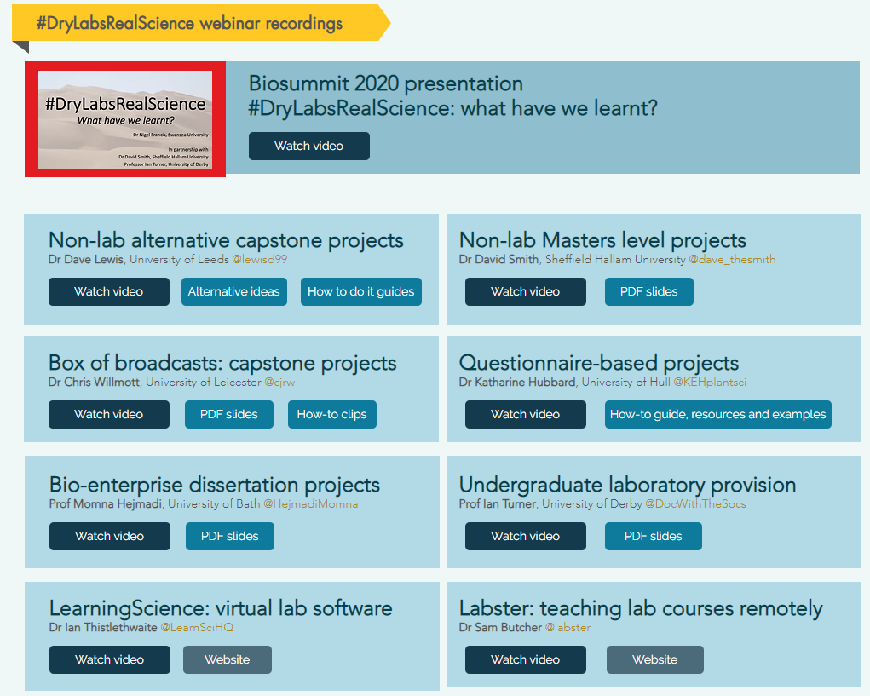
What have we done so far?
We have created a resource of material

Slide 5
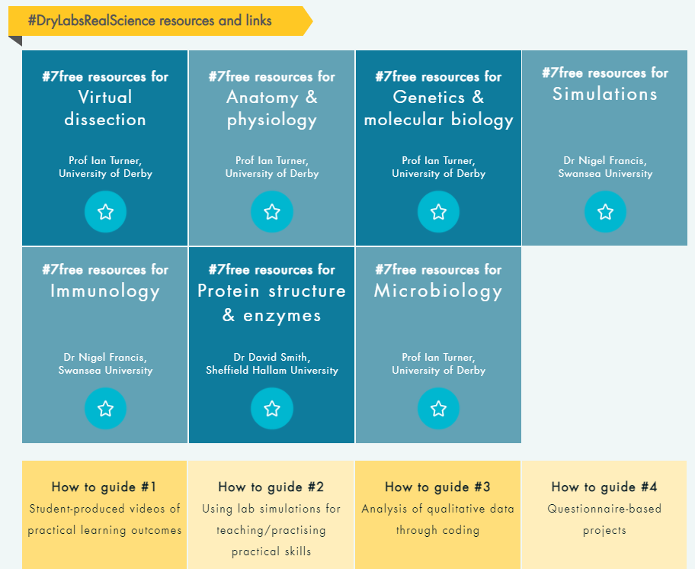
What have we done so far?
We have created a resource of material

Slide 6
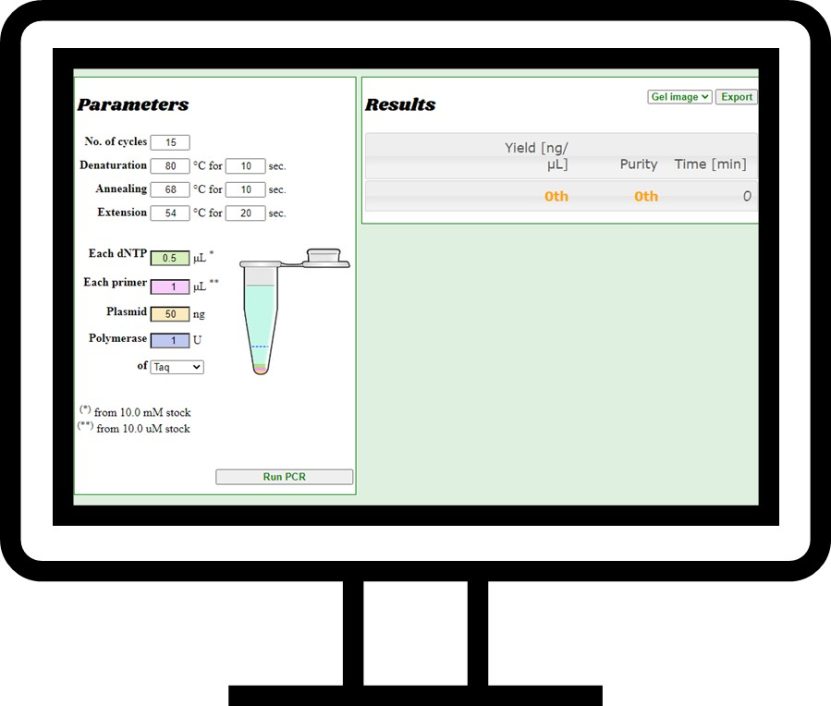


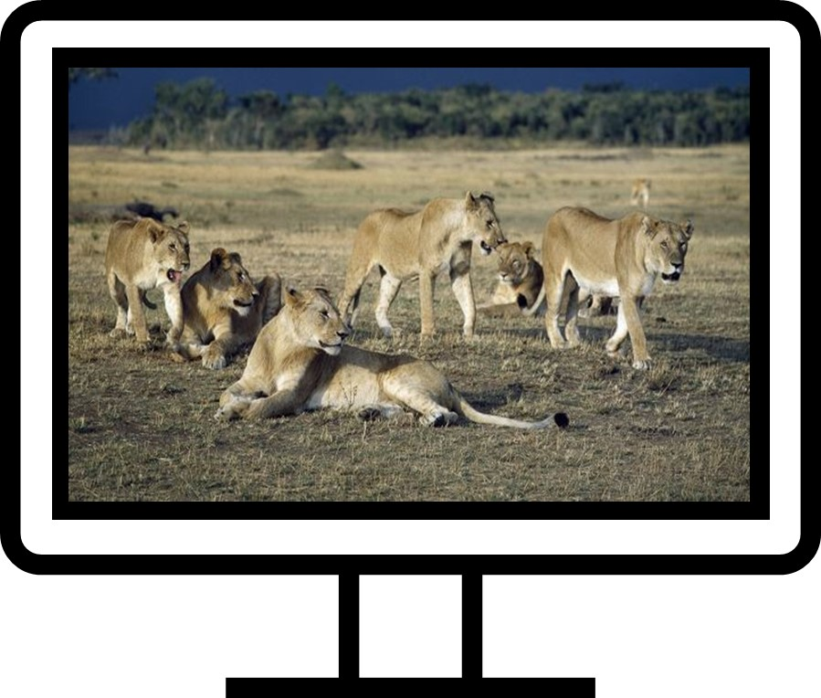

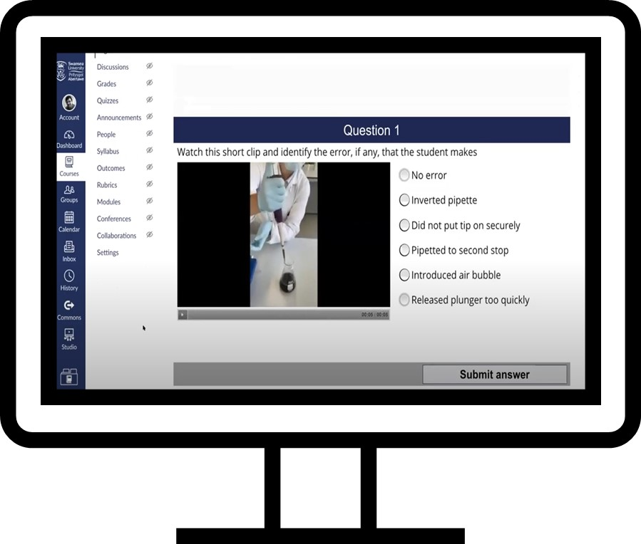
Learning Gains?
Simulations can be a very effective learning tool. Equipment can be accessed remotely.
Field work can be conducted virtually leading to a richer experience.
Infinite individual datasets and calculations can be generated and delivered.
Interactive videos/animations can be used as effective tools to understand ideas, methods and gain the most from the practical experience.

Slide 7

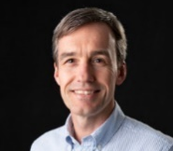
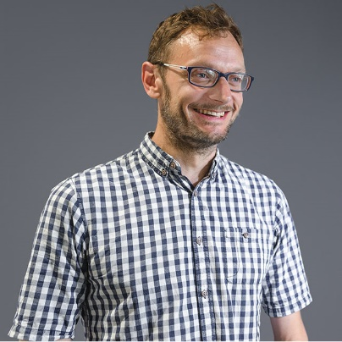
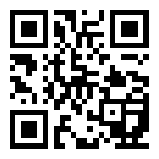
CASE STUDY
Dr Robert LeSuer
Dr Tom Bassindale
https://www.bobthechemist.com/
http://www.weareforensic.co.uk/

Slide 8
Virtual delivery of a program-wide lab simulation
Dry Labs - designed to allow group interaction and data generation.
6 labs created on HPLC, Western Blotting, PCR, Protein Purification, etc
week 1
week 2
week 3
week 4
week 5
Lab
Lab
Lab
PRE-LAB
PRE/ POST
PRE/ POST
POST LAB
Hand In
Each lab has an online tutorial associated with it to preview what is to come and review what occurred.

Slide 9
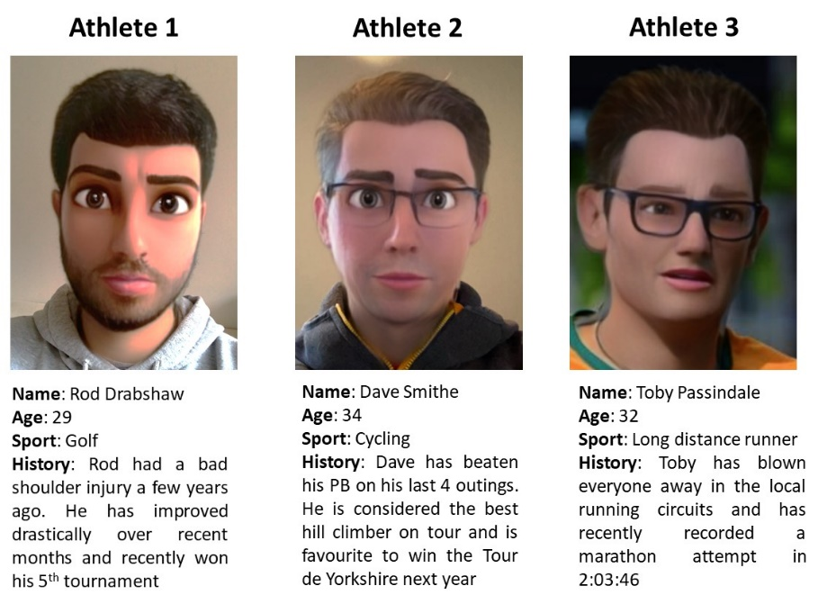
Pre-Lab Session
Introduced simulation
Gave a general overview of the lab
Ran through specifics
(health and safety)
Scenario shown is for the HPLC lab to quantitate testosterone and epitestosterone in urine samples from athletes

Slide 10
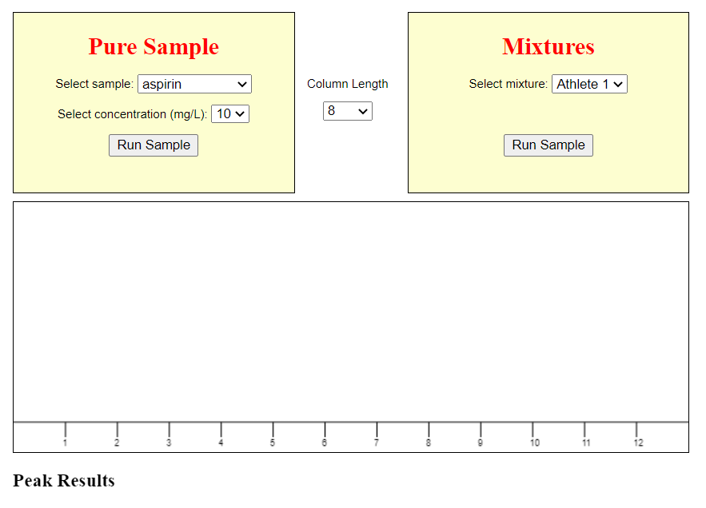
Briefing the Students
Students read script:
http://kabyn.com/hplc5/index.html
What you control:
  ‘Select sample’ = drug/compound
  Select concentration (mg/L) for calibration
  Column length = 1-15
  Mixtures = samples 1 – 3
Hit ‘Run Sample’ to get chromatogram

Slide 11

Online Live Delivery
Zoom
Main Room
Breakout 1
Course A
Breakout 2
Course B
Breakout 3
Course C

Slide 12

Lab Scripts – Using Command Prompts
DO
[DO] means you are to follow the directions provided
EXPLORE
[EXPLORE] Exploring typically will involve looking at the user interface options
REPORT
[REPORT] is a question or task that requires a response from you
PLOT
[PLOT] tasks require you to use Excel (or similar) to create a plot of some sort
WRITE
[WRITE] means you are expected to write a paragraph in response to the question or task
Dr Robert LeSuer
https://www.bobthechemist.com/

Slide 13
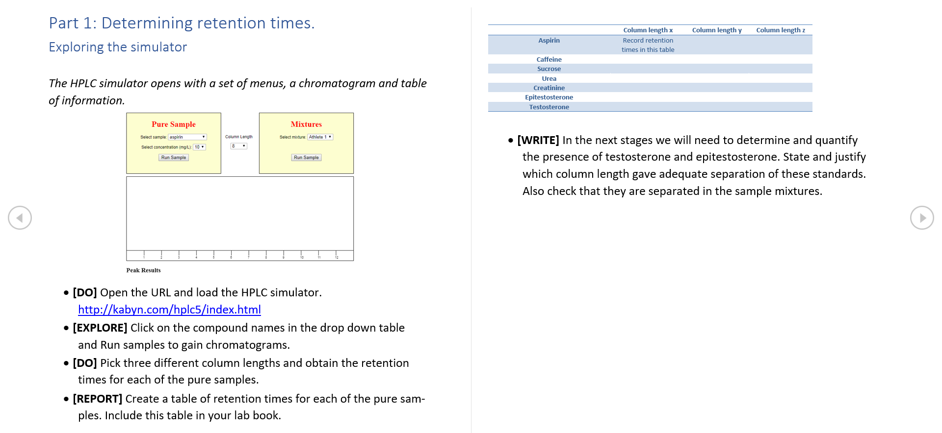
Example Lab Script

Slide 14
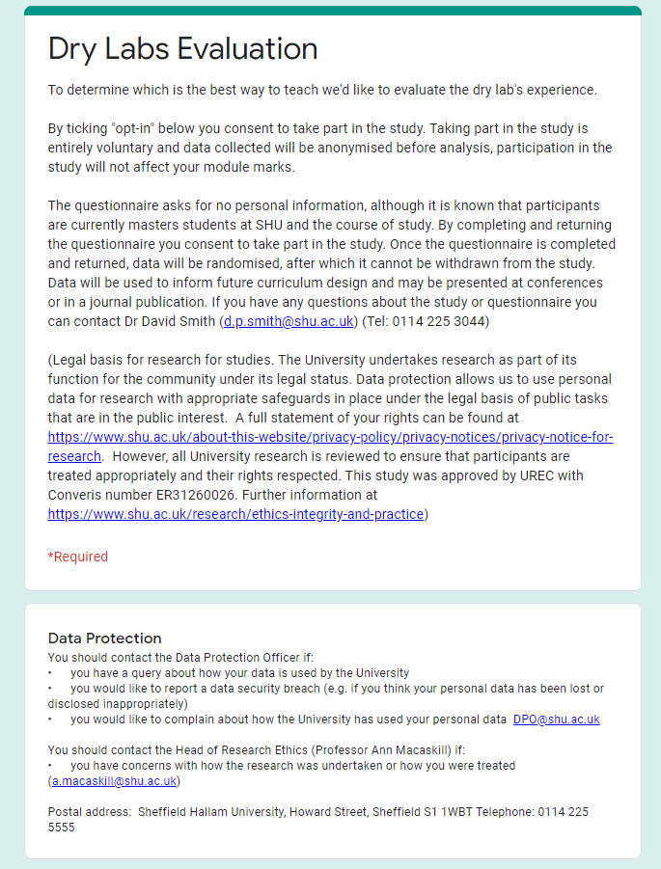

Evaluating Student Perceptions
81% response rate

Slide 15
Enjoyment, data handling and community
‘It helped improve the interaction between students’
‘The breakout rooms are very useful because it splits larger groups down’
‘Really good, the lecturer was always available and ready to answer any concerns‘
‘Less daunting to ask questions, fewer people talking’

Slide 16
Challenge vs Support
Students were asked to rate the level of challenge and support on a five-point scale from:
1 - low challenge/support
to
5 - high challenge/support
The Mode value is shown in red and corresponds to 14 responses.

Slide 17
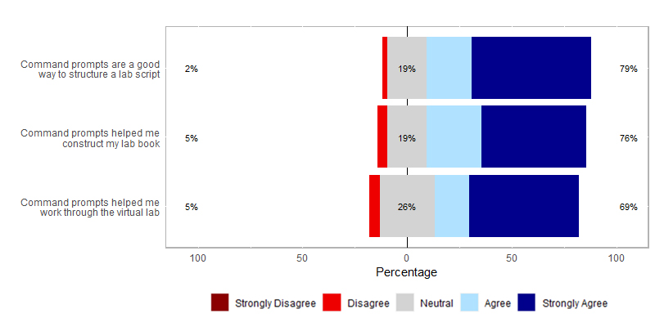
Command prompts were effective in the lab scripts
“Command prompts could be
used in other labs in the future”

Slide 18
Lessons Learnt
“They can't replace labs but they might help students make better use of lab time.”
Excellent for method development/optimisation practice.
Support needed prior, during and after labs.
An academic may take 2 hours to complete a lab that takes students all day.
Better prepared students do better.

Slide 19
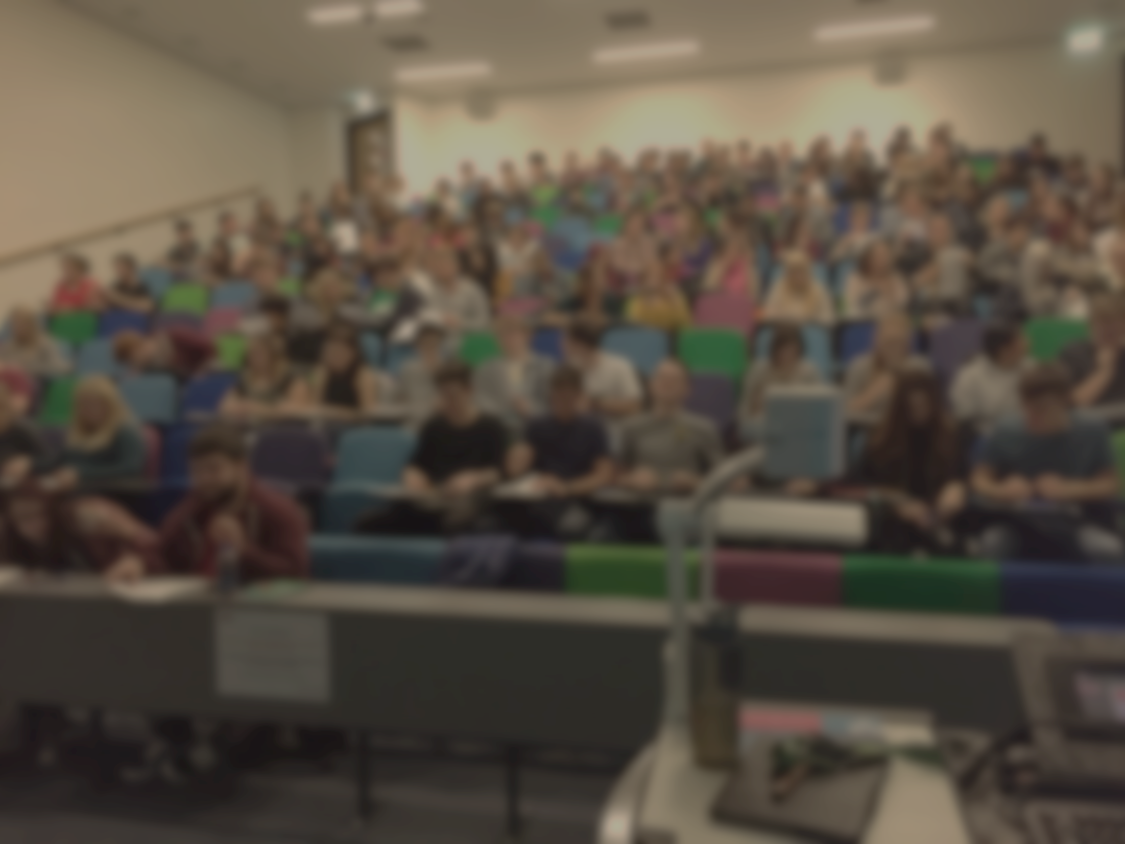

#AccessibilityOfScience Research Group
The students studying MSc Analytical Chemistry and
MSc Pharmaceutical Analysis at SHU
Dr Tom Bassindale
Dr Robert LeSuer (SUNY)
Dr Gail Haddock
Dr Sarah Haywood-Small
Dr Peter Klappa (Kent)
#DryLabsRealScience - Network
Dr Nigel Francis (Swansea)
Prof Ian Turner (Derby)
https://www.lecturemotely.com/
Journal of Forensic Education

