Slide 1
Summative assessment and digital collaboration: scaffolding reflection in laboratory learning
Becca Ferrari
Christof Jäger
Notes:
Chen, W., Shah, U., Brechtelsbaue, C., Edu. Chem. Eng., 17, 2016, 44-53
Savery, J. R. (2006) Interdisciplinary Journal of Problem-Based Learning, 1(1)
Kolb, A. Y., Kolb, D. A. (2005) Academy of Management Learning & Education, 4 (2). 193-212
Seifert, T. (2004) Understanding student motivation, Educational Research, 46:2, 137-149
Buchal, R.O. (2017) CEAFF Conference Collaborative Digital Design Notebooks

Slide 2
Background
Laboratories central to Chemical and Environmental Engineering curriculum curriculum
Transfer theoretical knowledge of science and engineering fundamental concepts to practical application
Teamwork, problem solving
Peer exchange
Y1
Structure
Fixed problem & solution
Technical skills
Errors & uncertainties
Health & safety
Teamwork & collaboration
Project planning
Design of experiments
Y3
Open ended problem & solution
Competencies
Notes:
Laboratories key in CEE learning and teaching (students spend between 24 and 40h in laboratories each year)
Imperial naming: Foundation; Knowledge; Discovery laboratories
From fixed to open ended solution

Slide 3
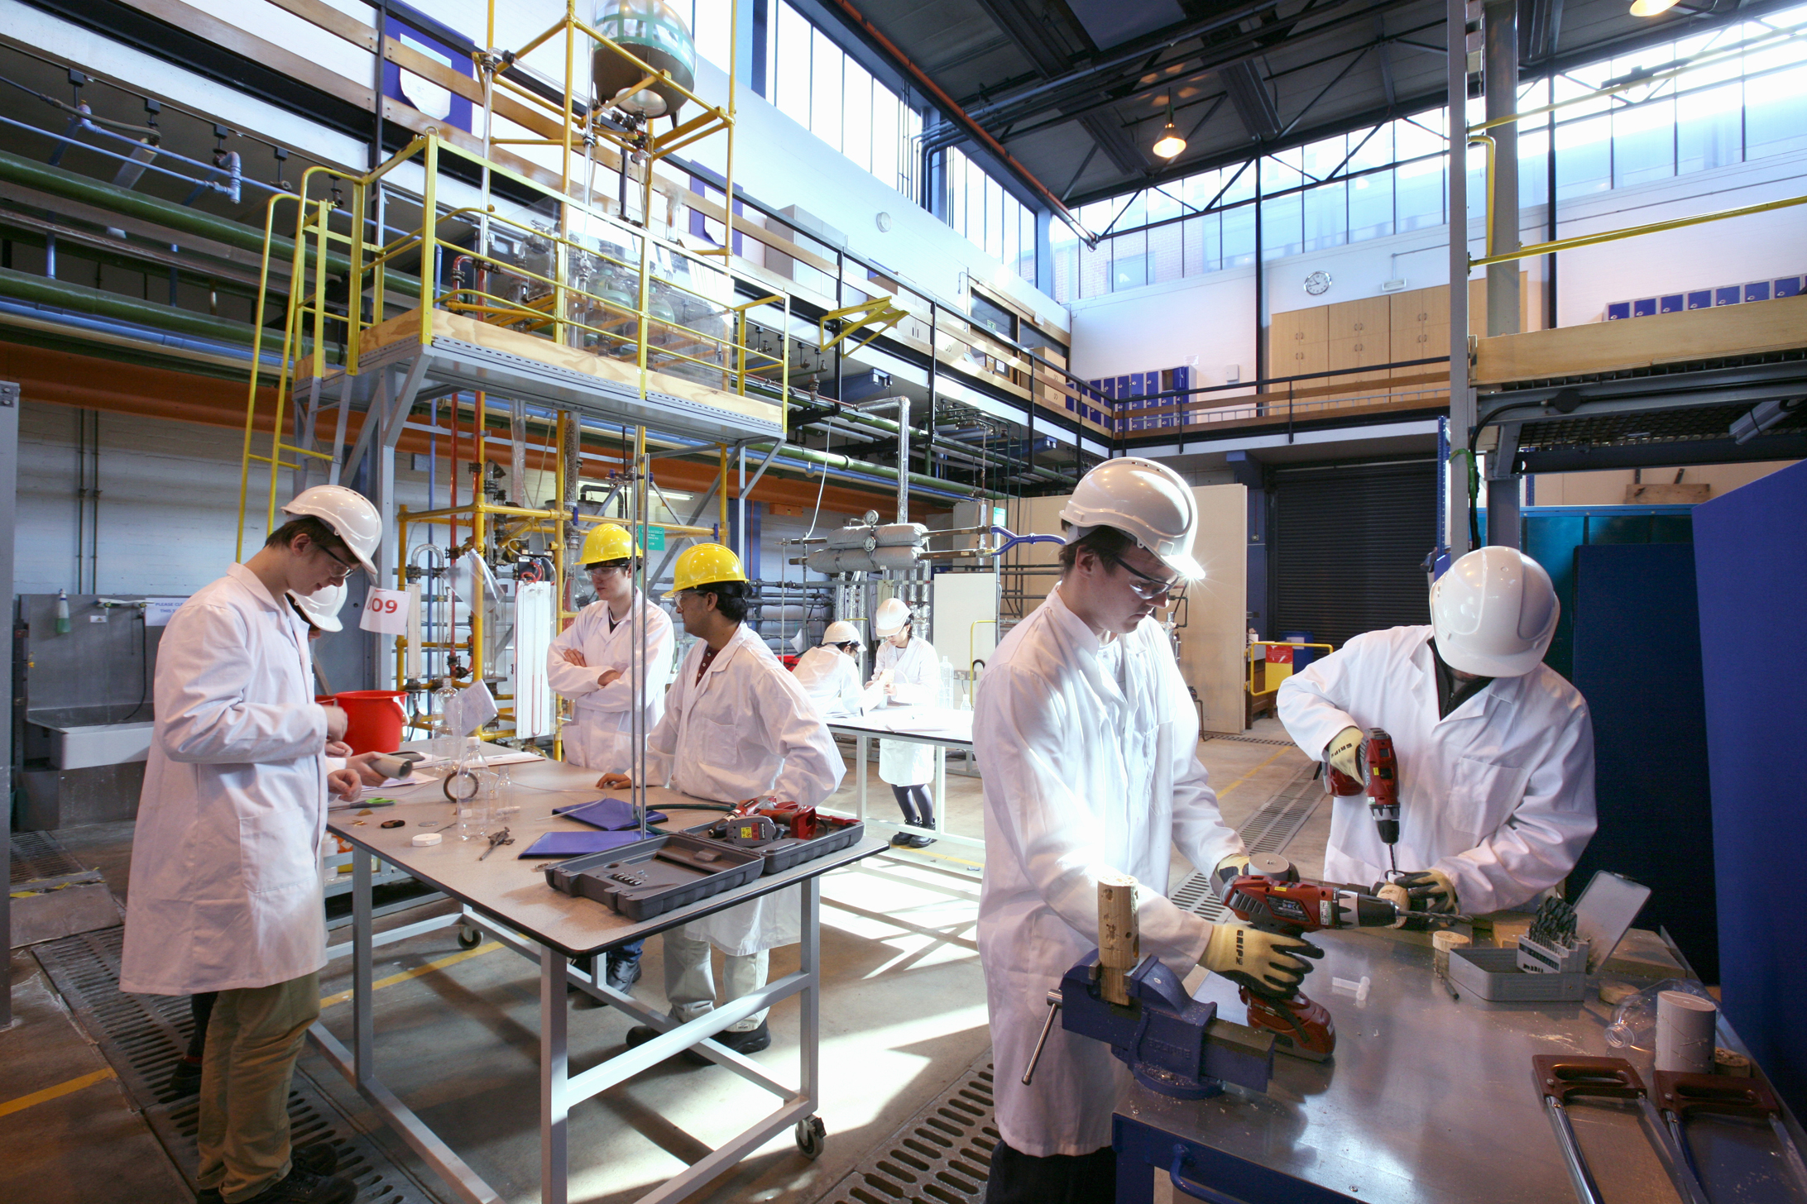
The CEE Y3 Process engineering laboratories
Key element of Design of Experiments (planning and reflection)
Students feel challenged by transition to open problem, open solution
Lack of group preparation, reflection and analysis
Motivation comes too late: ‘end product’ motivated (goal theory)
Notes:
Y3 labs are a step up from Y2 and Y1 labs that are much more prescriptive
Following (PBL) approach as described by Savery (2015).
Students struggle to transition successfully from short, highly structured laboratory sessions in their first year (fixed problem, fixed solution) to group based extended, open ended, self-directed problem based learning strategies during the later phase of their curriculum (open ended problem, open ended solution).
We attribute this to lack of group preparation and reflection before and in between lab sessions,
There is much more to be said then on the slides e.g. a better description of how labs run: 1 workshop + PRA preparation + 3 lab days with analysis and planning + 1 lab report as final assessment (lab pre-briefings not assessed)
paper on Understanding student motivation: Timothy Seifert 2004
And therein the ‘Goal theory’ Dweck, 1986; Dweck & Leggett, 1988; Nicholls et al., 1990; Pintrich & Garcia, 1991)

Slide 4
Aims and objectives
General aim to validate understanding of student preparation and better support the transition to self-directed, open-ended, collaborative learning in advanced laboratory settings.
Research questions:
Does changing to a more guided and ongoing assessment structure motivate more self-directed learning, preparation, and teamwork?
Can digital collaboration tools be used to support better teamwork and engagement?
Gerard, J., Goldie, S. (2016) 38 (10), 1064-1069
Buchal, R. O. (2017) Proc. Canadian Engineering Education Association (CEEA17) Conf.
C
Notes:
Work on collaborative digital tools in engineering, including working on lab notebooks by Buchal (CEEA17 Conf, 2017) has shown that shared team notebooks can be effective for collaborative knowledge building, and support feedback and equity of contribution, but that appropriate training for learners and staff is key to make best use of these technologies.
For the assessments I need to find one about ‘assessment for not of learning’ assessment of learning
Connectivism as a Digital Age Learning Theory
https://www.hetl.org/wp-content/uploads/2013/09/HETLReview2013SpecialIssueArticle1.pdf
John Gerard Scott Goldie (2016) Connectivism: A knowledge learning theory for the digital age?, Medical Teacher, 38:10, 1064-1069, DOI: 10.3109/0142159X.2016.1173661

Slide 5
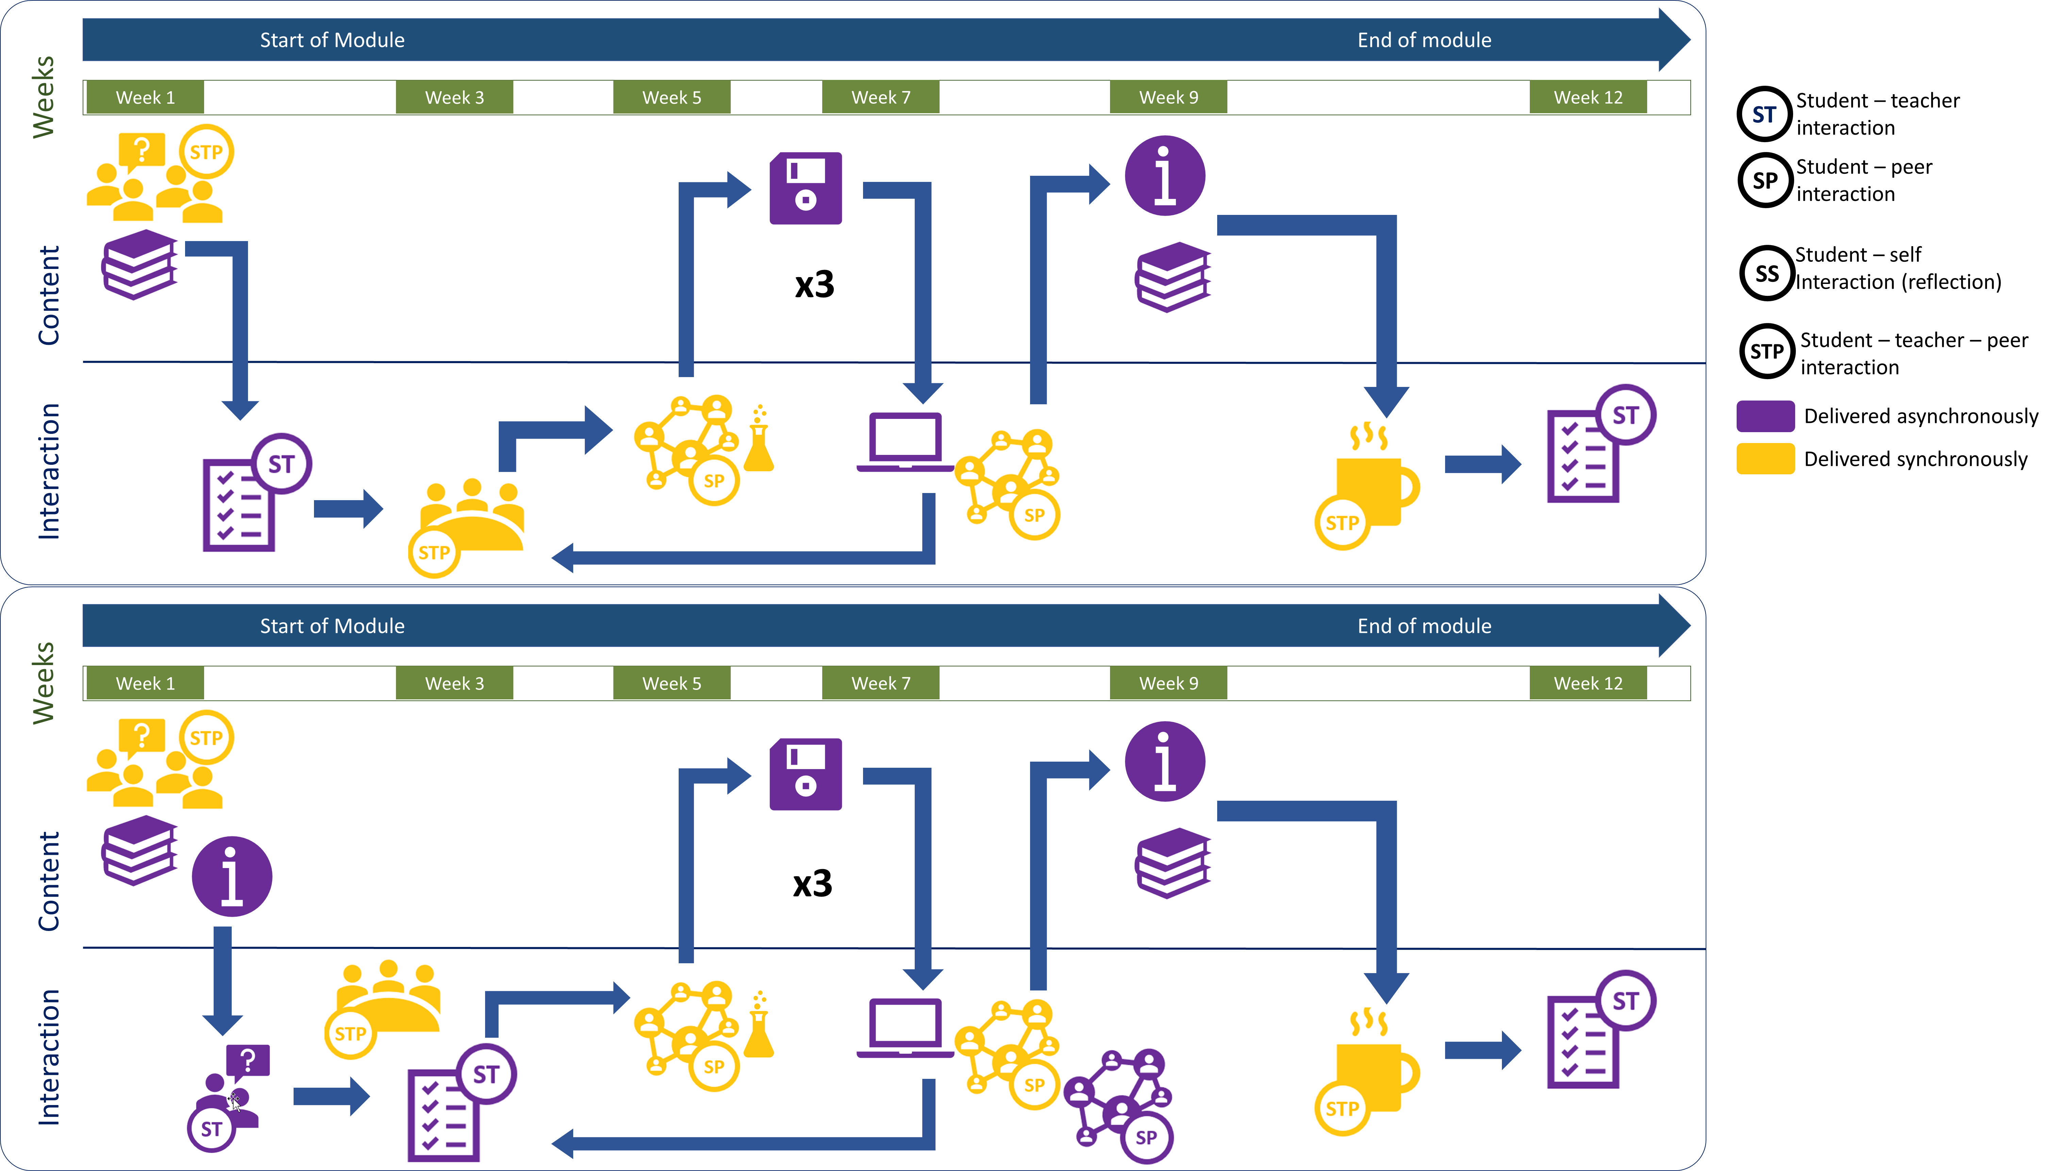
Implementation
Post intervention 19-20 Pre intervention 18-19
Initial workshop, introduction to rig & documentation
Report writing workshop
data
Individual report submission
Group formative risk assessment submission
Lab work
Analysis, reflection & planning
Discussion with rig supervisor
Informal discussion with rig supervisor
Key changes
Training on digital collaboration tools for enhanced teamwork, analysis, and communication
3x bi-weekly formative STP discussions shift to 3x bi-weekly 10% summative pre-lab assessments
Initial workshop, introduction to rig & documentation
Training: Teams & Onenote
Report writing workshop
data
Individual report submission
Lab work
Analysis, reflection & planning using digital tools
Group assessment by rig supervisor
Informal discussion with rig supervisor
Notes:
Additional pre-lab sessions with academics implemented as summative group assessments (counting 10% each against final mark)
Provision and training on (workshops) digital group working tools to be used by students for enhanced teamwork, analysis, and communication

Slide 6
Data collection and analysis
2 year groups (pre- and post intervention) analysed (~160 students per cohort)
Staff interviews: 5 pre-intervention, 5 post-intervention
Survey Monkey student surveys: 10 questions, 1-2 min response time, 30/31 students, ~20% respond rate, 2 cohorts
SEM written feedback: 2018/19: 18 comments from 11 students; completion rate 31 students, 20%; 2019/20: 14 comments from 13 students; completion rate 62 students, 43%
Online engagement data: MS teams engagement analysis for 19/20 cohorts
Marks: comparison of 18/19 and 19/20 cohorts
B

Slide 7
Results - Staff interviews
Pre-intervention Post-intervention
Preparation and reflection
Students not well prepared (4/5) better prepared (5/5)
Working together
No significant difference in group work
Independent open-ended labs
No/small change in working against assessments;
self-guided learning remains most challenging component
Digital engagements (only post-intervention)
"Mixed bag outcomes"
Staff engagement varying; some groups very active; good for data analysis
Notes:
Could split in two slides and add best quotes

Slide 8
Results - SEM
18-19 Pre-intervention
18 comments from 11 students
19-20 Post-intervention
14 comments from 13 students
Comments focus on support and workload
Different level of guidance given to different groups (3)
Minimal guidance on methodology (2)
Minimal guidance on report writing (2)
Workload too much for 10 credit module (4)
Workload too little for 10 credit module (2)
Single lab report for 10 credits not appropriate (2)
Comments focus on pre-lab assessments and group work
Strict vs lenient academics in pre-lab assessments, subjective assessment and grading criteria (4)
Different levels of contribution by different team members (2)
WebPA (peer assessment) requested (2)
Clearer definition of what experiment plans/risk assessments meet pre-lab assessment criteria
Report assessment criteria too vague
Notes:
Key points
Parity of support shifted to parity of assessment

Slide 9
Results – Survey Monkey
2018-19
2019-20
Do you have the impression that the 3rd year labs were more challenging than earlier labs?
Did the laboratories engage you in more independent learning and planning?
Notes:
The ones that didn’t change (significantly)
Students see the labs challenging, observation we had confirmed
Important: No indication that interventions lowered the independent learning aspect (from the student’s point of view)

Slide 10
Results – Survey Monkey
2018-19
2019-20
Did your group meet between the laboratory sessions to analyse the data and plan the next lab session?
Do you think you should have done more preparation for the lab sessions?
Notes:
The ones that didn’t change (significantly)
Students see the labs challenging, observation we had confirmed
Important: No indication that interventions lowered the independent learning aspect (from the student’s point of view)

Slide 11
Results – Survey Monkey – Online engagement
Did you make use of the Microsoft Teams/OneNote environment to share and work on data?
MS Teams engagement
Students regularly shared data (34/36)
Groups either used chat very frequently (12/36) or not at all (16/36)
Group posts: Avrg. 15; max. 131; min 0
Did you make use of the Microsoft Teams chat to communicate with your team or supervisors?
Notes:
The ones that didn’t change (significantly)
Students see the labs challenging, observation we had confirmed
Important: No indication that interventions lowered the independent learning aspect (from the student’s point of view)

Slide 12
Results - Marks
Changes of overall marks were not anticipated or observed
Number of individual academics involved gives intrinsic spread
Key finding that students went through a learning curve in group assessments
Slight correlation between group assessment mark and best student of group report found (R² 0.26)
Pre-assessment marks
d: decrease; i: increase; c: constant
Notes:
light but not significant increase in overall marks: 2018/19 average:
68.3 % (+-7.0) 2019/20 70.4% (+-5.8)
Lab report average below Pre-assessment average:
69.6% (+-7.2) vs 72.6% (+-6.1)
Pre assessment show interesting learning curve, with drop in marks for second assessment:
1st 72.7% (+-8.5); 2nd 70.7%(+-7.5); 3rd 74.4%(+-7.9)
This trend is also represented for the groups with
33% of the groups going through this learning curve (down>up)
Other prominent trends: down-constant (14%), up-up (11%), constant-constant (11%)
55% of groups had a decrease of marks after the first session, while only 25% had an increase
There is NO correlation between individual lab report marks and average group pre-assessment marks (R2=0.06)
However, there is a slight/moderate correlation (R2=0.23) between the average lab report mark per group and the average pre-assessment mark
Now, this could be assessor dependent, but
There is a similar correlation (R2=0.26) between the best lab report per group and the average pre-assessment mark for the group (while there is no correlation for the weakest report against the pre-assessment marks, R2=0.05)
So this indicates that indeed a good student can lift the group assessment marks
Also the best lab report per group was in 75% of the cases above the average pre-assessment mark of the group, while 89% of the weakest lab reports were below the average-pre assessment marks
individual lab reports were in 59% the cases below the average pre-assessment mark

Slide 13
Summary – Against Objectives
Does changing to a more guided and ongoing assessment structure motivate to better self-directed learning, preparation, and teamwork?
  Yes. Better preparation and enhanced engagement was visible. Students still assessment driven towards meeting criteria
Can digital collaboration tools be used to support better and self-directed teamwork and engagement?
  Not on its own. a) sufficient training and practise needed; b) You need to build a learning community/community of enquiry (teachers and students); c) expectations need to be set more clearly
Wiliam, D. (2011) Studies in Educational Evaluation, 37(1), 3-14
Seifert, T. (2004) Understanding student motivation, Educational Research, 46(2), 137-149
Tomlinson, M. (2016) Higher Education Policy, 29, 149–166
Salmon, et al., (2010). Educational Research, 52(2), 169-182.
Garrison, D. R., Anderson, T. E. (2003), Learning in the 21st century: A framework for research and practice. London: Routledge/Falmer, 2003.
Garrison, D. R., et al. (2001), American Journal of Distance Education, 15:1, 7-23
Notes:
Summary and room for improvements
To point one:
- Goal driven students: That result is despite the fact that the assessment changes where deliberately implemented as ‘assessments for learning’ not ‘assessments of learning’
Tomlinson, M. (2016) Higher Education Policy, 29, 149–166
“The Impact of Market-Driven Higher Education on Student-University Relations: Investing, Consuming and Competing”
What is assessment for learning
D. Wiliam
Studies in Educational Evaluation
Volume 37, Issue 1, March 2011, Pages 3-14
To point 2:
5 stages model, Gilly Salmon (2014)
Social, cognitive and teaching presence Community of Enquiry Garrison & Anderson (2003)
Practical enquiry model Garrison, Anderson & Archer 2001)
Training needs to be given
Expectations need to be set more clearly to students AND staff
Online interactions need to be clearly structured (if not by individual academics then by module convenors)
Training will change significantly due to situation; this cohort did not use the software in advance, while every other from now on will have done so

Slide 14
Limitations
Comparison of two consecutive 3rd year cohorts only (~160 students per cohort)
Learning curve of staff with implementation of new assessment approach
Technical issues during week 1; unable to provide intended level of training to students on use of Teams/Onenote
B

Slide 15
Future work
Short Term – supporting COVID-19 mixed mode learning
  Optimise choice of digital tools
  Optimise guidance (expectations) and documentation of group assessments
  Better training and support on digital tools for students and staff
  Build and support a more structured learning community, clear guidance to staff on expectations
Long Term – addressing assessment motivation
  Include professional (digital collaboration) skills development in learning outcomes
  Apply laboratory learning to a real-world problem, assess this too
B
Notes:
Short term: COVID teaching in 2020
Provide
Long term:
How to we move the motivation away from the assessment (more assessment for learning than of learning)? create a more constructivist environment where the learning becomes for relevant to a real world problem that is explicitly assessed in the report? Eg use the outcome of the experiments to validate a HYSYS simulation, or to produce a data driven model, or to design a unit operation – this then also links to year 4 where they do a redesign of a whole process based on some extended individual research
https://www.sciencedirect.com/science/article/pii/S174977281930065X#fig0005

Slide 16
Thank You
References:
Chen, W., Shah, U. (2016) Brechtelsbaue, C., Edu. Chem. Eng., 17, 44-53
Savery, J. R. (2006) Interdisciplinary Journal of Problem-Based Learning, 1(1)
Kolb, A. Y., Kolb, D. A. (2005) Academy of Management Learning & Education, 4 (2). 193-212
Seifert, T. (2004) Understanding student motivation, Educational Research, 46:2, 137-149
Buchal, R.O. (2017) Proc. Canadian Engineering Education Association (CEEA17) Conf.
Gerard, J., Goldie, S. (2016) Medical Teacher, 38(10), 1064-1069
Salmon, et al., (2010). Educational Research, 52(2), 169-182.
Salmon, G. (2013). E-tivities: The key to active online learning. London: Routledge
Garrison, D. R., Anderson, T. E. (2003), Learning in the 21st century: A framework for research and practice. London: Routledge/Falmer.
Garrison, D. R., et al. (2001), American Journal of Distance Education, 15:1, 7-23
Wiliam, D. (2011) Studies in Educational Evaluation, 37(1), 3-14
Tomlinson, M. (2016) Higher Education Policy, 29, 149–166

Slide 17
Results - Staff interviews questions
Can you give a reflective account of how your student groups worked together and developed their projects?
Based on the accounts/responses given by staff, we will use the following questions to probe further:
  Do remember over the last few years any specific positive or negative examples?
  What do you think were the differentiating factors between the groups?
  Chronological story about how their groups worked together?
  What made the difference between the groups?
  Have you experienced any issues within the groups and what were they?
  How did the students engage with the problem based and open ended learning approach?
  Do you think the students prepared sufficiently before the laboratory sessions? (show feedback from student survey monkey as use as discussion point)
How did the students engage with the team working approach (e.g. preparation, data analysis, adaptation)
  Did any of the students become a leader?
  What did the students struggle with the most?
Do you feel about the opportunities you had to provide support and feedback to the students?
  Would you change it in the future?
What opportunities do you see to improve the learning outcomes for students on this module?
Notes:
Could split in two slides and add best quotes

