Slide 1
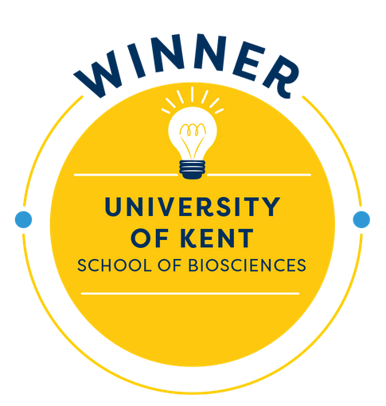

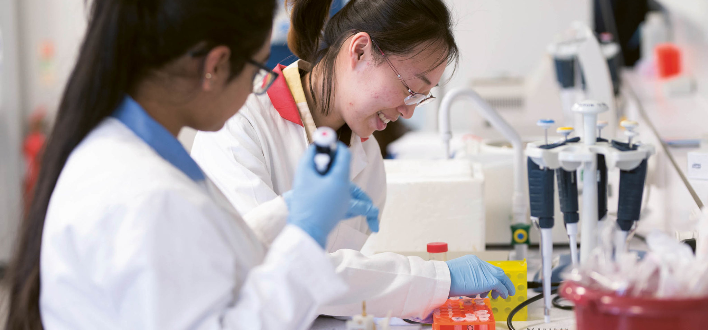
Smart Worksheets To Identify Student Numeracy Skills In The Division Of Natural Sciences/ In Collaboration With Learning Science
Dr Alexandra Moores
Lecturer in Microbiology, School of Bioscience, The University of Kent

Slide 2
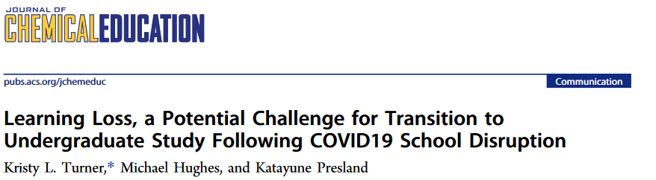
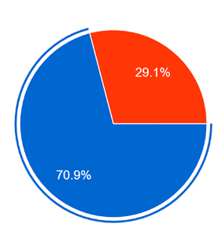

Impact of pandemic on STEM
Do you think students starting an undergraduate Chemistry course in 2020 will have less knowledge than previous years?
Notes:
20th March 2020 – All face-to-face teaching (A-levels & BTEC) stopped
Examinations cancelled & ‘U-turn’ result prediction

Slide 3

Impact of pandemic on Natural Sciences?
Division of Natural Sciences
Chemistry
Forensic Science
Sports and Exercise Science
Biomedical Sciences
Biology
Biochemistry
Diagnostic Tool Development for mathematic skills

Slide 4

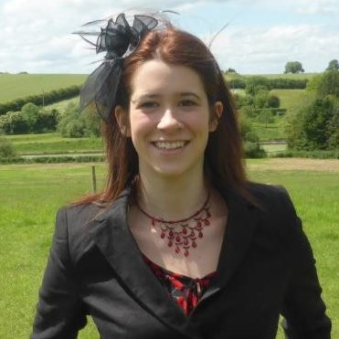

Numeracy Smart Worksheet Design
Interactive online resource
Fundamental mathematical principles in a range of presentation styles
Incorporated GCSE, A-level, and BTEC level questions
Randomised questions
Repeated attempts
Instant feedback for incorrect answers (offering a hint)
If answer is unknown = 'Solve' button
Emily Coyte
Notes:
To ascertain not only the theoretical areas but additionally how the problems appear (i.e. graphically, tabular, written format) that students might find problematic.

Slide 5
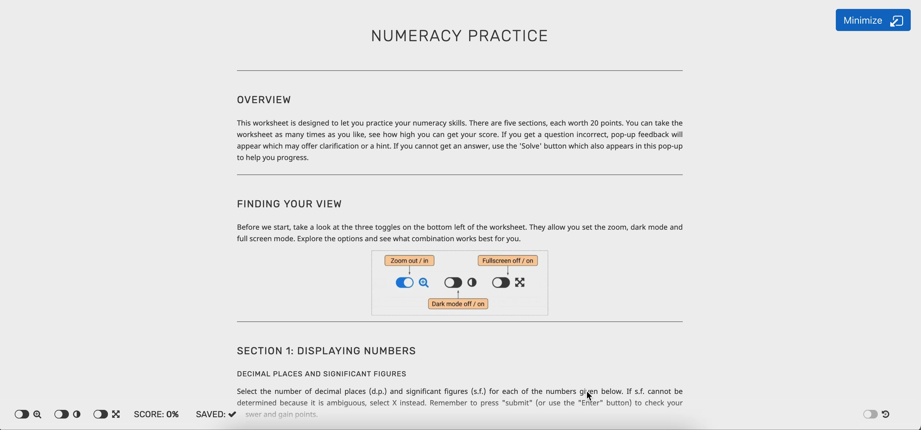


Numeracy Smart Worksheet

Slide 6
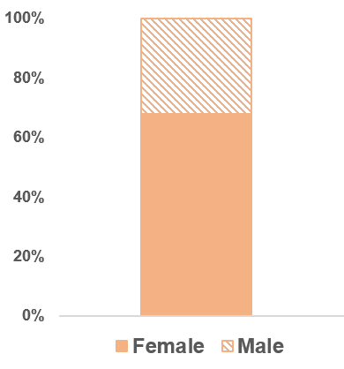
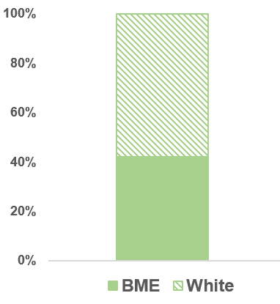
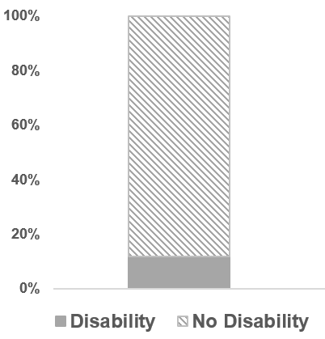
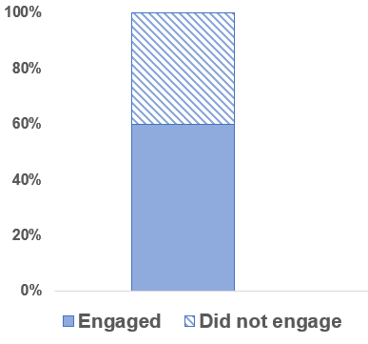
Biosciences Student Engagement Analysis
Comparing student engagement and average marks against equality, diversity and inclusivity characteristics
260
Students
32%
58%
88%
40%
68%
42%
12%
60%
Analysis of 75% of the data (n=122)

Slide 7

Biosciences Student Competence
76%
Average
Mark
Displaying numbers
Working with numbers and units
Averages and spread of data
Rearranging and solving equations
Graphs
BTEC students performed 10% lower than A-level students

Slide 8
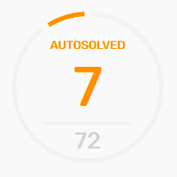
Bioscience Students are inquisitive
Displaying numbers
Working with numbers and units
Averages and spread of data
Rearranging and solving equations
Graphs

Slide 9
Who in Bioscience is struggling?
40 % of students that did not engage
A low engagement: Male and BME student cohorts, where 45% and 48% engaged, respectfully.
260
Students
Lack in confidence in mathematical skills?
Intervention: Support all students, the School of Biosciences
Adding resources that would enhance their ability and understanding in mathematics
40%
60%

Slide 10


Acknowledgements
Emily Coyte & the team from Learning Science
Mr Francis Samra (Student Success Project Officer)
Dr Ewan Clark (Senior Lecturer in School of Physical Sciences)
Dr Kyra De Coninck (Lecturer in Sports Therapy and Rehabilitation in the School of Sport and Exercise Science )
Funded by the University of Kent Student Success Project

Slide 11
Notes:
This

