Slide 1
Learning Science UK & UWC
Partnership:
Integrated pre-lab simulations and Smart Worksheets
Student-Centric Design

Slide 2
UWC & Learning Science Partnership
Dean of Science Faculty (Professor Michael Davies-Coleman) reflected on this project and states the following: Before launching Learning Science in the Faculty in February, 2020, Dr Stoltenkamp and her team, working with our colleagues at Learning Science UK, established the feasibility of delivering the Learning Science suite of programmes efficiently and effectively on our institutional Learning Management System, iKamva.
  iKamva is an isiXhosa word which means “future” and in the current context prophetically refers to the way in which technological and social developments are advancing and converging.
Once the iKamva accessibility to Learning Science simulations was firmly established, the Centre for Innovative Education and Communication Technologies (CIECT) team then implemented a teaching and learning methodology, in which Learning Science Champions, identified by the Faculty, were shown how to incorporate the Learning Science simulations in a structured, interactive environment.
The initial phase was to enhance the Pre-Lab accessibility and e-impact of Learning Science simulations. At the onset of the 8-month pandemic lockdown, when our undergraduate laboratories were closed
CIECT were pivotal in assisting lecturers integrate the simulations into discipline specific teaching modules, enabling them to effectively align the simulations to a specific topic, discussion forum and assessment. This was critical to keep our students engaged remotely with practical technique. [Dean of Science Faculty, Prof Michael Davies-Coleman]

Slide 3
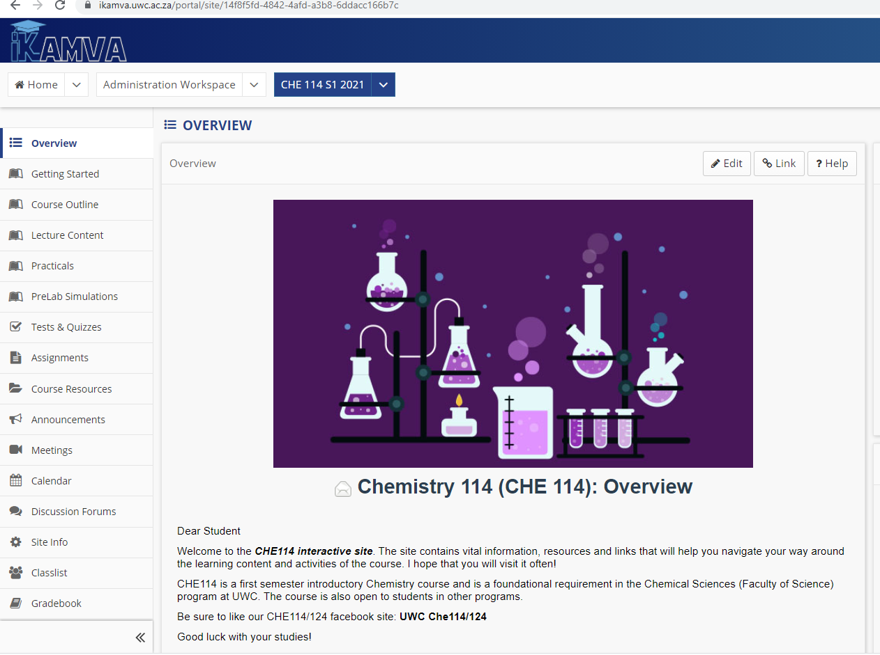
Student-Centric: Interactive online environment
Lecturers were assisted to design and develop a structured online modules within the Learning Management System- iKamva (Sakai Platform)
Lectures were structured according to weeks and lecture topics/themes which included:
- Learning outcomes for each lecture
- Narrated PowerPoints lectures
- Printable PDF notes
- Pre-lecture quizzes setup as polls
- Manageable snippets of learning materials
- Embedding of external resources which includes the smart worksheets

Slide 4
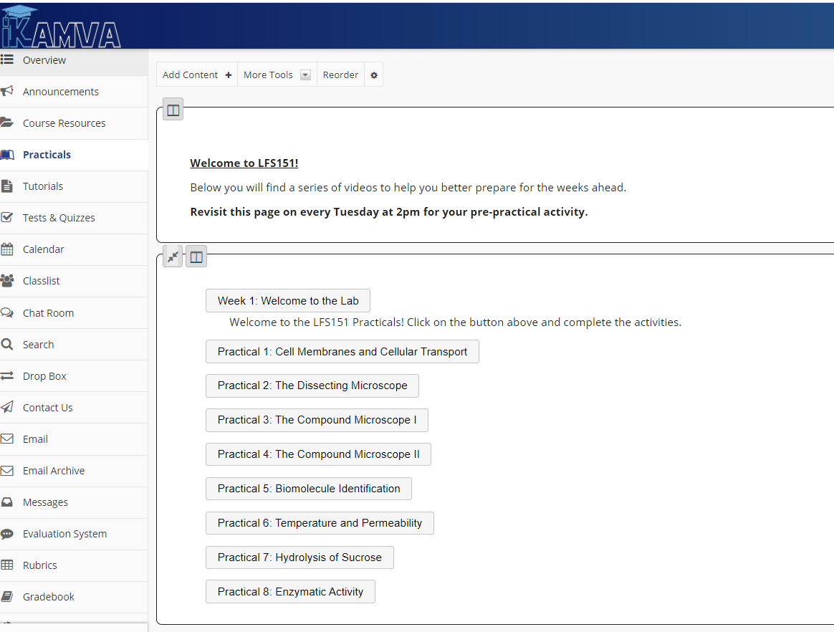
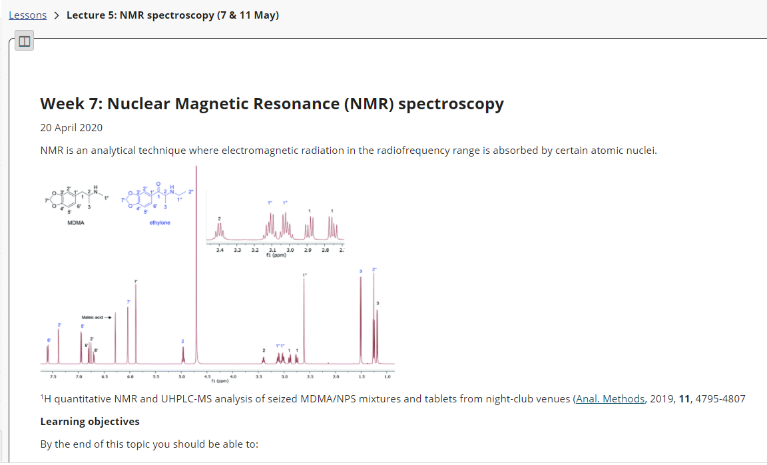
Structured Weekly Practicals

Slide 5

Integrated Pre-Lab Simulations- How was it used? Flipped-Classroom
Pre-lecture: Pre-Lab safety simulations were embedded in online environments to familiarise and prepare students regarding the safety protocols, specific labware, and dress code they need to adhere to work safely within any physical or virtual lab space
During the lecture: The embedded simulations arranged within the structured environments enabled students to interactively engage and practice experiments to weigh out sample solutions and collect material.
Post-lecture: The interactive simulations were accessible to students throughout the entire duration of the module and they could review and revisit the experiments at any stage to reinforce their learning processes.

Slide 6
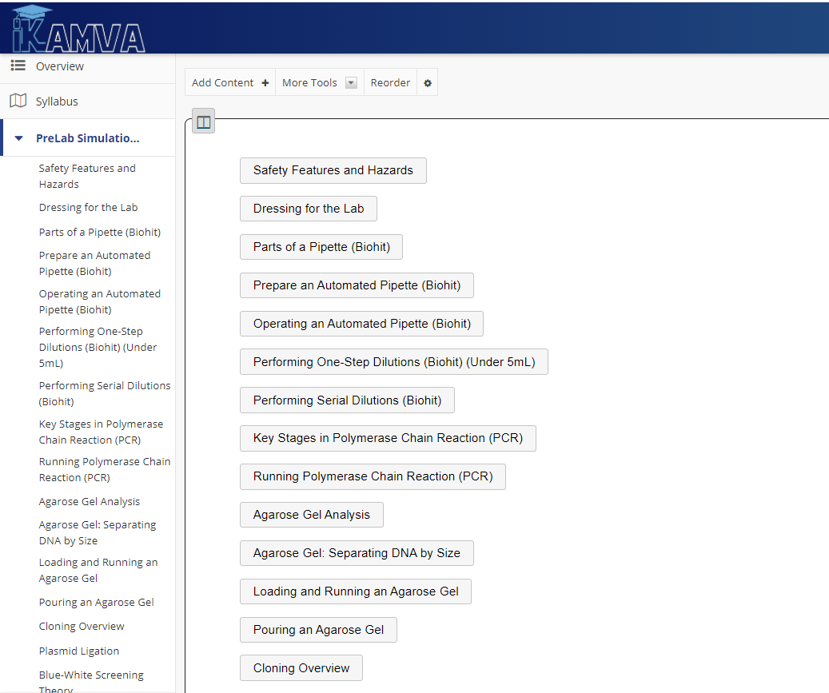
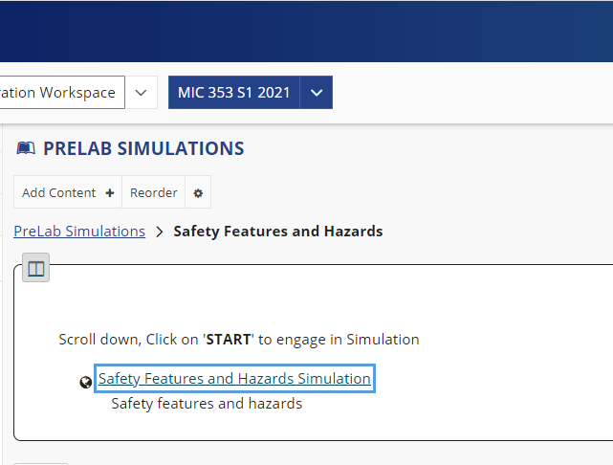
Flipped-Classroom: Pre-Lecture
Self-directed Learning
Preparation

Slide 7
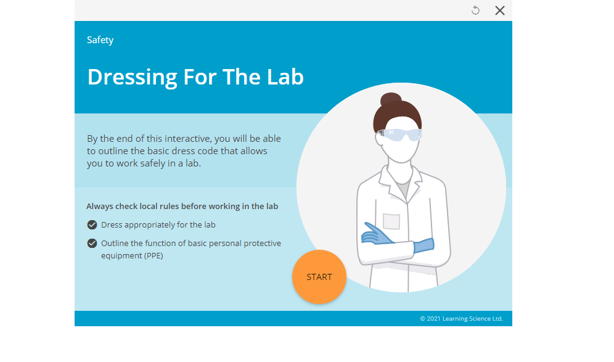
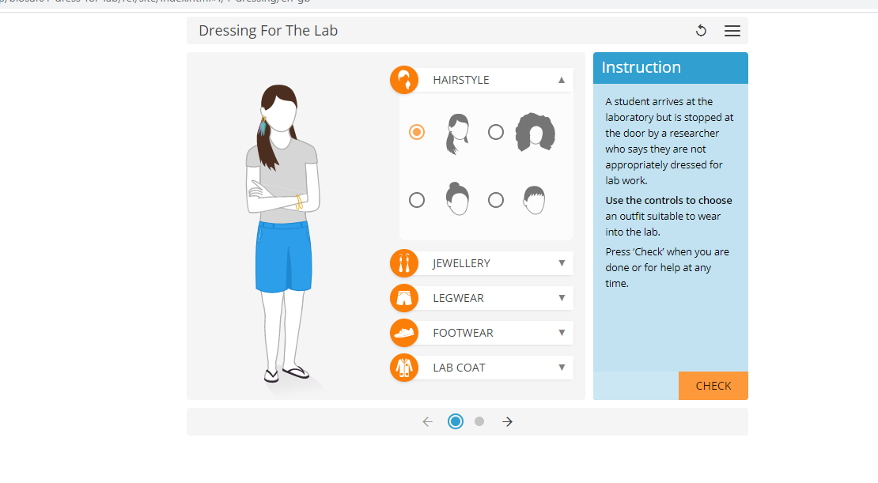
Flipped-Classroom: Pre-Lecture
Remote Access (no contact lab sessions)
Limited Resources

Slide 8
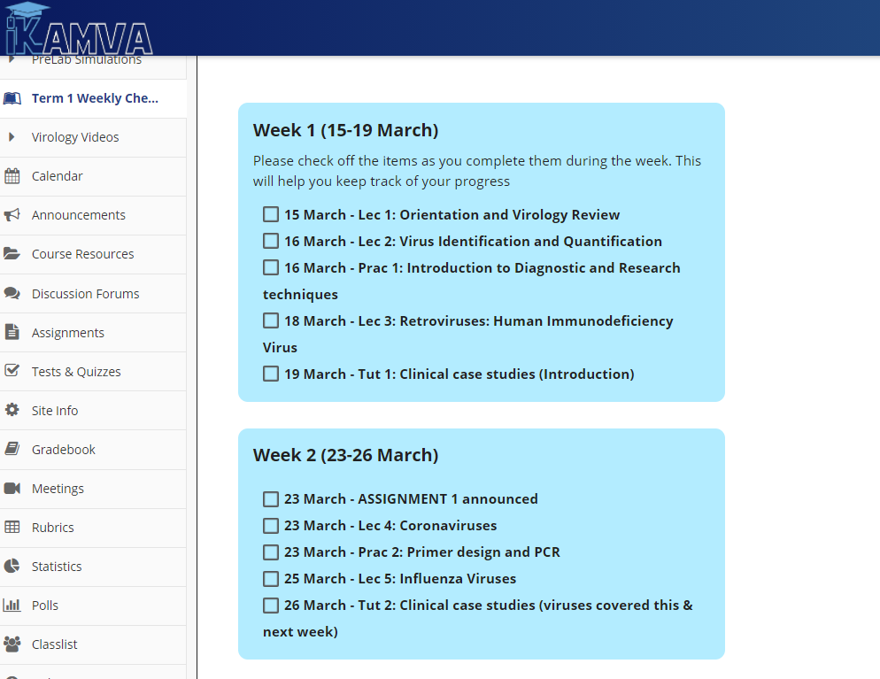
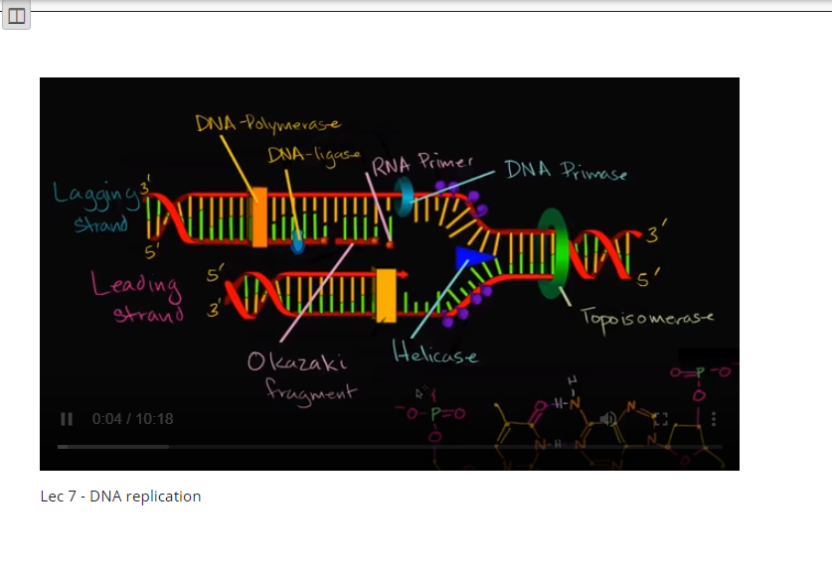
Alignment: Weekly structured themes and activities

Slide 9
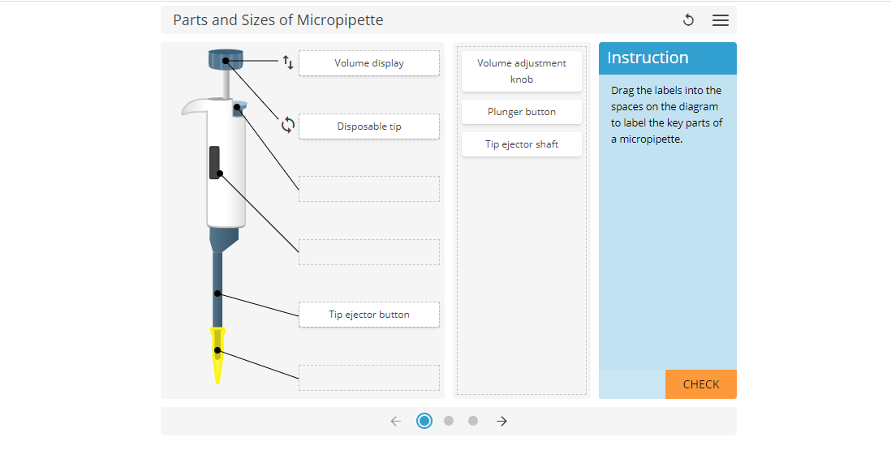
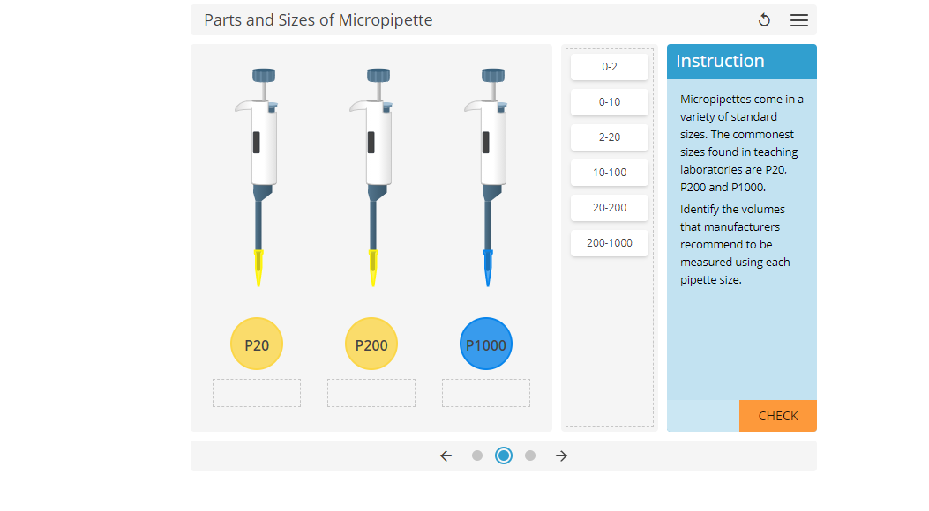
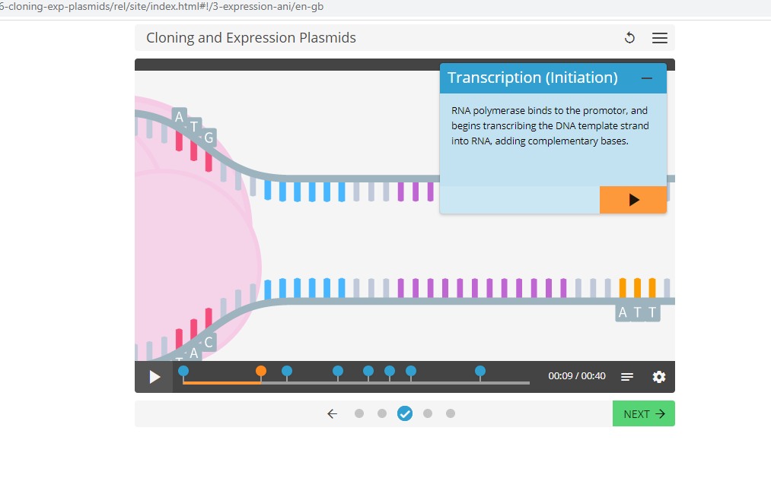
Flipped-Classroom: During Lecture
Structured Online Lessons
Relevant additional resources
Integrated Simulations
Reinforcement
Student Development and Support

Slide 10
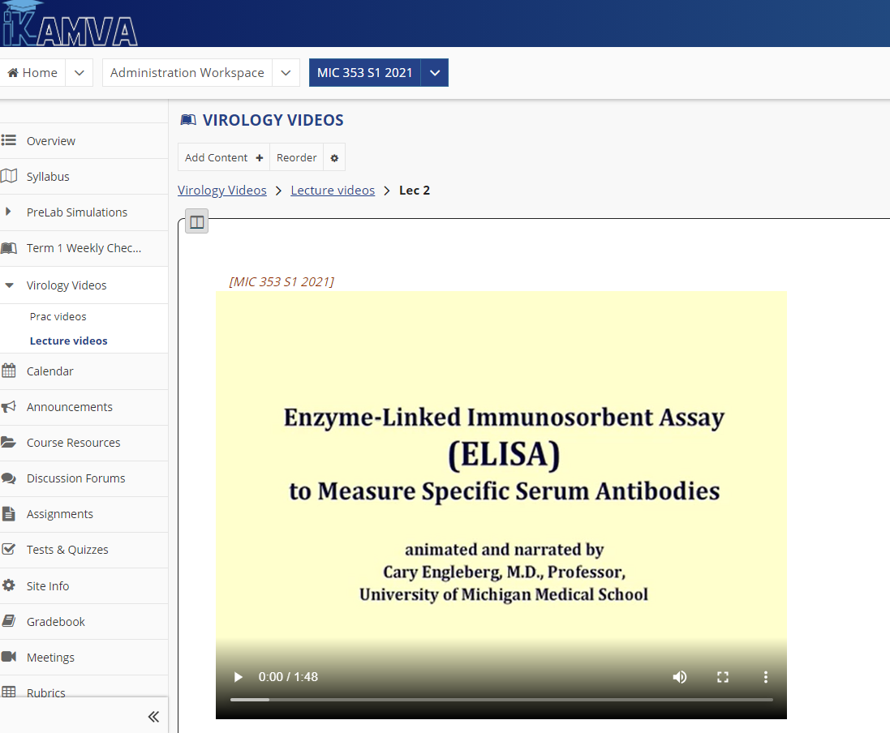
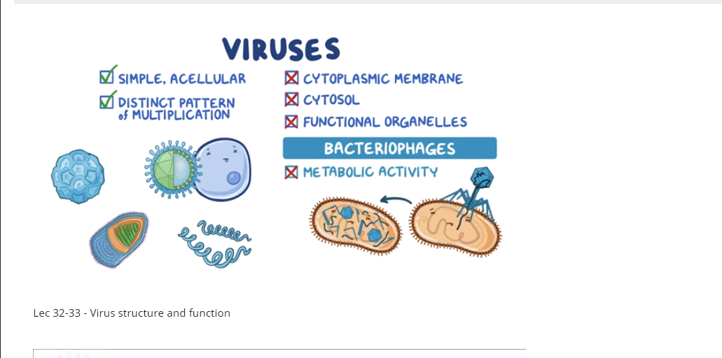
Flipped-Classroom: During Lecture
Reinforcement
Lecture Videos
Practical Videos
Multimedia Resources

Slide 11
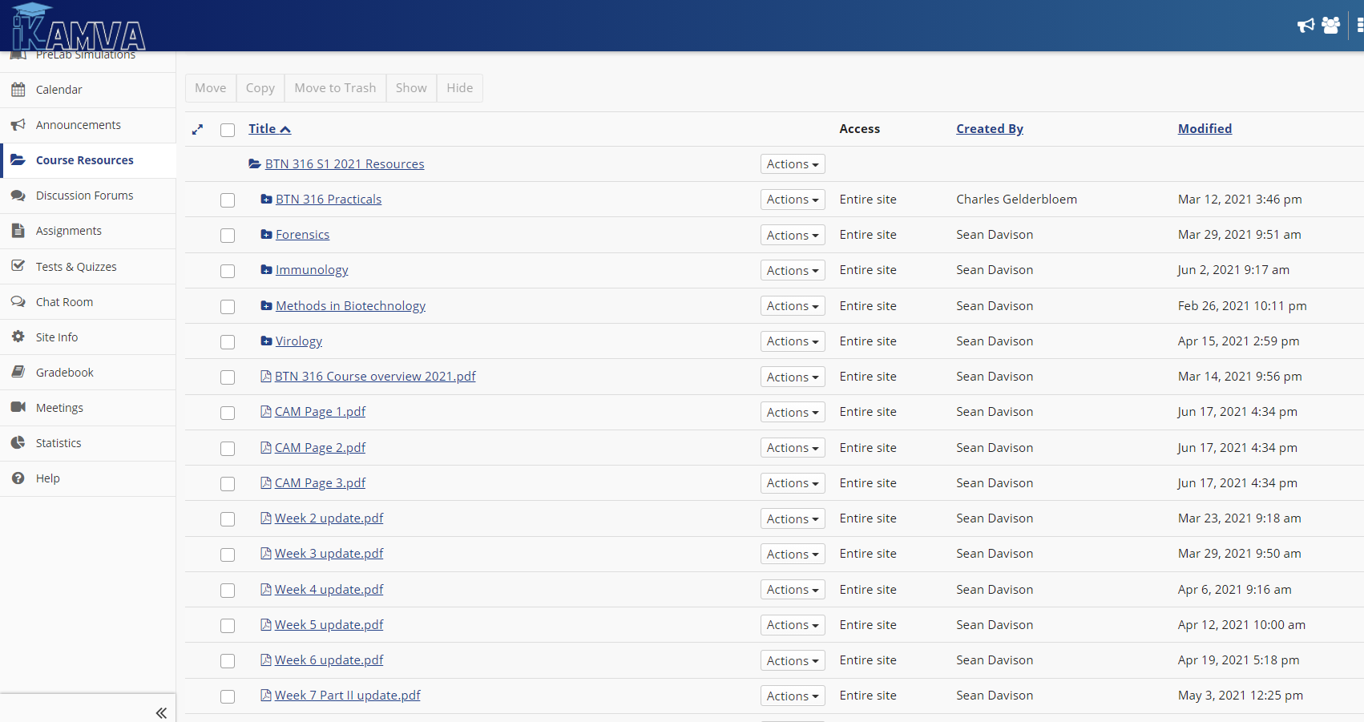
Flipped-Classroom: During Lecture
LMS- Branded iKamva at UWC
Repository
Structured Resources
“Not a dumping site”

Slide 12
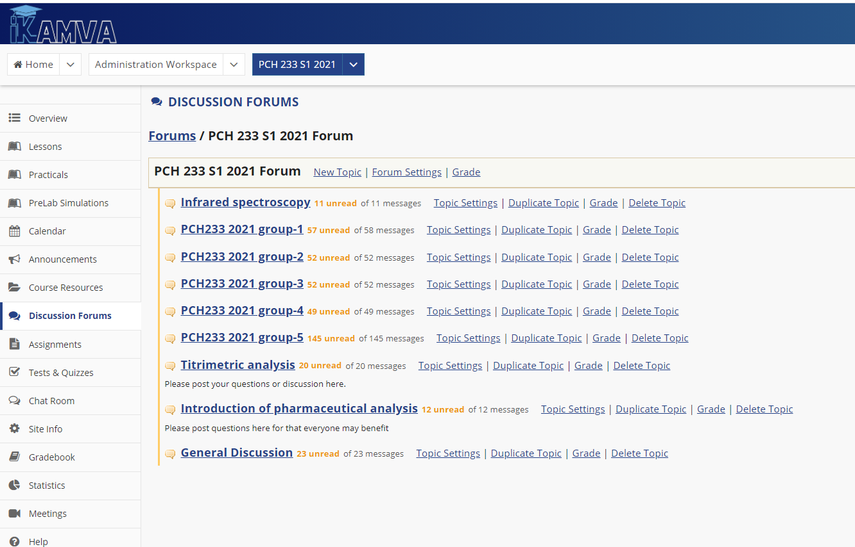
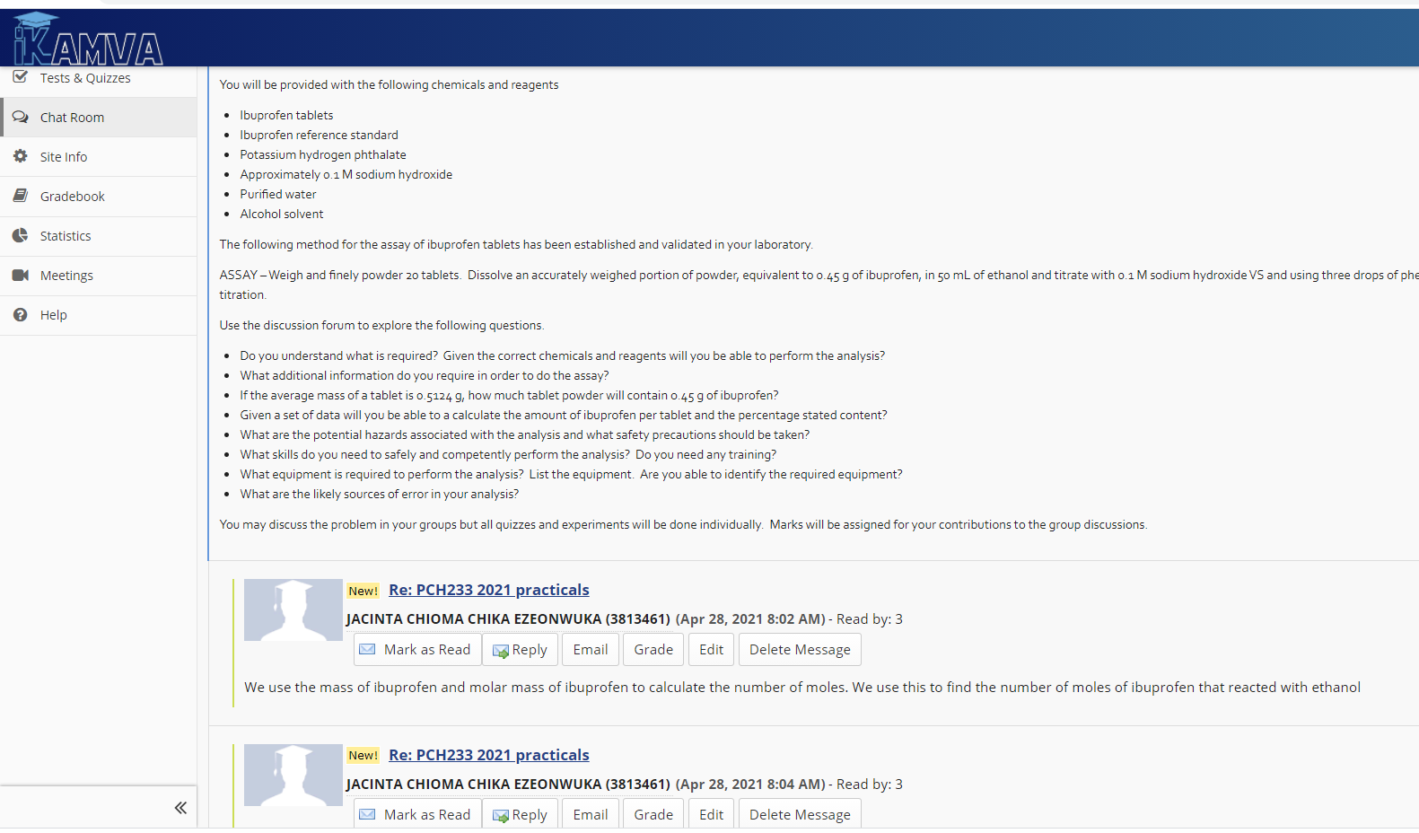
Flipped-Classroom: Post Lecture
Create discussion topics
Engage in discussion related to theory and related simulations

Slide 13
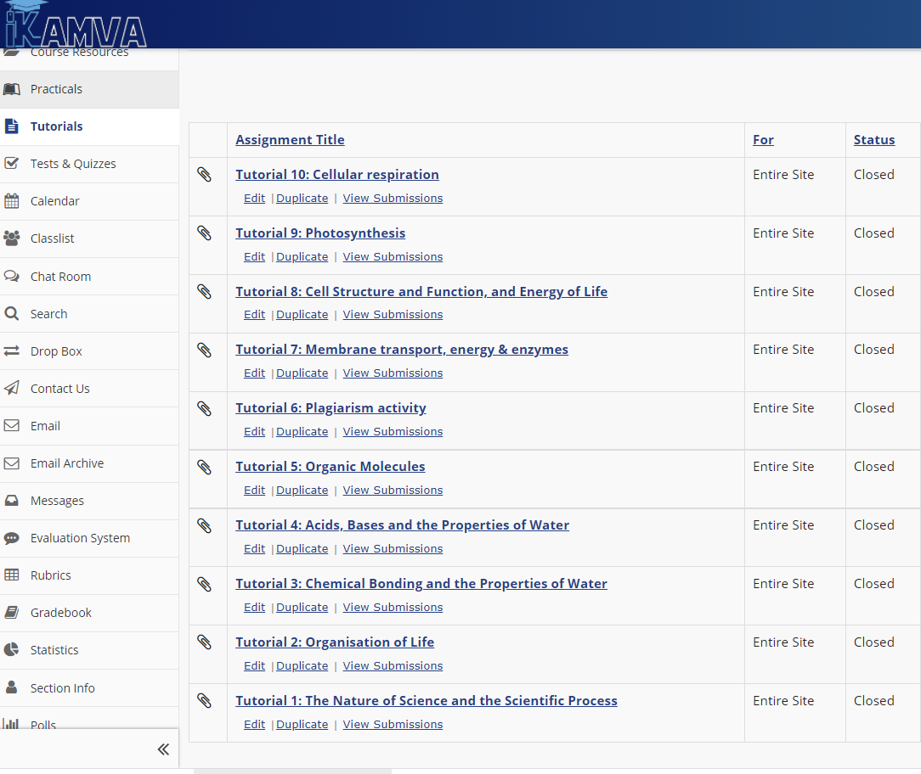
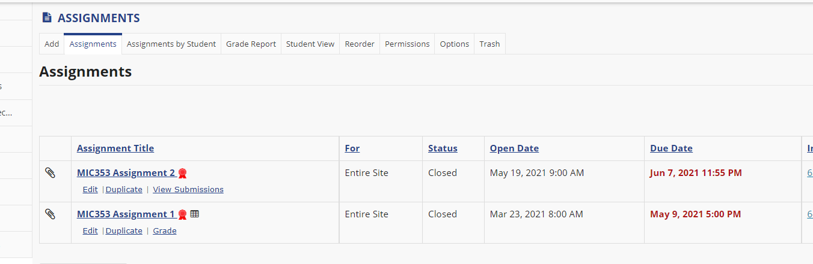
Flipped-Classroom: Post Lecture [Assessment]
Supporting tutorial sessions
Practical Assignments
Aligned to Turnitin (anti-plagiarism detection)
Theory and practical

Slide 14
Integrated Smart Worksheets: How was it used? Online Assessment
The Smart worksheets (aligned to the pre-lab simulations) is a collection of customised worksheets preloaded with auto-generated data
enables students to analyse and complete calculation activities.
Worksheets include a broad range of disciplines across Bioscience, Chemistry, and Mathematics.

Slide 15
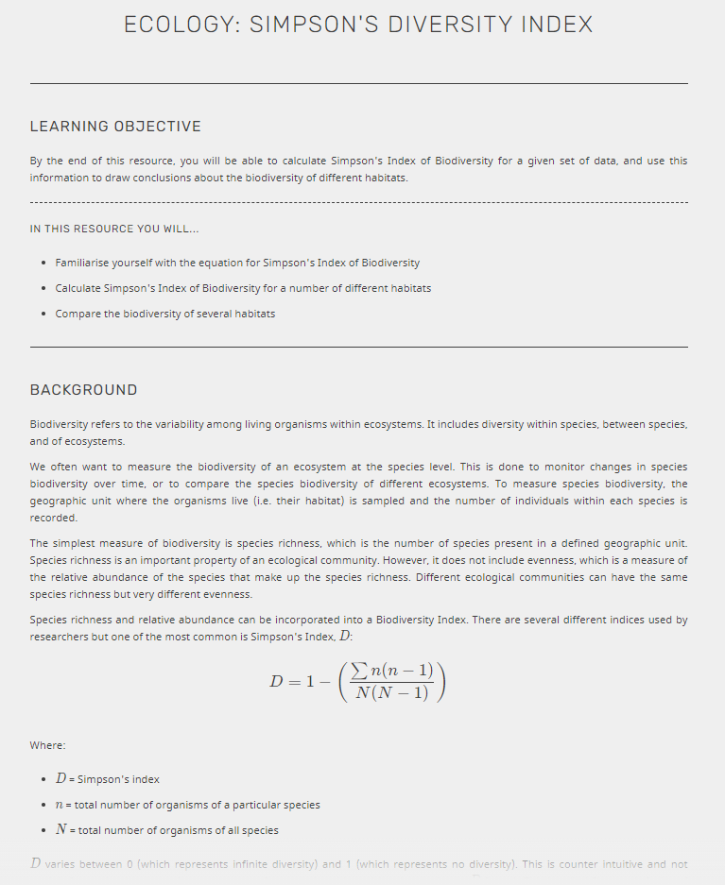
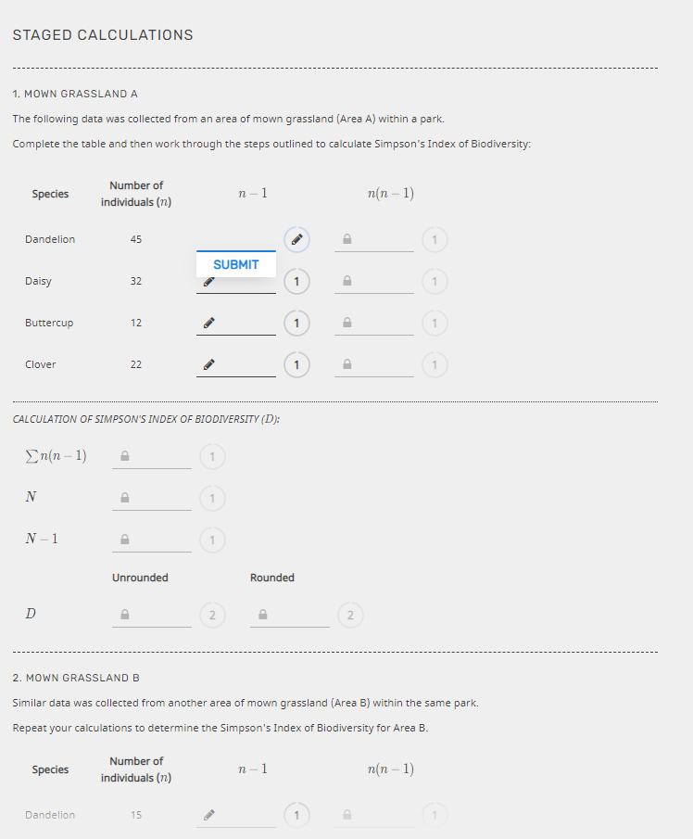
Smart Worksheet: Student Engagement
Student engagement in worksheet
Alignment to theory and simulation (practical)
Reinforcement
Attainment of skills, knowledge & competencies
‘New world of work’

Slide 16
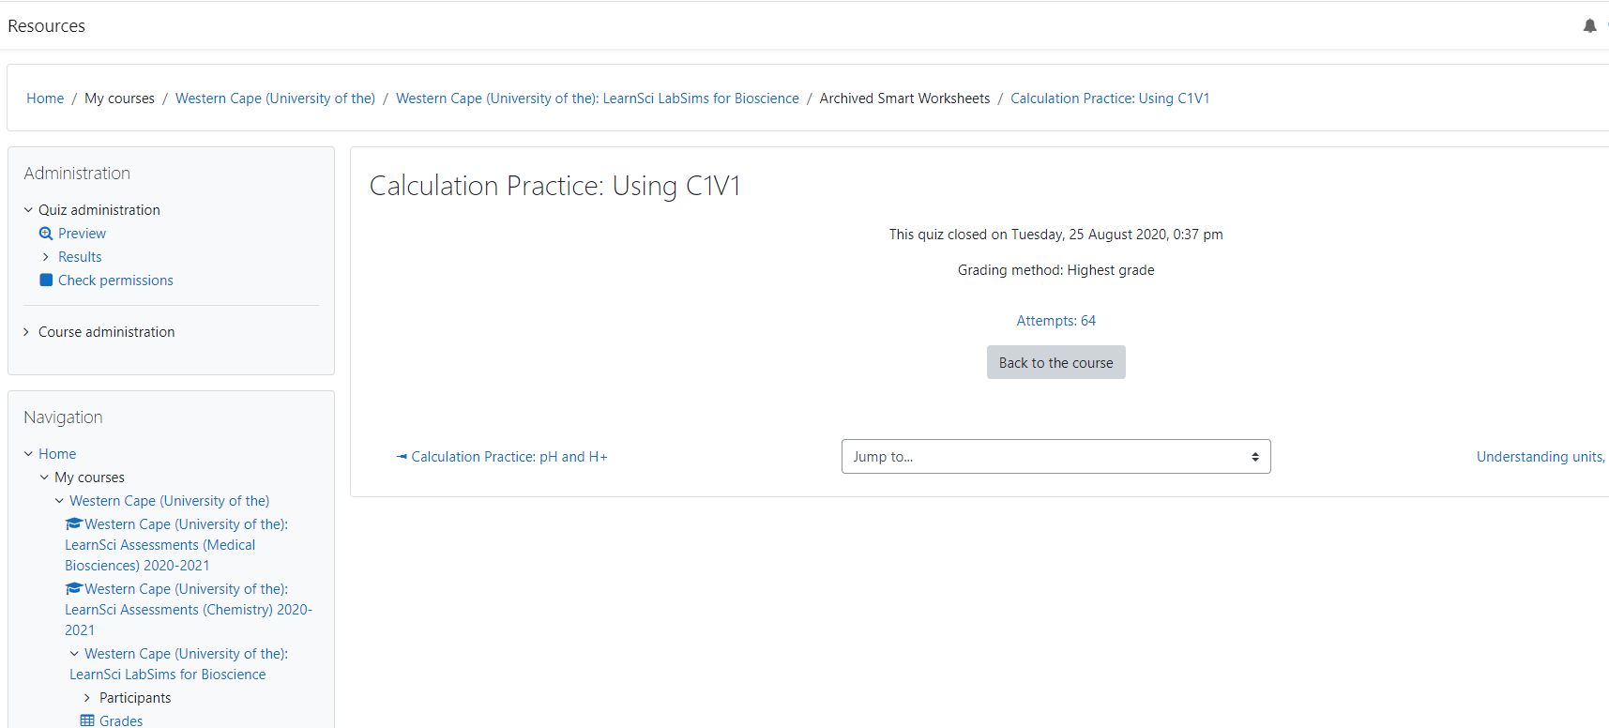
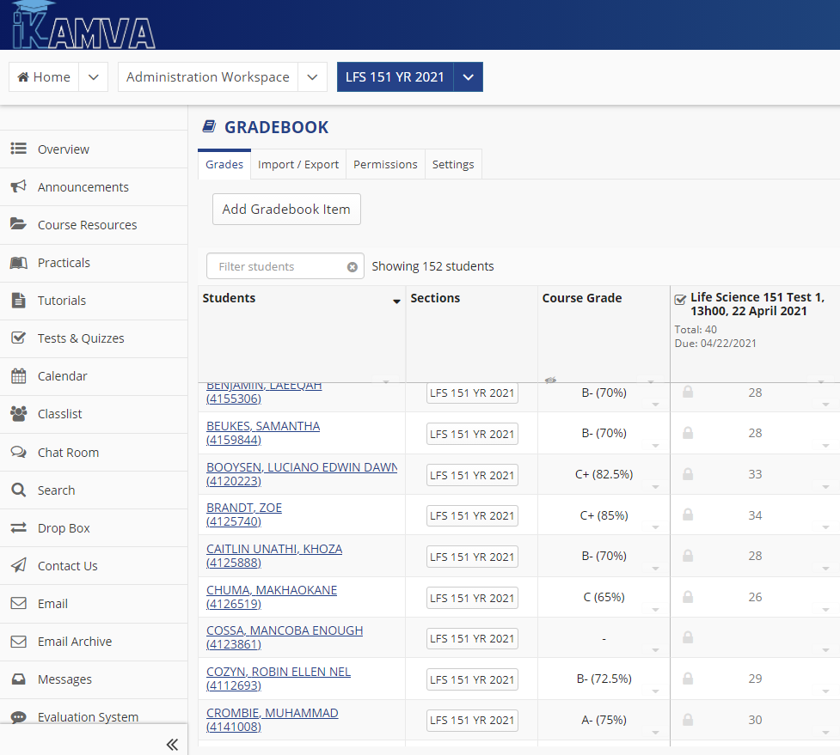
Integrated Smart Worksheets: Aligned to Themes and Topics
Continuous assessment
Multiple attempts
Self-directed learning
Self-assessment
Integrated Gradebook tool (LMS)

Slide 17
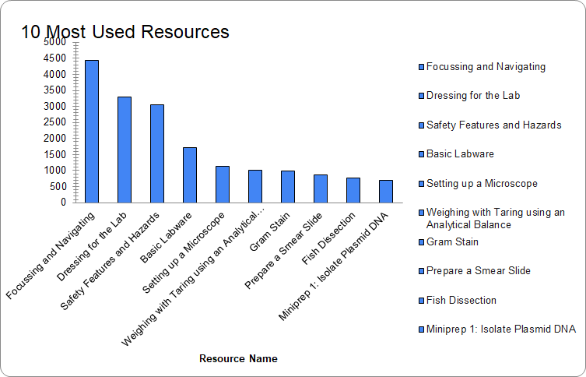
Statistics: Use of Chemistry LabSims
Chemistry LabSim Assessments has been accessed a total of 43 473 times.
Learning Science Chemistry resources were integrated into iKamva via LTI (Learning Tools Interoperability) standards.
*Stats retrieved 11 June 2021

Slide 18
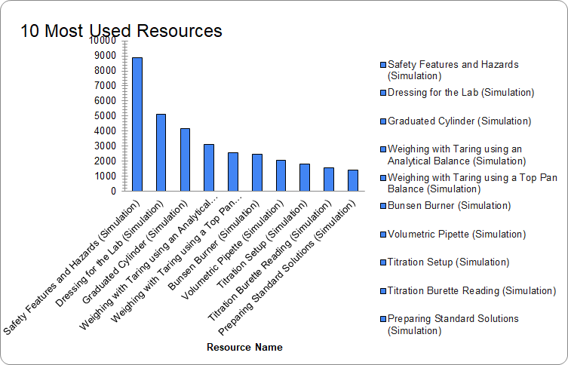
Statistics: Use of BioScience LabSims
Bioscience LabSim Assessments has been accessed a total of 28 944 times.
Learning Science Bioscience resources were integrated into iKamva via LTI (Learning Tools Interoperability) standards.
*Stats retrieved 11 June 2021

Slide 19
Ensure Stable System and Effective Design
The CIECT Software Developers work closely with the Learning Science Support team when integrating and testing the Simulations and Smart Worksheets
Once UWC Science lecturers completed the LabSim Assessment request form and submitted the form to the Learning Science team, they provide the CIECT team with a list of resources to be added to the specific course
The Developers integrate the selected resources via the LTI (Learning Tools Interoperability) “External Tool” within a specific course
Following the integration,the CIECT Instructional Design Team structures the Prelab- Simulations within the modules via the ‘Lessons’ eTool within the specific course
Smart Worksheets allow integration within iKamva’s Gradebook tool, where student grades are recorded and lecturers are able to view students’ grades

Slide 20
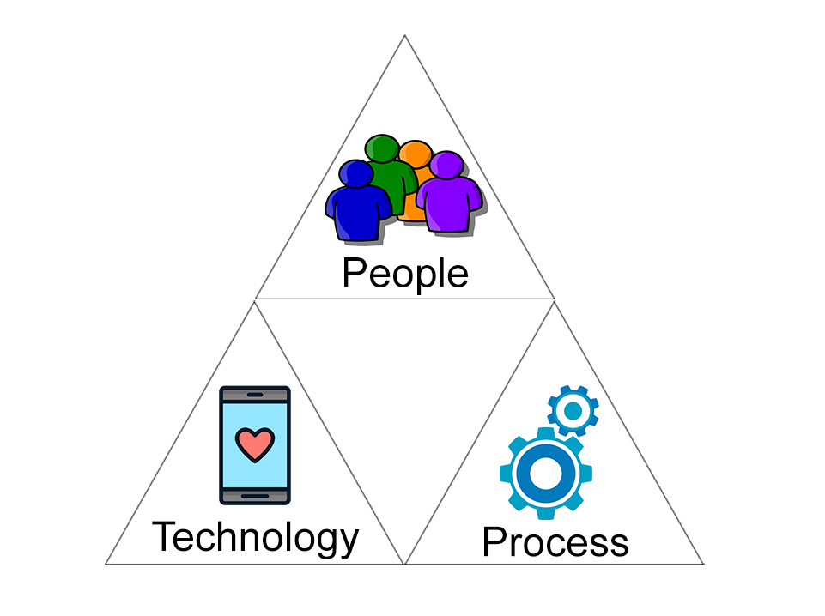
People, Process & Technology
People - Learning Science UK members, UWC Lecturers and CIECT Team, LMS (iKamva) Administrators & Developers, Students and Tutors
Technology- Learning Management System, Learning Science Resources
Processes – Important to ensure sustainable team processes in relation to integration, implementation, training, support; design and development of online environments.

Slide 21
Thank You
Centre for Innovative Education and Communication Technologies (CIECT)
Dr Juliet Stoltenkamp
Mr Faghad Khan
Ms Carolynne Kies

Slide 22
DISCUSSION

