Slide 1

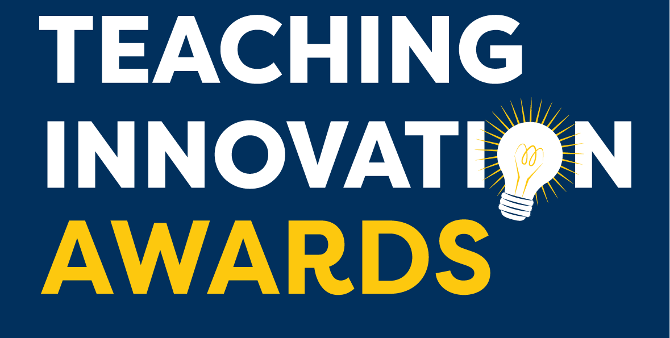

Horizons in STEM
Higher Education Conference 2021
Teaching Innovation Award Winners 2020 Workshop
Ashleigh Steele
Education Specialist
www.learningscience.co.uk
Notes:
Welcome everyone. My name is Ashleigh Steele, Education Specialist at Learning Science. Firstly, thank you to Trevor and Diane at the Open University, along with all the organisers of this conference, it is a pleasure to be here.
Today I will give a very brief introduction to Learning Science, our Teaching Innovation Awards and then introduce four of the outstanding 2020 winners who will share details of their projects and the positive impact they have had on their students.

Slide 2

200
university departments worldwide
15 years
developing digital solutions for
HE STEM
200
University departments worldwide
Notes:
Learning Science is an educational technology provider that work in close collaboration with universities world wide. We’ve been developing solutions for lab courses for over 15 years. Our experienced expert team is made up of scientists, web developers, instructional designers and education specialists.
We’ve been working closely with university partners for many years to provide bespoke digital solutions. Understandably with the COVID19 pandemic, the importance of these digital resources increased. We are confident that digital solutions are here to stay, to support in-person lab teaching.

Slide 3
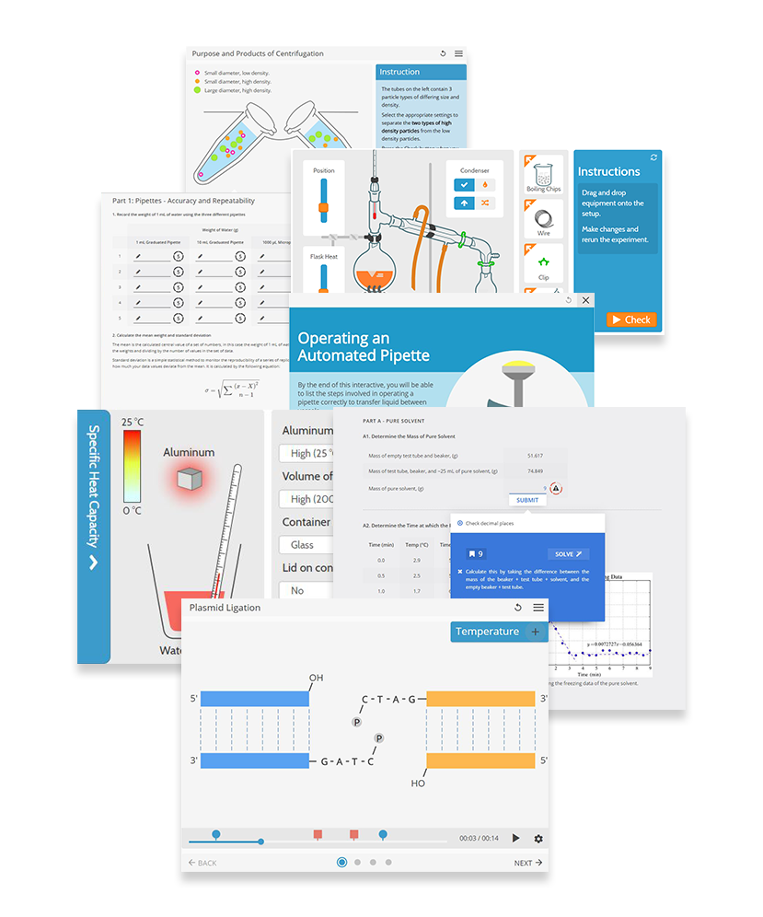
Cover a wide range of Bioscience and Chemistry topic areas.
Support scientific and workplace skill development
Practical lab skills
Data analysis
Graphing
Statistics
www.learningscience.co.uk
Notes:
Our resources, LabSims and Smart Worksheets, cover a wide range of Bioscience and Chemistry topics.
In addition our resources support scientific skill development including practical lab skills, preparing students for the lab and therefore maximising their valuable time in the lab. Along with data analysis, graphing, statistics and much more.

Slide 4
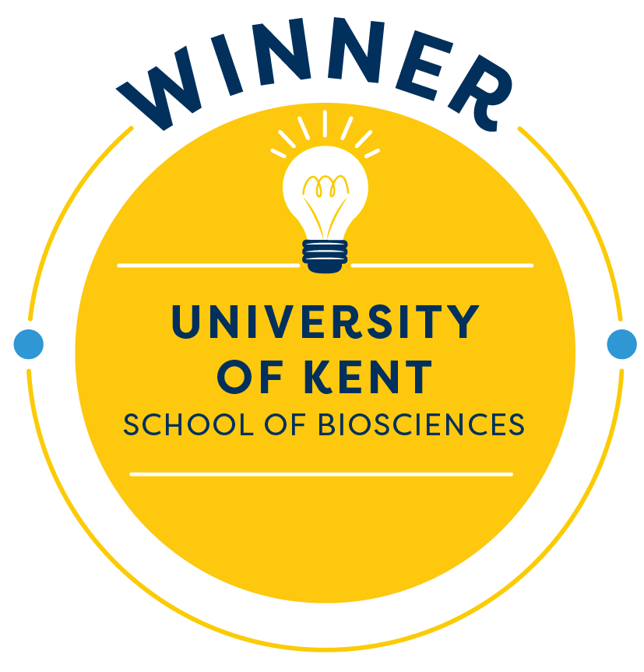
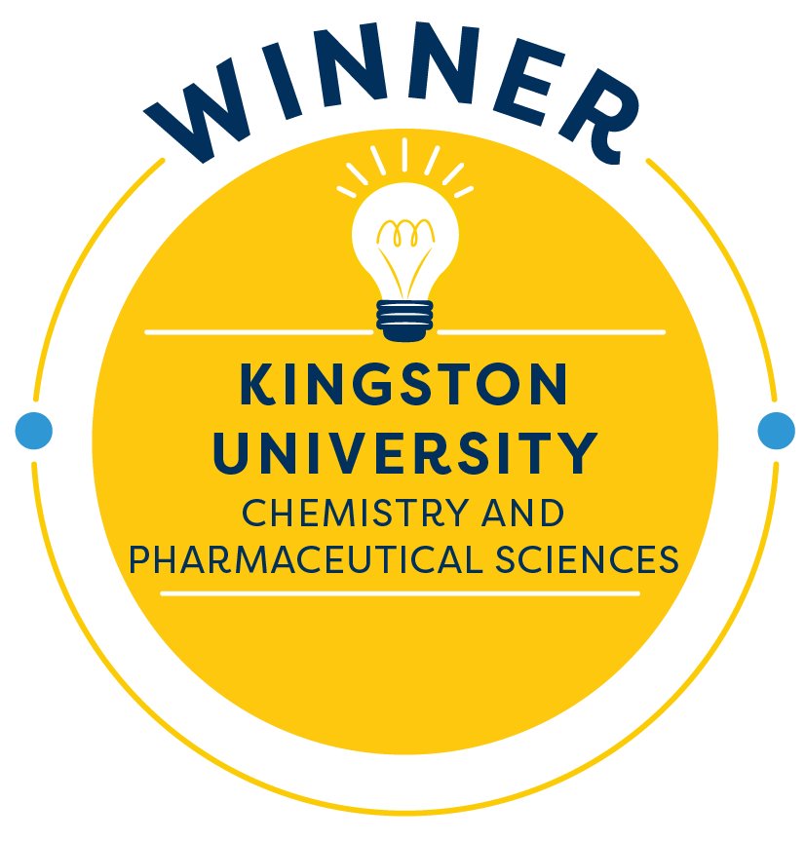
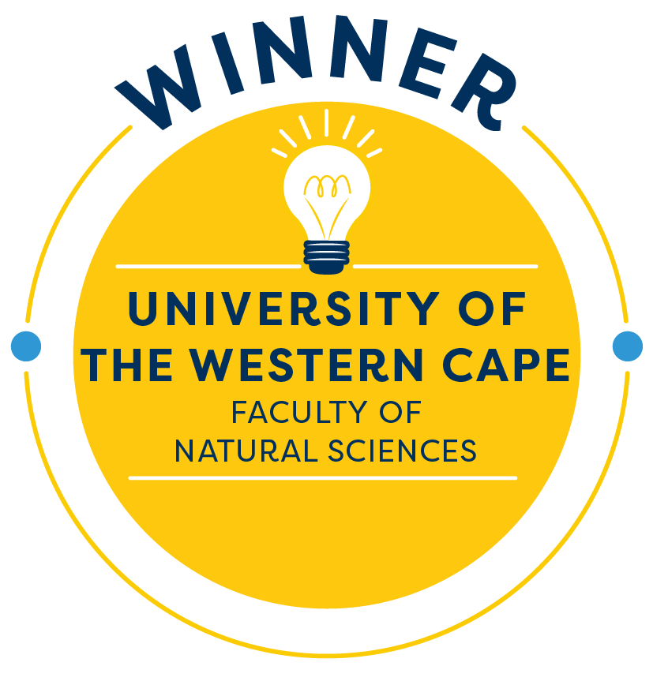
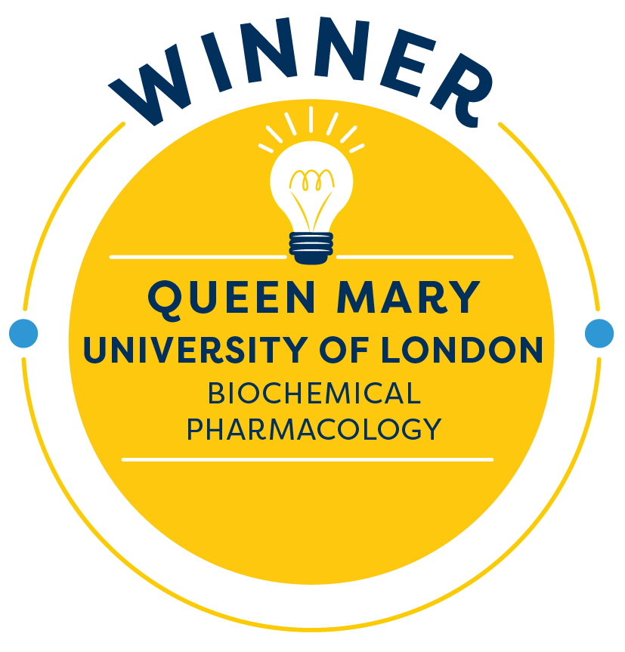
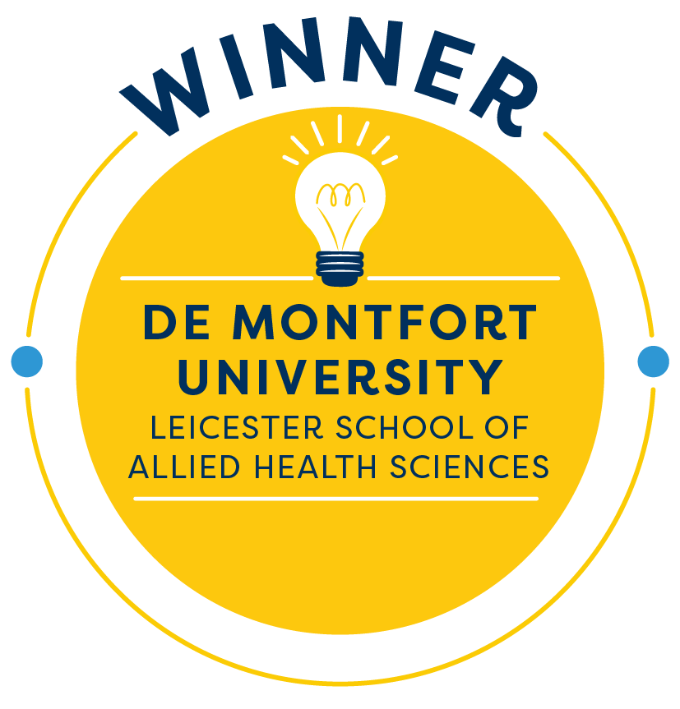
2020 WINNERS
Alexandra Moores & Francis Samra
David Gould & Sadani Cooray
Juliet Stoltenkamp, Carolynne Kies & Faghad Khan
Neil Williams, Gemma Shearman & Richard Singer
Furaiya Spibey,
Jo Rushworth
& Shabana Cassambai
Notes:
We believe in the dissemination of best practice, educational research and teaching innovation. Our partners were doing amazing things to innovate their teaching and learning, and we wanted to celebrate and share these outstanding practices. So the Learning Science Teaching Innovation Awards were launched last year and will continue to be an annual event.
The awards aim to support innovation to positively impact teaching quality and enhance student learning. Applicants demonstrated how they have led innovation in their institution using Learning Science resources and winners are chosen by an expert judging panel.
These five shown are the outstanding 2020 winners, and we have four of them today that are going to share details of their project and the positive impact it has had on the students.
There will be time for a few questions at the end of each presentation, so please put these in the chat.
So without further ado I shall welcome the first presenters, Alexandra Moores and Francis Samra.

Slide 5
Find out about all the Teaching Innovation Awards 2020 entries:
www.learningscience.co.uk/tia-2020-winners
Thank you to all applicants, our partners and the Horizons in STEM HE organisers.
We look forward to the Teaching Innovation Awards December 2021.
www.learningscience.co.uk
Notes:
Details of all the Teaching Innovation Awards 2020 entries and their innovative work can be found on our website. We hope this helps disseminate best practices.
Thank you to all applicants, our partners and of course the Horizons in STEM HE organisers.
We look forward to the Teaching Innovation Awards 2021.

