Slide 1
Success for All Students in the STEM Curriculum
Professor Paul C Taylor
Dean: Student Education (Experience)
University of Leeds

Slide 2
Overview
Continuation, Completion & Awarding Gaps
Inclusive Teaching Practice
Inclusive Student Opportunity
Sense of Belonging
Decolonisation of the STEM Curriculum

Slide 3
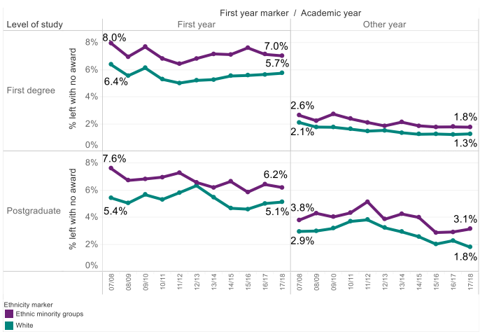
Continuation, Completion & Awarding Gaps
Non-continuation Gaps
UK-domiciled STEM
Joice & Tetlow, Royal Society (2020)

Slide 4
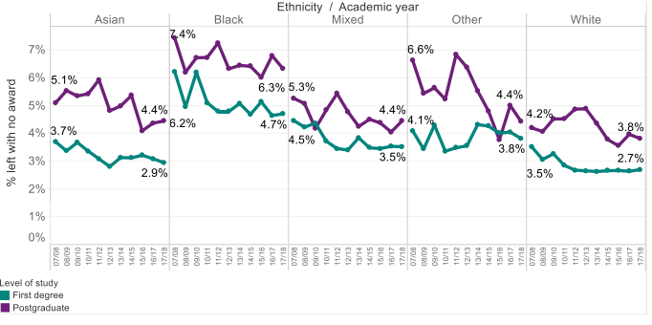
Continuation, Completion & Awarding Gaps
Non-Completion Gaps for UK-domiciled STEM students

Slide 5
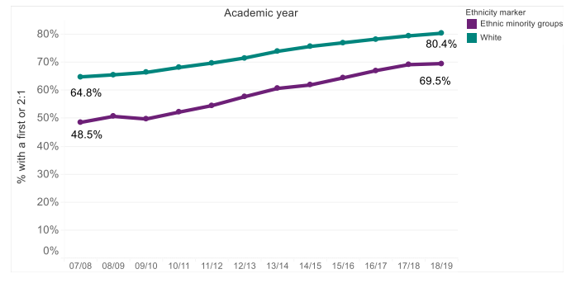
Continuation, Completion & Awarding Gaps
Awarding Gaps ("good" degrees) for UK-domiciled STEM students

Slide 6
Continuation, Completion & Awarding Gaps
Awarding Gaps ("good" degrees) for UK-domiciled STEM students
Awarding gap
between black &
white students =
19% in 2018/19

Slide 7
Overview
Continuation, Completion & Awarding Gaps
Inclusive Teaching Practice
Inclusive Student Opportunity
Sense of Belonging
Decolonisation of the STEM Curriculum

Slide 8
Inclusive Teaching Practice
Baseline Standard 1
We will ensure that all learning and teaching practices, activities, and supporting materials, can be used by all students. (Reasonable adjustments may still be required in some circumstances.)
Baseline Standard 2
We will release materials in advance so that students have sufficient time to engage with them prior to scheduled sessions.
Baseline Standard 3
We will ensure that there is an appropriate range of assessment methods at a programme level, and that the language used in assessment tasks is clear.

Slide 9
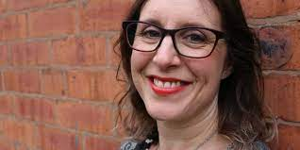
Inclusive Teaching Practice
Baseline Standard 4
We will ensure that colleagues with marking responsibilities are up to date with the inclusive marking policy.
Baseline Standard 5
The University will support staff to achieve these baseline standards.
Baseline Standard 6
Schools will identify academic inclusivity leads to help embed guidance in local contexts.

Slide 10
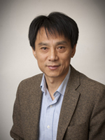
Inclusive Teaching Practice
Digital Accessibility in Chemical & Process Engineering (Xiaojun Lai)
The biggest challenge for digital accessibility is the large number of modules and wide range of types of teaching document.
Intern Ella Burn has done a fantastic job. In the beginning, the School provided Ella access to selected modules and worked on files for improvements. From there, she has become familiar with the methods.
In the later period of the internship, we decided to explore all the documents of all the 63 SCAPE modules of Semester 1, which has been successfully done. With more than 11 thousand Minerva files reviewed, a summary of performance (categories of low, medium, high and perfect) was provided. Particularly, for each of the 63 modules, a detailed table summarised with the score and the main accessibility issues of each document (including Word, ppt and pdf) was provided. A clear step by step instruction was provided as to how to fix different types of problems that generated.
It was valuable to get interns together and generate the top tips/golden rules, from which internship experiences can be exchanged between schools.

Slide 11
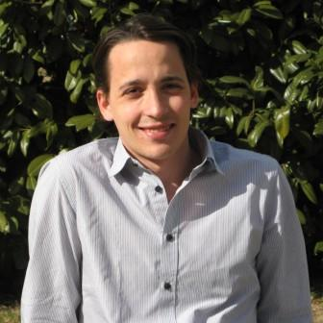
Inclusive Teaching Practice
Accessible Scripts in Maths (Martín Lopez-Garcia)
The biggest challenge that we face to inclusive practice in Maths is the wide use of PDFs with inaccessible equations and mathematical content.
These PDFs are typically generated in a variety of ways (from MS Word, LaTeX, scanned, etc), and different solutions need to be considered for each of these sources.
Particularly challenging are documents fully generated from LaTeX. At Leeds, we have identified HTML as a natural format to replace or complement LaTeX-generated PDFs containing mathematical content, where equations can be displayed in an accessible way (e.g. compatible with screen readers).
Solutions to generate HTML versions of these documents include the LaTeXML package or the RMarkdown language. These allow to generate accessible HTML documents containing mathematical content, while still using LaTeX to create your equations.

Slide 12
Overview
Continuation, Completion & Awarding Gaps
Inclusive Teaching Practice
Inclusive Student Opportunity
Sense of Belonging
Decolonisation of the STEM Curriculum

Slide 13
Inclusive Student Opportunity
Evidence suggests opportunities such as placements lead to better degree outcomes
Are our internal processes allowing all students equal access to opportunities?
Are we confident all providers of opportunities use inclusive practice?
Some students have particular difficulties with application processes, interviews etc.
Can we offer opportunities ourselves to students who need them?
C.M. Jones, J.P. Green & H.E. Higson (2017) Do work placements improve final year academic performance or do high-calibre students choose to do work placements?, Studies in Higher Education, 42:6, 976-992

Slide 14
Sense of belonging
Never underestimate the difference you can make

Slide 15
Defining sense of belonging
‘students’ sense of being accepted, valued, included and encouraged by others (teacher and peers) in the academic classroom setting and of feeling oneself to be an important part of the life and activity of the class. More than simple perceived liking or warmth, it also involves support and respect for personal autonomy and for the student as an individual’
Goodenow (1993)

Slide 16
A few ideas
Give
Give students a chance to discuss the challenges they face
Use
Use names as much as possible
Show
Show awareness of diversity and talk about different student characteristics, such as part-time, carer and mature students
Allow
Allow students to choose whether or not to contribute online
Leave
Leave cameras on as much as possible – familiar faces count
Share
Share information about your own life if you are comfortable doing this
Offer
Offer a range of times when students know they can contact you
Remember
Remember cultural differences and expectations of teachers

Slide 17
Overview
Continuation, Completion & Awarding Gaps
Inclusive Teaching Practice
Inclusive Student Opportunity
Sense of Belonging
Decolonisation of the STEM Curriculum

