Slide 1
Training the Lively mind
Toward a signature pedagogy for cybersecurity education
horizons in STEM Higher Education Conference:
Making Connections, innovating and sharing pedagogy
29th – 30th June 2021
The open university, UK
Dr. Ashley J. H. Gess

Slide 2


In the us,
Attacks happen every
39 seconds

Slide 3
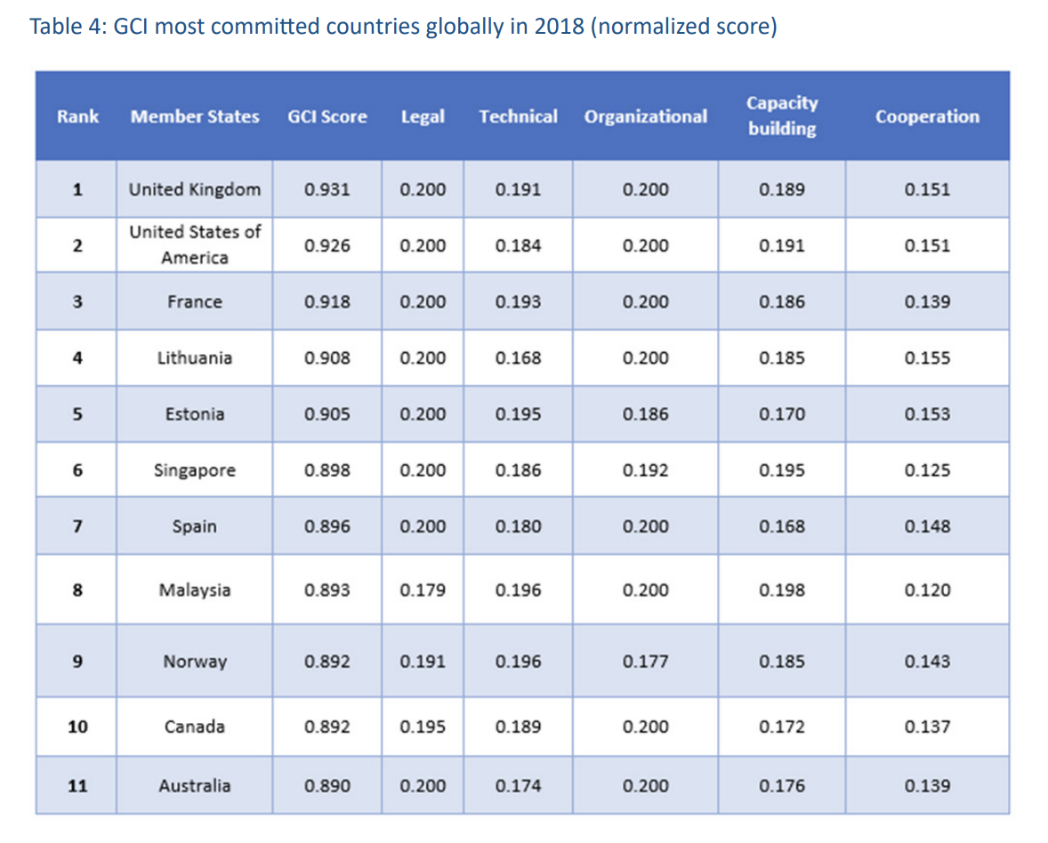


https://dataprivacyblog.com/the-glacial-movement-of-global-cybersecurity/
https://www.itu.int/dms_pub/itu-d/opb/str/D-STR-GCI.01-2018-PDF-E.pdf

Slide 4


Threats to one are threats to all

Slide 5
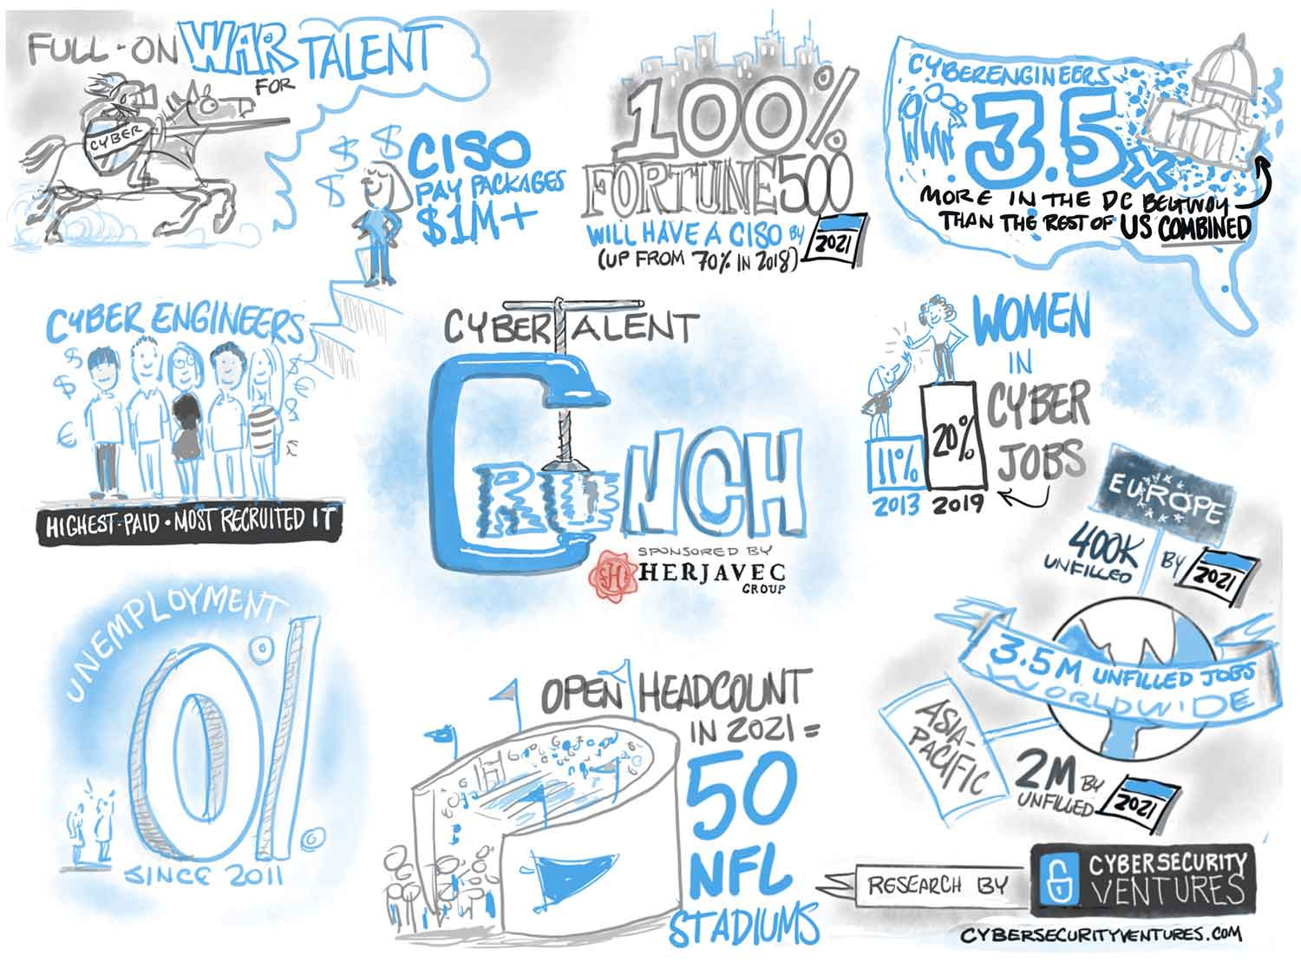
350 percent growth in open cybersecurity positions from 2013 to 2021
2019/2020 Official Annual Cybersecurity Jobs Report is sponsored by Herjavec Group
Cyber Talent Shortage Undermines U.S. in Cyber Warfare
https://www.newsweek.com/cyber-talent-shortage-undermines-us-cyber-warfare-1601384

Slide 6


Slide 7

Signature Pedagogy How professionals “think, perform, and act with integrity” in their profession.
(Shulman, 2005)

Slide 8
Surface Structure
Concrete, operational acts of teaching and learning
Showing and demonstrating
Questioning and answering
Interacting and withholding, etc
Deep Structure
Assumptions about how to best impart a certain body of knowledge and know-how.
Implicit Structure
Moral dimension that comprises a set of beliefs about professional attitudes, values and dispositions.
(Shulman, 2005, p. 54-55)

Slide 9
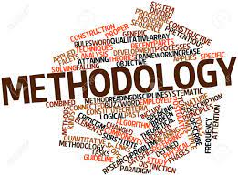
Mixed Method
Quantitative Survey
Qualitative Focus Group
Qualitiative Interview

Slide 10

Surface Structure
Case Study
Experiential Learning
Gamify
Certifications
Research
Standards
https://cybersecurityventures.com/jobs/
Implicit Structure
Ethics
Dispositions

Slide 11
Deep Structure
Bricolage
Questions
Breaking stuff
Keeping current
Curiosity
Exploring

Slide 12
Conclusions
A Unique LIVELY MIND
“..you need to have a lively mind…”

Slide 13
The Design Process

Slide 14
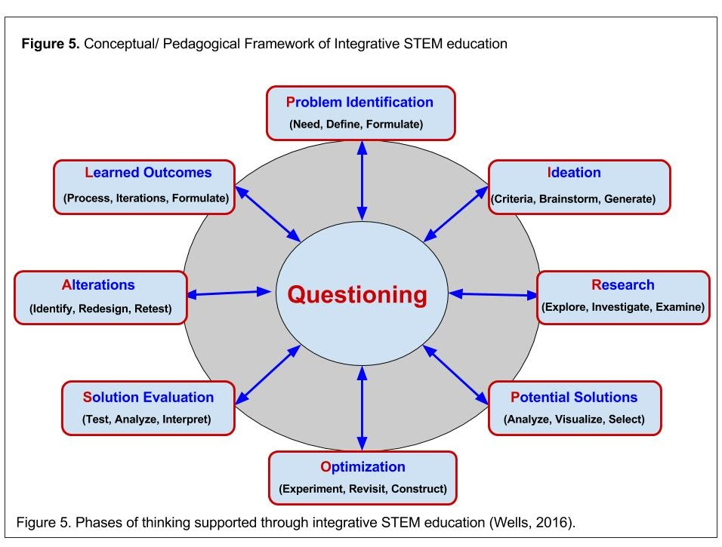

Slide 15
Integrative STEM Education: A pedagogical approach where the teacher or professor intentionally plans for students to apply the content and practices of science and math through the design process in outcomes of engineering or engineering technologies.
Integrative STEAM Education: A pedagogical approach where the teacher or professor intentionally plans for students to apply the content and practices of science and math through the design process in outcomes of engineering, engineering technologies, or arts.

Slide 16
Questions? Comments?
Dr. Ashley J. H. Gess,
Assistant Professor of STEM & STEAM Education
Augusta University
Augusta, GA, USA
Agess@augusta.edu

