Slide 1
Learning & Teaching Adjustments within the Mathematical Sciences in Response to the Covid-19 Pandemic
Matthew Henley¹
With Michael grove¹, Rachel Hilliam², kevin Houston³ & Duncan lawson⁴
¹University of Birmingham, ²Open University, ³University of leeds, ⁴Coventry University

Slide 2
Methodology
      Thorough survey conducted relating to teaching arrangements, exam arrangements, student experience and plans for the future
      37 departments responded to the survey, representing 65% of UG and PGT students of mathematical sciences
      Short follow-up survey relating to academic misconduct

Slide 3
Findings
  This is an ongoing piece of work and what follows is a first analysis of the results from the survey
  A practitioner survey will be conducted through the TALMO initiative by Michael Grove, Rachel Hilliam, Kevin Houston, Duncan Lawson and myself
  We are intending to publish our findings

Slide 4
Delivery of new material
 | Percentage of departments that indicated they are using each method to this extent (n=37)
 | We do not use at all | Some modules use | Most modules use | All modules use
Live in-person lectures delivered on-campus | 70% | 14% | 11% | 5%
Live lectures delivered synchronously online | 35% | 32% | 22% | 11%
Pre-recorded lecture-based material, primarily recorded in a previous academic year | 68% | 32% | 0% | 0%
Pre-recorded lecture-based material, recorded specifically for the 2020/21 academic year | 3% | 30% | 32% | 35%
“We have had much student feedback valuing synchronous online lectures where lecturers decided to use that approach.”
“Online activities are welcomed by some students as they provide flexibility with their timetable.”

Slide 5
Other teaching arrangements
  Arrangements for problem classes, computer labs and tutorials were broadly similar across departments
  Challenges identified concerning student engagement in online sessions
  Use of breakout rooms to encourage students to work together on problems
“Frequently it's a sea of black, silent screens.”
“Another problem is of course in getting students to engage in Zoom classes. There are various strategies (use of polls, chat, encouraging spoken answers) but no single thing works very well.”

Slide 6
Approaches to written assessment
 | Percentage (and number) of departments using this format (n=34)
Short release | 47% (16)
Intermediate release | 9% (3)
24 hour release | 20% (7)
48 hour release | 12% (4)
Unclassified | 12% (4)
“Due to access concerns, and how tight time limits might negatively affect certain groups, we felt that it would not be right to impose significant time constraints on exams.”
“Due to grade inflation and cheating … we reduced the exam window from 24-hour to (n+1)-hour”
Notes:
(5 mins up to here) Now as I said at the start, how departments were running exams was of particular interest, and so we started by asking departments to detail exactly what their arrangements were. 34 departments said they were using written assessment. But where they differed was in the amount of time they allowed students to do this. You can see from the table that just under half of departments were categorised as following a short release format, by which I mean … But over half of respondents were using a longer release format, whether that be an intermediate release of between 6 and 9 hours, or a 24 hour or 48 hour release. 4 departments did not neatly fit into one of these categories, including 2 depts who were yet to decide, one who were entirely continually assessing students, and one whose approach was more complicated and fell somewhere between a short and intermediate release. So as you can see, there are a variety of approaches being used and so I was interested in departments reasons for using one approach over another and their experiences of using it. Lots of departments using a longer release said it was more accommodating of students, and students studying in other time zones were of particular concern. But several depts using a short release said that they were doing so in attempt to minimise the opportunity for cheating.

Slide 7
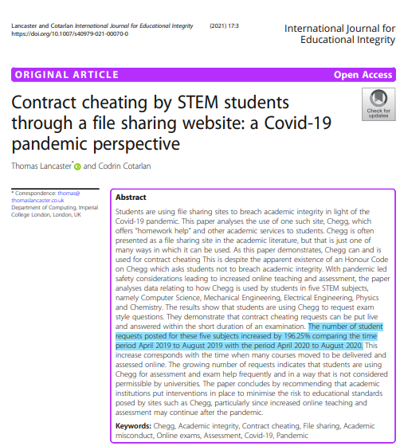
Academic misconduct
“There were clear cases of the questions being asked (and answered) on the internet.”
“There were clear cases of the questions being asked (and answered) on the internet.”
“We had heard from others that issues of collusion were more rife in the 24 hour version.”
“We had heard from others that issues of collusion were more rife in the 24 hour version.”

Slide 8
Follow-up survey
  8 (out of 12) departments identified cases of plagiarism
  11 departments identified cases of collusion
  5 departments identified cases of contract cheating
“[6 or 7] students were supposed to have divided up exam questions between themselves for the first hour or so of the examination, shared findings between themselves, then spent the remaining 90 minutes copying from other solutions.”
“We found over 500 of our exercises on internet forums, primarily Chegg.com. This term, 15 students (out of about 250) in one year cohort have been identified as posting questions on Chegg (and all of whom have now admitted to doing so).’’

Slide 9


Slide 10
Question Randomisation
  In the initial survey, 51% of respondents indicated they have used some question randomisation this year
“We were concerned about the workload in setting these up ... and possible confusion in marking, but it turned out to be much easier than we thought.”
“Each paper has somewhere up to 8-10 variants, with changes such as notation, numeric parameters, different choices of function to consider etc.”
“For this question, choose the starting position corresponding to the last digit of your student number.”

Slide 11
Setting clear expectations
  More communication to students and staff regarding acceptable exam conduct
  Communicating any sanctions imposed on individuals to the whole student body
“We hope that as word gets around of students being caught out and punished, students will be put off thinking about doing this.”

Slide 12
Other solutions identified
  Reducing duration of exam
  Viva examinations
  Watermarking exam papers
  Proctoring/invigilation

Slide 13
Student Community
 | Percentage of departments that considered and took action to address each of the following challenges (n=37)
 | Considered and took some action to address | Considered but did not take action to address | Did not consider this as important
Students might feel isolated in their studies | 92% | 8% | 0%
Lack of opportunities for peer-to-peer learning | 81% | 19% | 0%
First year students in particular might struggle to make friends on their course | 78% | 22% | 0%

Slide 14
Student Community
  Networking sessions, Maths discussion rooms, quizzes etc.
  In general, interest in departmentally organised sessions has been low
“It would seem that a student-led approach to motivating students to engage is preferable”
“Year 3 students set up their own Discord server; this has proved a very useful addition - it provides academic and informal pastoral peer support.”

Slide 15
Future plans for Teaching
  17 departments envisaged greater use of ‘blended learning’ or the ‘flipped classroom’ approach
  3 departments anticipated a return to face-to-face lectures and indicated they thought students would prefer this
“Online activities are welcomed by some students as they provide flexibility with their timetable and they’re more efficient in reducing travel time.”
“The bulk of lecture delivery should return to face-to-face mode, and there is very strong student expectation that this should happen when it becomes possible to do so.”

Slide 16
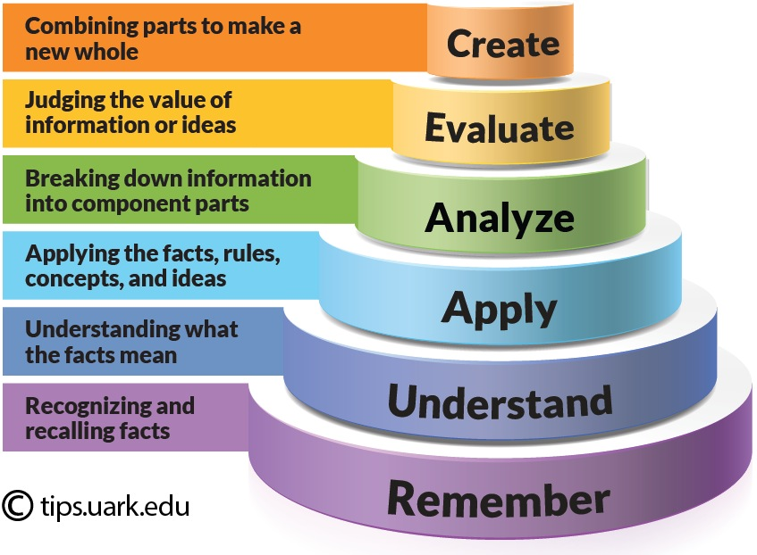
Future plans for Assessment
  4 departments considering online assessments
  An additional 6 considering open-book assessments
  More assessment of higher-order skills
  5 departments considering giving more weight to coursework
  More low-stakes quizzes to keep students engaged throughout the term
  Electronic marking “is less of a rigmarole”

Slide 17
Areas to consider in the future
Greater investigation into the best approach for online written assessments
How to minimise the risk of academic misconduct in online exams
The use of synchronous lecture-based material in online courses
How to engage students in online sessions
The potential of the flipped classroom approach to teaching

