Slide 1

Design and application of the LIVChoices web app to signpost programme pathways for C100 Biological Sciences students.
Dr. Rachel Floyd
Biosciences Building G61
floyd78@liverpool.ac.uk
@DrRachelFloyd

Slide 2

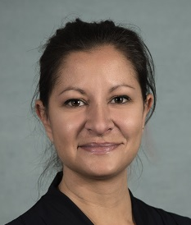
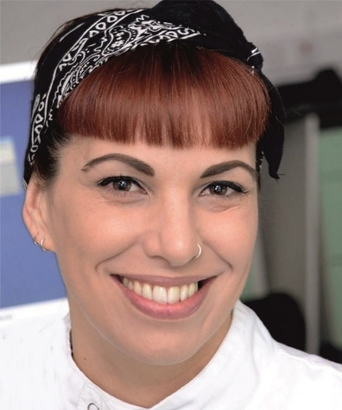
Meet the Team
Dr Rob Treharne
Technology Enhanced Learning SoLS
Prof Zen Lewis
C100 Deputy PD
& Director of Employability
Dr Rachel Floyd
C100 BiolSci
Programme Director

Slide 3
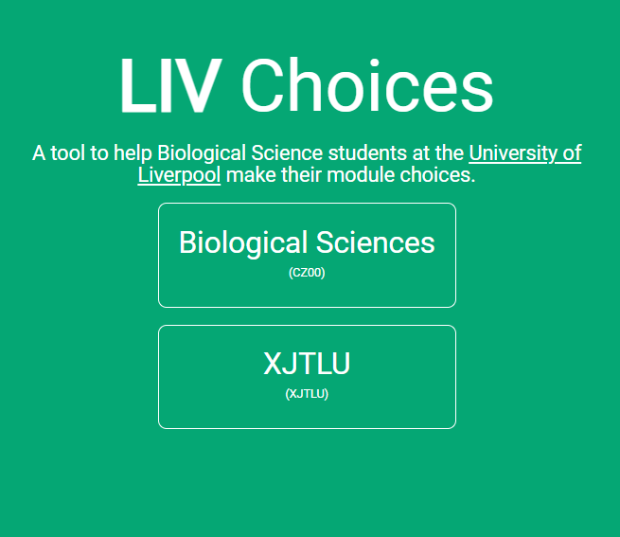
PAST
PRESENT
FUTURE

Slide 4










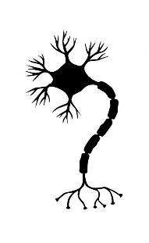


ANATOMY & HUMAN BIOLOGY
BIOCHEMISTRY
BIOLOGICAL & MEDICAL SCIENCES
BIOLOGICAL SCIENCES
BIOVETERINARY SCIENCES
SoLS Programmes
GENETICS
WHOLE ORGANISM
BIOMOLECULAR
HUMAN PHYSIOLOGY
MICROBIOLOGY
PHARMACOLOGY
TROPICAL DISEASE BIOLOGY
INFECTION
BIOMEDICAL
ZOOLOGY

Slide 5
What is Biological Sciences?
Biological sciences encompass a broad area of specialist subjects linked to the study of living organisms and the science behind ‘life’
WHOLE ORGANISM
BIOMOLECULAR
INFECTION
BIOMEDICAL

Slide 6
Cross-disciplinary Curriculum
“Modern biology research requires a breadth of skills that go well beyond the limited set of experiences that undergraduate biologists are exposed to in their traditional biology courses”
Louis Gross 2004 Cell Biol Educ
“Understanding the unity and diversity of life requires mastery of a set of fundamental concepts. This understanding will be greatly enhanced if biology courses build on material begun in other science courses to expose students to the ideas of modelling and analysing biological and other systems”
Bio2010 Transforming Undergraduate Education for Future Research Biologists
Strategy 2026 Digital fluency, Confidence, Global Citizenship

Slide 7


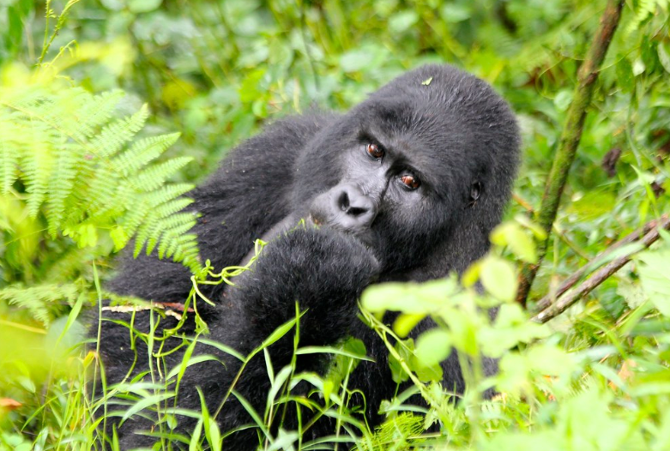
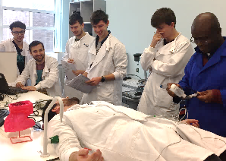
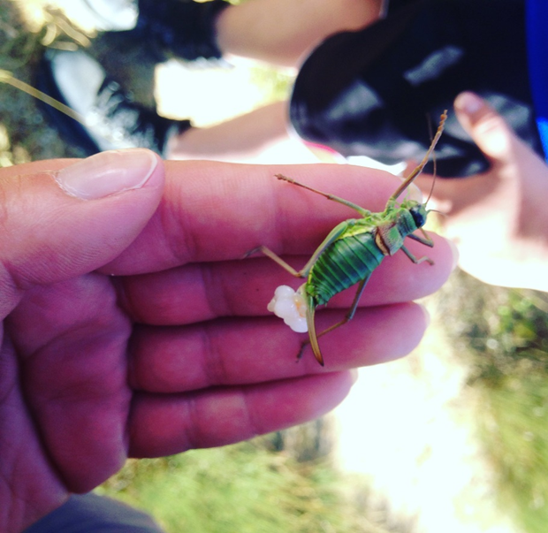
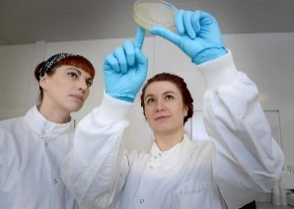











The C100 Programme
YEAR 1
YEAR 2
YEAR 3
Semester 1
Life Sciences
foundation modules
Biological Sciences
intermediate modules
Biological Sciences
advanced modules
Theory modules
Practicals
Tutorials
Field courses/labs
Theory modules
Research project
Advanced skills
Field courses/labs
Semester 2
Biological Sciences
introductory modules

Slide 8
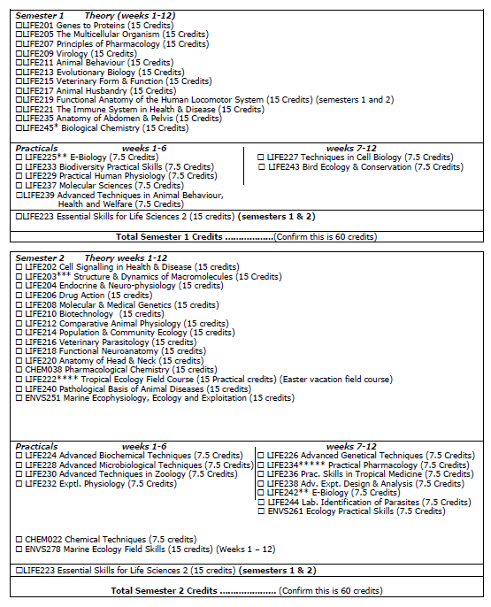
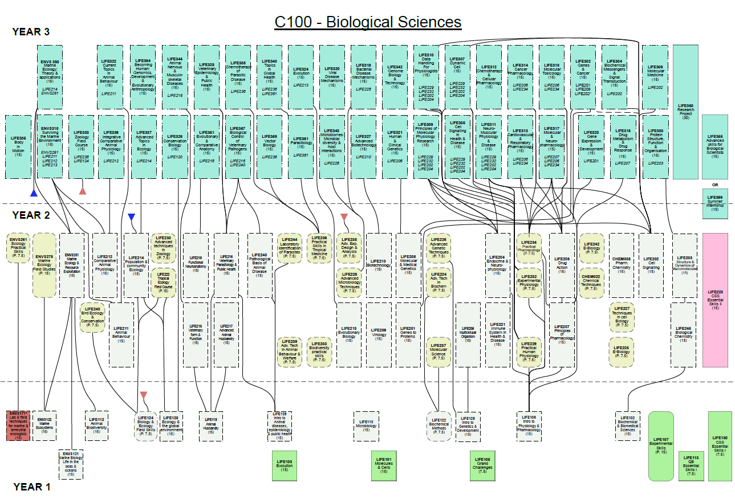
2017/18 Choosing modules

Slide 9
PRE-REQUISITES
STAFF TIME
DIFFICULTIES ARISING FROM EXTENSIVE FLEXIBILITY OF MODULE CHOICE
COHESIVE PROGRAMME
CREDIT BALANCE
APPLICANTS
TOO MUCH CHOICE
PARTNER UNIVERSITIES
TIMETABLING

Slide 10
LIVChoices Development
  Analytics of common module choices
  Staff and student feedback
SURVEY
  Identify external host – ADD, Open Days
  Identify ‘rules’
BUILD
  Roll out to Year 2 students on 22nd April 2018
  Survey students May 2018
TEST
  Respond to feedback and update
UPDATE

Slide 11


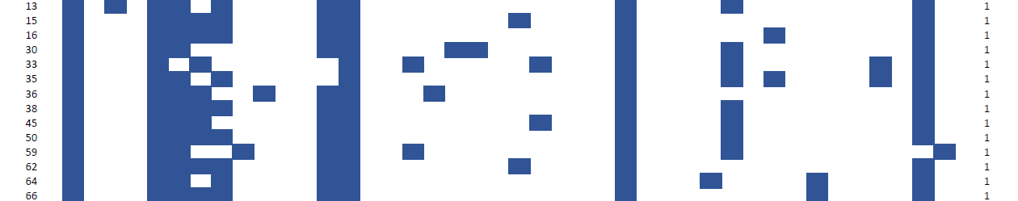










LIFE223
ENVS215
ENVS251
ENVS261
LIFE211
LIFE212
LIFE213
LIFE214
LIFE215
LIFE216
LIFE217
LIFE222
LIFE230
LIFE233
LIFE238
LIFE239
LIFE240
LIFE201
LIFE202
LIFE203
LIFE208
LIFE209
LIFE210
LIFE224
LIFE225
LIFE226
LIFE227
LIFE228
LIFE237
LIFE242
LIFE204
LIFE205
LIFE206
LIFE207
LIFE218
LIFE221
LIFE229
LIFE231
LIFE232
LIFE234
LIFE236
LIFE244
LIVChoices Development
SURVEY
WHOLE ORGANISM
BIOMOLECULAR
BIOMEDICAL
INFECTION
Analysis completed by Dr Alan Boyd – SoLS Data Manager

Slide 12
LIVChoices Development
LIVCHOICES
RELEASED
SURVEY
2018
JAN | FEB | MAR | APR | MAY | JUN | JUL | AUG | SEPT | OCT | NOV | DEC
ANALYTICS |  |  |  | SURVEY STUDENTS
APP DEVELOPMENT |  |  |  | ‘AMAZON’ FEATURE
 |  |  |  | PRE-REQUISITE OVERIDE |  | LINK TO MODULE SPECIFICATIONS
BUILD
LIVCHOICES2
RELEASED
TEST
2019
JAN | FEB | MAR | APR | MAY | JUN | JUL | AUG | SEPT | OCT | NOV | DEC
 | XJTLU ADDED |  |  |  |  | ROLL OUT TO ALL C100
 |  | 30 PRACTICAL CREDITS |  |  |  |  | ANALYTICS
 |  |  | UPDATE FOR IPHONES |  |  |  |  | APP2 DEVELOPMENT
UPDATE

Slide 13
Key Features
BUILD
Students see modules upfront to design their programme
Helps calculate total module credits for each semester
Helps students quickly identify module pre-requisites
Recommends complementary modules
Generates a transcript of module choices to be approved by PD
Identifies potential timetable clashes between practicals
Students can “fiddle” with choices before registering

Slide 14
LIVChoices Impact
TEST
RECRUITMENT
RETENTION
Dr Rob Treharne – Innovation of the Year 2019 at UoL Staff Awards

Slide 15
LIVChoices Development
  Survey Year 1 – 3 students before building LIVChoices3
  Survey Year 1 – 3 students after launching LIVChoices3
SURVEY
  Integrate Study Abroad module mapping
  Integrate programme pathways
BUILD
  Launch LIVChoices3
TEST
  Respond to survey feedback and retire LIVChoices Legacy
UPDATE

Slide 16
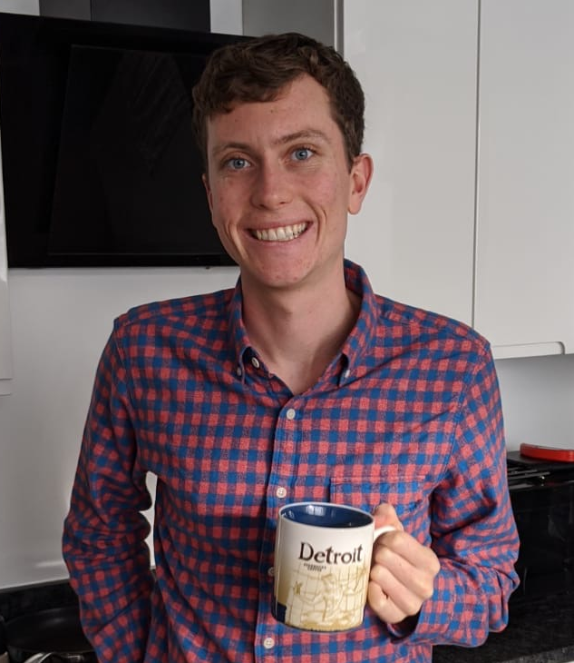
Integrate Pathways
UPDATE
John Newman
(C100 → C400)
Transferred to Genetics
LIFE128
LIFE110
LIFE102
LIFE122
LIFE201
Summer project: Medical microbiology
Hons project: Drosophila melanogaster to study genetic mutations in cancer
PhD: Factors influencing urinary tract infections caused by Pseudomonas aeruginosa
LIFE210
BIOMOLECULAR
LIFE213
LIFE208

Slide 17
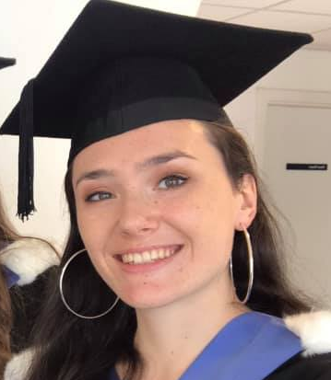
Integrate Pathways
UPDATE
Rosie Clewett
(C100)
Graduated as BiolSci
LIFE112
LIFE118
LIFE120
LIFE124
LIFE212
Study abroad: Hong Kong
Uganda Field Course
LIFE399: British Ecological Society
Hons project: Blue Planet Aquarium
MRes: Biodiversity, Evolution & Conservation, UCL
LIFE216
WHOLE ORGANISM
LIFE222
LIFE240

Slide 18
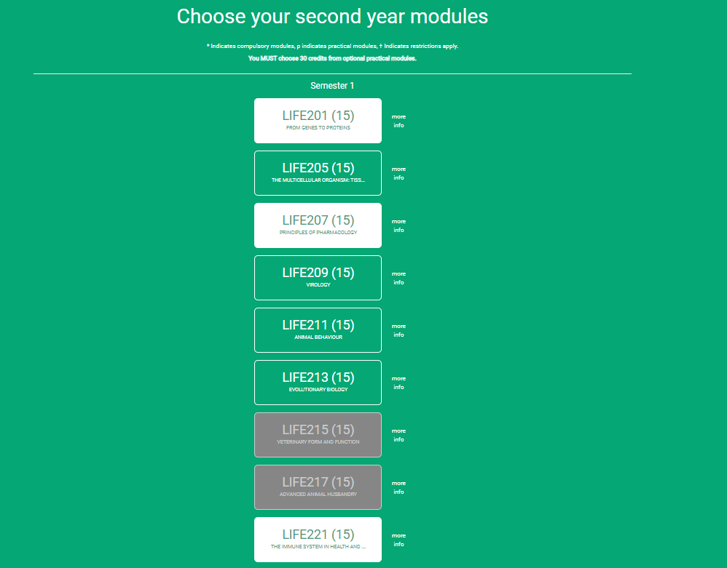
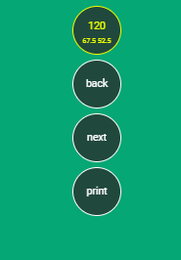
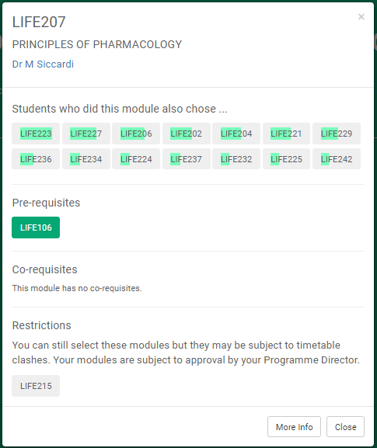
Study Abroad Mapping
UPDATE
Study Abroad Equivalents
AUSTRALIA
N. AMERICA
ASIA

Slide 19

http://www.livchoices.com

