Slide 1

Enhancing Programme Management to enable Programme Leadership:
A Roadmap for Programmes
STEM Horizons 21 paper 56
Tuesday 29th June 2021
Notes:
Both: Introductions

Slide 2
Biological Sciences Undergraduate Suite
500 students
36 modules
5 programmes
4 year leads
1 programme administrator
1 programme leader

Slide 3

Notes:
Eva: Context and Challenge (new PL, suite big and messy) 2m

Slide 4
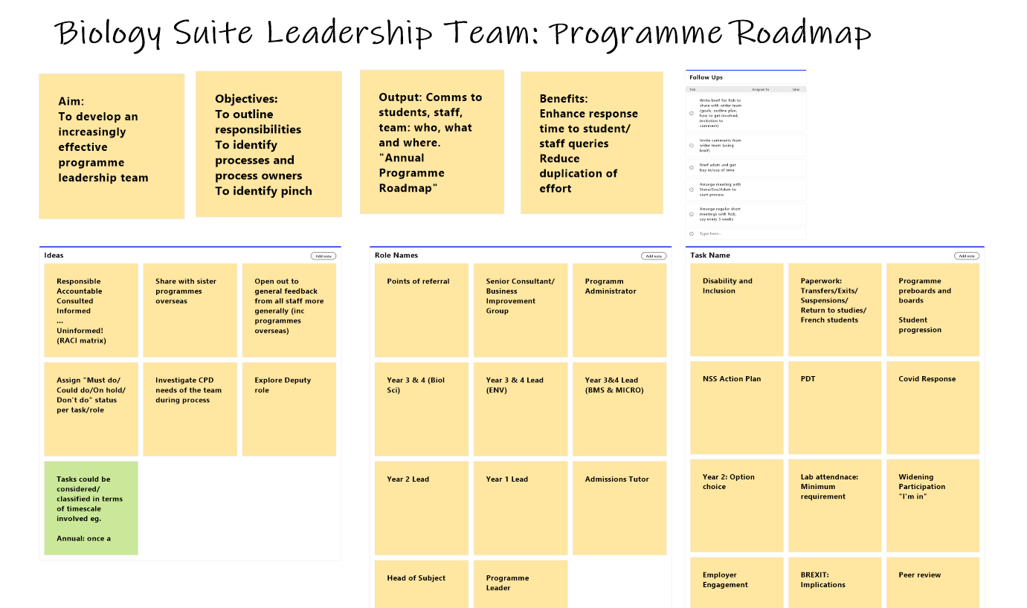

initial brainstorming
of roles and tasks
online
Notes:
Steve: Approach taken and background to it (make it visible, don't over think, try RACI) 2m

Slide 5

Notes:
Eva: How the approach went down with the folks (RACI needed adjustment) 2m

Slide 6
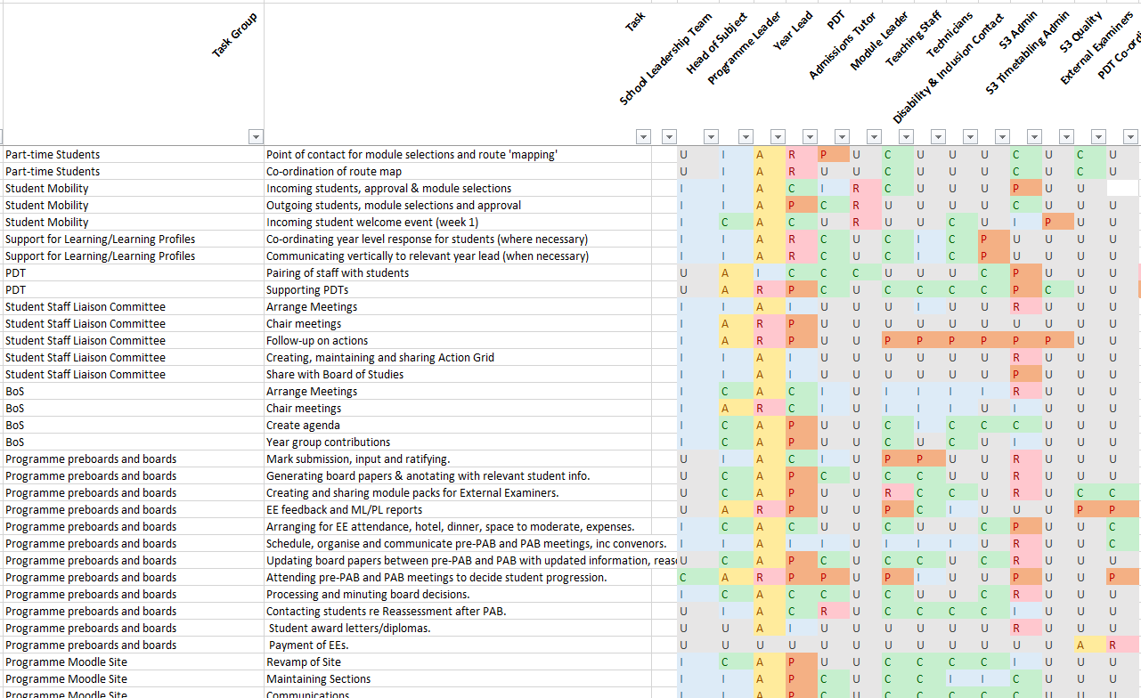


grouping the information in a format
where we can sort and filter
and add useful functions
Notes:
Steve: Observations about how the process is the thing not the outcome (making it was partly the value the journey is the destination) 2m

Slide 7

Notes:
Eva: How it is now used day to day, and how the relationship with Steve helped enable 2m

Slide 8























Interest so far
E. Malone & S. Yorkstone; ‘Building a programme roadmap: managing the management to focus on educational leadership’, in J. Lawrence, S. Morón-García & R. Senior (forthcoming) Supporting Course and Programme Leaders in Higher Education: Practical Wisdom for Leaders, Educational Developers and Programme Leaders, Routledge

Slide 9
Role Ambiguity & the Programme Leader
Research is being conducted to form a masters dissertation, which aims to reduce role ambiguity in the context of the Programme Leader role at the University, and evaluate the existing support mechanisms in place, including this programme roadmap.
Some of the initial findings :
The importance of culture & networks of support
Scope of the Role
“I found myself in a situation where focusing the programme leadership was my day job, preparing teaching materials was what I was doing in the evenings and at weekends and then when I had to be in a classroom or as meeting then I fitted that into my day”
Notes:
Within my research, it is important to me to identify a specific area which would be beneficial to address for the specific research area. In this case discussions with members of the DLTE at the University throughout my masters placement with them led me to consider the ambiguous nature of the Programme Leader role. Therefore, this research plays a part in being able to better define the role and support those in it.
From the interviews I have carried out with School Leads and Programme Leaders so far, culture has been identified as playing an important role in setting the tone of the relationships Programme Leaders hold in the various relationships they need to maintain, and the importance of networks of support between Programme Leaders.
The scope of the role, as identified within the Literature Review was also emphasised at the interviews, emphasised by one interviewee: “I found myself in a situation where focusing the programme leadership was my day job, preparing teaching materials was what I was doing in the evenings and at weekends and then when I had to be in a classroom or as meeting then I fitted that into my day.”
Further interviews aim to form a complete picture of the role to establish commonalities across the institution to use as a basis to enhance the support mechanisms in place.

Slide 10
Thank you
Adam Satur (Programme Administrator), James Fontana (MSc Researcher), Dr Rob Briers (Head of Subject)
Edinburgh Napier University Department of Learning and Teaching, Life Sciences Subject Group, Biological Sciences Undergraduate Programme Suite
e.malone@napier.ac.uk s.yorkstone@napier.ac.uk
Notes:
Eva: Thank you to supporters

Slide 11
References / Reading
Edinburgh Napier University DLTE (2021). Programme Leader Operational Checklist 2019/20. [online] Available at: <https://staff.napier.ac.uk/services/dlte/PL/Documents/PL%20Checklist%20FINAL.pdf> [Accessed 12 May 2021].
Murphy, M., & Curtis, W. (2013). The micro-politics of micro-leadership: exploring the role of programme leader in English universities. Journal of Higher Education Policy and Management, 35(1), 34-44.
Cahill, J., Bowyer, J., Rendell, C., Hammond, A., & Korek, S. (2015). An exploration of how programme leaders in higher education can be prepared and supported to discharge their roles and responsibilities effectively. Educational Research, 57(3), 272-286.

