Slide 1
Student use of digital experience insights and transitions data to develop data literacy via undergraduate MPharm research projects
Elizabeth Newall,
Cristina De Matteis, Stephanie McDonald, Vibhu Solanki, Helen Boardman,
Celine Thien, Chidubem Ugwu,
Madihah Hussain and Po Kamta
Notes:
Elizabeth
1 min (00-01)

Slide 2
Session outline
Student use of digital experience insights and transitions data to develop data literacy via undergraduate MPharm research projects
Institutional context
Student digital capabilities at
University of Nottingham
Elizabeth Newall
(UoN Libraries)
Faculty context
Faculty of Science digital learning transition project
Stephanie McDonald (Digital Learning Lead, School of Psychology)
School context
Pharmacy student research projects
Vibhu Solanki
(Digital Learning Lead)
Madihah Hussain,
Celine Thien and Chidubem Ugwu
(MPharm students)
Notes:
Elizabeth
1 min (01-02)

Slide 3
Institutional context
Elizabeth Newall
(Senior Librarian – Digital Literacy, UoN Libraries)

Slide 4
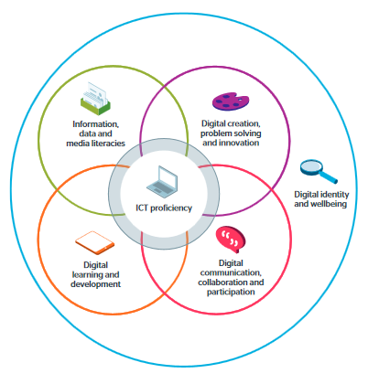
Student digital capabilities at UoN
Evidence-based enhancement work:
  Jisc’s Digital Discovery Tool
  Bespoke (UoN) alumni survey
  Jisc’s Digital Experience Insights surveys
Recommendations including:
  Greater student involvement in decision-making about ‘digital’
  Data literacy key priority for curriculum review
  Use of UoN data to support students’ data literacy
Student Digital Capabilities Delivery Plan:
  The Digital Student
  The Digital Researcher
  The Digital Graduate
Jisc’s Digital Capabilities Framework:
The Six Elements
Copyright: Jisc, Digital Capabilities Framework. Made available under Creative Commons CC BY-NC-ND licence
Notes:
Elizabeth - UoN context
2 mins (02-04)

Slide 5
Faculty context
Stephanie McDonald
(Digital Learning Lead, School of Psychology)

Slide 6

Faculty of Science: Digital learning transition project
Incoming UG students' digital learning experiences, perspectives, digital skills
Evidence-based approach to identify opportunities to further support student transition
  The Digital Student work package
Survey – some of the questions adapted from JISC’s Digital Experiences Insights survey (2020)
Focus groups
Notes:
Stephanie
2 mins (04-06)

Slide 7
School context
Vibhu Solanki & Helen Boardman
(Digital Learning Lead & Director of ESE, School of Pharmacy)

Slide 8

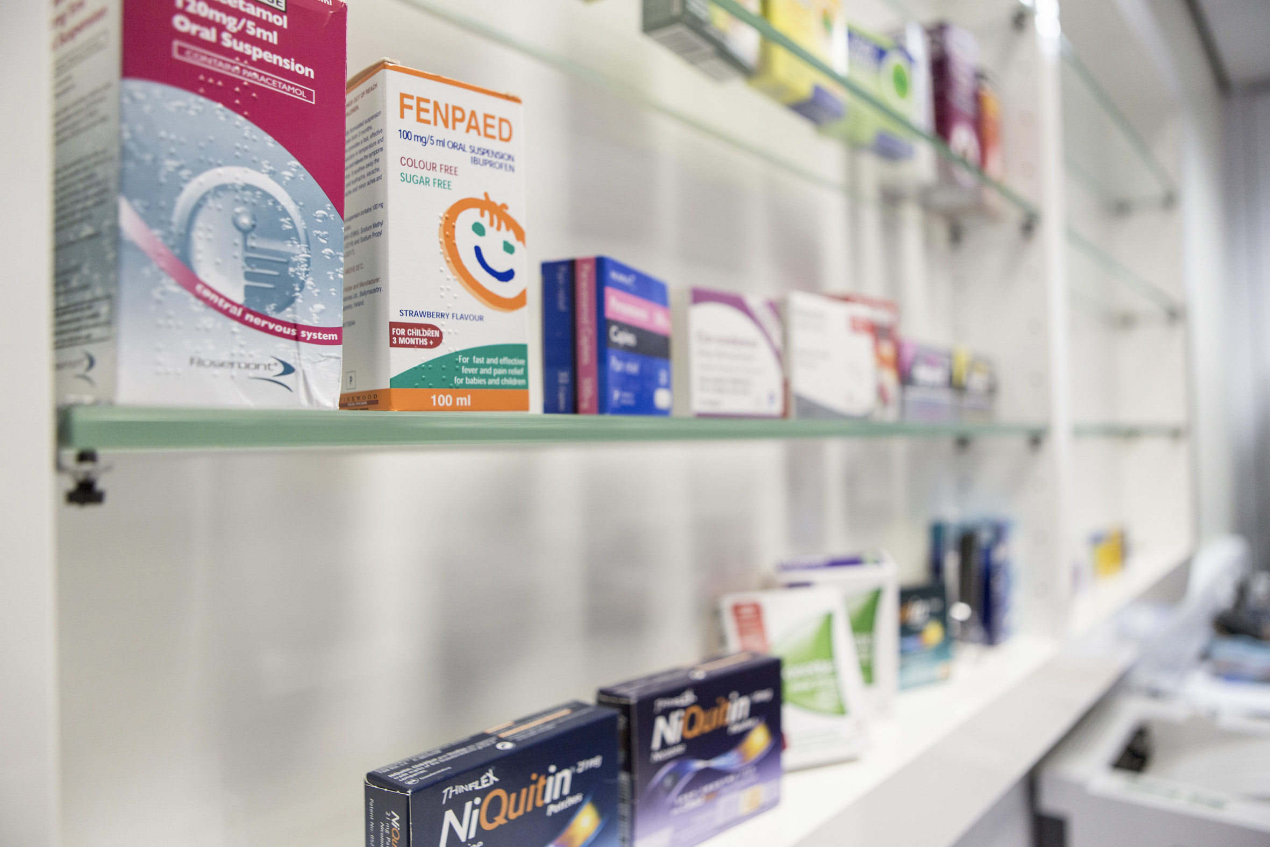
School of Pharmacy student research projects
Year 3 Research Projects/Digital Lead for Pharmacy
Working with Director of Education and Student Experience on T&L Strategy
Short Term- Student opportunity to analyse digital insights data
  Improvements to MPharm
  Student led recommendations
Long Term – Student projects from more schools in the faculty
  Continuous data analysis
  Student collaboration across faculty
  Student led recommendations to digital strategy
Notes:
Vibhu - Pharmacy context/motivations
2 min (06-08)
Mention Digital Learning faculty- delegate leadership into the school

Slide 9
Student experience
Madihah Hussain, Celine Thien and Chidubem Ugwu

Slide 10
The student experience – 3 research examples
Research questions and corresponding data sets
  Exploring and supporting the digital learning transition of pharmacy students from school to university
  Madihah Hussain, Digital Learning Transitions from Secondary Education
  Students' access to and engagement with the virtual learning environment
  Celine Thien, Digital Experience Insights
  The remote learning crisis: exploring how university support in digital literacy impacts the quality of remotely delivered higher education
  Chidubem Ugwu, Digital Experience Insights
Notes:
Vibhu or Helen
1 min (08-09)

Slide 11
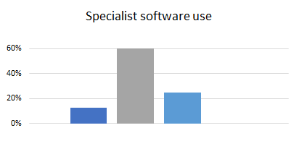

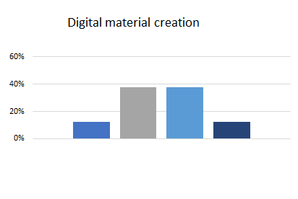
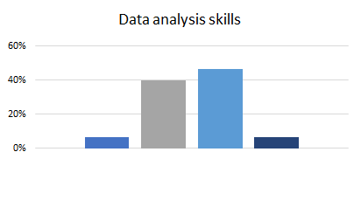

Exploring and supporting the digital learning transition of pharmacy students from school to university
Majority were comfortable and confident (65%) in using technology to support their learning.
When inquired about trying out new technologies, there was a fall in the proportion of confident respondents (53%).
A significant part of the sample reported lacking competence in data analysis (50%), digital material creation (50%) and specialist software use (73%).
Provide in-class teaching via workshops where a new technology or skill is introduced in the course
The university offers a wide range of pre-existing support facilities to assist with students’ digital learning.
Improve student awareness and direction to the assistance already available at their need.
Notes:
Madihah (in person or pre-recorded)
1 min (9-10)

Slide 12
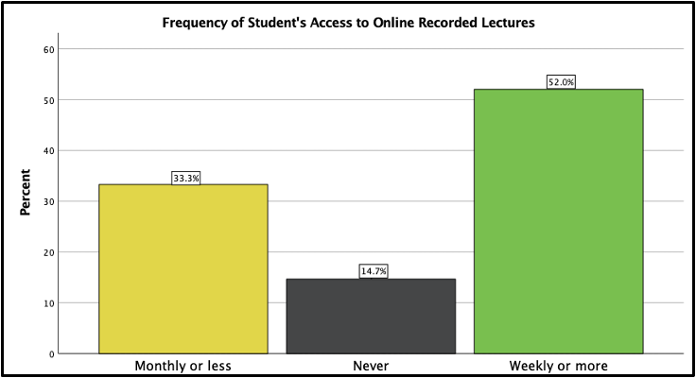
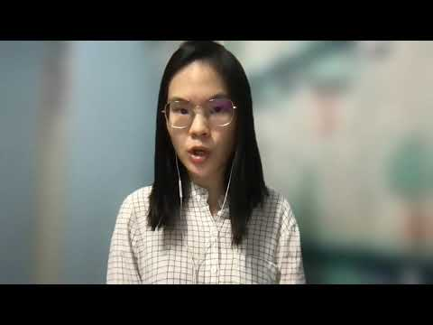
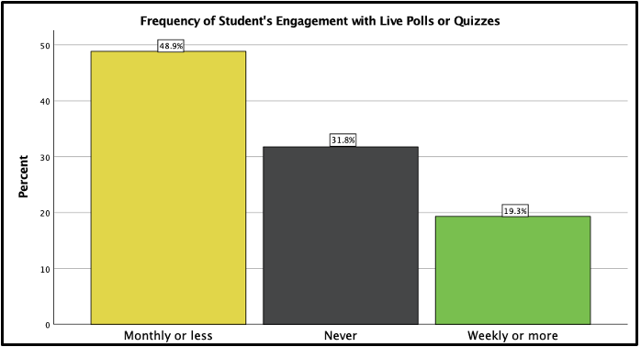
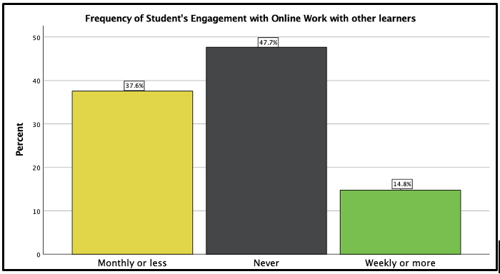
Students' access to and engagement with the virtual learning environment
52.0% of the sample accessed recorded lectures weekly or more, and 33.3% accessed monthly or less
While the quality of recorded lectures and other course materials should be maintained, frequent delivery of virtual synchronous teaching and digital skills training workshops should also be encouraged for student digital literacy empowerment
Increase the use of online interactive learning tools (i.e., Xerte) and quizzes on Moodle to encourage students' access to Moodle learning resources, as a significant proportion of the sample preferred engaging with online quizzes frequently
Encourage collaborative digital learning by designing more small group tasks or assignments, as significant proportion of the sample never engaged (47.7%) with online collaborative work with other students
Notes:
Celine (in person or pre-recorded)
1 min (10-11)

Slide 13
The remote learning crisis: exploring how university support in digital literacy impacts the quality of remotely delivered higher education
Figure 1: Graph showing student access to various learning resources
Figure 2: Do students agree that they have access to information about the following?
Table 1: Frequency of performance of various tasks requiring different competences.
 | Digital usage |  |  | Collaboration | Progress
 | Work with data | Use simulations, virtual or augmented reality (VR or AR) |  | Work with other learners | Get digital feedback
Weekly or more | 37.2 |  | 6.2 | 14.8 | 20.4
Monthly or less | 42.5 |  | 12.7 | 37.6 | 71.7
Never | 20.3 |  | 81.1 | 47.7 | 7.9
Table 2: Skills the university supports students in each faculty to develop (%)
Figure 3: Student demographics a) age and b) gender in digital skill guidance.
 | Arts | Engineering | Medicine & Health Sciences | Science | Social Sciences | Overall average per skill
Data Analysis Skills | 14.7 | 44.7 | 50.2 | 60.1 | 45.1 | 43.0
Basic IT Skills | 53.5 | 64.5 | 60.8 | 63.9 | 56.8 | 59.9
Specialist Software Use | 11.9 | 65.5 | 27.3 | 49.3 | 22.2 | 35.2
Research and Information Skills | 62.7 | 51.4 | 69.3 | 64.1 | 67.7 | 63.0
Create Digital Materials | 14.5 | 22.6 | 11.7 | 15.7 | 15.3 | 16.0
Average skill support per faculty: | 31.5 | 49.7 | 43.9 | 50.6 | 41.4
Notes:
Chidubem
1 min (11-12)

Slide 14
Further results and recommendations
Table 3: Agree/disagreement of teachers to statements about their support of students in digital learning.
Figure 4: Graph showing student and teaching staff comparisons of the quality of teaching and learning received at the university.
 | My use of digital technologies in teaching benefits my learners | Support students to use digital tools for learning | Signpost your students to a range of digital resources | My students engage positively with the digital learning activities I create for them
Agree | 57.8% | 41.4% | 48.9% | 47.7%
Neutral | 34.4% | 45.0% | 41.1% | 45.0%
Disagree | 7.9% | 13.6% | 10.0% | 7.2%
Bitesize or detailed video tutorials in digital content creation and problem-solving skills for teacher training in learning material construction & devising individual teaching plans.
  to administer information in other ICT areas to both staff & students, including in health & wellbeing, data management/privacy policy, information skills.
Introduce yearly 0-credit digital development training modules for students - maximal engagement in digital skill development is achieved in the context of one’s course and must be tailored to the very different digital literacy requirements in each faculty.
Short student evaluation polls at the end of each lecture or each week, with results stored in dated databases – obtains prompter, specific responses about teaching and how well it has been received.
Conduct regular process evaluations using appropriate methods e.g. questionnaires – rolling analysis of success of any strategy implementation.
Notes:
Chidubem
1 min (12-13)

Slide 15
The student experience – data literacy
Data literacy skills developed:
Data concepts, application and governance
Data access and collection
Adopting appropriate Data Tools
Support the students in Data relevancy
Strategy for own critical thinking and analyses using Data
How to make Data-based decisions and communicate them
Notes:
Vibhu or Helen
1 min (13-14)
1. Foundational understanding of the uses and applications of data. They should understand the high-level issues and challenges associated with data. They should also understand the importance of data and be familiar with concepts such as data ethics and data security. For example using OneDrive to regularly back-up and securely store data
2. Students should be knowledgeable about which sources exist and what information is contained therein.They should be able to assess the trustworthiness and usefulness of data sources, too
3. Adopting appropriate Data Tools- new software such as SPSS Statistics for data analysis
4. Students who misunderstands data feel overwhelmed when the results of their efforts are not meaningful. Students should, therefore, understand how different types of data are relevant to different problems and questions and be able to prioritise data for use. They should understand the relationships among data from multiple sources and various literature.
5. Data analysis refers to reading and interpreting data to glean insights from it. While analysis can be conducted using statistical models, algorithms, and other complex tools and frameworks, you can also achieve it by simply reviewing data and drawing conclusions from it.
6. Data Comms- Students should feel comfortable both receiving and making communications about data from and to a variety of stakeholders. They should be able to frame why data is useful and to whom in ways others can understand. They should be schooled in data visualisation techniques and options and be able to critically assess graphical representations of data for relevance and errors

Slide 16
Next steps

Slide 17
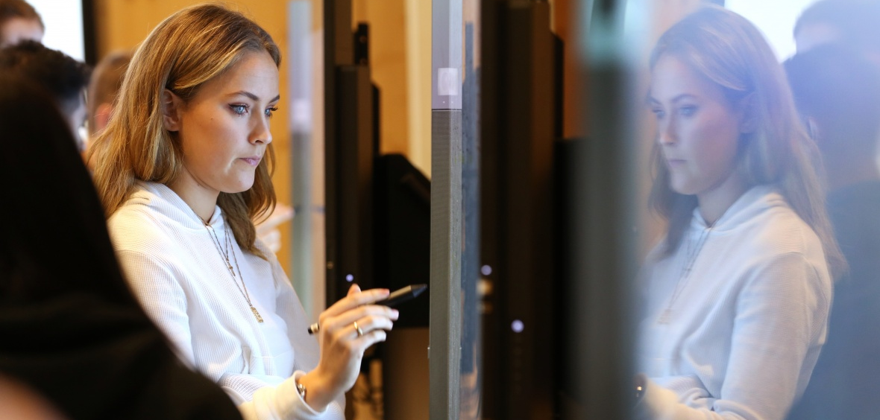
Next steps
The Digital Student to consider MPharm student recommendations within its work package for implementation in September 2021
School of Psychology to offer similar opportunities with latest data for year-long research projects in 2021/22
Faculty of Science to further invite the student voice through student representation on its Digital Learning Committee
Digital Learning Transitions in the Faculty of Science research to continue for a third year
Institutional analysis and reporting of Jisc’s Digital Experience Insights ongoing, annually
Notes:
Elizabeth
2 mins (1-15)

Slide 18
Any questions? elizabeth.newall@nottingham.ac.uk stephanie.mcdonald@nottingham.ac.uk vibhu.solanki@nottingham.ac.uk helen.boardman@nottingham.ac.uk

