Slide 1

Forging friendships in first year
CS entrants collaborating in a virtual small-group, large-class setting

Slide 2
Forging friendships in first year: CS entrants collaborating in a virtual small-group, large-class setting
Jyoti Bhardwaj
Centre for Computing Education Research, School of Computing, Edinburgh Napier University
Horizons in STEM Higher Education Conference June 2021

Slide 3
Purpose of the study
To explore the self-reported, semester-long teamwork experience of a cohort of CS entrants
To discover key themes emerging from a qualitative analysis of students’ responses
To highlight discussions of relationships and friendships in the context of pandemic-related restrictions

Slide 4
September 2020 context
Persistently high drop out of 9.2% averaged across all institutions and entry qualifications in UK computing courses, the highest of all university subjects (HESA, 2021)
Teamwork essential CS graduate soft skill (Marbach-Ad, Hunt & Thompson, 2019) (Largent, 2016) (Radermacher & Walia, 2013)
Partial or entire closure of campuses
Virtual or curtailed Freshers’ Weeks and socialising
Technology-enabled distance learning

Slide 5
Theoretical context - engagement
Active learning design (Leontiev, 1978)
Improving engagement amongst CS first years (Liénardy, Leduc & Donnet, 2021) (Al-Sakkaf, 2019) (Garcia, 2018)
Collaborative learning in CS to improve retention (Miller, Soh & Peteranetz, 2019) (Green, Plant, & Chan, 2016)
Anonymity in large CS1 classes (Minnes, Alvarado & Porter, 2018)
Increased loneliness amongst students (Lippke, Fischer & Ratz, 2021)

Slide 6
Theoretical context – remote learning
Pandemic-related emergency remote teaching (Hodges, Moore, Lockee, Trust & Bond, 2020)
Digital communication via Slack and Discord (Vladoiu & Constantinescu, 2020) (Kruglyk, et al., 2020)
Anxiety amongst students learning remotely during pandemic (Copeland et al, 2021) (Lischer, Safi & Dickson, 2021)
CS students’ sense of belonging during the pandemic (Mooney and Becker, 2021)

Slide 7
Theoretical context – small groups
Social interaction in the learning process (Carter, Hundhausen, & Adesope, 2017)
Zones of proximal development (Vygotsky, 1978)
Small groups to facilitate discussion (Liao, Griswold, & Porter, 2017)
Semester-long projects (Pastel, Seigel, Zhang & Mayer, 2015)
Team composition (Salas, 2017)
Fair sharing of work (Latané, Williams & Harkins, 1979)

Slide 8
Theoretical context: friendship
CS entrants seeking friends (Cabo & Satyanarayana, 2018)
Importance of friendship for gaining confidence (Heron, 2019)
Friendship in first year (Lippke, Fischer and Ratz, 2021)
Friends in first year teams (Gledhill & Novak, 2019)

Slide 9
Pre-pandemic learning design
First year, first semester module comprising lectures, tutorials, and practicals based on SimVenture business simulation
Practicals: two hour sessions; lasted from weeks 2 to 11 of the semester
Instructor facilitated, aided by two student demonstrators
Learning design of extreme co-location: on-campus lab; three or four students on the same degree clustered round a single machine
Teams formed in first lab by grouping students sitting in proximity; chance of some being friends

Slide 10
September 2020 learning design
Cisco WebEx-enabled in the same two-hour timetabled slots; lasted from weeks 2 to 11 of the semester
Students randomly assigned in teams of four or three; unlikely to have met before or become friends
Each lab started with short plenary sessions, then teams worked in pre-assigned breakout rooms
Instructor visited each breakout room every ten minutes, attempting to replicate walking round the in-person lab
Student demonstrators were assigned several teams to support and answer specific questions

Slide 11
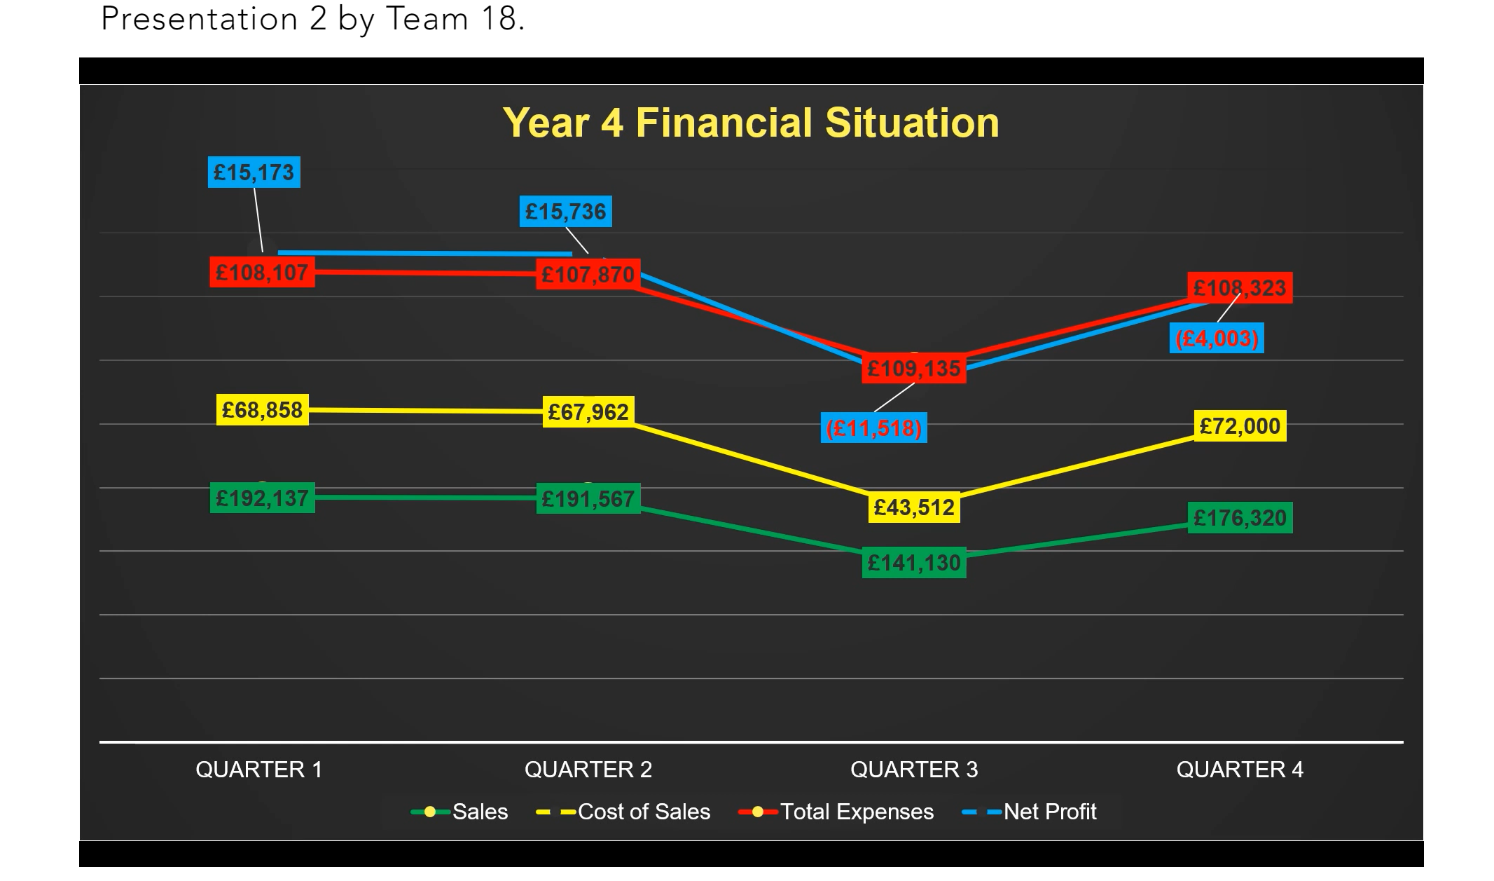

Slide 12
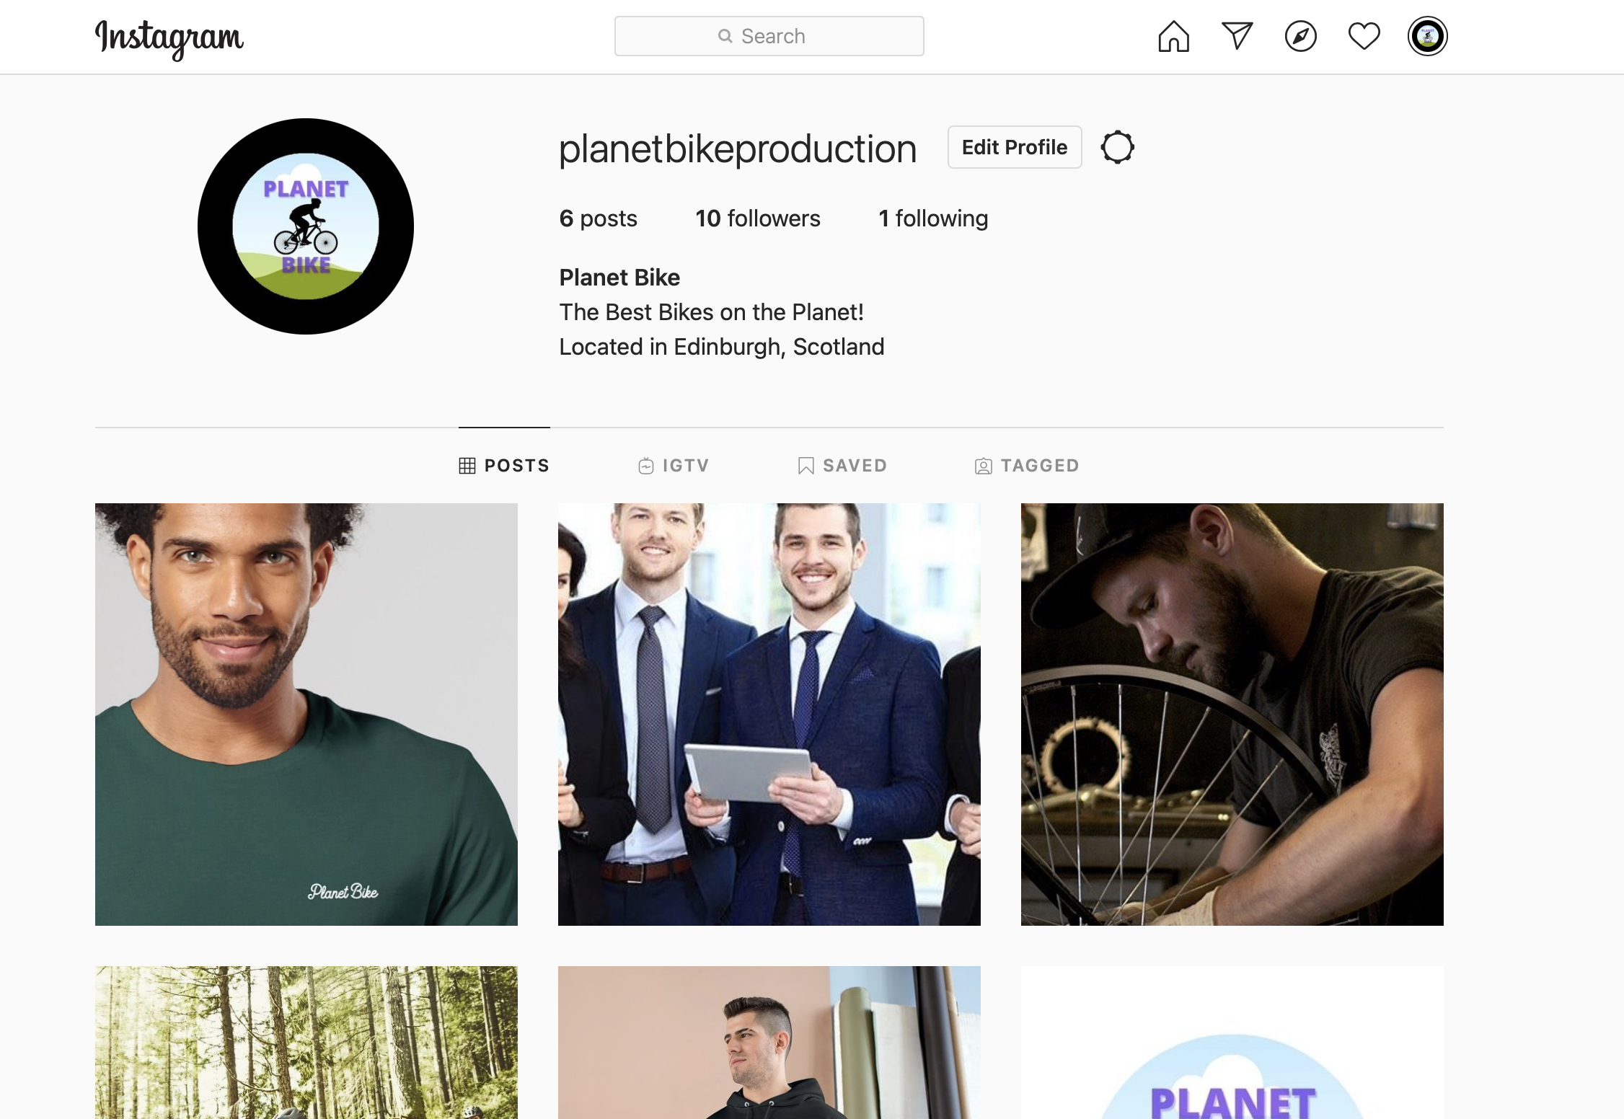
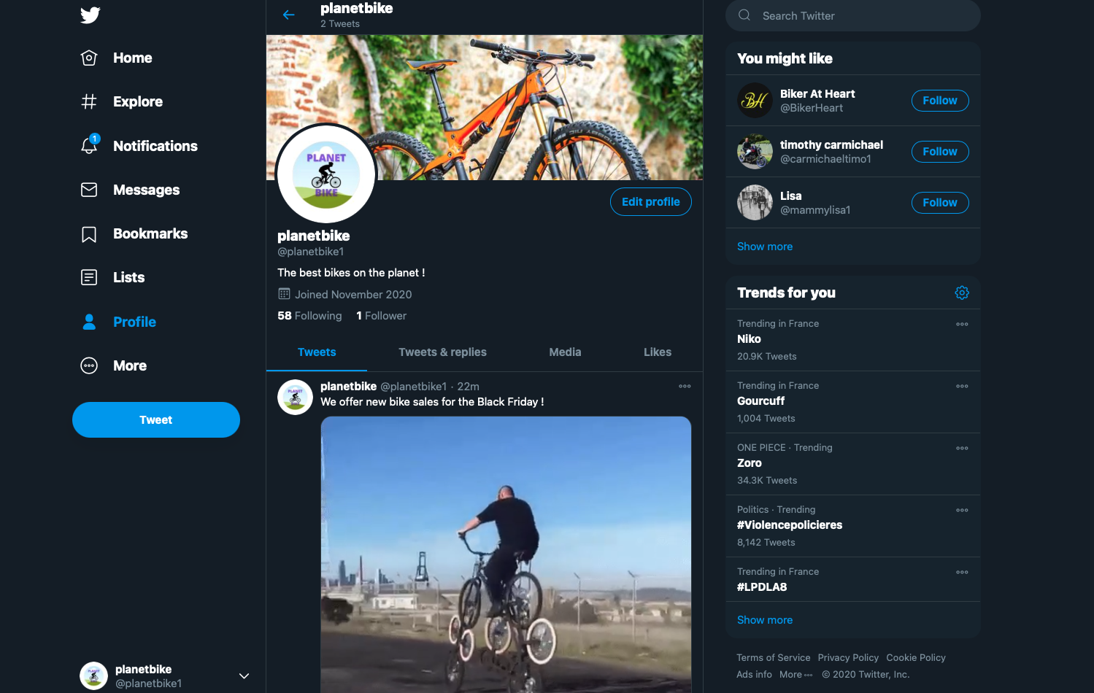


Planet Bike- join the community
Feel free to contact us
bike@planetmail.com
@planetbike1
Planet bike
@planetbikeproduction

Slide 13
Sales Performance Between Y3Q1 and Y4Q4
Due to these changes we saw an upwards sales trend
This continues throughout the entire run
Aspect that lead us to profitability and to saving the company

Slide 14
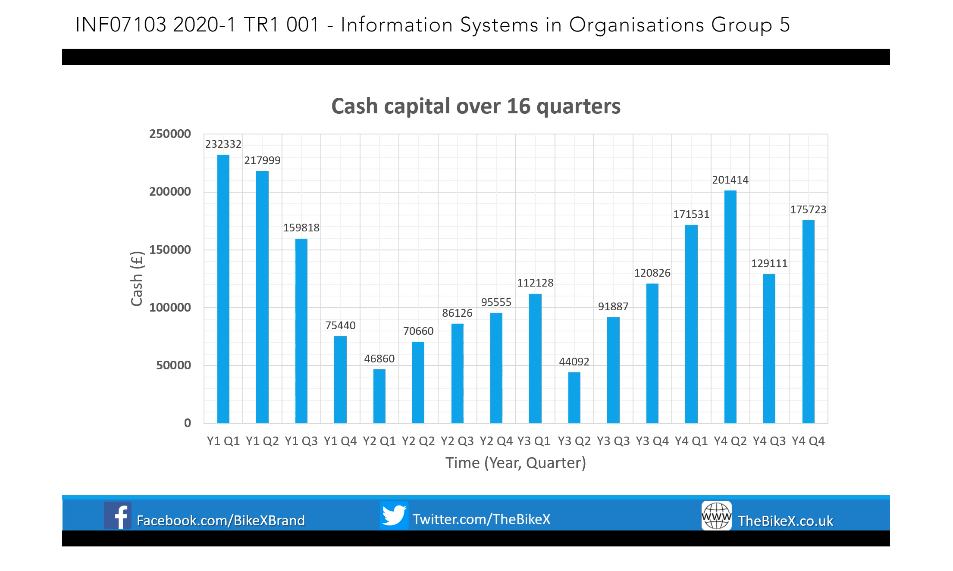

Slide 15
Participants
Compulsory module, first semester of first year
Students enrolled on a range of undergraduate courses: Business Information Technology, Computer Systems and Networks, Cyber Security and Forensics, Computing, Software Engineering
Of the 104 students in 32 groups, 67 students in 20 groups gave consent for their words to be analysed and extracts/slides to be reproduced
Of them, 53 consented to be quoted using their first names

Slide 16
Data gathering
The teams formed and ran bike companies as part of the SimVenture simulation
Assessment was by two online group presentations, the second in week 11, at the beginning of December
Groups evaluated their teamwork in response to the criterion “Working as a team: challenges and solutions”, worth 20% of the presentation
Participation was invited by email to all students only after presentations were over and feedback given

Slide 17
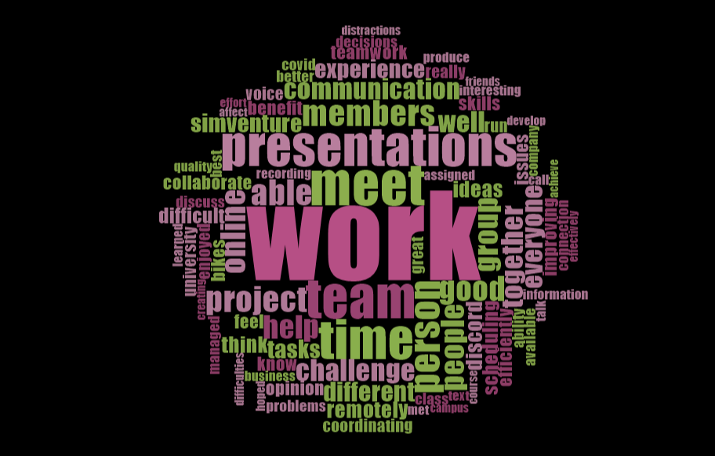
Nvivo word cloud of key themes

Slide 18
Data analysis
Voiceovers of the relevant teamwork sections were transcribed from MP4 into MS Word
We encoded the text using QSR NVivo 12 to discover emergent themes
At first pass, we identified key themes or “nodes” by a frequency query, ignoring words of three letters or fewer, common words such as “work”, conjunctions, etc
Subsequently, we assigned each phrase to a node, amalgamating four nodes to accommodate synonyms

Slide 19
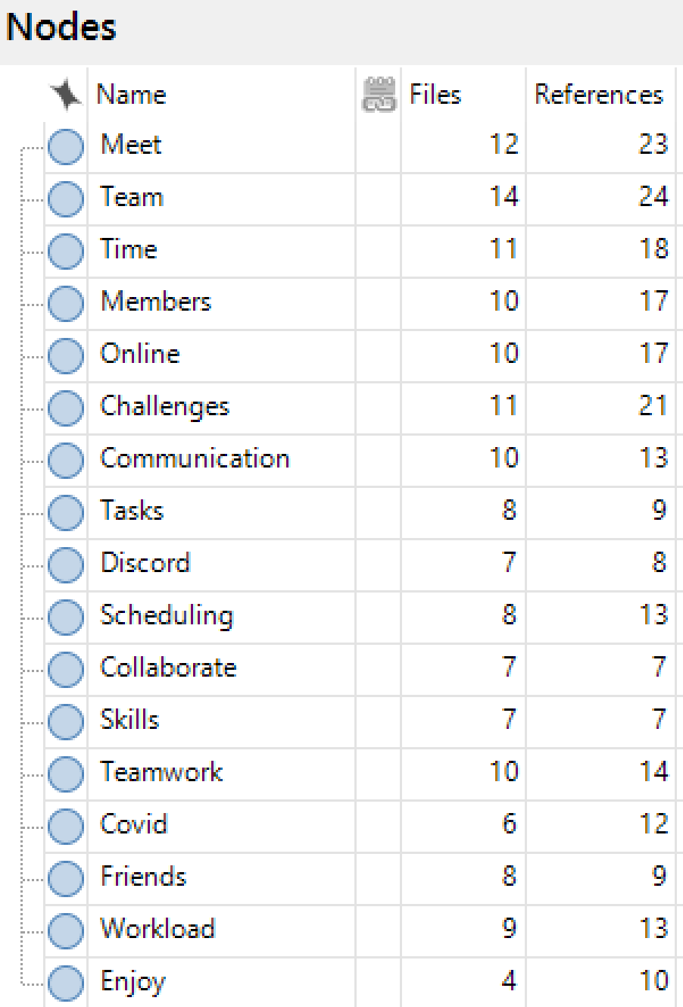
Identifying themes
Nvivo 12 was used to code responses
Predictably, words such as ‘team’, and ‘challenges’ featured strongly, reflecting wording of the presentation task

Slide 20
Expected themes
Emergent themes
“Meet”
“Challenges”
“Team”
“Time”
“Communication”
“Online”
“Workload”
“Members”
“Teamwork”
“Scheduling”
“Discord”
“Covid”
“Enjoy”
“Friends”
•••

Slide 21
Emergent theme: “Meet”
Node includes “meeting”, “met”
The term was used in two main contexts, to meet regularly, and to meet for the first time:
“One of the pillars of our co-operation was daily check-in meetings for status updates.” (Group EX)
“Especially this year, you don’t get to meet many people from your course, so this was a good opportunity for that.” (Group LB)

Slide 22
Emergent theme: “Challenges”
Node includes “Challenge”, “Challenging”, “Difficulty”, and synonyms for “Challenge” deduced from the context
“One thing that has impacted our project has been the distractions of working at home.” (Group MR)
“The biggest challenge was working online, as it was hardest to show quick drafts of ideas, especially presentations.” (Group TW)
“Different schedules and personal lives often made co-ordination difficult, where in a traditional project environment more options would be available to allow for interactions between team members.” (Group BFB)

Slide 23
Emergent theme: “Team”
Comments addressing teamwork and individual members were coded at separate nodes
“Despite being spread across four countries and two continents, we believe our team worked well together, surpassing the challenges of these unprecedented times.” (Group HITR)
“We all feel as a team we worked quite well together, although we do feel that we should have developed our strategy more thoroughly.” (Group CB)
“All of us also brought a positive influence on the group, so there was never a day when we felt any of us weren’t pulling our weight or there to assist the team.”(Group S)

Slide 24
Emergent theme: “Time”
Term is used with two meanings: a period of time, and a point in time
“Because it was solely online it was more time-consuming.” (Group MR)
“A challenge with this presentation was finding a time that would suit everyone for a group call discussion.” (Group EB)
“It was difficult sometimes to find times when everyone was available, as we all have work and study different modules.” (Group B)

Slide 25
Emergent theme: “Communication”
Node includes “Communicate”
“A lot of the time, it was difficult to communicate our ideas to each other while not being able to meet up face-to-face.” (Group EB)
“We were always on calls together.” (Group LB)
“There were also times when communication could be slow or we could be busy and not checking our messages, so we could miss a key piece of information before it was too late.” (Group S)

Slide 26
Emergent theme: “Online”
Node includes “remote” and “internet connection”
“Remotely co-ordinating with university staff on questions or class material was also difficult outside class hours as all student interaction occurs online.” (Group BFB)
“Team members easily accessible because everything was online.” (Group BX)
“At first it was slightly jarring because at times your internet connection isn’t perfect, but after a while we all got into the groove of things and all naturally fell into place.” (Group CM)

Slide 27
Emergent theme: “Members”
Node includes “Member” and pertains to individuals
“Using these tools while co-ordinating with fellow students has allowed each member to improve their teamworking ability.” (Group BFB)
“We come from various countries; we are different ages; we have different points of view.” (Group GH)
“I’m convinced that we used the mix of age, sexes, opinions and skills and transformed it into a great presentation.” (Group GH)
“Each member has their own unique perspective of how things should be.” (Group TW)

Slide 28
Emergent theme: “Workload”
“We pushed each other to work much harder than we would individually, and therefore we got a lot more done than we would have alone.” (Group BB)
“We were never letting one person do all the work. (Group LB)
“The workload was also easily spread out between all of us which allowed for a more relaxed work environment.” (Group S)
“A benefit of this, however, was that since there was four of us, we were still able to do a lot of work and help each other to split the workload if any of us was struggling too keep up.” (Group EB)

Slide 29
Emergent theme: “Teamwork”
“We made lots of our decisions together, and everybody’s voice had equal strength.” (Group GH)
“Another benefit we all found with the teamwork is, it was more engaging than just doing solo work.” (Group MR)
“Every team member was taking an active part in a discussion and work on the presentation, which resulted in very efficient work.” (Group BX)
“For our teamwork, we have split the work between us.” (Group TW)

Slide 30
Emergent theme: “Discord”
“Google Docs and Discord were especially helpful in ensuring that team members were updated and on track with current tasks.” (Group BFB)
“We made a Discord group that let us efficiently contact with each other.” (Group BX)
“Given that we weren’t able to meet face-to-face, we met regularly over Discord and through voice chats.” (Group CB)
“From the beginning, we set up a Discord as a place for communication and collaboration, and for the most part we found working remotely as a team straightforward.” (Group TW)

Slide 31
Emergent theme: “Covid”
“The Covid-19 pandemic has made meeting in person practically impossible, and for co-ordinating, recording and editing the final presentation, this has been quite a challenge.” (Group BFB)
“It changed the way you would usually do this.” (Group LB)
“The most pressing challenge we faced was producing and presenting a quality presentation remotely without ever meeting in person due to Covid-19.” (Group WG)

Slide 32
Emergent theme: “Enjoy”
“It was a great experience.” (Group B)
“Enjoyed meeting people and improving communication skills.” (Group CB)
“Great first group project and enjoyed meeting people.” (Group CB)
“I’ve really enjoyed working with these people this year.” (Group LB)
“I enjoyed making friends with people I wouldn’t have known about if it wasn’t for SimVenture.” (Group LB)

Slide 33
Emergent theme: “Friends”
Node includes friendships
“We ended up being entirely comfortable round each other, and I feel our improvement in our work is reflected in this.” (Group EDI)
“During our SimVenture classes and meetings, we were able to get to know each other better, become friends, and bond as a team, which made our work together even more interesting and entertaining.” (Group EX)
“Another thing we benefited from during this project was the ability to meet new people, build new friendships, get to know each other better and more personally.” (Group MR)

Slide 34
Emergent theme: “Friends”
“All this made it possible for us to make new friends, which is very important, especially because we are in our first year of university.” (Group R)
“It was exciting getting to know new people while working on this project.” (Group N)
“Really getting to know people who are in the same uni as you.” (Group MR)
“No in-person meeting meant we maybe did not get to know each other as much as we hoped.” (Group WG)

Slide 35
Initial conclusions
Teams’ biggest challenge was scheduling meetings
Great importance was attached to “meeting”, meaning, to meet regularly (online), and to meet for the first time (Liénardy, et al., 2021)
No teams saw benefits in remote groupwork except those whose members were in different countries
Remote working caused predictable problems in communicating
Loss of opportunity to meet new people and in person was felt – heightening value of this groupwork (Mooney and Becker, 2021)

Slide 36
Initial conclusions
Teams valued having all material online
Discord was a popular and useful tool (Vladoiu & Constantinescu, 2020) (Kruglyk, et al., 2020)
Participation by every team member in discussions was an important element of teamwork (Liao, Griswold, & Porter, 2017)
Individuality and difference amongst members was valued
Communication skills were seen as important to acquire (Marbach-Ad, et al., 2019)

Slide 37
Initial conclusions
Making friends is important at the start of first year (Lippke, et al., 2021)
Much of the enjoyment of the simulation was associated with meeting and interacting with the team (Gledhill & Novak, 2019) (Carter, Hundhausen, & Adesope, 2017)
Despite the presentations attracting marks, teams did not mention social loafing (Latané, et al.,1979)
Teams took pride in overcoming the considerable challenges and limitations caused by Covid-19

Slide 38
Thank you!
soc.napier.ac.uk

