Slide 1

Moving beyond a threshold
– developing writing skills in a Bioscience undergraduate cohort
Alfred Thumser, Sarah Bailey and Simon Lygo-Baker
University of Surrey

Slide 2


Slide 3
“A threshold concept can be considered as akin to a portal, opening up a new and previously inaccessible way of thinking about something. It represents a transformed way of understanding, or interpreting, or viewing something without which the learner cannot progress
student ⇨ student*
https://classteaching.wordpress.com/2018/11/08/threshold-concepts-for-teachers/#:~:text=%E2%80%9CA%20threshold%20concept%20can%20be,which%20the%20learner%20cannot%20progress.

Slide 4
Roadmap
Module overview
Workshops
Peer review
One-to-one feed-forward
Submission
Essays graded [rubric]
One-to-one feedback [SNOB analysis]

Slide 5

Writing Workshops:
Overview & Reflection

Slide 6
What are the components of a good essay?
Always relate back to the essay question
Could include balanced points of view on a topic
Appropriate use of figures & figure legends
Correct spelling and grammar

Slide 7
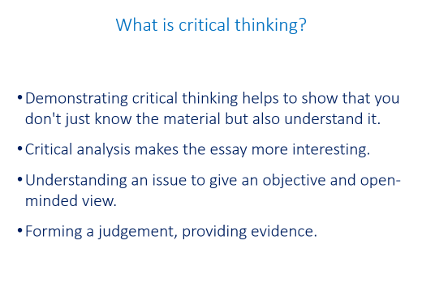
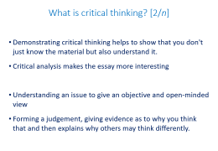
What is critical thinking?
Demonstrating critical thinking helps to show that you don't just know the material but also understand it.
Critical analysis makes the essay more interesting.
Understanding an issue to give an objective and open-minded view.
Forming a judgement, providing evidence.

Slide 8
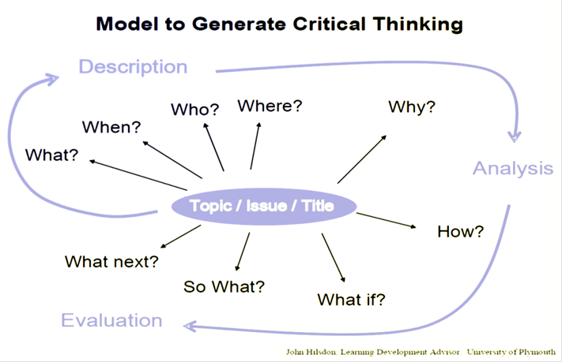
What is critical thinking? (with permission, Learning Development, University of Plymouth).

Slide 9
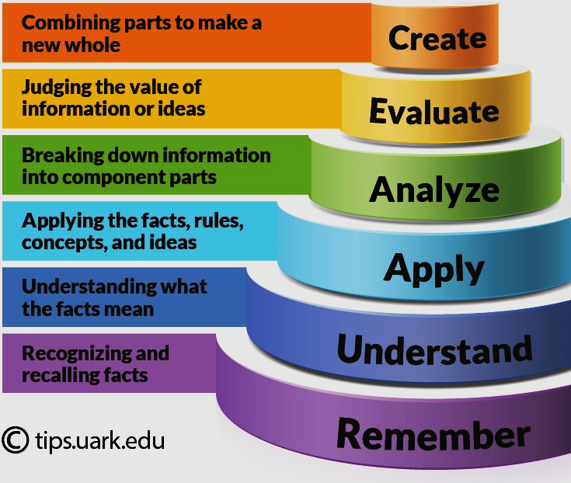
Bloom’s Taxonomy
Higher order thinking:
Critical Analysis
(video, transcript)

Slide 10
Marking Criteria [Grade Descriptors]
60-69 VERY GOOD (2:i)
Knowledge
Development of argument
Independent study
Application
Transferable skills

Slide 11
Clarifying expectations [example]
Describe the main regulatory steps of glycolysis [20% × 3].
How does gluconeogenesis differ from glycolysis [40%]?

Slide 12
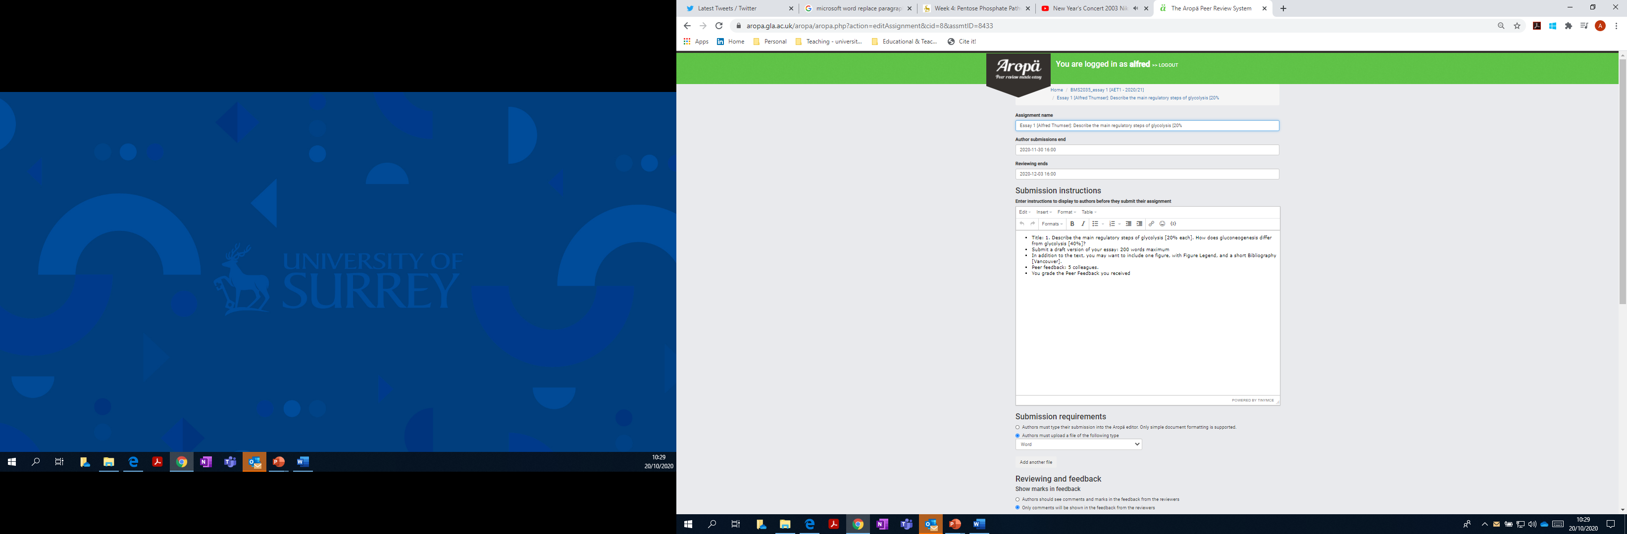
Aropa Peer Feedback

Slide 13
Students grade the Peer Feedback received
How useful is this peer’s feedback with respect to helping you to improve your future work? The scale is as follows:
0: no feedback provided
1: Some feedback provided, but not helpful in improving my work
2: Average feedback: mainly syntax & grammar, limited suggestions in terms of improvement
3: Good feedback: good suggestions for improvement
4: Very good feedback: good suggestions for improvement that should improve my work substantially
5: Exceptional feedback - provided novel insights that I am definitely taking forward (wow!)

Slide 14

One-to-one feed-forward/feedback
Bookings app
15 minute slots [one each]
Preparation: SNOB analysis
Notes:
SNOB: Strengths Needs Opportunities Benefits

Slide 15

So, what happened?

Slide 16
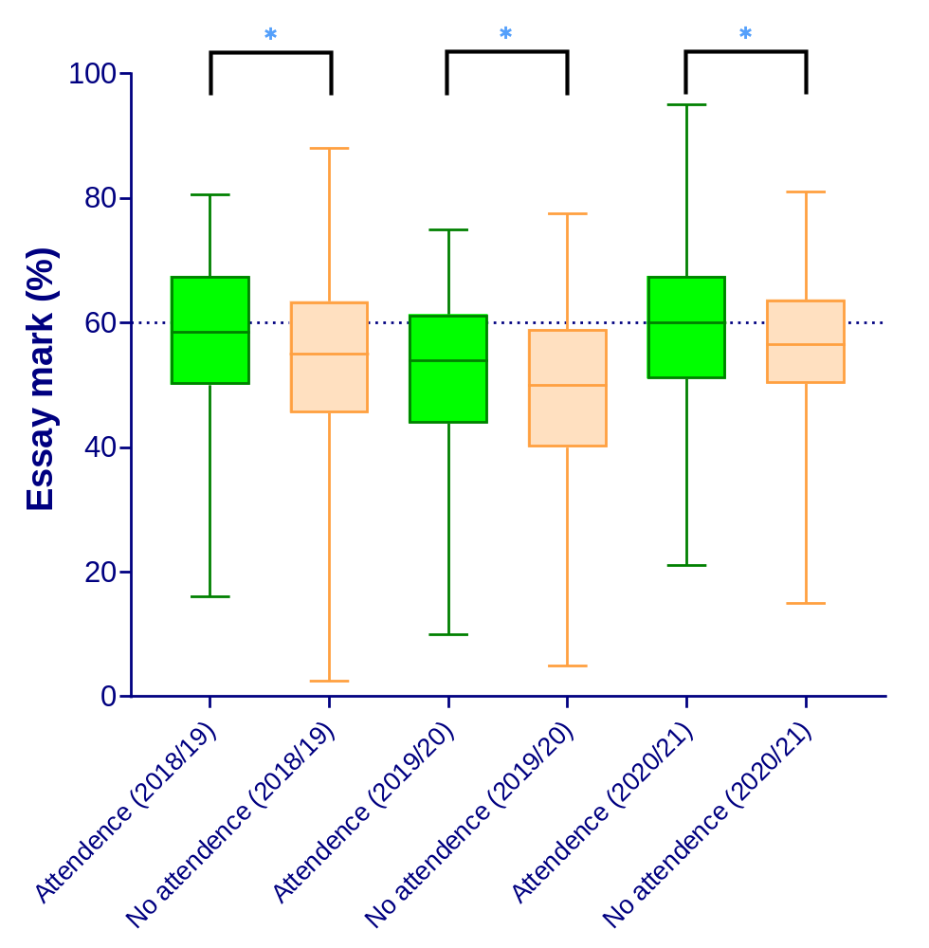
Effect of student attendance on coursework mark

Slide 17
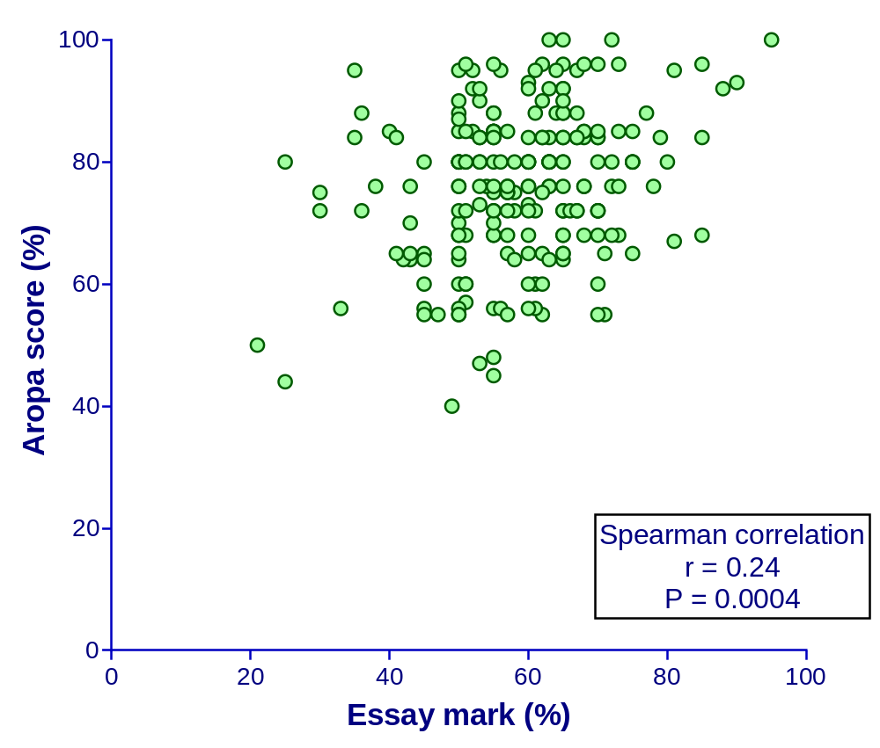
Essay mark vs Aropa score
Notes:
Essay mark (%)
vs.
Aropa score
Spearman r
r 0.2390
95% confidence interval 0.1060 to 0.3636
P value
P (two-tailed) 0.0004
P value summary ***
Exact or approximate P value? Approximate
Significant? (alpha = 0.05) Yes
Number of XY Pairs 219

Slide 18
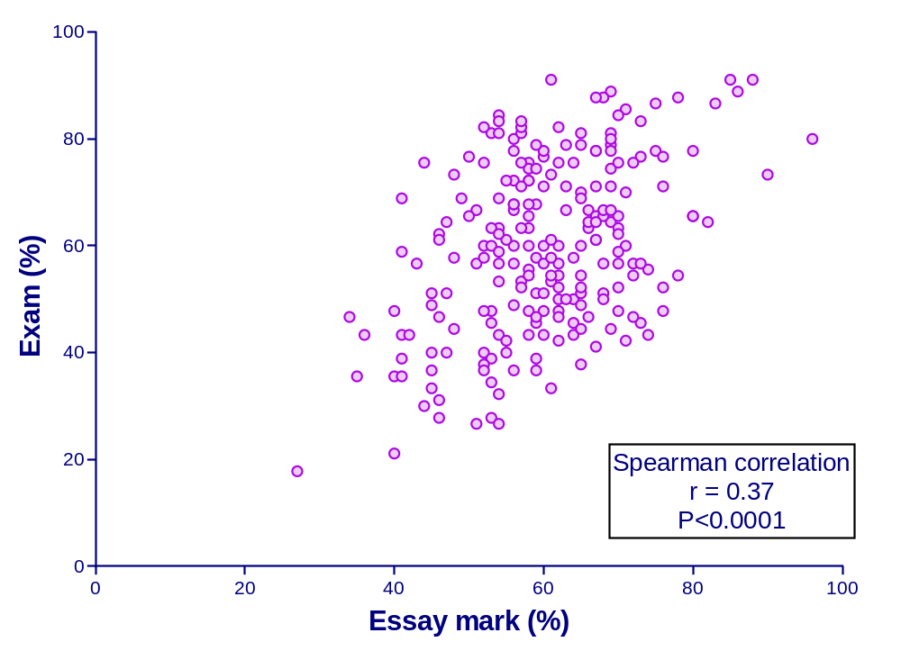
Correlation: Coursework vs Exam
Notes:
Coursework
vs.
Exam
Spearman r
r 0.3745
95% confidence interval 0.2549 to 0.4829
P value
P (two-tailed) <0.0001
P value summary ****
Exact or approximate P value? Approximate
Significant? (alpha = 0.05) Yes
Number of XY Pairs 233

Slide 19
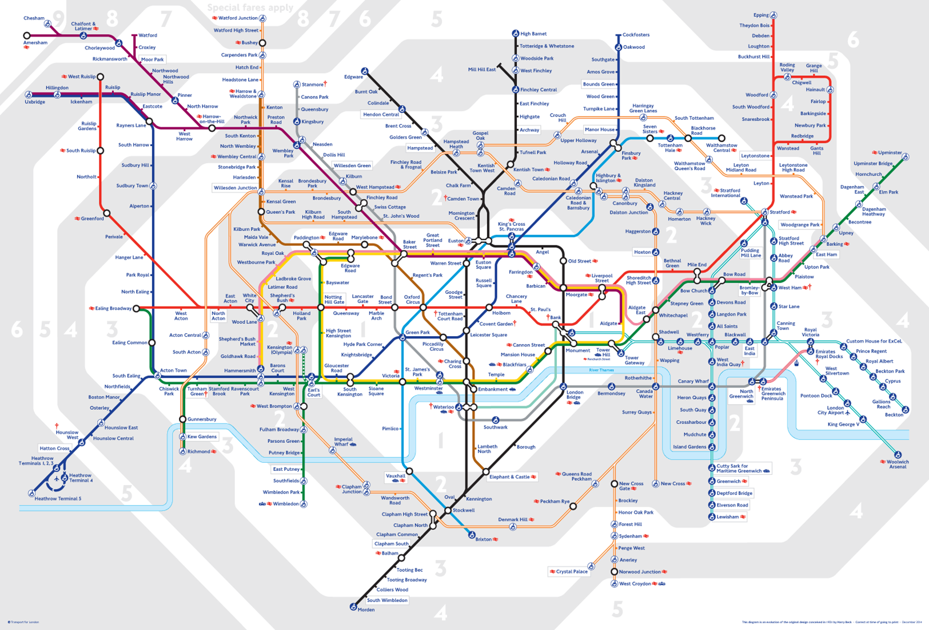
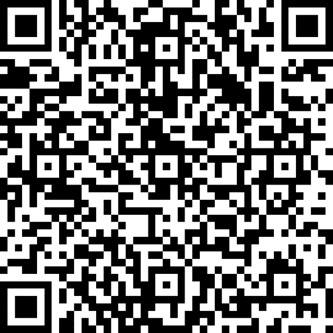

Concluding thoughts
Did [all] students cross the threshold?
How can we incentivise students?
[e.g. BAME and/or male students?]
Use of rubrics
Exemplars & anti-exemplars

