Slide 1
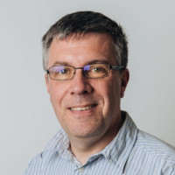
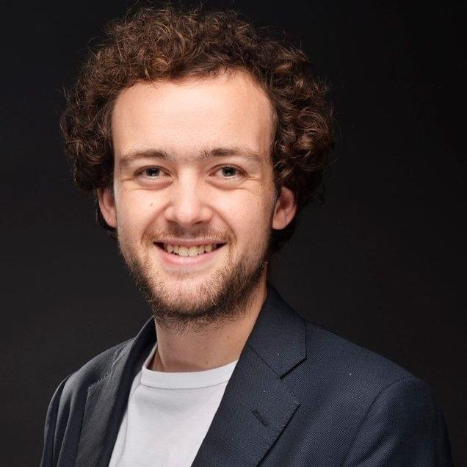
Maintaining Engineering Students’ Sense of Community through a Peer Assisted Study Scheme
Sean Lancastle Aaron Grice Lucy Rycroft
Faculty of Engineering Student Inclusion Service

Slide 2
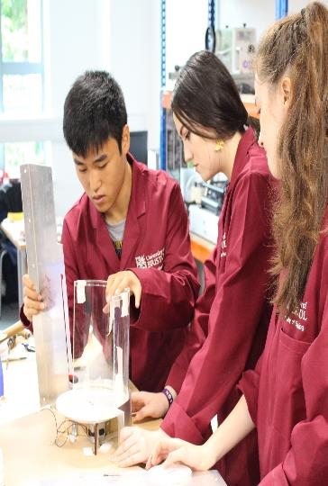
Contents
What is PASS?
Guidelines for leaders
PASS attendance
Participant feedback
Wellbeing
Benefits to PASS leaders
Access barriers
Challenges & conclusion

Slide 3
What is PASS?
Fortnightly 1-hour voluntary classes for first year students (participators)
Facilitated by students from later years (leaders)
Timetabled
All year 1 students (around 500 in the School)
University-funded

Slide 4

What is PASS?
PASS leaders given training
Senior PASS leader recruited
Supported by Academic Enhancement Manager
Otherwise independent

Slide 5
Guidelines for PASS leaders
It is not teaching!
Settling into the city, the university and the course
Making the most of the first year
Solving course-related problems together
Finding answers to participants’ questions
Planning ahead to the higher years

Slide 6
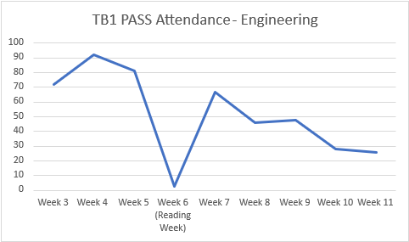
PASS attendance – semester 1 2020/21
Of around 250 students timetabled each week

Slide 7
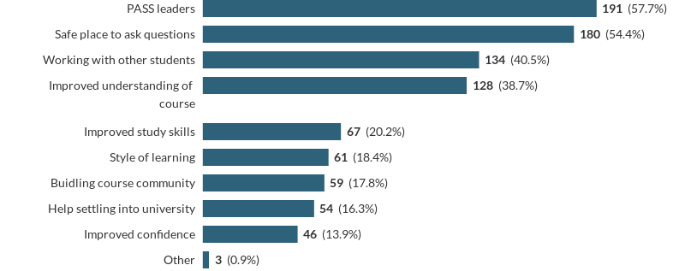
Participant feedback
The best thing about PASS is:
Notes:
95% of participants agreed attending PASS has improved their experience of university. This increased to 99% when only those who had attended 3 or more sessions were asked; and 100% of those who attended 5 or more sessions.

Slide 8
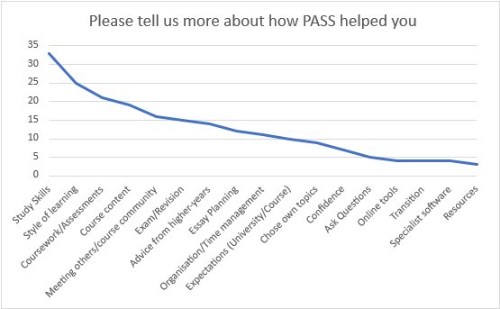
Participant feedback
Topics covered in PASS sessions:

Slide 9
Participant feedback
I found it useful to go through difficult questions with students from further on in the course as they knew the areas that they struggled with and were able to give tips to help
‘They helped explain problems we may have in a way that was easy to understand, they gave a perspective of a student not a lecturer’
PASS helped me feel a lot more connected to people on my course and helped me feel more confident in my own ability to do the course
It has helped me feel less stressed – I know now that it’s normal to feel a little overwhelmed

Slide 10
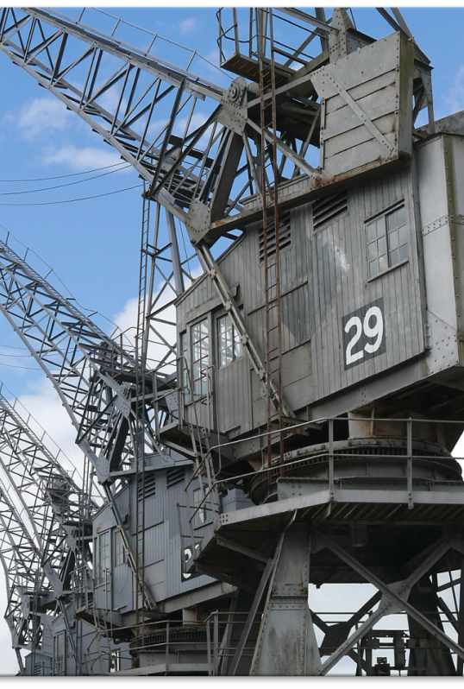
Wellbeing – leader’s perspective
“What I relish most was the students saying “oh I feel so much better” and them going away from the sessions with a smile on their faces! It was the most amazing feeling – they were laughing and engaging with the session really well. It is such a shame that PASS leaders weren’t available to me when I was in first year as I often find myself telling students it’s going to be okay! Just relax and have fun!”

Slide 11
Wellbeing – participant’s perspective
“Helped have a community at a time where being at uni feels detached and lonely. PASS has brought the opportunity for support when it has been most needed. The sessions make us feel like we're not alone, and the PASS leaders are friendly, reassuring and always willing to help”
“It has been a good source of wellbeing help during a time where contact has been limited”

Slide 12
Benefits to PASS leaders
In a December 2020 survey 93% of PASS Leaders agreed that being a PASS Leader had improved their experience at the University of Bristol.
It is really rewarding seeing people grasping concepts and gaining understanding/becoming more confident
We have enjoyed feeling like we have actually helped people’
Notes:
develop personal skills such as leadership, teamworking and coaching skills
revise and practise your subject and gain a deeper understanding of it
gain valuable experience to enhance your CV
attend PASS conferences and training, and share experiences with student Leaders from other institutions

Slide 13
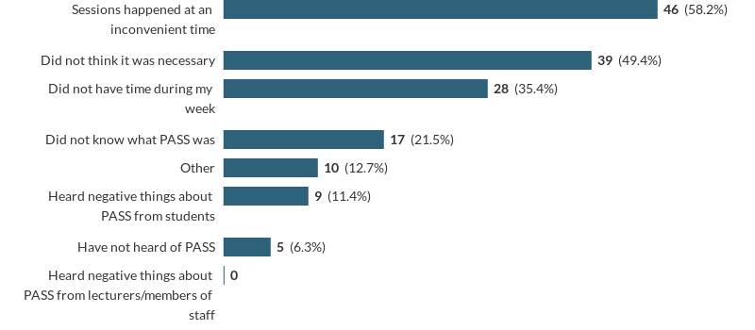
Access barriers
Why did you not attend PASS sessions?
Notes:
Interestingly, they didn’t mention shyness / technical problems

Slide 14
Challenges & conclusions
Limited resource
Timetabling
Limited participation
Limited engagement
Technical difficulties
Very effective at building course community
Notes:
PASS leaders working in pairs – group every other week – looses continuity
Finding times participants and leaders available (plus rooms)
How do we get the students that would most benefit to participate
A particular challenge this year – students very passive – not turning on cameras
Also specific to this year

Slide 15
Thank you for listening
Thoughts/comments/questions? Please feel free to get in touch:
Sean Lancastle: sean.lancastle@bristol.ac.uk

