Slide 1
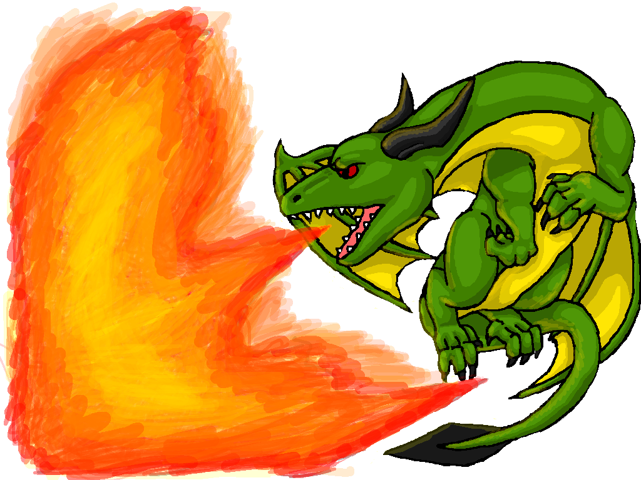
Dr. Louise Robinson
@Doc_R_
Prof. Ian Turner
@DocWithTheSocs
Dungeons and Dragons for Employability Skills?

Slide 2

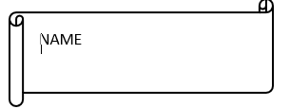
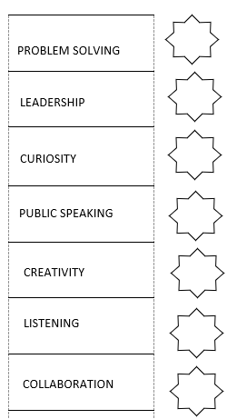
Jot down your name.
What was your number between one & six.
One (21), Two (19), Three (23), Four (20), Five (22) & Six (18).
Distribute this number of points amongst the skills here.
Six is the highest score possible. Try and represent your personal strength in how you distribute the points.

Slide 3

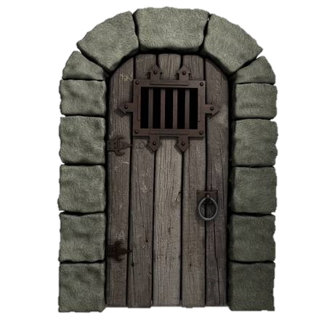
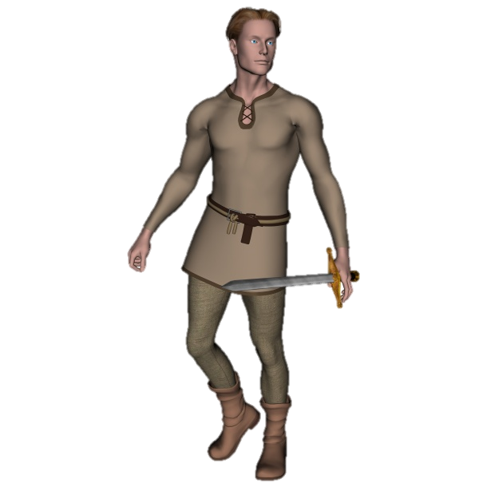
Enter

Slide 4
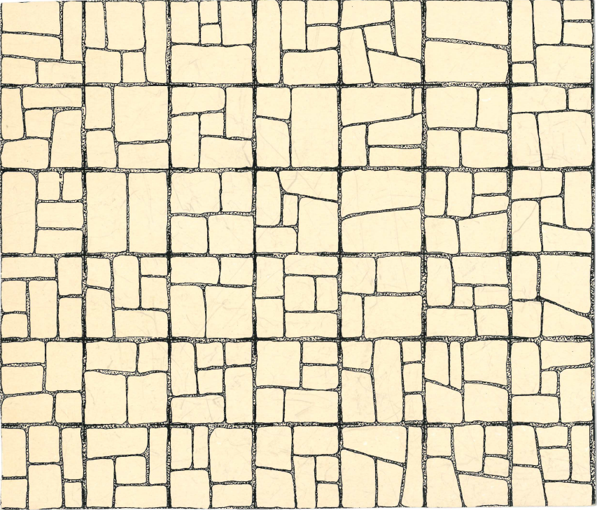


1 2 3 4 5 6 7
A B C D E F

Slide 5

A B
1 2 3 4 5 6 7 8

Slide 6
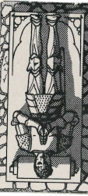
1 2 3 4 5 6 7
A B C D E F

Slide 7

1 2 3 4 5 6 7
A B C D E F

Slide 8
1 2 3 4 5 6 7
A B C D E F

Slide 9

Employability?

Slide 10
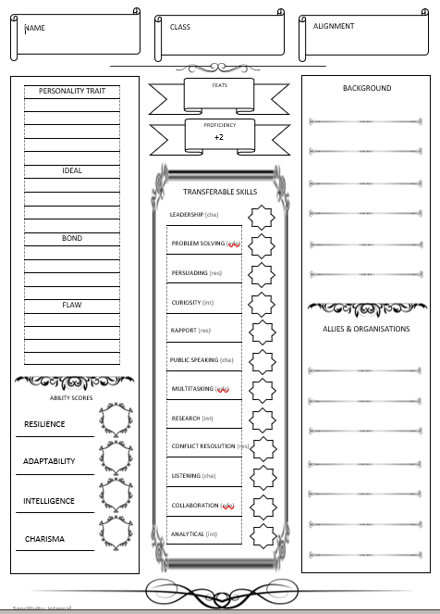
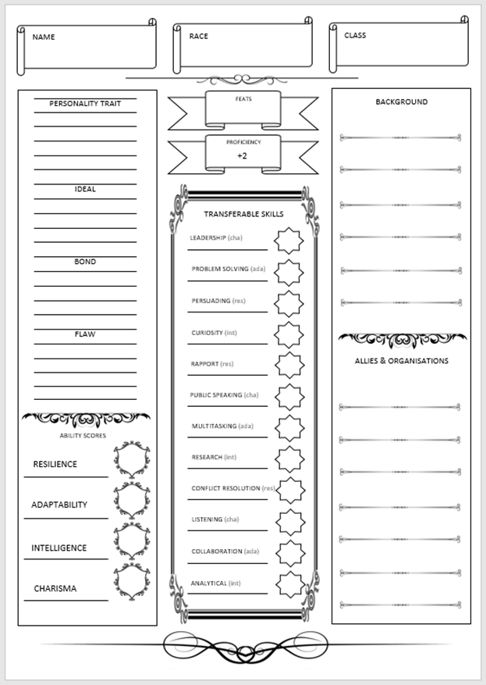
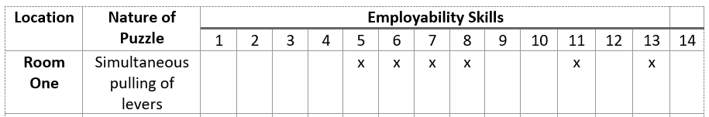

Slide 11




Skill Acquisition
Skill Presentation
CV Construction
?
Interview

Slide 12
